Slide 1
We are experiencing technical difficulties
We will return at xx:xx AM

Slide 2
Just a moment,
Thank you for your patience!

Slide 3
Welcome!
We will begin the meeting momentarily.

Slide 4
PUBLIC PERFORMANCE REVIEW
Goal 4 – Healthy and Safe Communities
Topic: Reentry of Formerly Incarcerated Individuals
April 24th, 2024

Slide 5
Welcome
Presented by:
Mandeep Kaundal, Director, Results Washington

Slide 6
Building Logistics
Emergency exits are located through the conference room doors directly ahead
Restrooms are located outside of the conference room next to the elevators
Please take side conversations outside the room
Attendees will find a QR code and a physical survey located on conference room tables
Our meeting is being live-streamed by TVW
Meeting materials are located at www.results.wa.gov

Slide 7
Topic Selection
Reentry of formerly incarcerated individuals is tied to the Governor’s goal 4: Healthy and Safe Communities
Recommended by leaders across the state to review needs and ongoing challenges faced by justice involved individuals reentering communities
Progress and initiatives presented by:
  Department of Corrections
  Washington Statewide Reentry Council
  Health Care Authority
  Department of Commerce
  Employment Security Department’s WorkSource Program

Slide 8
Governor’s Opening Remarks

Slide 9
Reentry Overview
Presented by:
Cheryl Strange, Secretary, Department of Corrections
Danielle Armbruster, Assistant Secretary, Reentry Division, Department of Corrections

Slide 10


Results Washington
Reentry
Cheryl Strange, Secretary
Danielle Armbruster, Assistant Secretary, Reentry Division

Slide 11
Source: Bureau of Justice Statistics, Correctional Populations in the United States
Why Reentry Matters
2019 Global and US Incarceration Rates
National Standing
455
789
583
328
555
761
342
288
328
824
663
599
376
394
275
850
601
582
659
341
713
435
497
765
659
531
549
614
731
749
698
735
930
838
617
868
733
993
942
678
1031
938
968
840
1094
718
795
439
275
1094
Incarceration rate per 100K

Slide 12
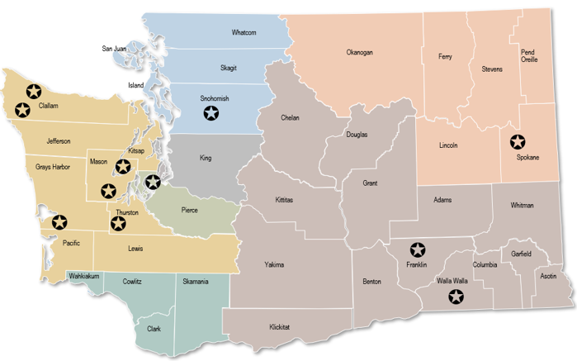
Washington Prisons
11 prisons in WA
Total Population is 13,972
Down from over 18,000 in 2019
Source: OMNI
Sources: US Census Population estimates, July 1, 2023, (V2023)
WA DOC Agency Fact Card 100-RE005

Slide 13
Types of Crimes and Length of Stay
Source: WA DOC Agency Fact Card 100-RE005
Source: OMNI
Average Length of Stay = 30.6 months

Slide 14
Recidivism
2018 National average estimate*
Sources: *2018 National Average from 36 states, World Population Review
DOC Overall recidivism rate, OMNI

Slide 15
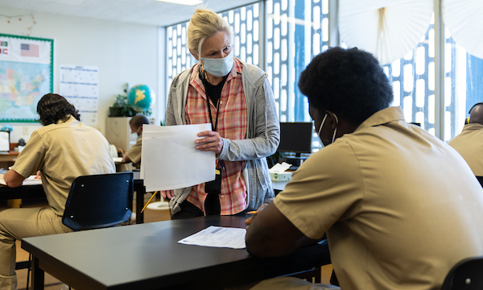
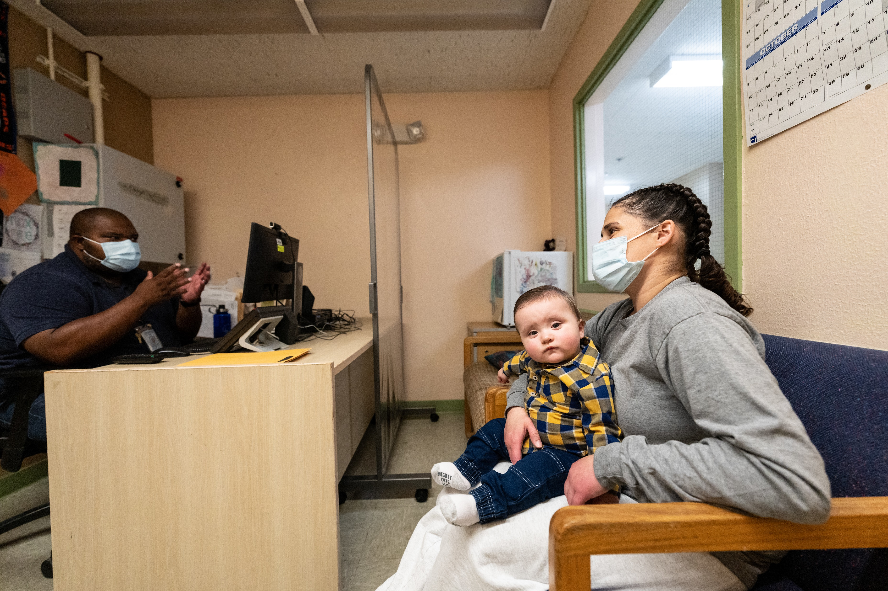
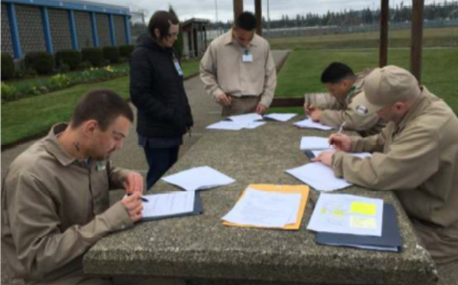
Reentry Begins at Reception
Every incarcerated individual receives an Individual Reentry Plan on admission, for use throughout their stay.
On admission we assess:
    Medical and mental health needs
    Education needs
    Risk level and classification
    Substance use history
    Treatment and program needs

Slide 16
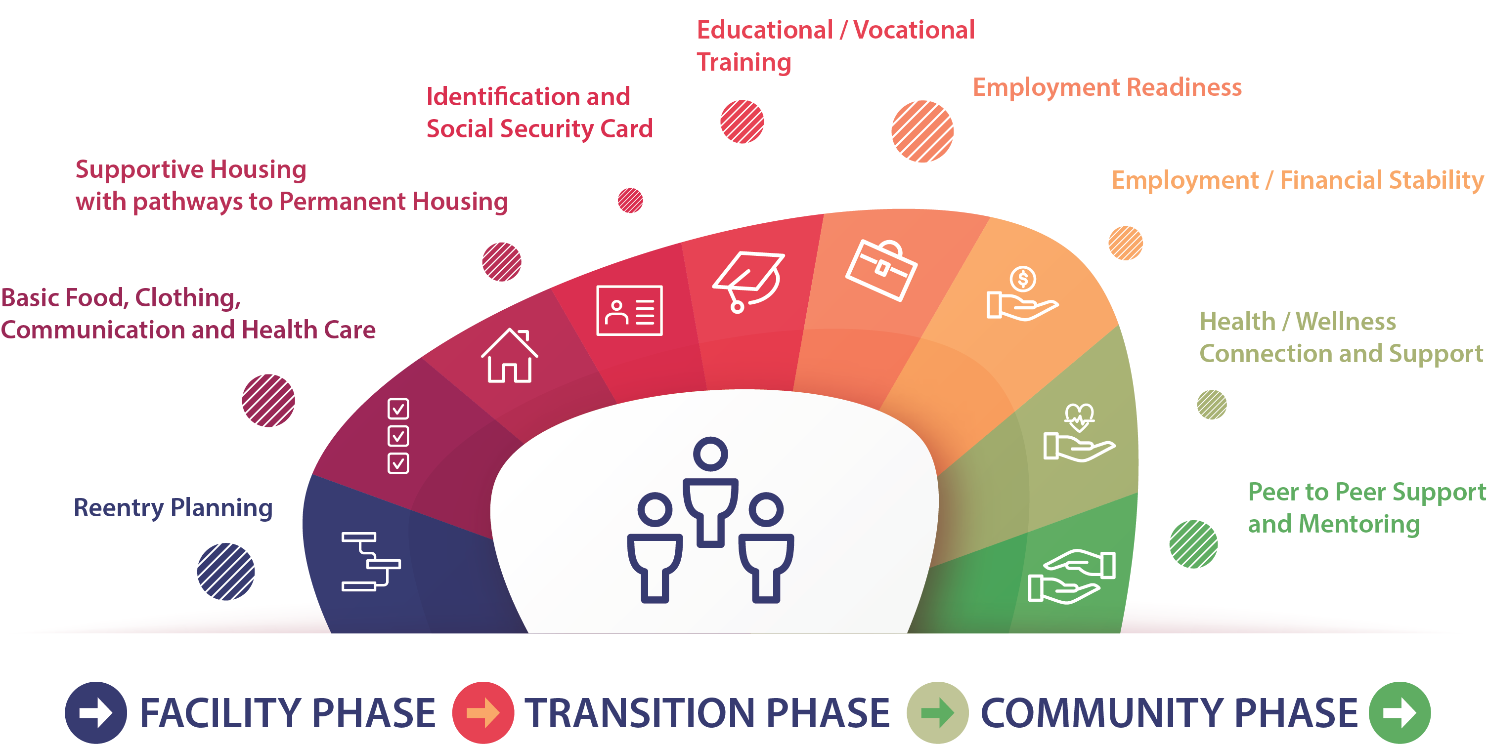
Reentry Planning

Slide 17
We Have Colleges in all 11 Prisons
For every dollar invested in corrections education, up to $19.80
is saved from reduced recidivism in WA State (WSIPP, 2018).
High school equivalency
  High school diplomas and GED® pathways at each facility.
Postsecondary workforce certificates
  30 workforce certificates and 13 state-recognized pre-apprenticeship programs
Postsecondary associate degrees
  20 associate degrees offered with 8 additional pathways anticipated in FY25
Bachelor’s degrees
  3 Bachelor pathways with 7 additional pathways anticipated in FY25

Slide 18
Programs and Work Readiness
All core programs are evidence-based, research-based, or promising practice.
  Cognitive Behavioral Interventions (CBI)
  Strength in Families
  Residential Parenting Program
  Soft skills development
  Reentry life skills
  Financial literacy
We have established community partnerships to enhance opportunities for living-wage and sustainable employment.
  Aerospace Joint Apprenticeship Committee (AJAC)
  Construction Trades Apprenticeship Preparation (CTAP)
  Trades Related Apprenticeship Coaching (TRAC)

Slide 19
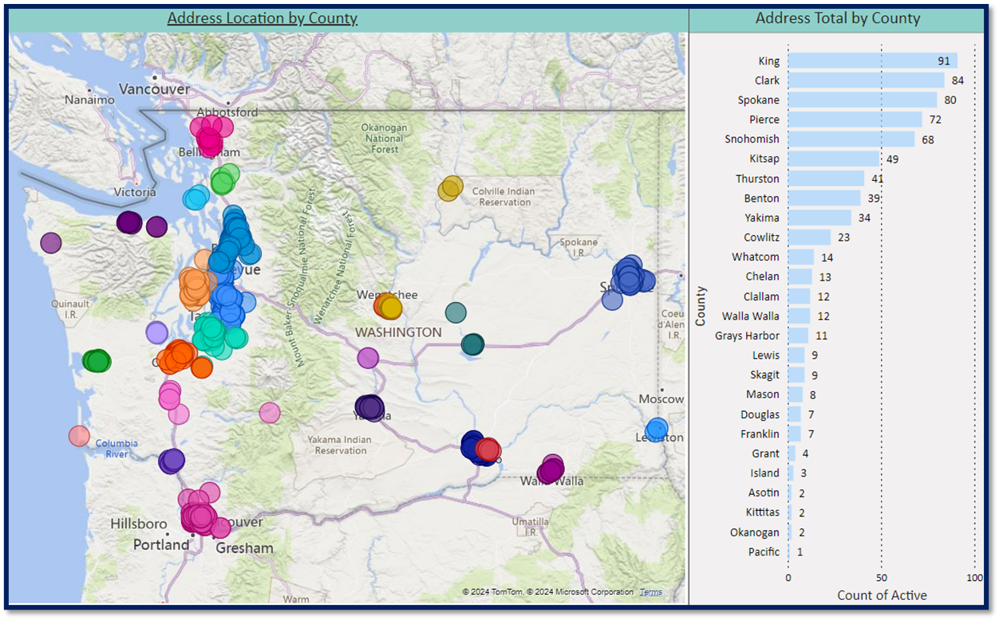
Reentry Housing Assistance Program

Slide 20
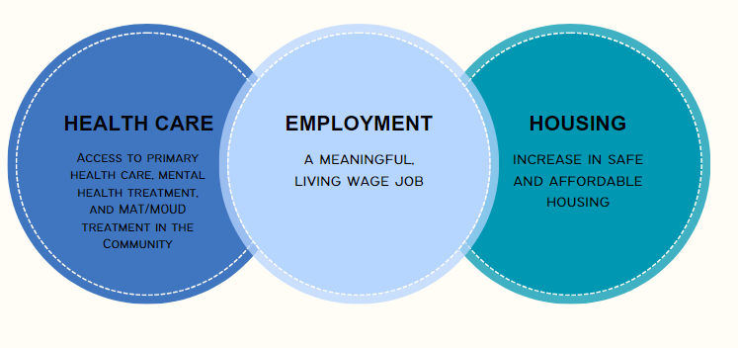
Looking Ahead

Slide 21
Governor Q&A

Slide 22
Washington State Reentry Council
Strategic Plan
Presented by (in order of presentation):
Janel McFeat, Executive Director, Statewide Reentry Council
Karen Lee, Co-Chair, Statewide Reentry Council
Ty Reed, MBA, PHR, CWDP, CPC, CFAA-HR, Member, Statewide Reentry Council

Slide 23
Statewide Reentry Council
Established by Governor Inslee in 2016 with the goal of improving public safety and outcomes for individuals reentering the community (43.380 RCW).

Slide 24
Statewide Reentry Council Mission, Vision, Values
Our Mission
The Washington Statewide Reentry Council advocates for Washington laws, investments, and attitudes that improve reentry outcomes and increase public safety by supporting equitable reentry systems that are more humane and restorative.
Our Vision
We disrupt the cycle of mass incarceration by transforming systems so that each individual is treated equitably and with dignity.
Our Values
Integrity
Equity
Justice
Relationships
Respect & Dignity
Restoration
Anti-Racism

Slide 25
Strategic Plan Goals: 2023-2026
Foster effective relationships with interested parties​ (Increase visits to jails, youth facilities, tribal jails, and prisons)
Embark on becoming a Reentry 2030 State
Raise awareness about current custody conditions (DOC giving voice to currently incarcerated by allowing them to speak at our Council meetings)
Influence how resources are directed (Talk with our legislators about supporting innovative reentry programing and tribal programming)
Notes:
Foster effective relationships with interested parties​ (Increase visits to jails, youth facilities, tribal jails, and prisons)
Embark on becoming a Reentry 2030 State
Raise awareness about current custody conditions (DOC giving voice to currently incarcerated by allowing them to speak at our Council meetings)
Influence how resources are directed (Talk with our legislators about supporting innovative reentry programing and tribal programming)

Slide 26
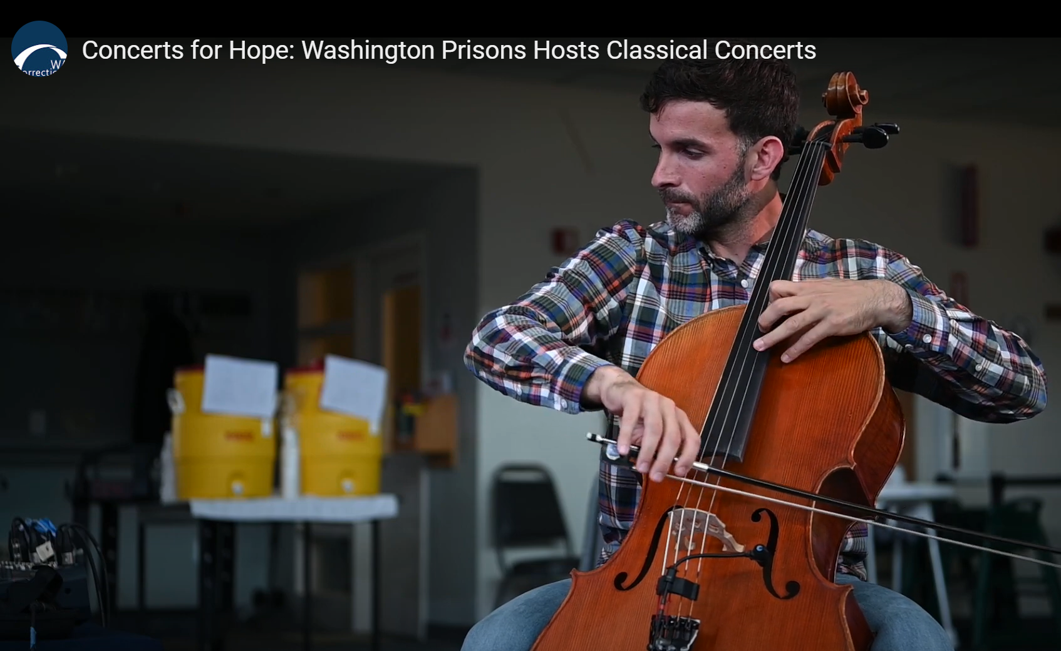
Reentry Council Successes 2023
Completed Strategic Plan and Key Performance Indicators
Completed Logic Model and Performance Evaluation
Increased community, stakeholder, and tribal engagement
  Listening circles with people who are incarcerated informed creation of the strategic plan
  Community survey sent to 14,000 people who are incarcerated with a Partnerships with Securus Technologies, Department of Corrections, and The Athena Group
Increased activity with Juvenile Stakeholder Groups through DCYF partnership
Held First Washington Statewide Reentry Council meeting hosted on Tribal land
Involved people who are currently incarcerated in WSRC meetings
Collaborated with other State Reentry Councils across the Nation
Visited 14 facilities:
  11 prisons
  2 jails
  1 tribal Jail
Supported Concert Series of Hope

Slide 27
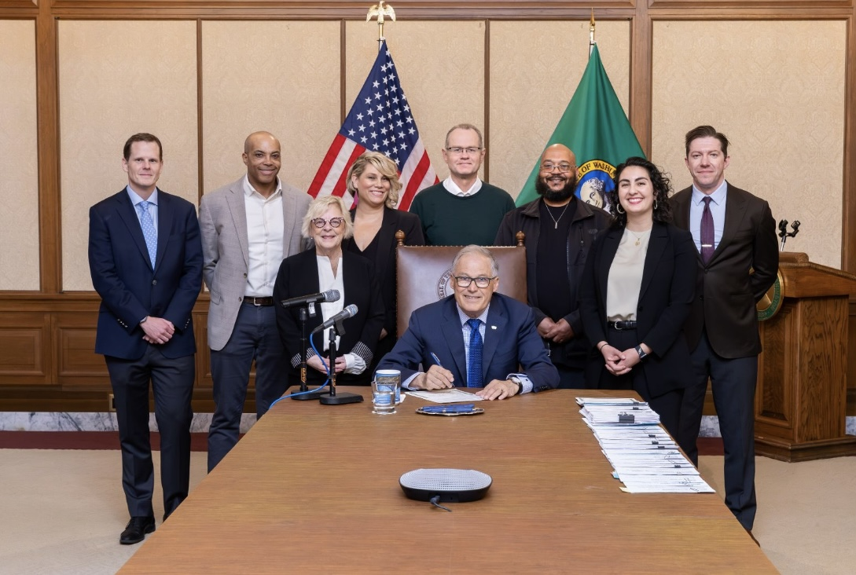
Early Successes for 2024
Received proviso for jail pilot project to do work using a human dignity model for jails
Received funding to support implementation of the Reentry Strategic Plan
Supported 4 bills that passed:
  HB 2084: Ombuds Oversight for Construction Apprenticeship
  HB 2099: Releasing w/Official State ID Card
  SB 5893: Gate Money
  SB 5794: Removes Legal Financial Obligations (LFOs)

Slide 28

Challenges
Peer access inconsistencies in prisons
Additional funding and support needs
Reentry support for tribes, jails and youth

Slide 29
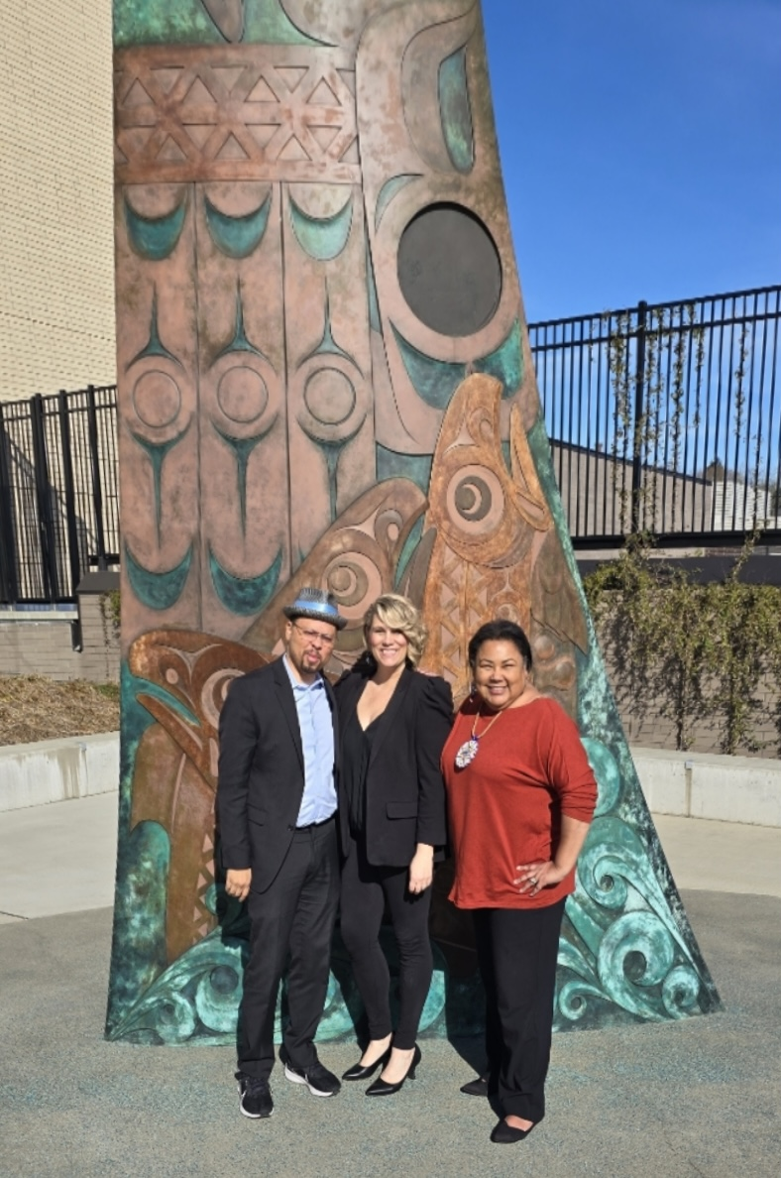

The Future of Reentry
Reentry 2030 is a national initiative that aims to dramatically improve reentry success for people exiting prison and those under supervision.
Commitments:
Human-centered
Coordinated
Transparent
Equitable
More information: Reentry2030.org

Slide 30
Council Members
CO-CHAIRS
Durell Green, Choose 180 (representing experience reentering the community after incarceration)
Karen Lee, Plymouth Housing (representing community leaders)
Winona Stevens, member of the Ho-Chunk Nation and Native American Reentry Services Executive Director/Wellbriety Movement for Prisons Representatives Program (representing Tribal Affairs)
MEMBERS
Danielle Armbruster, Assistant Secretary of Reentry/Department of Corrections (representing Department of Corrections)
Jerry Goodstein, Professor Emeritus of Management with the Carson College of Business at Washington State University (representing business and employers)
Ayodele (Ayo) Idowu, Prison Fellowship volunteer (representing faith-based organizations or communities)
Larry Jefferson, Director of Public Defense for the State of Washington (representing public defenders)
Roger Kluck, Projects for a Civil Society (representing community leaders)
Ty Reed, MBA, PHR, CWDP, CPC, CFAA-HR, Career Coach, Professional Speaker, Recovery Career Services
Eric Richey, Whatcom County Prosecutor (representing prosecutors)
Penelope Sapp, Kitsap County Sheriff’s Office Jail (representing law enforcement)
Felice Upton, Department of Children, Youth & Families (representing Juvenile Rehabilitation Administration)
Heather Wehr, Washington State Coalition Against Domestic Violence (representing crime victims)
Hilary Young, Pioneer Human Services (representing housing providers)
Hanan Al-Zubaidy- Associate Director For Corrections Education at the Washington State Board for Community and Technical Colleges (representing a statewide organization

Slide 31
Thank you
Janel McFeat
Executive director, statewide reentry council
Janel.McFeat@commerce.wa.gov
Washington Statewide Reentry Council

Slide 32
Governor Q&A

Slide 33
Programs, Grants, and Initiatives
Presented by (in order of presentation):
Tyron Nixon, Transformation Implementation Manager, Health Care Authority
Kurt Myers, Reentry Program Manager, Department of Commerce
Ismaila Maidadi, Employment Connections Director, Employment Connection, Employment Security Department

Slide 34
Washington’s Section 1115 Medicaid demonstration waiver – Reentry Services
What’s on the horizon
April 24, 2024
PPR Meeting

Slide 35
Goals of Reentry Services
In June 2023, HCA received federal approval to implement this program.
Reentry Services focuses on whole-person care, which includes physical and behavioral health and health related social needs (HRSN), which are services designed to help with social determinates of health.
Reentry Services will deliver a targeted set of services to adults and youth in state prisons, jails, Tribal jails, or youth correctional facilities in the 90 days prior to their release. The program launches on July 1, 2025.
HCA received authorization to distribute up to $300 million in Capacity Building Program funding to our implementation partners to support planning and implementation of this program.

Slide 36
Eligible population & scope of services
For all Medicaid-eligible individuals within 90 days of release from a state prison, jail, Tribal jail, youth rehabilitation center, or youth correctional facility (pretrial or post-conviction).
Delivery of pre-release services in the 90-days prior to release, which includes care management, physical and behavioral health clinical consultations, pre-release medications (medications for substance use disorders, HIV, and Hepatitis C) lab and radiology services.
Reentry support, which consists of a 30-day supply of medications, durable medical equipment and supplies, and a warm handoff to post-release care management at release.
Post-release for HRSN include:
  Housing transition navigation services
  Rent/temporary housing for up to six months
  Nutrition supports
  Respite care

Slide 37
Thank you!
Tyron Nixon
Transformation Implementation Manager
tyron.nixon@hca.wa.gov
Emma Oppenheim
Medicaid Transformation Project Director
emma.oppenheim@hca.wa.gov

Slide 38
Reentry Grant Program
Results Washington
Kurt Myers, Reentry Program Manager
Office of Firearm Safety Violence Prevention -
Community Safety Unit
April 24, 2024

Slide 39
Reentry Grant Program
In 2021, the Washington State Legislature created the Reentry Grant Program, appropriating $5 million to the Department of Commerce “to administer a competitive grant program for grants to community-based programs to provide reentry services for formerly incarcerated persons and supports to facilitate successful transitions to the community.”
It requires at least 30% of funding go to applicants in rural counties.
Commerce must work in collaboration with the Washington Statewide Reentry Council to administer the program.

Slide 40

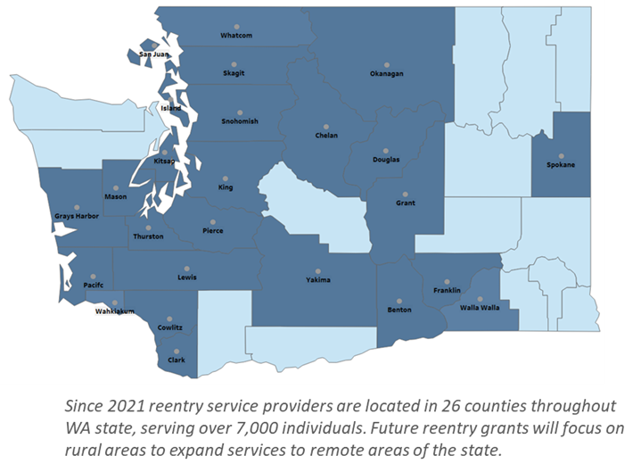
Collective creation
  The Council’s collective knowledge and expertise helped stand up the Reentry Grant Program
  Sought insight from ongoing grantees, applicants and other stakeholders from impacted communities
  Best practices research continues to inform program development

Slide 41
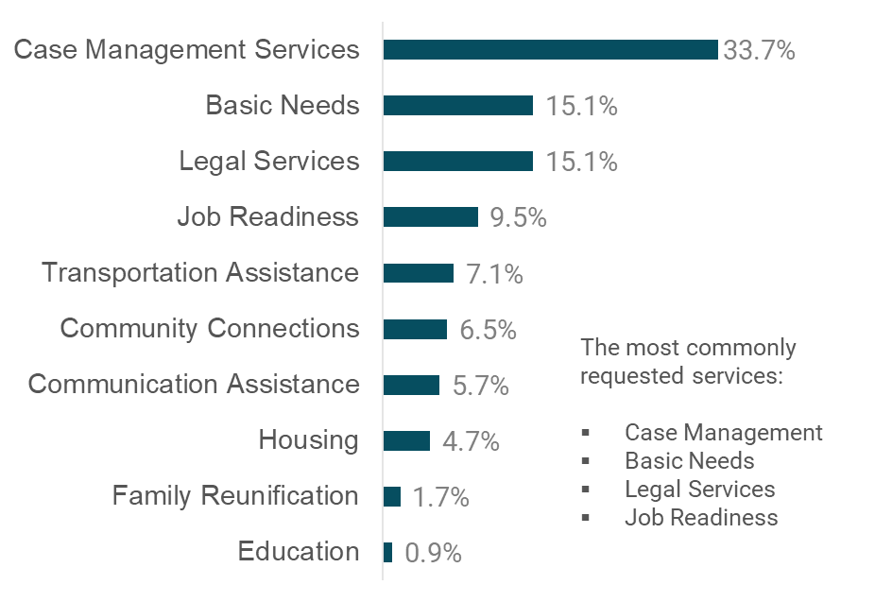
Approach
SFY 22-23 Types of Services Provided
33.7%
15.1%
  Invest in community-based organizations whose services address key barriers for people reentering our communities.
15.1%
9.5%
7.1%
6.5%
5.7%
4.7%
1.7%
.09%

Slide 42
SFY 2021-2023
SFY 22: $2.5 million
Competitive grant program
28 application proposals
Evaluated by subject matter experts
10 organizations awarded $250,000 each
24 of 39 Washington counties served
SFY 23: $2.5 million
Two competitive categories:
  Tier 1: Small-to-medium organizations
    Up to $120,000 each
  Tier 2: Medium-to-large organizations
    Up to $220,000 each
28 application proposals
14 organizations awarded $120,000-$220,000
18 of 39 Washington counties served

Slide 43
SFYs 2024-2025 Program enhancements
An additional $12 million in Community Reinvestment Plan funds to support reentry
SFY 24: $8.5 million
SFY 25: $8.5 million
$2.5 million — Reentry Grant
$6 million — CRP
Three competitive categories
  Tier 1: Small to Medium Organizations
  Tier 2: Medium Organizations
  Tier 3: Large organizations
64 application proposals
23 organizations awarded ($300,000, $500,000 and $1 million over the biennium for each tier, respectively)
$2.5 million — Reentry Grant
$6 million – CRP
New competitive category
  Small “grassroots” organizations
Award up to $150,000 each
50% of funds to rural communities
Procurement in process

Slide 44
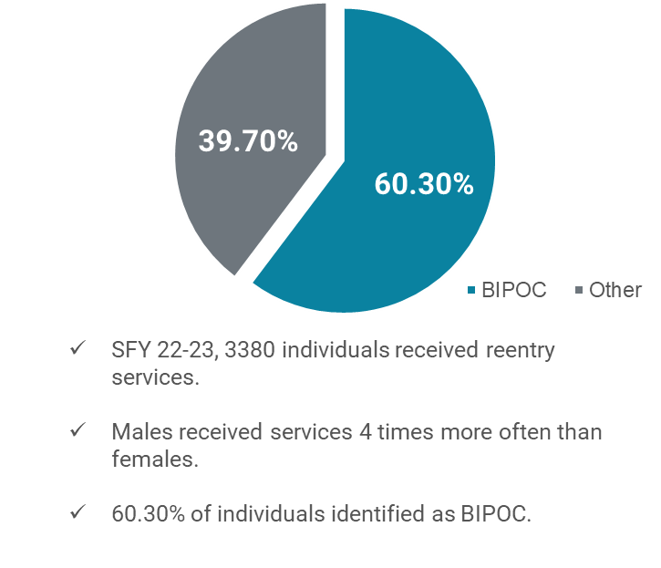
Individuals served
Individual and Total Services Provided
Services to BIPOC individuals
For a breakdown of types of service provided, see slide 4
Total number of individuals receiving services and gender was reported

Slide 45
Housing success at reentry
Reentry Grant Program:
86% of our reentry grantees provided some form of housing support in SFY22-23
Types of Housing Support Funded by Reentry Grant Program in SFY22-23
Other Commerce Housing Initiatives:
$528 million to state Housing Trust Fund
Apple Health and Homes – in cooperation with the Health Care Authority
Changes to local land use

Slide 46

Key changes and lessons learned
Focus solicitations on non-profits and tribal government programs
Implement a tiered funding model, making competition more equitable
Establish collaboration between state agencies
Streamline reporting and data collection
Create opportunities for collaboration between funded programs
Identify service deserts and target rural counties
Listen to feedback from people and communities impacted by incarceration and take action in response

Slide 47
Thank you!
Kurt Myers
Reentry grant Manager, Office of Firearm safety and violence prevention – Community safety unit
Kurt.Myers@commerce.wa.gov
https://www.commerce.wa.gov/serving-communities/public-safety//

Slide 48
Reentry Initiatives
ESD’s reentry activities are provided through the WorkSource system, Washington State’s one-stop partnership funded by WA State and the US Department of Labor to provide workforce development services.
The Employment Security Department and WorkSource are equal opportunity employers/programs. Auxiliary aids and services are available upon request to individuals with disabilities. Language assistance services for limited English proficient individuals are available free of charge. Washington Relay Service 711.

Slide 49
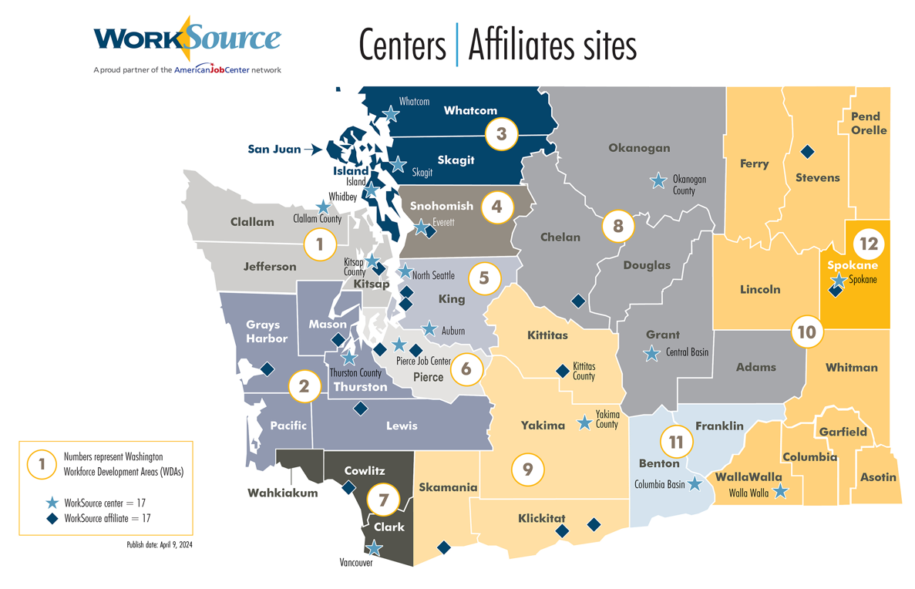
WorkSource affiliate sites

Slide 50
Reentry Metrics
Performance | 2019 | 2020 | 2022 | 2022 | 2023
Total reentry participants served | 12,424 | 10,482 | 8152 | 7783 | 9166
Self-service reentry participants | 5289 | 5946 | 3926 | 2395 | 3594
Staff assisted reentry participants | 8275 | 5040 | 4541 | 5835 | 6392
Employment rate – 1st quarter after exit | 59.9% | 50.9% | 57.8% | 59.5% | incomplete
Employment rate – 2nd quarter after exit | 56.2% | 50.7% | 57.7% | 58.3% | incomplete
Median wage – 2nd quarter after exit | $5840 | $6825 | $7638 | $6390 | $8841
Reentry is an optional field for customers to complete, resulting in a smaller cohort size
Employment rate data is available up to three quarters following program exit

Slide 51
Service Delivery Improvements
PROWD
Veterans Referral Initiative
Expansion Initiative
Federal Department of Justice and Department of Labor Partners for Reentry Opportunities in Workforce Development (PROWD) grant initiative to provide employment services to federally incarcerated individuals as they approach community release and beyond
DOC compiles rosters of incarcerated Veterans and shares them with ESD. This enables local Veterans outreach staff to virtually introduce themselves to the Veterans before their release and to seamlessly continue providing services once the Veterans arrive in the community. In the initial 4 months, a total of 238 referrals were made.
In a manner similar to our Veterans initiative, ESD intends to extend facilitated warm handoffs to all reentry customers throughout the state.

Slide 52
Thank you!
Director of Employment Connections, Ismaila Maidadi: Ismaila.Maidadi@esd.wa.gov

Slide 53
Governor Q&A

Slide 54
Future Commitments and Next Steps
Presented by:
Chris Poulos, Esq., Executive Director, Center for Justice and Human Dignity
Cheryl Strange, Secretary, Department of Corrections

Slide 55


CJHD’s Mission
The Center’s mission is safely expanding innovative and effective alternatives to incarceration while improving conditions for incarcerated people and correctional staff
The Center also works to improve reentry policies, practices, and outcomes
The Center recently supported successful legislative efforts to increase gate money and provide necessary medication and state IDs to everyone exiting Washington’s prisons

Slide 56
Recommendations
The Center recommends:
Increasing access for community groups and peer-facilitated programs inside Washington’s prisons
Increasing access to laptops and providing technology training, including smartphones
Changing the uniforms Community Corrections Officers utilize for routine visits
Providing opportunities for incarcerated people to earn outside wages to prepare for reentry and reduce the burden on families and taxpayers
Continuing efforts to center human dignity and breaking down “us vs. them” dynamics
Joining the Department of Justice and Council of State Government’s “Reentry 2030” initiative

Slide 57
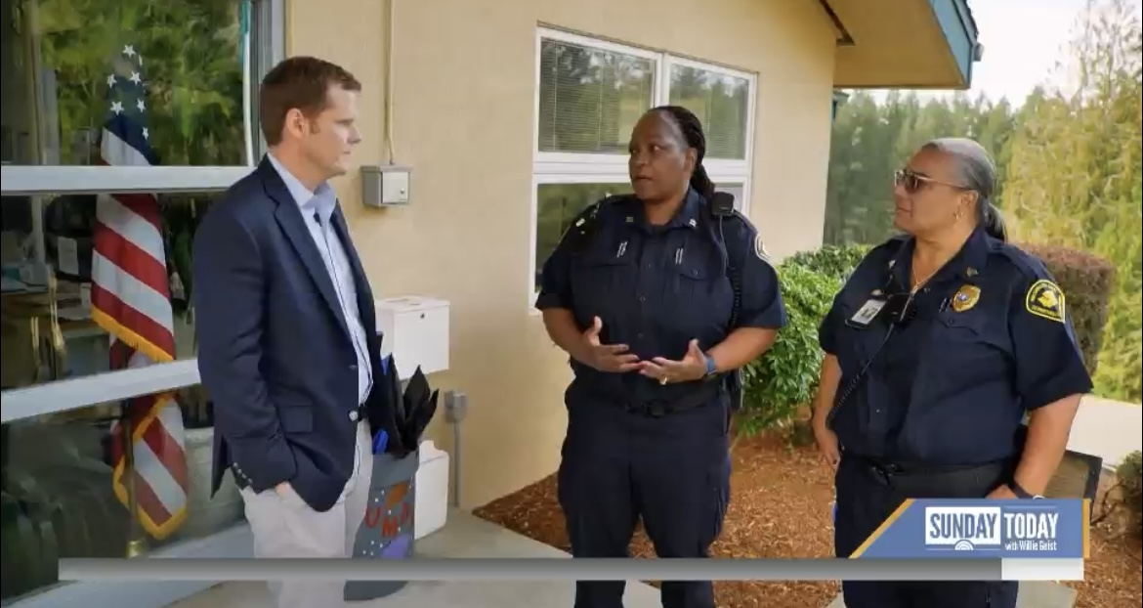
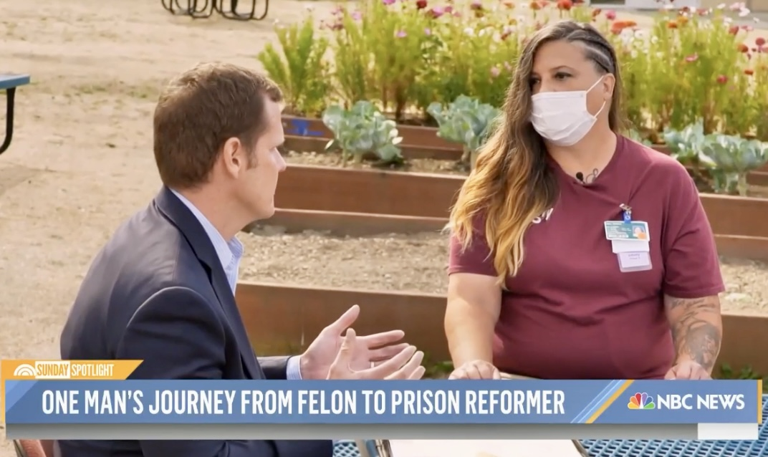
Washington prison visits

Slide 58
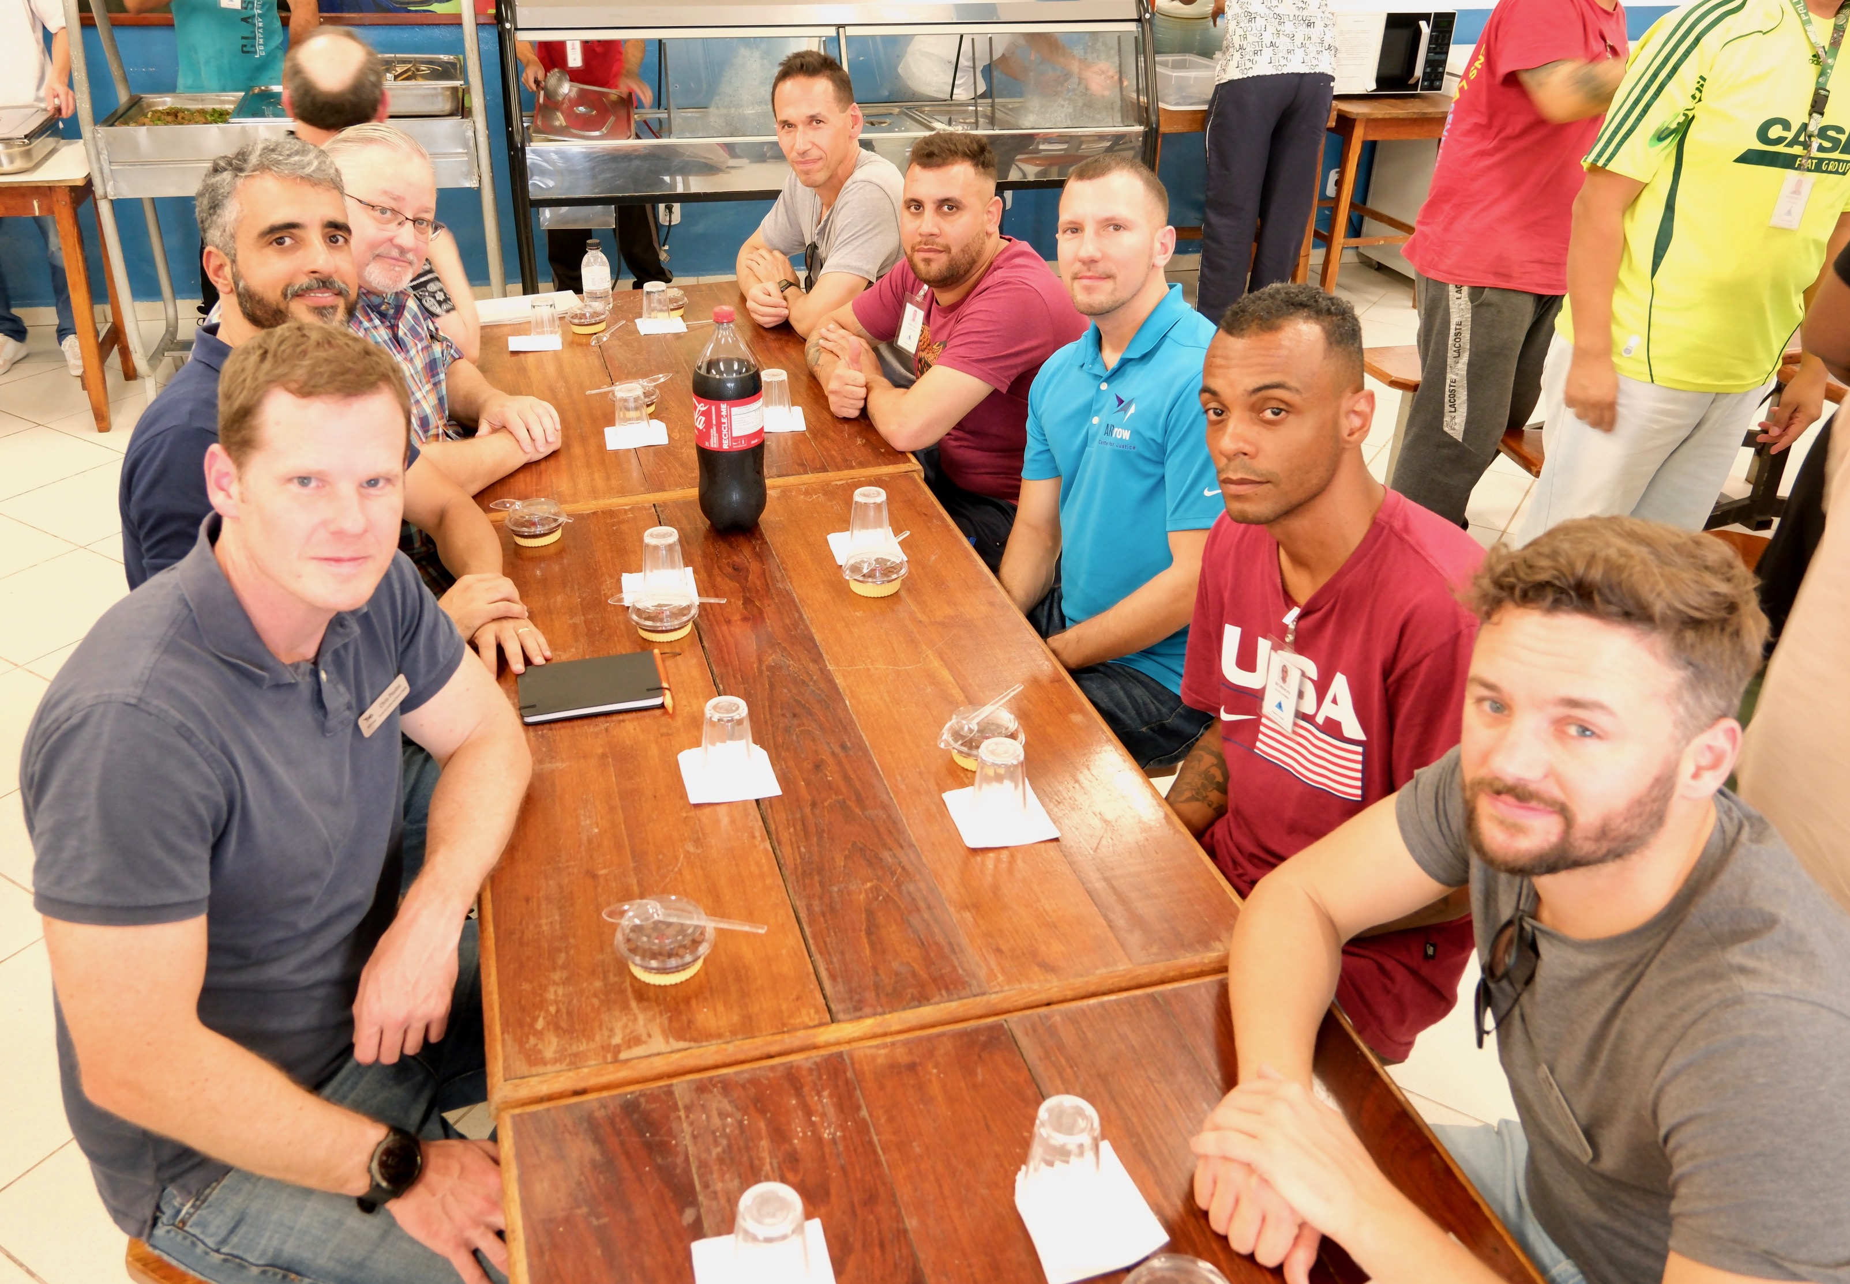
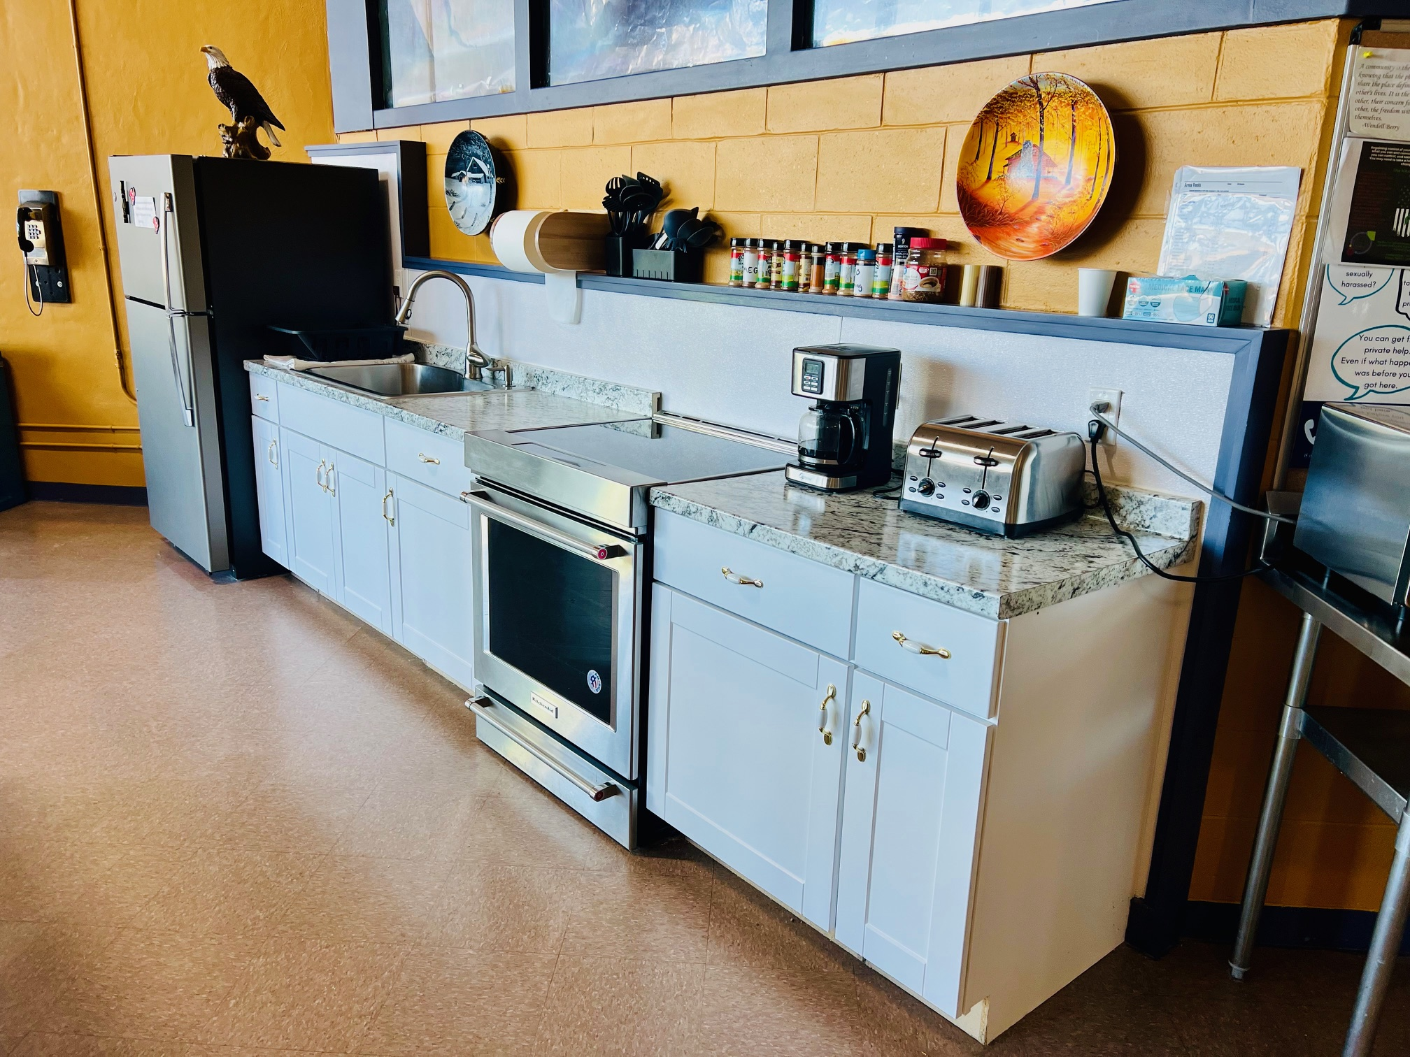
Brazil and Maine prison visits

Slide 59
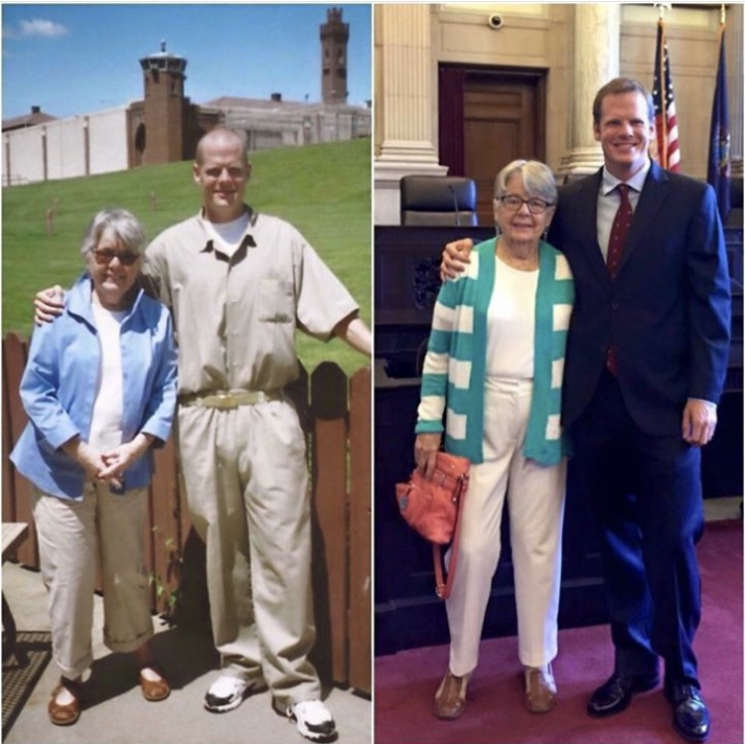
“Successful reentry occurs when internal healing and growth is met with external opportunity.”
Contact
Christopher Poulos
Executive Director
cpoulos@cjhd.org

Slide 60
Final Points
Housing, healthcare and livable wage jobs are not about being soft on crime, they are about following the science to create public safety for all Washingtonians.

Slide 61
Governor Q&A

Slide 62
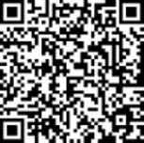
Thank You for Attending Today!
Please Take a Moment to Complete Our Brief Survey using the QR code below:
You can view the recording of today’s meeting at: https://results.wa.gov/measuring-progress/public-performance-reviews
Join us May 13th
10:30 a.m. – 11:45 a.m.
Topic:
Climate Commitment Act
Notes:
Thank you to all who attended this meeting today.
As a reminder, please take the time to complete the survey that will pop up at the end of this meeting.

Slide 63
Governor’s Closing Remarks

