Slide 1

Organization Strategy and Performance Unit - Customer Feedback Initiative
March 19, 2024

Slide 2
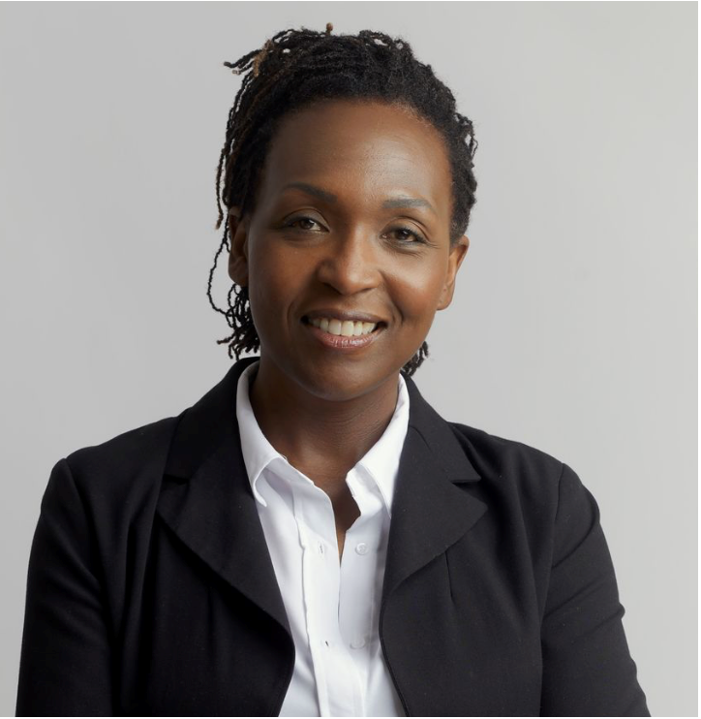
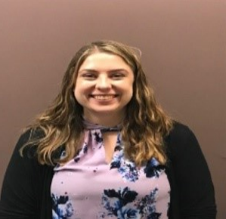
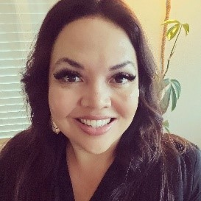
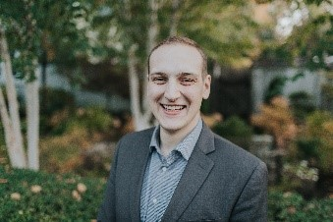
Who we are
Max Brown
Consultant
Lenora Sneva
Director
Aunna Moss
Lead Consultant
Amber Coleman
Equity Consultant
50+ years of public service and non-profit experience. Certifications: lean, organization change management, DEI (Diversity, Equity, and Inclusion), behavioral assessments, personal and leadership development.
Human-centered consulting – leading with empathy, respect and flexibility.

Slide 3
Agenda
Challenges
Successful outcomes
Metrics to improve
What’s next and closing
Goals
Background
Customer feedback – methods used to gather and themes

Slide 4

Background
Organization Strategy and Performance (OSP) unit formed in the fall of 2022
Service offerings
Equity
Strategic planning
Organization change management
Process improvement
Project management

Slide 5
Background continued
The OSP unit hired a consultant in spring 2023 to help our unit understand the most valuable actions we were performing in the current state and to identify activities for consideration in the future state.
Ultimately, we wanted to learn from customers what had been helpful and what changes we could make in the future to increase the value of our services.

Slide 6

Goals
Define project and change management
Develop an organizational strategy
Conduct a gap analysis
Determine organization and team structure
Discuss roles and responsibilities, deliverables, and outcomes.
By understanding customer perceptions and the types of work requests we were receiving.
To help us understand overlaps and gaps between the work conducted by our team and the services requested from our customers. ​
By understanding the most valuable work, competencies required, and resources required.

Slide 7
Methods used to gather customer feedback
The consultant gathered feedback primarily via 1:1 interviews

Slide 8

Customer feedback – themes
Define the role the OSP unit plays within OFM
Define service offerings
Designate a singular point of contact

Slide 9
Customer feedback – themes continued
Decide how to delineate specialization on the team
Deliver high-quality and consistent services
Understand clients and their work context
Execute effective project management and organization change management skills

Slide 10

Challenges
Actioning general feedback without an opportunity to ask clarifying questions
Balancing current workloads to action feedback provided
Did not have customer feedback framework established before the initiative

Slide 11

Successful outcomes
Based on customer feedback
Created unit vision, mission, values and strategic priorities
Clearly defined service offerings
Standardized work, templates and deliverables
Established and participate in regular check-ins with OFM directors

Slide 12
Successful outcomes
Based on customer feedback
Adjusted our customer outreach approach
Identified core competencies for our work portfolio
Each consultant is focused on upskilling and learning in their identified growth areas
Sharing resources with OFM employees that align with our service offerings

Slide 13
Metrics to improve
Connected
Establish a customer service framework with an equity focus by June 30, 2024
Begin using standardized templates with OFM staff by January 30, 2024
Receive an 80% or more “agree” or “strongly agree” score on pulse survey questions related to OSP customer service by Dec. 30, 2024
    Valued
          Engaged

Slide 14


Our “why”
(Our) Mission (is) We create human-centered strategic partnerships to build skills, foster a culture of belonging and operational excellence.
(So that we can realize a)
Vision (of) Working together to empower one OFM

Slide 15

Our values
Collaboration
Curiosity
Diversity, Equity, Inclusion and Belonging
Empathy
Support
Wellness

Slide 16

Our priorities
Promote and support Diversity, Equity, Inclusion and Belonging
Utilize customer center practices
Provide a consistent consultative experience

Slide 17

What’s next
Continue to grow and learn
Regularly reassess service offerings based on customer feedback
Continue to build deliverables and templates

Slide 18
Closing
Summary
Questions?

