Slide 1
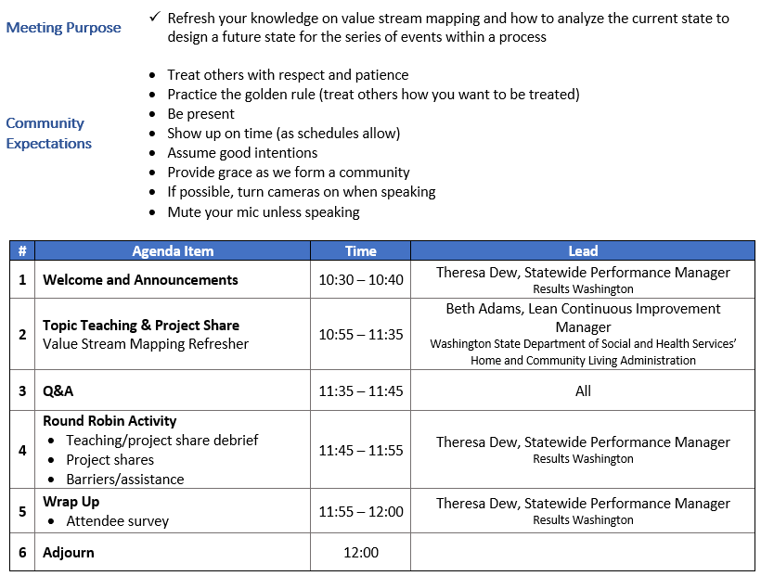

Agenda

Slide 2

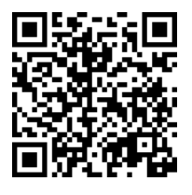
ROLL CALL!
Please take a moment to complete our Attendance Form

Slide 3
Announcements
Announcements
Save the date!
Customer Experience Conference
Tuesday, October 28th through Thursday, October 30th
Keynote and 11 unique sessions that focus on increasing customer experience through services, interactions, and Lean and human-centered practices
Includes presenters you know and love from our Lean Transformation Conference!
Public-Facing Staff Survey
Survey for agency staff that interact with the public directly
Gain insight on customer needs, challenges and expectations, elevate their voices, and understand what opportunities we have to improve their experience
Will be part of this year’s Employee Engagement Survey

Slide 4

Poll
Poll: How would you describe your VSM level of expertise?

