Slide 1
Agenda

Slide 2
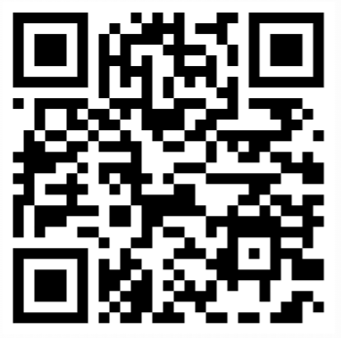
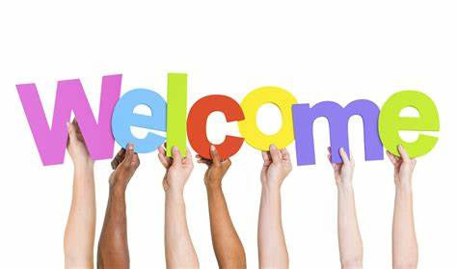
ROLL CALL!
Please take a moment to complete our Attendance Form

Slide 3
Community of Practice Updates
Extended
Time!
Announcing a repeat in-person workshop!
Date/time: Thursday, September 30th, 9:00 a.m. – 3:30 p.m.
Location: Helen Sommers Building (106 11th Ave. SW, Olympia, WA 98501)
Topic: Getting your idea across the finish line: How to communicate effectively with leaders to achieve buy-in
You will learn:
What leaders need to make good decisions
Lessons learned from years of experience with Results WA staff
Walk away with concrete tools you can immediately apply to your own ideas and projects
Who: State employees only; Limited to 45 people
“Resistance is greatest just before the finish line.” Steven Pressfield
Increased capacity!

Slide 4
Community of Practice Updates Cont.
Did you recently led or were involved of a process improvement project? Share your story through…
Results Washington’s Reflection Series
What: Video interview series that spotlights individual subject matter experts of an improvement project as they share their perspectives and experience on the improvement effort, highlight their achievements as well as barriers, and share any lessons they learned throughout the project
Why: Spotlight agency innovation and deepen the state’s culture by:
Highlighting individual voices directly involved in improvements
Sharing their knowledge and experience so others may learn and gain insight
Inspiring future improvements across the enterprise
Contact: Talia Mazzara (Talia.Mazzara@gov.wa.gov)
Check out our latest episode here!

Slide 5
Upcoming Events
Save the date for our 13th annual WA State Government Lean Transformation Conference!
“Leaning into the Future”
Purpose: To advance Lean and continuous improvement in Washington state by focusing on the tools and techniques of Lean, as well as explore other topics.
When: October 22nd through October 31st
Who: Local governments, other states, Washington businesses, educational professionals, and nonprofits Last year we welcomed over 3,600 attendees virtually!
Where: 100% virtually via Zoom with six days of presentations spanning the two weeks.
For additional information, please visit https://results.wa.gov/improving-government/lean/lean-conference

Slide 6
Upcoming Events Cont.
September Public Performance Review
When: Wednesday, September 25th @ 10:30 am – 11:45 am
Topic: Community Engagement with the Washington State Commissions and Small Agencies
Contributors: Washington State Women’s Commission, Commission on Hispanic Affairs, LGBTQ Commission, Arts Commission, and Department of Archeology and Historic Preservation
Discussion on the community engagement efforts happening around the state that make for more equitable and qualitative service delivery for Washingtonians
How to Join
In-person:
Legislative Building’s Columbia Room
416 Sid Snyder Ave. SW
Olympia, WA 98504
Virtually:
Live-streamed by TVW

