Slide 1
Compassionate Accountability
Lenora Sneva and Amber Coleman

Slide 2
“ Compassionate Accountability means treating people as valuable, capable, and responsible."
Nate Regier PhD

Slide 3
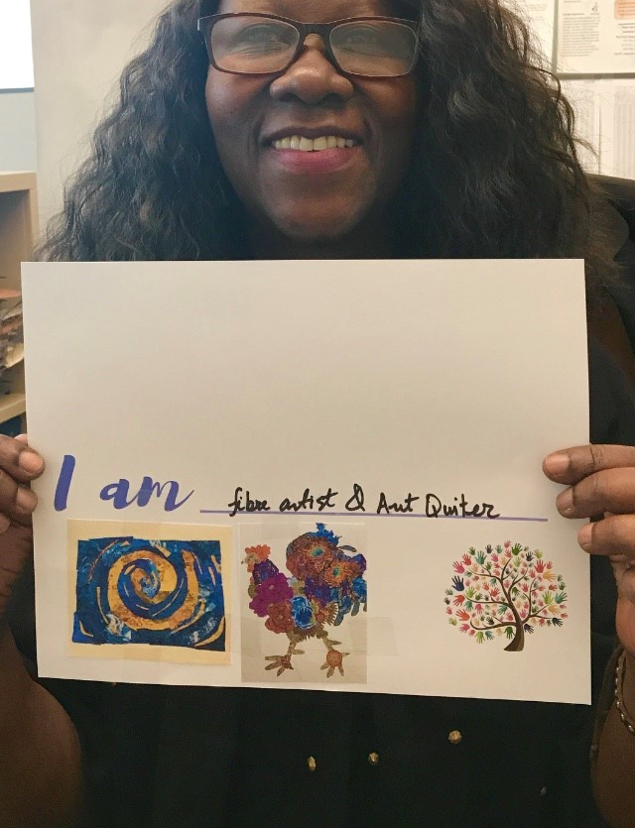
Agenda
Welcome and icebreaker
Learning objectives
Plan – Do – Check – Act
Compassionate Accountability PDCA
Office of Financial Mangement overview
Equity and belonging case study
Closing
Questions and answers

Slide 4
Icebreaker
Use the chat:
What words come to mind when you think of accountability?
How about compassion?

Slide 5
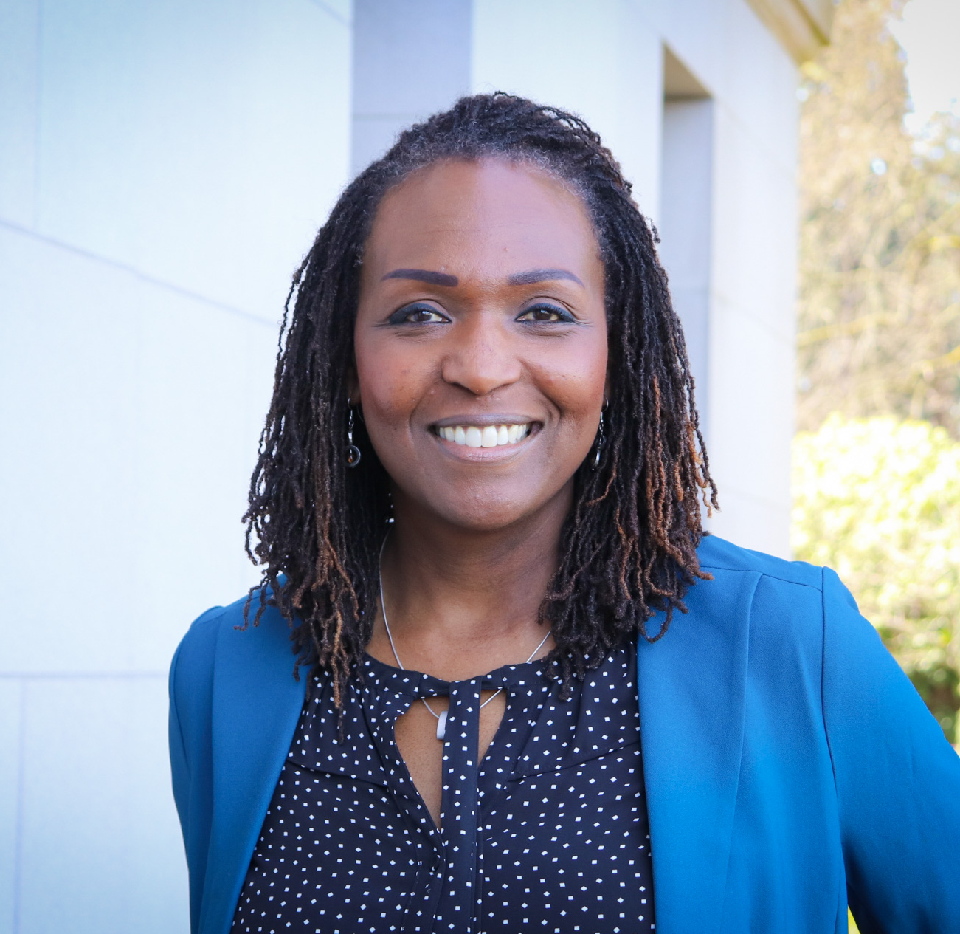
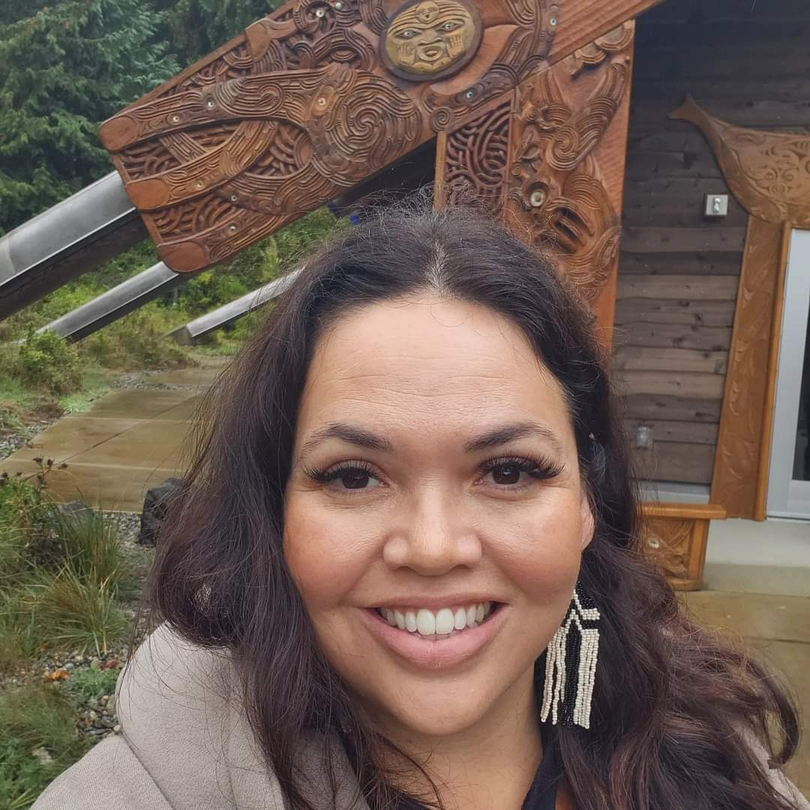
How are jobs help others
Lenora Sneva, OFM Organization Strategy and Performance Director and Equity Officer
Amber Coleman, OFM Pro-Equity Consultant

Slide 6
Lean Management PDCA
Plan
Do
Check
Act

Slide 7
Lean Management PDCA Explained
Plan — determine goals for a process and needed changes to achieve them.
Do — implement the changes.
Check — evaluate the results in terms of performance
Act — standardize and stabilize the change or begin the cycle again

Slide 8
PDCA Example
PLAN - Kitchen needed backsplash. shopped, consulted, education
DO - Installed the backsplash
CHECK - Didn't have all the experience or tools
ACT - Neighbor helped and repeated cycle to completion

Slide 9
Office of Financial Management
How well do you know OFM?
When was OFM created by the legislature?
How many divisions in OFM?
How many employees?

Slide 10
Office of Financial Management Overview
Enterprise central services for Facilities, Accounting, Human Resources, Legal and Contracts, and Information Technology
545 OFM Employees / 737 Employees including Gov, Affiliates and Office of Independent Investigations
Supports 10 small agencies/commissions/boards including the Gov's office
Headquarters on Capitol campus – Insurance Building

Slide 11
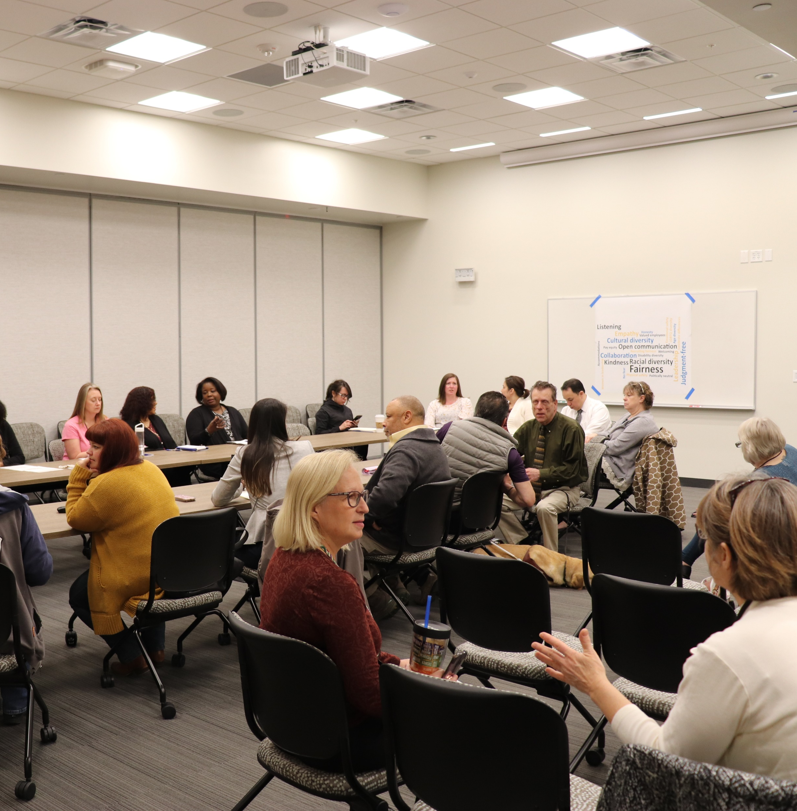
OFM Vision, Mission, Values
Vision – Working together for the equitable future of every Washingtonian.
Mission – We empower Washingtonians by helping state agencies and the Legislature connect people, budgets, policies, data and systems.
Values – Diversity, Equity, Inclusion and Belonging (DEIB), Integrity, Innovation, Collaboration, and Operational Excellence.

Slide 12
Equity and Belonging at your agency
On a scale of 1-5, how COMPASSIONATE is your division or administration equity and belonging efforts?
On a scale of 1-5, how ACCOUNTABLE is your division or administration equity and belonging efforts?

Slide 13
OFM Equity and Belonging History
2018
Training Forum Privilege session
2018
Strategic plan respect and inclusion
Survey design
2019
Respect and Inclusion Survey
Focus groups
2019
DEI Council formed
DEI Foundations class
2021
Survey
DEI questions in Employee Engagement Survey
Pro-Equity Anti-Racism efforts began
Equity Officer
2024
Equity Belonging Advisory Team and the Forum
2023
Survey
Pro-Equity Consultant DEIB Coaching
DEIB Retreat
2022
Language Access Specialist

Slide 14
Equity is a shared responsibility
Help
Help strengthen staff and leader’s knowledge and skill in discussing equity and belonging from a business
Provide
Provide space for personal stories
Rotate
Rotate Equity Belonging Advisory Team meeting facilitators
Encourage
Encourage BRG participation
Bring
Bring policy and communications liaisons to EBAT meetings

Slide 15
Compassionate Accountability PDCA
Plan
Prioritize the people determining the goals based on data and observations
Do
Collaborate and implement the changes
Check
Utilize feedback and evaluate the performance
Act
Build trust and stabilize the change or do it again

Slide 16
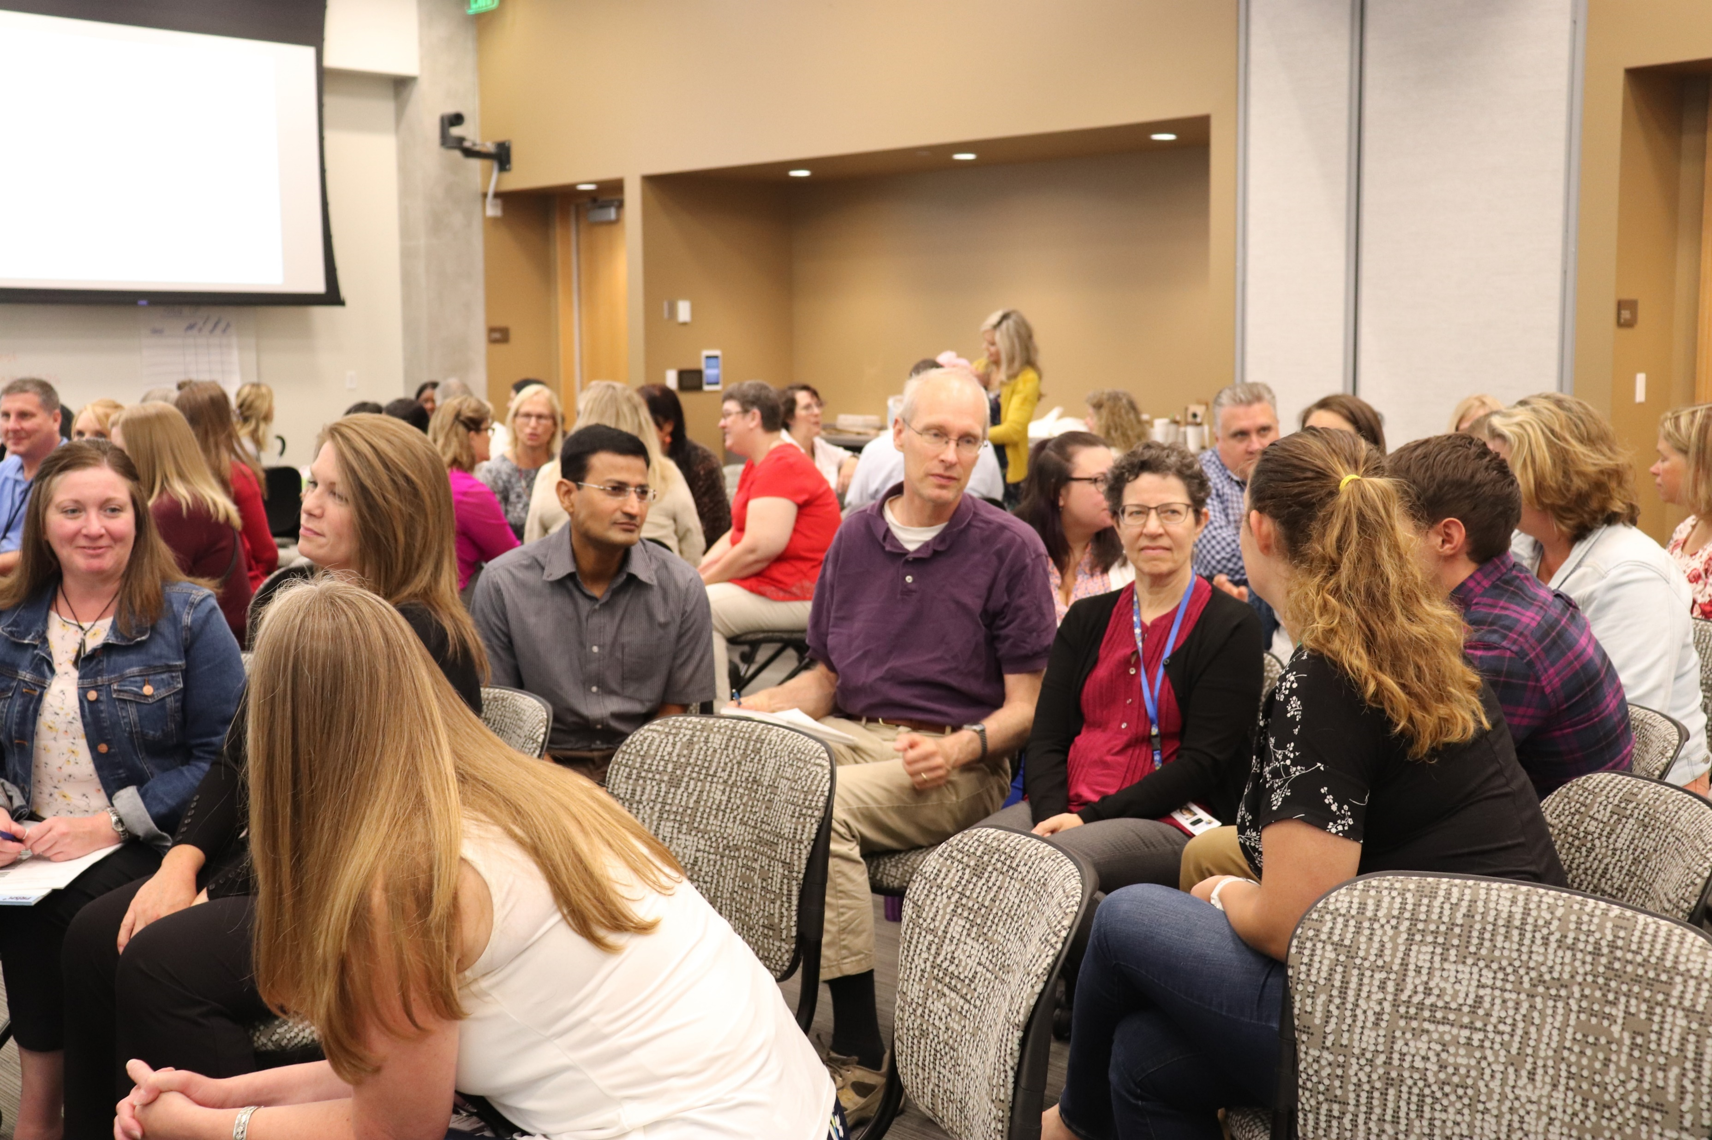
Forum and Equity Belonging Advisory Team
We retired our DEI Council, and the work has evolved into shared responsibility frameworks.
The Forum – Provide opportunities to strengthen knowledge and skill in discussing equity and belonging
Equity and Belonging Advisory Team – Focus on HR policies, communications and data

Slide 17
OFM Equity and Belonging Case Study
Prioritize the people
Collaborate
Utilize feedback
Build trust

Slide 18
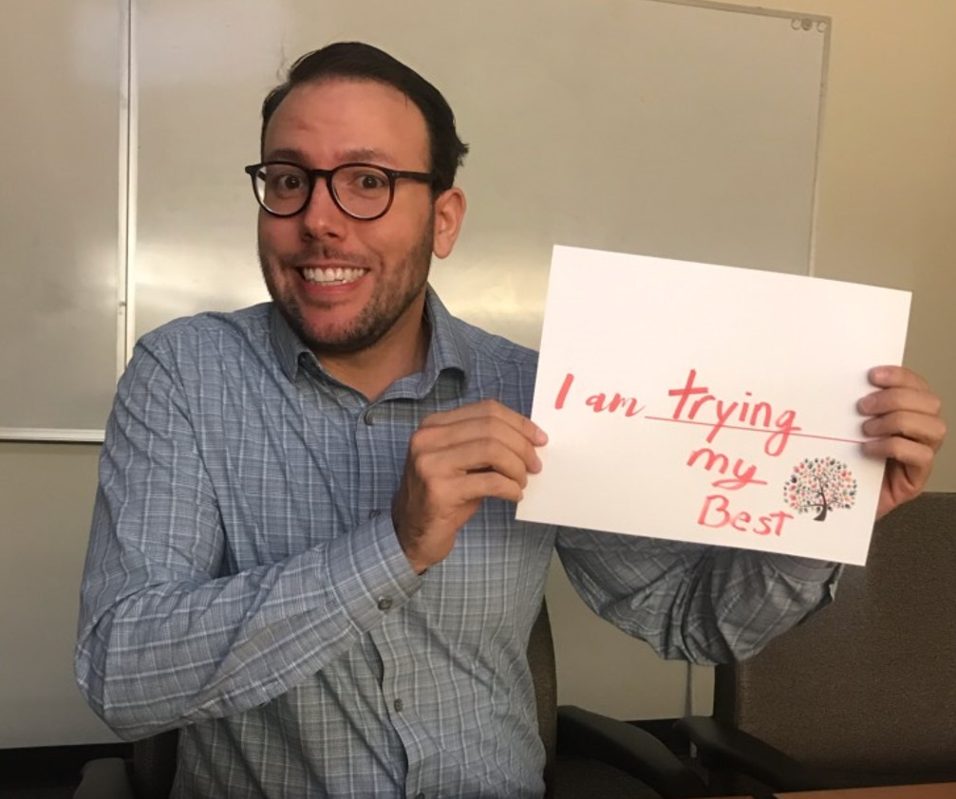
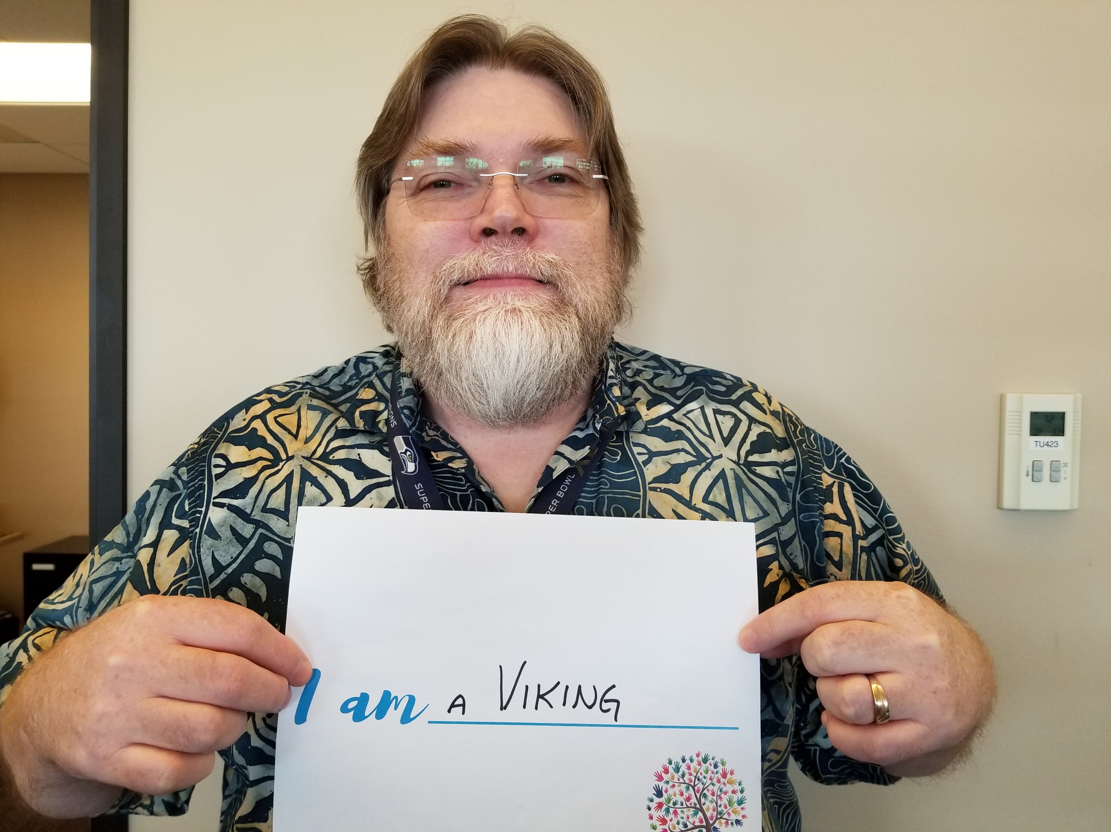
Plan: Prioritize people and identify gaps
Gathered employee feedback
OFM DEI Foundations Training Evaluations
2023 Employee Engagement Survey
2023 Respect and Inclusion Survey
Diversity, Equity and Belonging Retreat Brainstorm

Slide 19
Do: Collaborate by executing plan & collecting data
Coffee chats to share DEIB vision
Charter creation through working – open to anyone
Implemented Cultural Humility classes
Erin Jones was brought in for ELT to support leadership and in response from the Respect and Inclusion Survey
Launched the Forum April 2024 – OSP division gave presentation on how equity was embedded in strategic plan, personal stories, socialized EBAT.

Slide 20
Check: Utilize feedback
Customer Feedback Survey that goes out after every Forum
Lessons learned: Checklist was revised based on OSP and State HR’s presentation and feedback that was received (ex. accessibility check, planning meeting with Director and Admin was added). Asking for input and making changes as needed

Slide 21
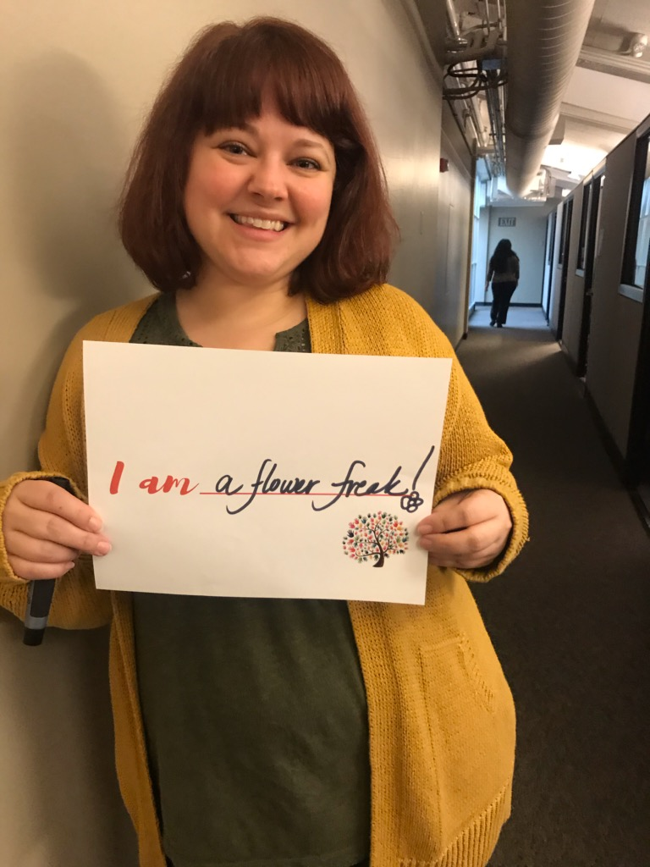
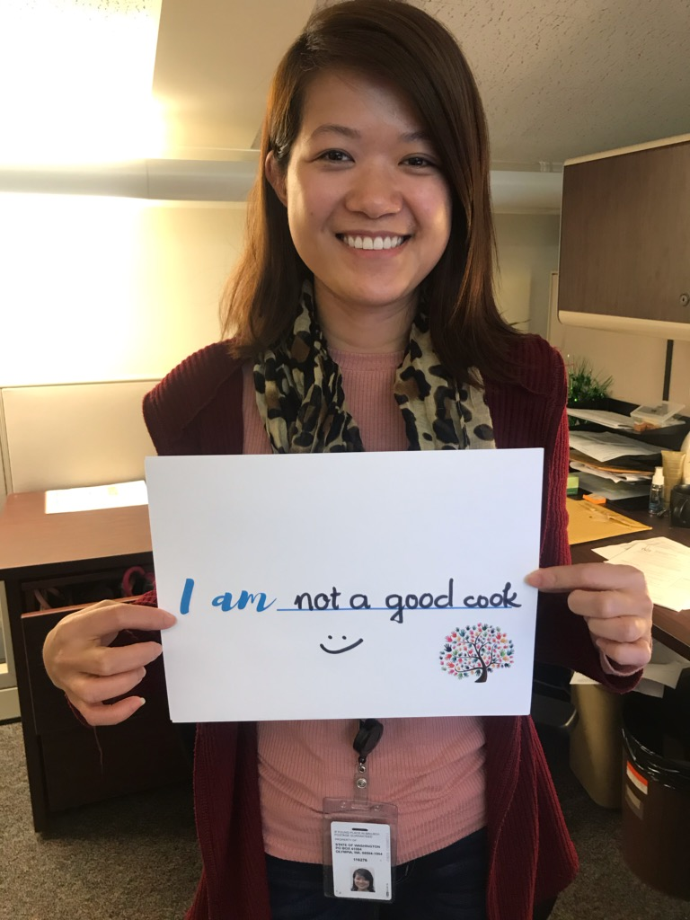
Act: Build trust
Participate and provide feedback in dry-run Forum meetings.
Division leaders and staff share business equity initiatives and personal stories.
Invites for all meetings were sent out for the remainder of the year per feedback.
Established a one-week deadline for presentation materials to allow for accessibility checks.
Building trust by following through on feedback and co-building our collective path forward due to our belief that equity is a shared responsibility.

Slide 22
Closing
Defined Plan Do Check Act or PDCA
Discussed Compassionate accountability with PDCA
Reviewed an equity and belonging case study

Slide 23
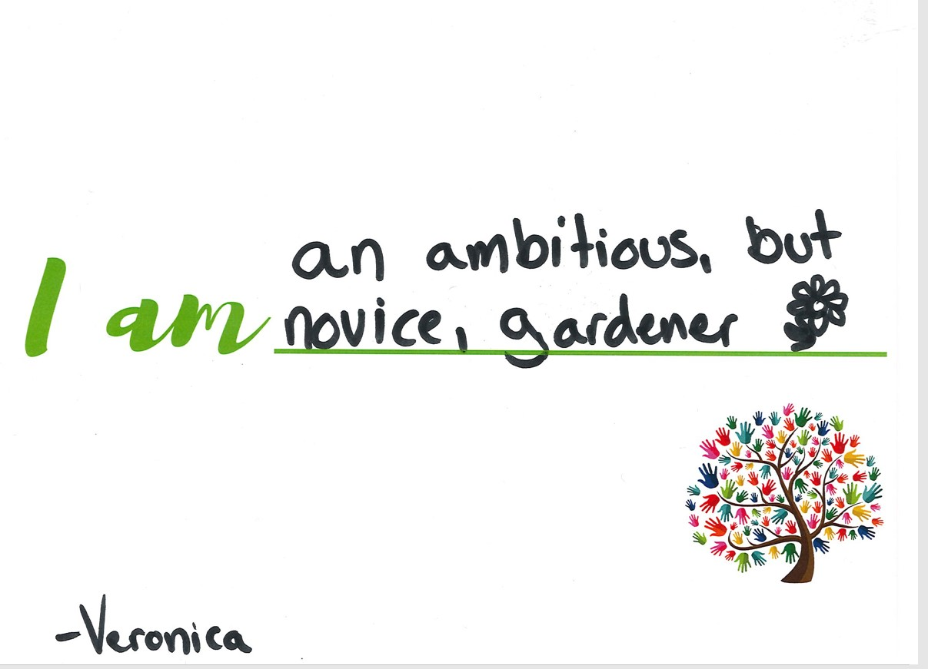
Questions and answers
How can you use this methodology at your work?
What are your aha moments?
What are your first steps?
osp@ofm.wa.gov

