Slide 1
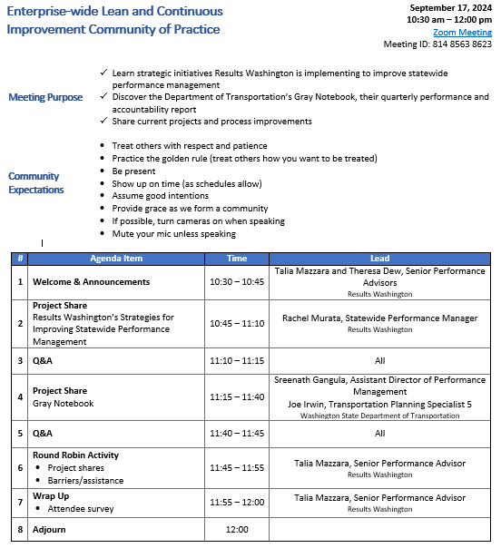

Agenda

Slide 2
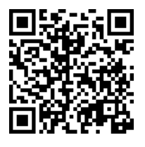
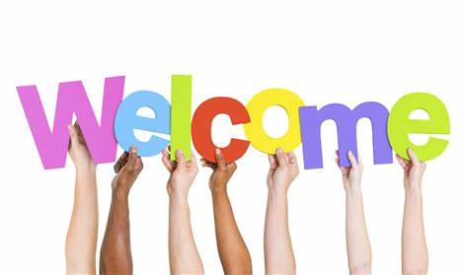
ROLL CALL!
Please take a moment to complete our Attendance Form

Slide 3
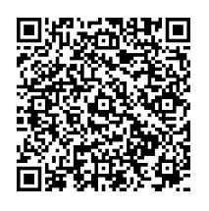
Community of Practice Updates
Extended
Time!
Registration now open!
Date/time: Thursday, September 30th, 9:00 a.m. – 3:30 p.m.
Location: Helen Sommers Building (106 11th Ave. SW, Olympia, WA 98501)
Topic: Getting your idea across the finish line: How to communicate effectively with leaders to achieve buy-in
You will learn:
  What leaders need to make good decisions
  Lessons learned from years of experience with Results WA staff
  Walk away with concrete tools you can immediately apply to your own ideas and projects
Who: State employees only;
Limited to 45 people
“Resistance is greatest just before the finish line.”
Steven Pressfield
Increased capacity!
Register here!

Slide 4
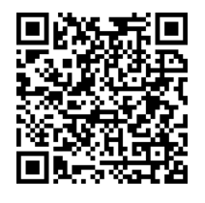
Upcoming Events
Register here!
Registration now open!
“Leaning into the Future”
Purpose: To advance Lean and continuous improvement in Washington state by focusing on the tools and techniques of Lean, as well as explore other topics.
When: October 22nd through October 31st
Who: Local governments, other states, Washington businesses, educational professionals, and nonprofits Last year we welcomed over 3,600 attendees virtually!
Where: 100% virtually via Zoom with six days of presentations spanning the two weeks.
Submit your success stories today!
For additional information, please visit https://results.wa.gov/improving-government/lean/lean-conference

Slide 5
Upcoming Events Cont.
September Public Performance Review
When: Thursday, September 26th @ 11:00 am – 12:15 pm
Topic: Community Engagement with the Washington State Commissions and Small Agencies
Contributors: Washington State Women’s Commission, Commission of Hispanic Affairs, LGBTQ Commission, Arts Commission, and Department of Archeology and Historic Preservation
  Discussion on the community engagement efforts happening around the state that make for more equitable and qualitative service delivery for Washingtonians
How to Join
In-person:
Helen Sommers Building
106 11th Ave. SW
Olympia, WA 98504
Rooms G015 A-C
Virtually:
Live-streamed by TVW

