Slide 1
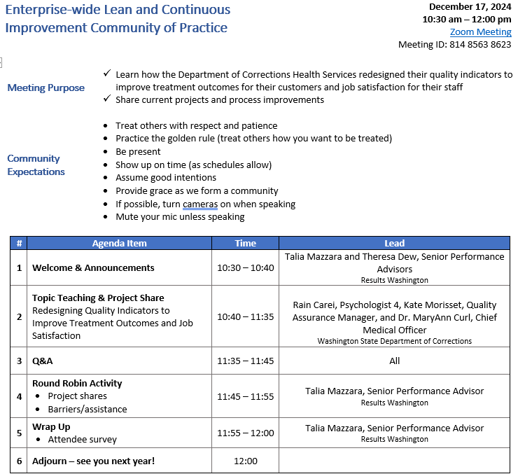
Agenda

Slide 2
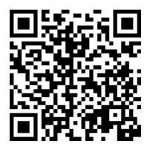
ROLL CALL!
Please take a moment to complete our Attendance Form

Slide 3
Community announcements
First half of our 2025 schedule finalized!
Invitations have been sent! Make sure to add the 2025 series to your calendar
Topic teachings covering Failing Forward, The Power of Heat Maps in Data Visualization, Perfecting PowerPoints, and so much more
Project shares provided by DOC, DSHS and more
Expanding to include organizations beyond the enterprise: Center for Public Impact, the AME Seattle Consortium, Arizona Government's Transformation Office, and more
View our schedule at https://results.wa.gov/community-practice
Interested in presenting? Fill out our new presenter form!
Lean & CI CoP Presenter Interest

Slide 4
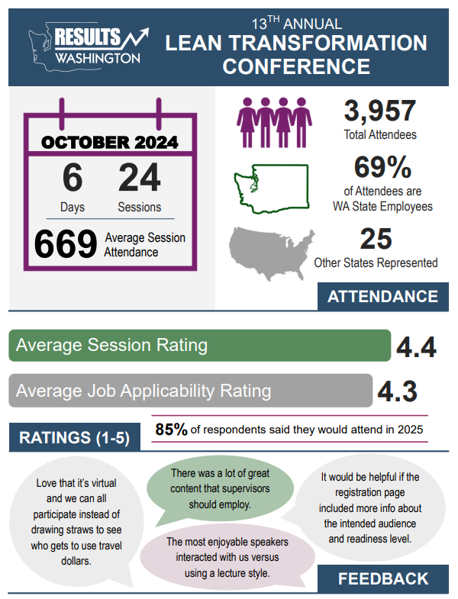
2024 Lean Conference Highlights
Top 6 agencies in attendance
DSHS, LNI, DOH, WSDOT, DCYF and DOR
Top 5 presenters with the highest attendance Amy Leneker, Brett Cooper, Marcus Glasper, Aaron Howard and Wendy Fraser
Top 5 Out-of-State attendees
Oregon (145), California (48), Colorado (15), Arizona (22) and Pennsylvania (21)

