Slide 1
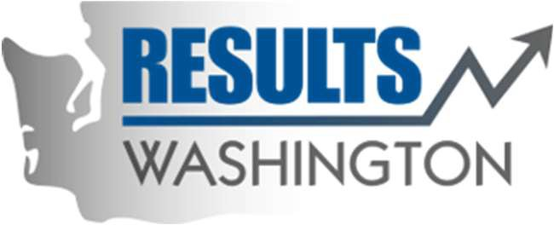
The Blast Newsletter
The blast
ENTERPRISE-WIDE LEAN AND CONTINUOUS IMPROVEMENT COMMUNITY OF PRACTICE
ISSUE NO. 22 | SEPTEMBER 2024
Transparency - Innovation - Results
WHAT YOU MISSED At our September CoP meeting, we were joined by Sreenath Gangula and Joe Irwin with DOT who shared their awesome CI journey with the Gray Notebook. We also heard from Rachel Murata and her team with ResultsWA who shared updates about the work they’re doing with statewide performance management. See page 2 for more! LOOKING AHEAD Mark your calendars and see what we have in store for you at our November CoP meeting on page 2. Questions? For questions on The Blast, the CoP, or to present a teaching or project share, contact:
Talia Mazzara, Results WA Senior Performance Advisor
Theresa Dew, Results WA Senior Performance Advisor
Register now to attend this year’s annual Lean Conference!
Registration is now open for this year’s Lean Transformation Conference. Our 13th annual conference is going virtual for the fifth year in a row, and we invite you to register now! Registration is first-come, first-serve, and the conference usually fills up quickly, so register as soon as you can.
This year’s event will be held over six days between October 22 – 31 and allows you to customize your learning by signing up for sessions that fit in with your schedule.
We hope to see you there!

Slide 2
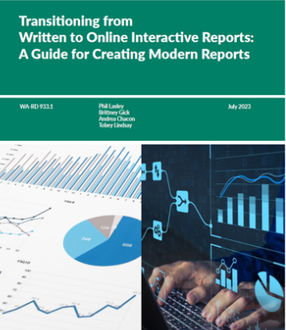
The Blast Newsletter – Page 2
ISSUE NO. 22 | SEPTEMBER 2024
The Gray Notebook Joining us from the Department of Transportation was Sreenath Gangula and Joe Irwin who shared their remarkable journey of continuous improvement. They presented a comprehensive transformation of their data and performance reporting system, highlighting their transition from facing revenue loss and public skepticism about their performance standards to achieving increased transparency, restored trust, and recognition as the "Gold Standard" for data and performance reporting. Their outstanding efforts were also acknowledged with two "Extra Mile Awards" from the Governor. Don't miss the opportunity to explore their presentation and learn more about their successful strategies!
“There are risks and costs to a program of action, but they are far less than the long-range risks and costs of comfortable inaction.” - John F. Kennedy
Click below to watch the September CoP presentation!
COMING UP NEXT
No CoP in October
November 19, 2024
10:30 a.m. – 12:00 p.m.
Zoom Meeting
Topics:
Digitally Accessible Presentations Vic Vong| Office of Equity
Disability Inclusion Network
Sarah Norton| Disability Inclusion Network
Results WA Update Rachel Murata, Statewide Performance Manager with Results Washington, was joined by her team to share their current strategies on improving performance management across the enterprise. As the governor’s performance management entity, RW is responsible for integrating performance data into decision making at the governor’s office. Their strategies to move toward a comprehensive statewide performance management system include:
Updating performance measure requirements to meet legislative and business needs
Empowering agencies with more control over reporting and updating their measures, and
Updating our current statewide performance management system for ease of use and seamless transfer of data
They will also assist agencies with measure development and reporting, providing resources so agencies can be successful throughout their performance management journeys, and report to the governor and legislature with opportunities for future policy improvements.

