Slide 1
Grass Roots Change Management
Empowering change for the individual
~ Kelly Walk, Prosci Certified, ACMP member

Slide 2
— George Bernard Shaw
“Those who cannot change their minds cannot change anything.”
Notes:
Read the quote
At any level of an organization, this maxim is true
Think about the most effective people you know, those who have the ability to get things done

Slide 3
Who am I?
WSH Civil Center Director of Organizational Change Management
(2+ yrs)
Change Management Practitioner for the WSH Split
(1 year)
WSH Project Manager in Lean
(1.5 years)
Previously in property management, education, and a small business owner
(18 years)

Slide 4
Sound familiar?
Is this you?
Your org lacks resources and attention for big upcoming changes.
Proprietary CM language is not well understood by your leaders or your staff.
All the change management tools and resources you’d like to use are “too cumbersome” for your organization.
Do we have 3 volunteers with examples?
Notes:
Read through the topics on the slide.
Ask for 3 or more individuals to share specific experiences they had in this vein.

Slide 5
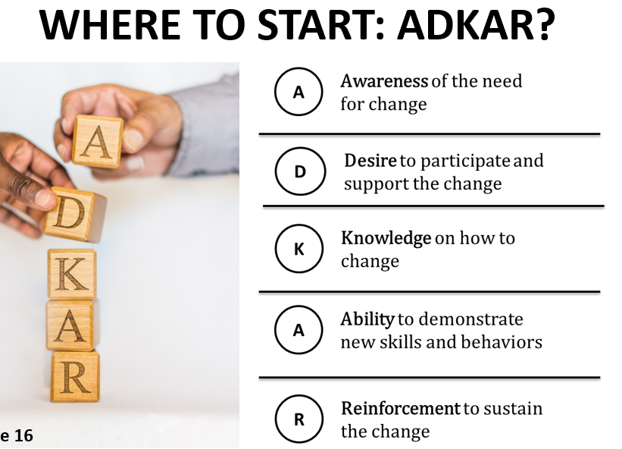
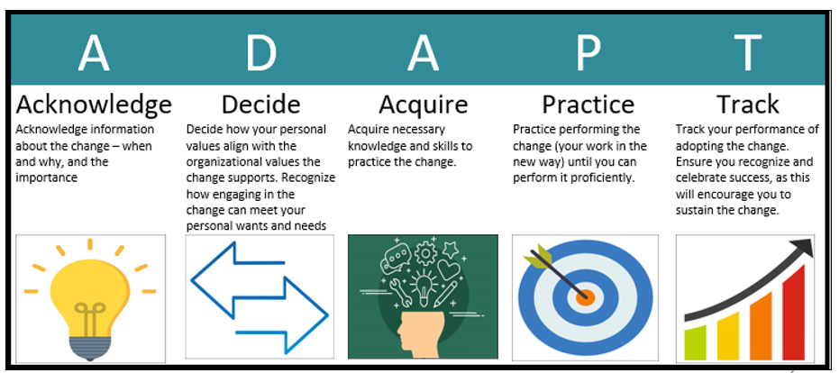
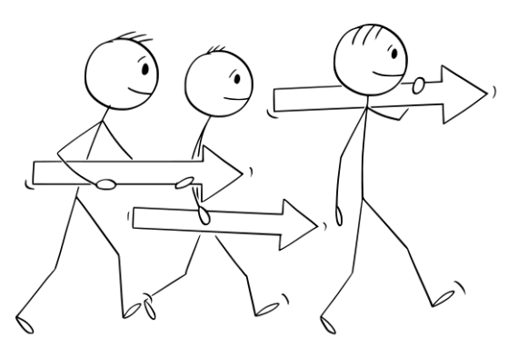
This story has 3 parts…
Starting with a proprietary approach
Middle: ADAPT
End (current state): ADAPT with grass roots approach

Slide 6
ADKAR
What does this mean, again?
Notes:
Most folks involved or trained in change management have heard of Prosci’s change management model: ADKAR.
When someone first hears this acronym, it may seem somewhat mysterious.

Slide 7
What works?
…in your experience...
Notes:
If you are familiar with the ADKAR model, please raise your hand.
I’m interested in knowing, from your perspective, what has worked for you in using this model at work?

Slide 8
How ADKAR helped me as a CMP
Where I experienced gaps
Empirical support deepened an intuitive understanding
Clearly defined elements necessary for change
Offered tools, training, support for instituting organizational change with leadership engagement and support
Tools, trainings, and resources were restricted
Limited resources prevented expanded awareness
Leadership experienced continuous fire fighting and engagement challenges
Limited ability to make approach transparent to staff

Slide 9
My solution
A language any staff can understand, regardless of CM familiarity
An apt name and behaviorally-based!
Notes:
I worked for about a week on analyzing the conceptual content of the ADKAR elements. I consulted several CM frameworks (see end of the presentation for references) and the Performance Improvement team I worked with at Western State Hospital, and came up with a new framework that individuals unfamiliar with CM could apply for themselves. This model was appropriately named, ADAPT – and took CM to a new level.
This was a model that from leadership, to change managers behind the lines, to front line staff most affected by the change, ALL could use and understand.
Most importantly….it was not only conceptual…it was behaviorally based – making it easier to understand when one had achieved a particular point along the journey of change.
Next I turned to examine what managers and supervisors needed to know and do to support successful change.

Slide 10
What does it mean?
Acknowledge change info (where, when, why, importance)
Decide how personal values align with org values that support the change. How does this fit your wants/needs
Acquire skills and knowledge needed
Practice performance until independently skilled
Track your performance in change adoption and celebrate your successes
Notes:
Let’s walk through each of the elements now, to see how ADAPT plays out with behaviorally-based, observable, and easy-to-track progress.

Slide 11
How can supervisors support staff through change?
LEADER model
Notes:
I also wanted a way to make the expectations of leaders more clear and easy to visualize. Thus, the aptly-named LEADER model was born.
While I developed both ADAPT and LEADER, I worked in the Performance Improvement Department at WSH. The dynamic team of CIMS and PMs all gave fantastic feedback and input on both models.

Slide 12
What does CM look like where you work?
Notes:
Break out rooms – 7 minutes – share how you see CM showing up in your workplace. Choose someone to be ready to share when you return.

Slide 13
WSH Civil Center CM Approach
CM CoP
Training
CM Plan
Messaging
CM CoP incorporating representatives (change agents) from every team, department, and discipline
Training on demand for staff of all levels (front line, management, executive leadership)
Overarching CM strategy for tracking major changes
Several platforms:
daily news
monthly newsletter
town halls
all supervisor meetings
Quarterly leadership
meet and greets

Slide 14
WSH CoP
Purposefully multidisciplinary
Participants strategically invited based upon change readiness/org alignment
Monthly cadence and room to share what’s working and what’s not
Find the gaps and address

Slide 15
Training
Notes:
We found that scheduled trainings at a 24/7 facility were problematic and burdensome for our staff.
Our current approach is to share with staff what is available, and create a list of interested participants, then hold a class when the list warrants holding the class (8-10 participants for all staff, 5+ for supervisors, and executives are offered micro-trainings as needed).

Slide 16
CM
Plan
Notes:
When any changes are being instituted in Civil Center practices, we evaluate the complexity of the change.
If it is determined that CM support is needed, it is entered into the Overarching CCE CM plan, and a change manager is assigned to support the change’s success.

Slide 17
Messaging
Notes:
Discuss the different ways these are used to message information regarding upcoming changes.

Slide 18
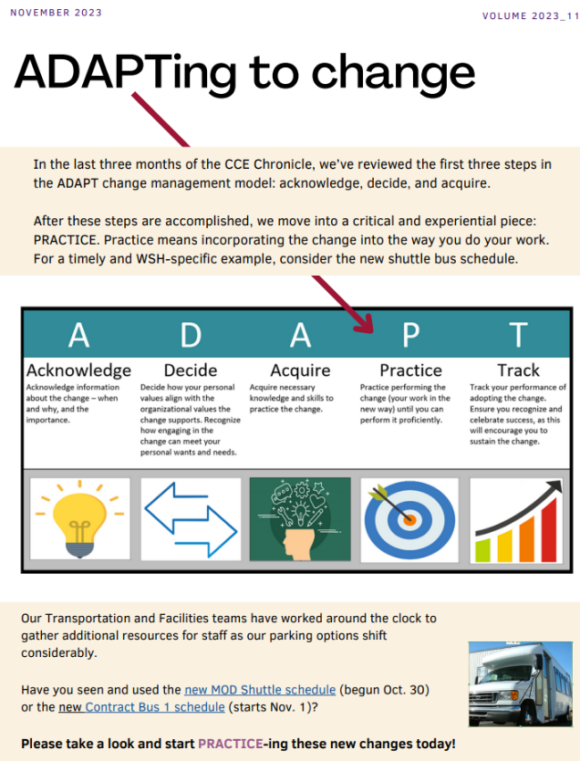
ADAPT section in each Civil Center newsletter

Slide 19
TOOLS
In addition to the CoP, Training, CM Planning
and Messaging, we have tools to share.

Slide 20
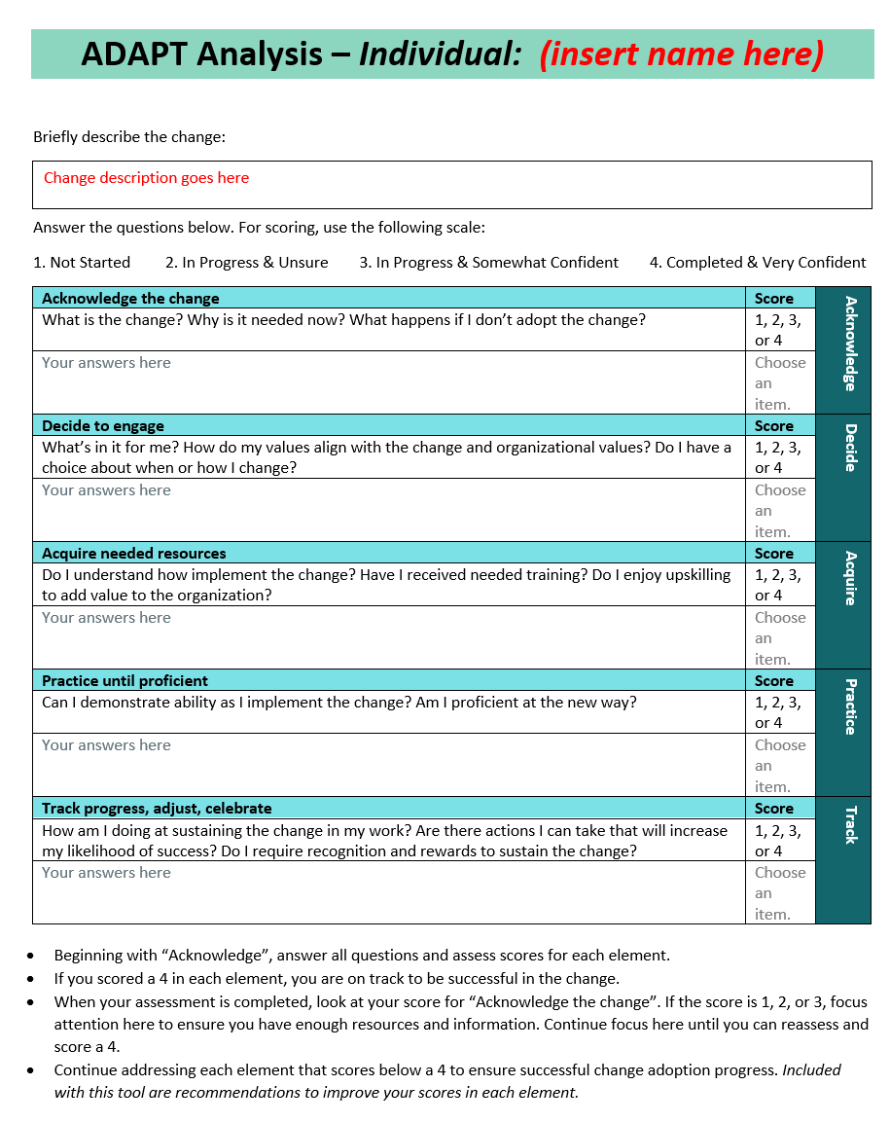
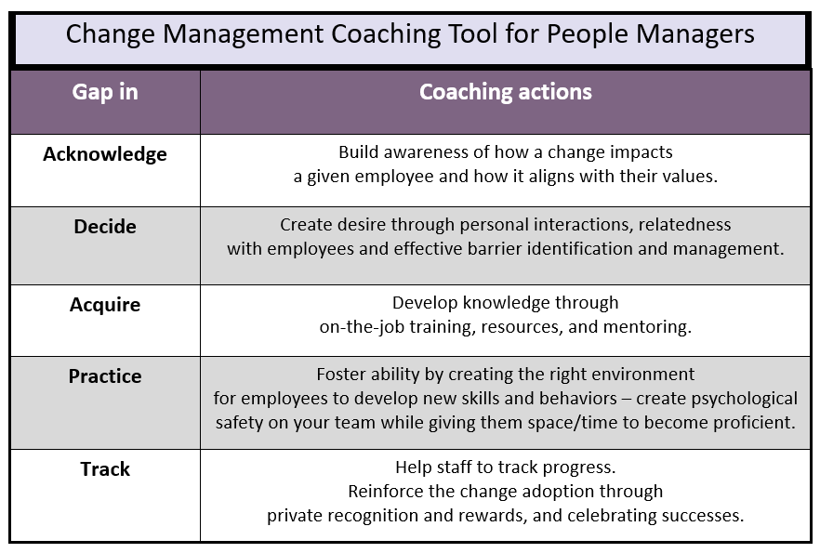
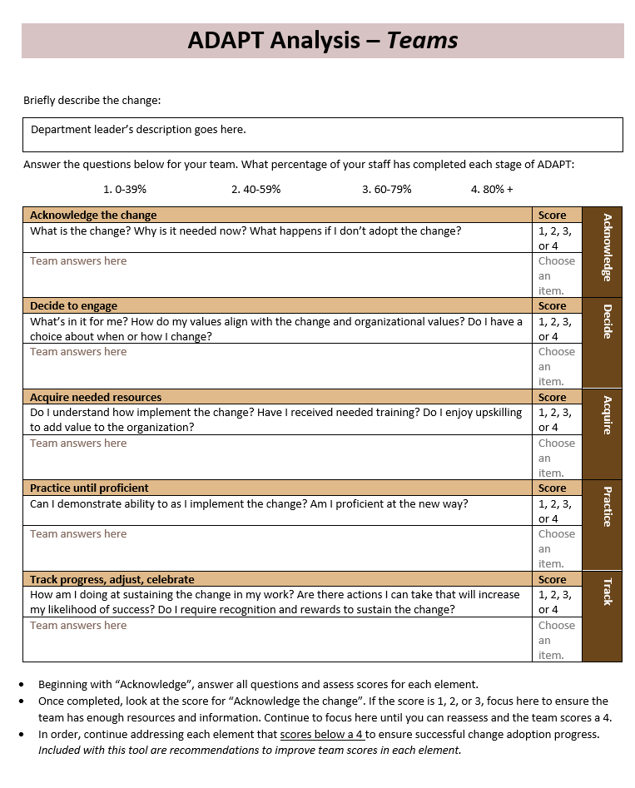
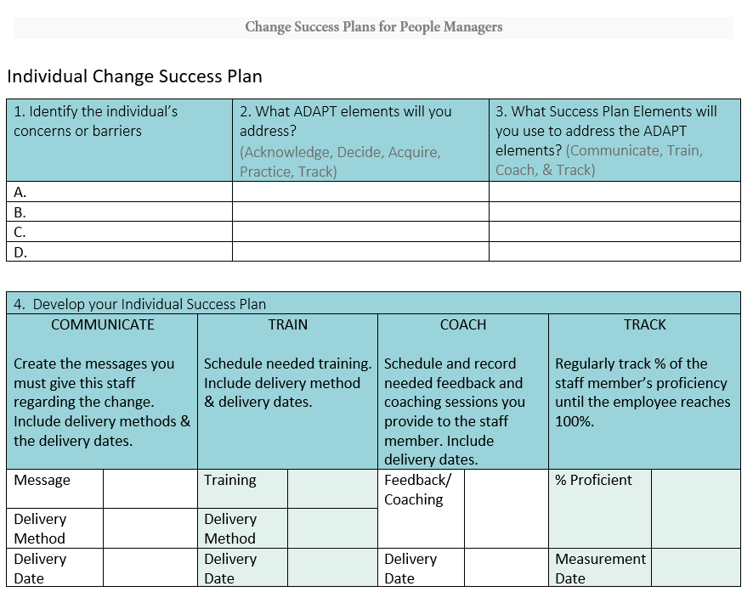
ADAPT gap coaching tool

Slide 21
Training overview
Individual
Supervisor
Executive

Slide 22
Remember
Training is the FIRST step….but practicing the behaviors is needed.
Notes:
Watch YouTUBE video here of the importance of practice to ensure success.

Slide 23
Questions?

Slide 24
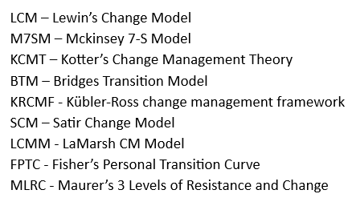
References
Change Management Theories’ support for ADAPT and LEADER
ADAPT / LEADER elements | LCM | M7SM | KCMT | BTM | KRCMF | SCM | LCMM | FPTC
Acknowledge | X^{1,2,3} | X^{4,5} | X^{6,7} | X⁸ | X⁹ | X¹⁰ | X¹¹ | X¹²
Decide | X^{1,2,3} |  | X^{6,7} |  | X⁹ | X¹⁰ |  | X¹²
Acquire | X^{1,2,3} |  | X^{6,7} | X⁸ |  | X¹⁰ |  | X¹²
Practice | X^{1,2,3} |  | X^{6,7} |  |  | X¹⁰ | X¹¹ | X¹²
Track | X^{1,2,3} | X^{4,5} | X^{6,7} |  |  |  | X¹¹ | X¹²
Listen & Learn |  | X^{4,5} | X^{6,7} | X⁸ | X⁹ |  | X¹¹ | X¹²
Equip |  | X^{4,5} | X^{6,7} | X⁸ | X⁹ |  | X¹¹ | X¹²
Advise |  | X^{4,5} | X^{6,7} | X⁸ |  |  | X¹¹ | X¹²
Demonstrate |  |  | X^{6,7} | X⁸ |  |  |  | X¹²
Empower |  | X^{4,5} | X^{6,7} | X⁸ | X⁹ |  |  | X¹²
Respect |  | X^{4,5} | X^{6,7} | X⁸ | X⁹ |  |  | X¹²

Slide 25
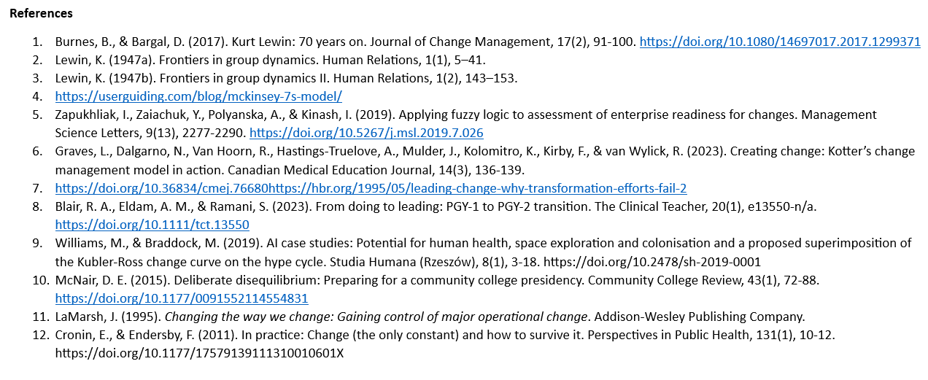
References

