Slide 1
3 Critical Mindsets that Shape People’s Ability to Get Along October 2024
Dr. Wendy Fraser

Slide 2
Critical mindsets
Am I truly, whole heartedly, open-mindedly…listening?
How am I choosing to use myself in this moment?
Am I seeking the “Third Truth”?

Slide 3
Mindset #1: Am I truly, whole heartedly, open-mindedly listening?

Slide 4
Four Levels of Listening
Source: Theory U: Otto Scharmer

Slide 5
How to Strengthen Listening
From Level 1 to Level 2: Downloading → Factual Listening Shift your attention from your own inner commentary (what you will say next) to what the person in front of you is saying (open up to what is being said). Invite curiosity and open your mind, let go of what you think they will say.
From Level 2 to Level 3: Factual Listening → Empathic Listening Step into the other person’s perspective (e.g.: “Oh, I may not agree, but I can see how they see the situation.”). This is a shift from the intelligence of your head to the intelligence of your heart. It requires assessing your ability to feel, to step into someone else’s place to be empathetic.
From Level 3 to Level 4: Empathic Listening → Generative Listening Listen with openness to what is unknown and emerging, so that your listening becomes a “holding space” for bringing something new into reality that wants to be born. You must let go of your ego.

Slide 6
Celeste Headlee: 10 Ways to Have a Better Conversation
TED talk filmed May 2015

Slide 7
Reflect
Coffee Break – Reflect…
When do you notice the quality of your listening changing?
What causes this to happen?

Slide 8
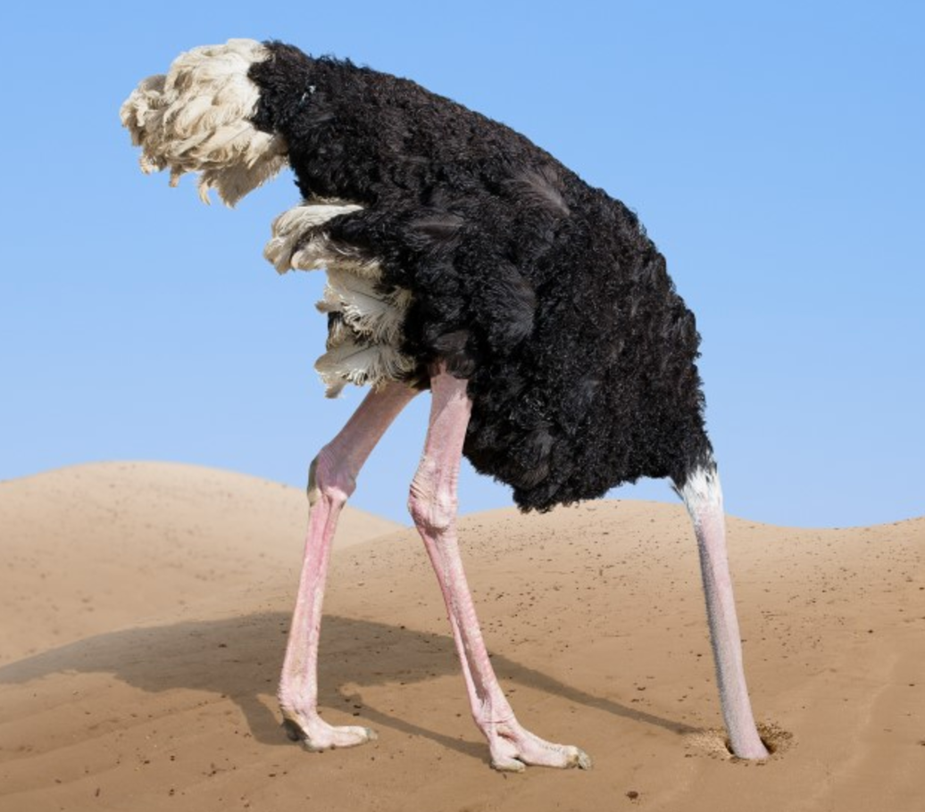
Mindset #2
How am I choosing to use myself in this moment?

Slide 9
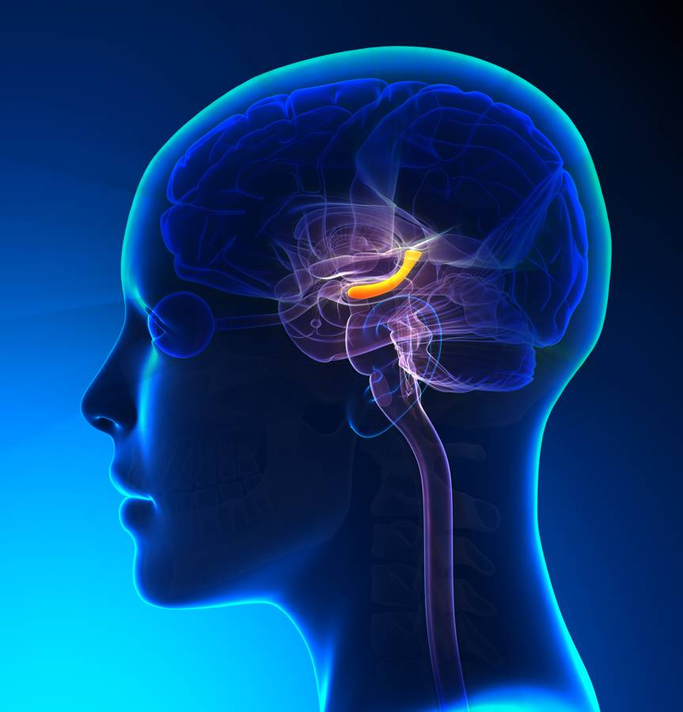
Amygdala Highjack
Experience
Amygdala Hijack
Prevents Thinking
Emotions Spike
Reaction

Slide 10
Reaction or Response
Experience
Amygdala Hijack
Prevents Thinking
Emotions Spike
Reaction
or
Response
Reflect
Curious
Reframe
Time Passes
Choices

Slide 11
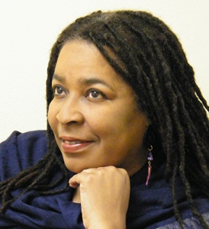
“When wounds, ego, and fear get involved, they interfere with accurate perception.”
Dr. Darya Funches

Slide 12
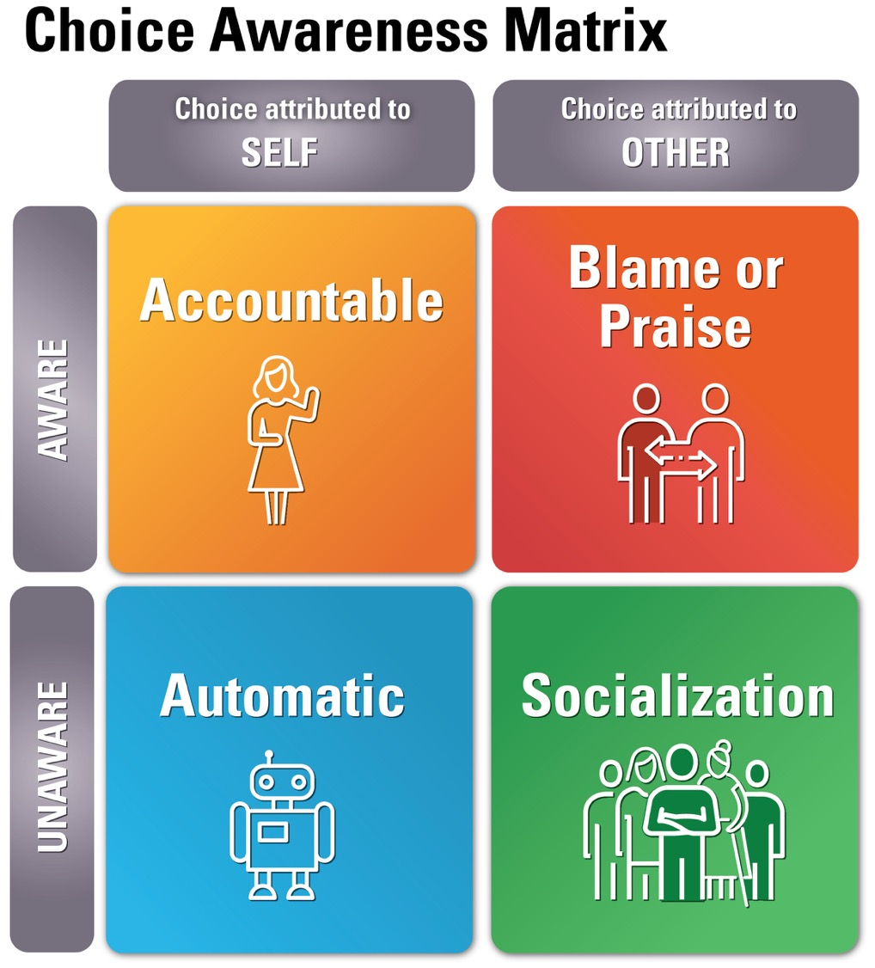
Choice Awareness Matrix
Tool
Source: Edith Whitfield Seashore

Slide 13
Reflect some more
Coffee Break – Reflect…
What are my choices?
What are my intentions?
How do I want to show up?

Slide 14
Mindset #3
Mindset #3
Am I Seeking the Third Truth?

Slide 15
What Deters Sound and Current Data?
Holding past experience as sound and current.
Believing we figured it out based on the information we already have.
We treat our perceptions as reality - filtering and creating our own meaning or stories that we then treat as facts.
We interpret nonverbals and behaviors without checking in.
We assume other’s intentions based on the impact their behaviors had on us.
Sometimes we believe we should know, so we don’t ask or don’t admit that we do not know.

Slide 16
Kathryn Schultz “On Being Wrong”
TED talk filmed March 2011

Slide 17
Quote
Trusting too much in the feeling of being on the correct side of anything, can be very dangerous.
Schultz, 2011

Slide 18
2nd Quote
When we stop entertaining the possibility that we could be wrong, we wind up doing things like…torpedoing the global economy.
Schultz, 2011

Slide 19
Choose to be Curious

Slide 20
Seek the Third Truth
Be open to other possibilities
Be curious
Note when you are not curious – what is going on?
Interview your feelings and assumptions
Expand your source of data

Slide 21
More reflection
Coffee Break – Reflect…
What is one thing I can do to improve my ability to be open to other perspectives?

Slide 22
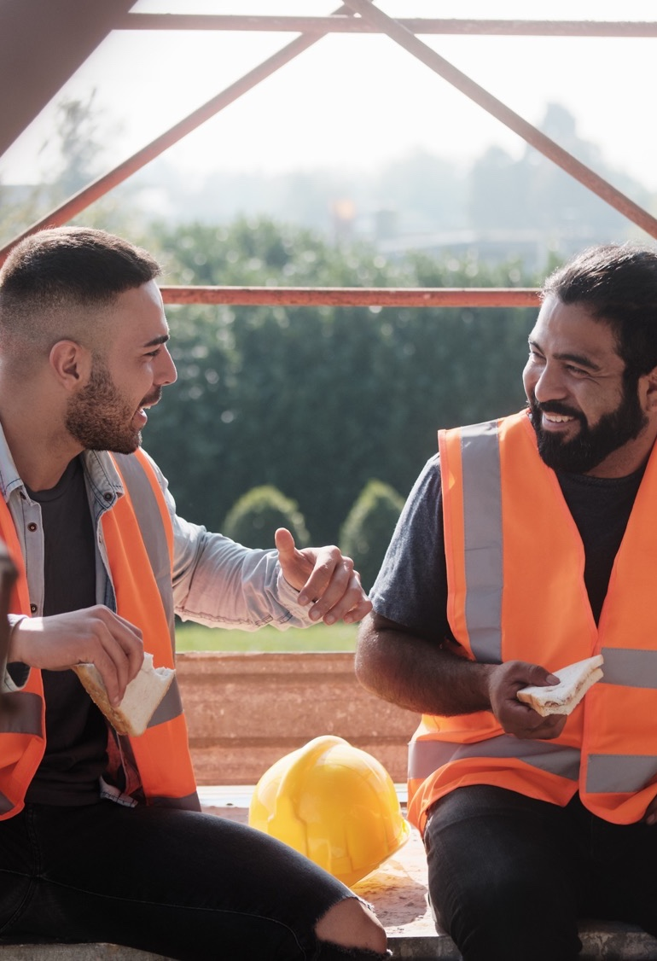
Remember to listen, stay curious, and use your powers for good!

Slide 23
Questions
Questions?
Contact Information:
Dr. Wendy Fraser
Wendy@WendyFraserConsulting.com
360-556-6056
www.WendyFraserConsulting.com
LinkedIn: Wendy Fraser, PhD

