Slide 1
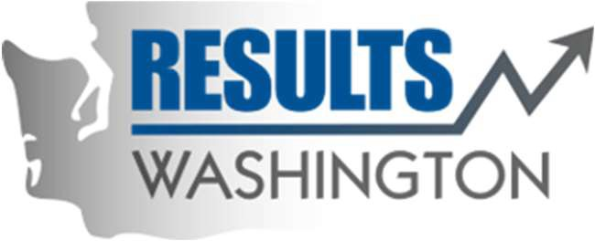
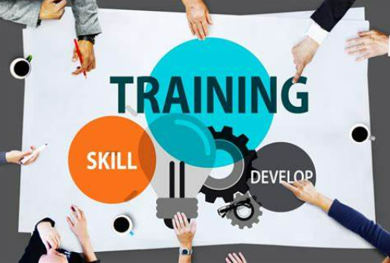
The Blast Newsletter
The blast
ENTERPRISE-WIDE CONTINUOUS IMPROVEMENT COMMUNITY OF PRACTICE
ISSUE NO. 28 | APRIL 2025
Transparency - Innovation - Results
WHAT YOU MISSED At our April CoP, we heard from Sumeda Madhuri, with DSHS/DDA, who shared an informative overview of the Dynamic System Development Methodology (DSDM). See page 2 for more! REFLECTIONS SERIES Click here to watch our Reflections Series, featuring Greg Mennegar, with the Office of the Secretary of State, as he shares about how state employees are helping to make Government more efficient with the Productivity Board. Questions? For questions on The Blast, the CoP, or to present a teaching or project share, contact:
Talia Mazzara, Results WA Senior Performance Advisor
Theresa Dew, Results WA Senior Performance Advisor
Upcoming Pacific Northwest Organization Development Network (PNODN) Event:
Navigating Organizational Trust Challenges Featuring Dr. Wendy Fraser | MOST Series
If you’re interested in joining a powerful session with
Dr. Wendy Fraser, you won’t want to miss this event, where she shares practical tools for repairing and strengthening trust at the organizational level.
🗓 Date: May 15th 🕠 Time: 5:30 – 7:00 PM (PDT) (Zoom opens at 5:15)
💵 Cost: $15 Members | $25 Non-Members |
$10 Students/Seniors
What You'll Learn:
- How to diagnose and address trust issues in your organization
- Dialogic approaches leaders can use to rebuild trust
- Real-world examples and takeaways from Wendy’s research
This event is part of PNODN’s MOST Series, exploring the Mastering Organizational and Societal Transformation framework. Don’t miss this opportunity to grow your leadership edge! 🔗 Register Now

Slide 2
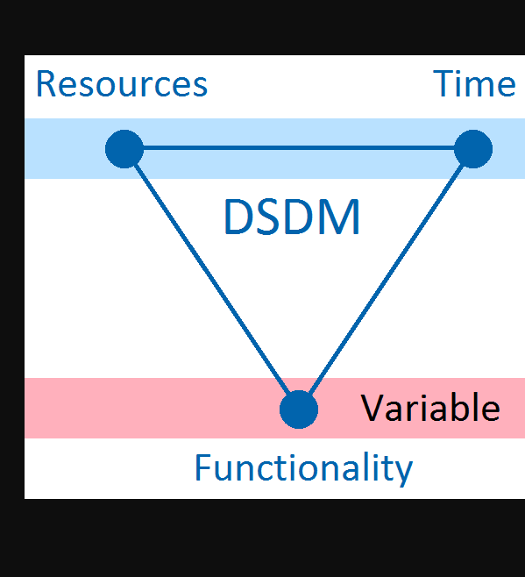
The Blast Newsletter – Page 2
Dynamic System Development Methodology (DSDM) and the Lake Burien Transitional Care Facility Project
At our recent meeting, Sumeda Madhuri with the Developmental Disabilities Administration within DSHS, shared how the Dynamic System Development Methodology (DSDM) played a key role in the success of the Lake Burien Transitional Care Facility Project. Originally designed for software, DSDM’s agile, iterative approach proved effective in managing the complex requirements of a healthcare build.
Key DSDM elements applied:
Timeboxing to stay on schedule
MoSCoW prioritization to focus on essentials
Continuous user feedback from staff
Collaborative workshops for stakeholder alignment
Key Takeaways:
User involvement improves outcomes
Flexibility + structure supports fast adaptation
Prioritizing needs ensures core features are delivered first
Iterative testing reduces rework
Sumeda demonstrated how DSDM’s principles, when applied beyond software, can guide efficient, people-focused project delivery in healthcare and beyond.
Click the play button below to watch the April CoP presentation!
Share Your Expertise with Our Community!
Do you have a successful project or teaching on a continuous improvement methodology that could inspire and empower others? We’re looking for passionate individuals to present and share their knowledge with our community!
This is a fantastic opportunity to: ✅ Showcase your expertise and accomplishments. ✅ Connect with like-minded professionals. ✅ Contribute to our shared growth and success.
If you’re interested, please take a moment to fill out this form, and we’ll be in touch!
Let’s learn and grow together by sharing what works. Your experience could be the key to someone else’s success!
COMING UP NEXT
May 20th, 2025
10:30 a.m. – 12:00 p.m.
Zoom Meeting
Topics:
Hoshin Kanri
Presenter: Ryan Zeng| Association for Manufacturing Excellence (AME) Seattle Consortium

