Slide 1
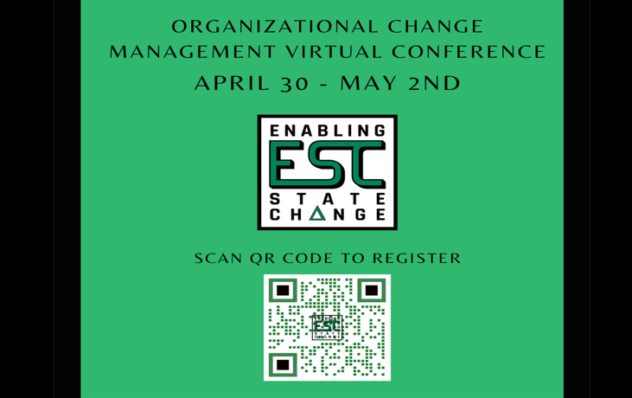
The Blast Newsletter
The blast
ENTERPRISE-WIDE LEAN AND CONTINUOUS IMPROVEMENT COMMUNITY OF PRACTICE
ISSUE NO. 17 | APRIL 2024
Transparency - Innovation - Results
WHAT YOU MISSED At our April CoP meeting, we were grateful to be joined by Professor Eric Stewart with Bellevue College who shared how to increase your productivity and manage your time more effectively by cleaning up your inbox and promoting positive behavior and strategies that change behavior for good. See page 2 for more! LOOKING AHEAD Mark your calendars and check out what we have in store for you at our May CoP meeting on page 2. Questions? For questions on The Blast, the CoP, or to present a teaching or project share this year, contact:
Talia Mazzara, Results WA Senior Performance Advisor
Theresa Dew, Results WA Senior Performance Advisor
Registration now open!
Calling all change managers, culture officers, engagement professionals, state agencies & partners of state agencies!
Mark your calendars!
On behalf of Washington State’s Organizational Change Management Community of Practice, we invite you to this year's Enabling State Change Virtual Conference.
Listen to speakers discuss working through resistance, changing the world one (MS) form at a time, implementing a Change Agent Network, being an “accidental” change manager, and more!
Don’t miss it – registration is open now.
To register, scan the QR code above or visit the registration page on our website.
We hope to see you there!

Slide 2
The Blast Newsletter – Page 2
ISSUE NO. 17 | APRIL 2024
Cleaning up your Inbox: Embarking on a Metacognitive Journey of Self-Awareness
Professor Eric Stewart with Bellevue College shared a helpful teaching that focused on increasing your productivity by decluttering your inbox and creating a process that allows you to manage your time more effectively. In teaching this, he made the connection between the emotional and cognitive process which promotes specific behavior, and then proposed strategies on how to modify that behavior.
Eric engaged the community with thought-provoking concepts and an activity that invited you to identify your pain points and define your action plan. Check out the Workbook and begin your journey to streamlining now!
“Under the influence of clutter, we may underestimate how much time we’re giving to the less important stuff.”
~ Zoe Kim
Click below to watch the CoP recording of Eric’s presentation!
COMING UP NEXT
April 21, 2024
10:30 a.m. – 12:00 p.m.
Zoom Meeting
Topics:
Productivity Board Greg Mennegar| SoS
DSHS & Productivity Board Partners in Success
Jessica Hernandez | DSHS
Additional Books and Resources Mentioned During Eric’s Teaching!
“Limitless” by Jim Qwik
“The Art of Impossible” by Steven Kotler
“The Happiness Advantage” by Shawn Achor
“Awake the Giant Within” by Tony Robbins
“Taking Back Your Life” by Sally McGhee
Inbox Zero: https://www.youtube.com/watch?v=z9UjeTMb3Yk
10 Usability Heuristics: https://www.nngroup.com/articles/ten-usability-heuristics/

