Slide 1
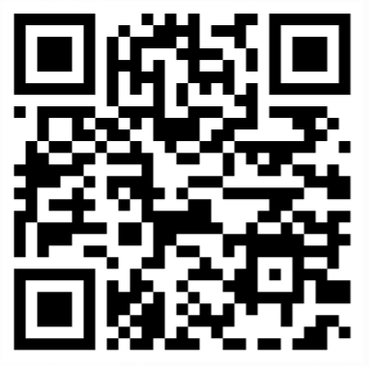
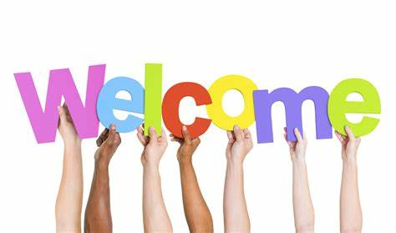
ROLL CALL!
Please take a moment to complete our Attendance Form

Slide 2
Upcoming Events
Get ready for our 13th annual WA State Government Lean Transformation Conference!
“Leaning into the Future”
Purpose: To advance Lean and continuous improvement in Washington state by focusing on the tools and techniques of Lean, as well as explore other topics.
^{When: October 22nd-31st}
Who: We expect to have attendance from local governments, other states, Washington businesses, educational professionals, and nonprofits. Last year we welcomed over 3,600 attendees virtually!
Platform: This year’s conference will be a virtual affair via Zoom with six days of presentations spanning two weeks.
For additional information, please visit https://results.wa.gov/improving-government/lean/lean-conference

Slide 3
Upcoming Events Cont.
July Public Performance Review
When: Tuesday, July 23rd @ 10:00 am – 11:15 am
Topic: Poverty Reduction with a focus on the Working Families Tax Credit
Contributors: Department of Social and Health Services, Department of Revenue, Poverty Reduction Workgroup Steering Committee, Family Education & Support Services, Working Families Tax Credit Outreach Advisory Committee
Overview of poverty in Washington state
Discussion on comprehensive poverty reduction strategies, including Working Families Tax Credit outreach and community engagement
How to Join
In-person:
Helen Sommers Building
106 11th Ave. SW
Olympia, WA 98504
Rooms G015 A-C
Virtually:
Live-streamed by TVW

Slide 4
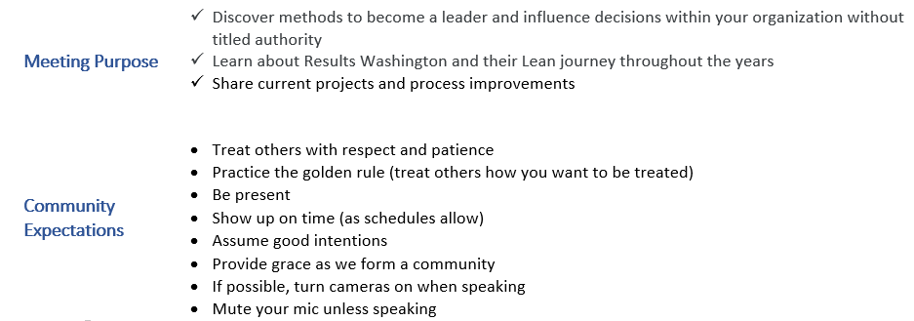
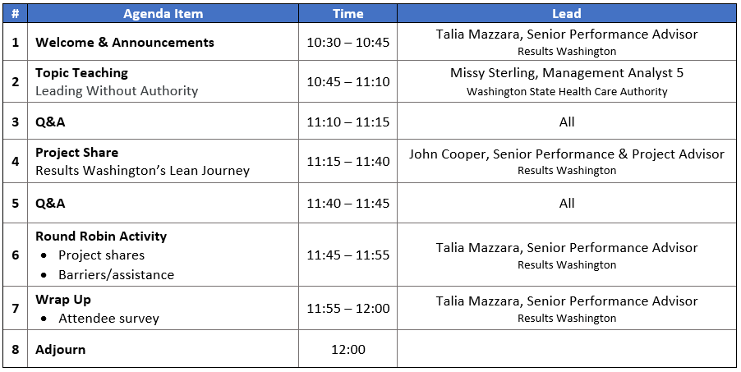
Today’s Agenda

