Slide 1
Image SLide
We will be starting in just a moment!
Notes:
CLICK

Slide 2
LEAN TRANSFORMATION CONFERENCE
2024 WASHINGTON STATE GOVERNMENT
Leaning into the Future!
Notes:
We know many of you are familiar with Zoom meetings, but there are some differences in Zoom webinar, which we’re using today. The biggest difference is that you won’t be able to talk or have your video visible. This ensures all participants can focus on today’s presentation.
CLICK

Slide 3
Good morning!
Mandeep Kaundal, Results Washington Director

Slide 4
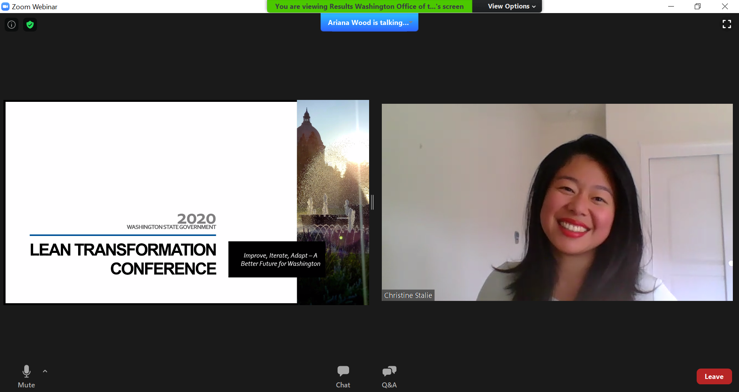
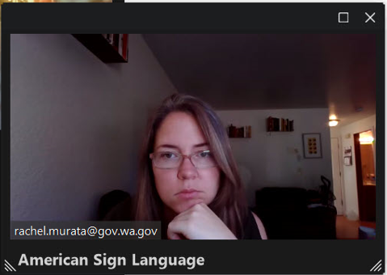
WOODGROVE BANK
Zoom overview
Alissa Julius is talking…
ASL Interpreter
Notes:
.
CLICK

Slide 5
Leaning into the future
Signature event for Washington state government
Fostering a culture of continuous improvement
Testament of our commitment to Lean and continuous improvement in Washington
Notes:
This is our 13th annual Washington state lean conference. This continues to be one of the largest continuous improvement events in country every year.
Since going to a virtual format we have had over 11,500 unique attendees to the conference. This event is a testament to the culture of Lean and CI in Washington State. This event doesn’t happen without all of you continuing to attend and learn with us. So thank you to all of our attendees. We truly appreciate your support over the years.

Slide 6
Three Criteria for Presentations
Concrete tools and methods that participants can readily apply to their work.
Learning that can be applied in hybrid and remote work environments to meet current and future realities.​
Learning that supports our commitment to advancing diversity, equity, and inclusion in Washington state government.​

Slide 8
welcome
Mandeep Kaundal, Results Washington Director

Slide 9
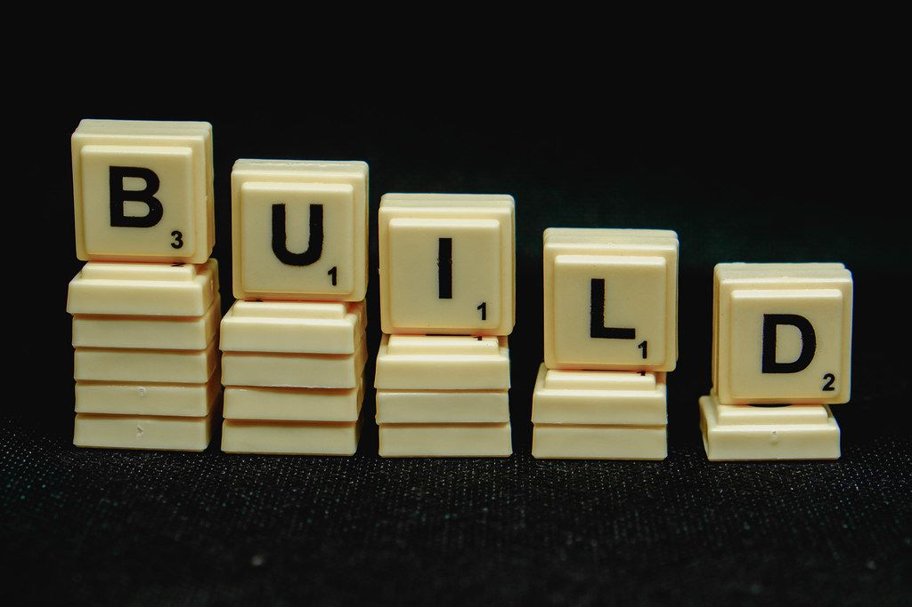
Building upon the past for a better future
This Photo by Unknown Author is licensed under CC BY
Notes:
Washington has a rich history of continuous improvement. We continue to see great improvements as we have developed a culture this culture of continuous improvement.

Slide 10
THANK YOU
We could not have done this without your support.
Our 2024 presenters
Lean Advisor community

Slide 11
Looking to give back?
In lieu of admission, consider donating to the Combined Fund Drive
CFD’s mission is to empower Washington public employees and retirees to strengthen their communities through the funding and support of charities.
The program currently distributes to 1,700 charities
Donate through CFD’s online system, via monthly, one-time and limited contributions
900 active volunteers stationed across various state offices and higher education
Visit www.give.wa.gov for more information

Slide 12
LEAN TRANSFORMATION CONFERENCE
2024 WASHINGTON STATE GOVERNMENT
Leaning into the Future!
Notes:
Good afternoon. Welcome to Respect for People: Explore Living into this Lean Value with Jennifer Haury.
I am Kristy Snow with Results Washington. My pronouns are she/her and I will be your moderator today. Today we have about 902 attendees in this session. We are happy you are here!
I am joined today by Melissa Shaw who will be providing ASL interpretation today.
Thanks also to my team member Cathy Holder who is managing technology behind the scenes.
We know many of you are familiar with Zoom meetings, but there are some differences in Zoom webinar, which we’re using today. The biggest difference is that you won’t be able to talk or have your video visible. This ensures all participants can focus on today’s presentation.
CLICK

Slide 13
Keynote
Marcus Glasper, Director with the Washington State Department of Licensing

Slide 14
2024 Washington State Lean Transformation Conference
Leaning into the Future
Marcus Glasper, Director

Slide 15
Agenda
7 fundamental concepts of Lean
Establishing a Lean philosophy
The future of Lean management

Slide 16
7 Japanese concepts
Kaizen: Continuous Improvement.
Mottainai: Value and Avoiding Waste.
Ikigai: Purpose or Reason for Being.
Shokunin: Craftsmanship and Pride in Work.
Gaman: Patience, Endurance, and Resilience.
Wabi-Sabi: Embracing Imperfection.
Nemawashi: Building Consensus.
2024 Washington State Lean Transformation Conference | 16

Slide 17
Body Content Slide
kaizen
2024 Washington State Lean Transformation Conference | 17

Slide 18
5 steps of kaizen
Identify Areas for Improvement
Analyze the Current Process
Develop Solutions
Implement the Solutions
Evaluate the Results
2024 Washington State Lean Transformation Conference | 18

Slide 19
Body Content Slide
Mottenai
2024 Washington State Lean Transformation Conference | 19

Slide 20
Two meanings of Mottenai
Regret about not utilizing something.
Gratitude about kindness or thoughtfulness from others.
2024 Washington State Lean Transformation Conference | 20

Slide 21
Body Content Slide
Ikigai
2024 Washington State Lean Transformation Conference | 21

Slide 22
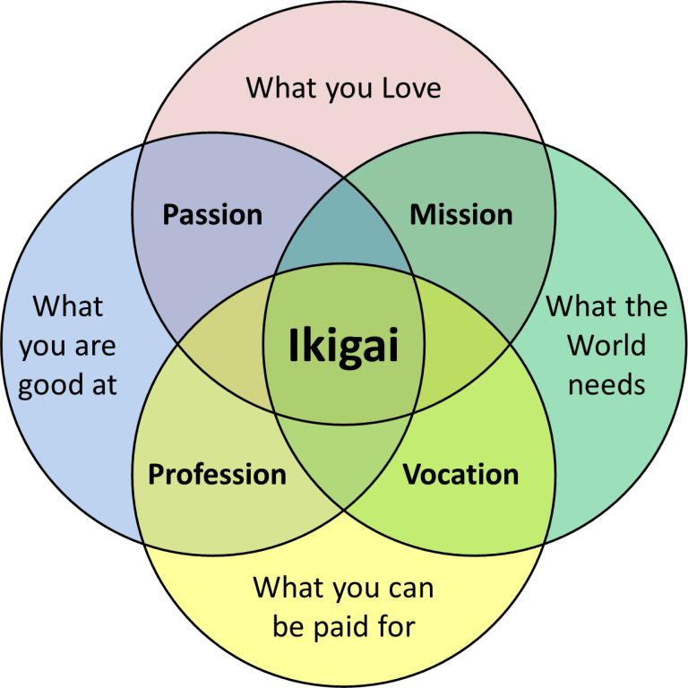
https://harishsnotebook.wordpress.com/2016/09/11/the-spirit-of-mottainai-in-lean/
2024 Washington State Lean Transformation Conference | 22

Slide 23
Body Content Slide
Shokunin
2024 Washington State Lean Transformation Conference | 23

Slide 24
Once you decide on your occupation you must immerse yourself in your work. You have to fall in love with your work. Never complain about your job. You must dedicate your life to mastering your skill. That’s the secret of success.
-- Jiro Uno
2024 Washington State Lean Transformation Conference | 24

Slide 25
Body Content Slide
Gaman
2024 Washington State Lean Transformation Conference | 25

Slide 26
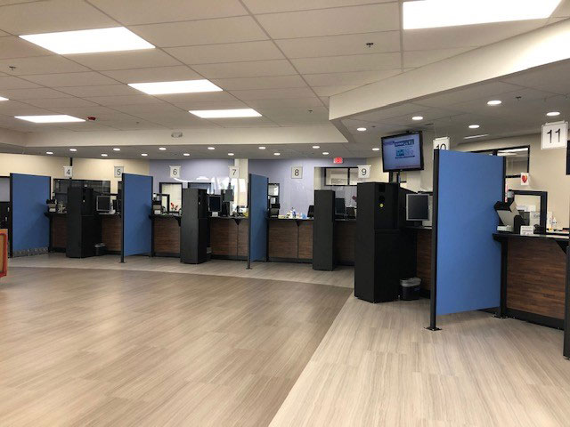
2024 Washington State Lean Transformation Conference | 26

Slide 27
Body Content Slide
Wabi-Sabi
2024 Washington State Lean Transformation Conference | 27

Slide 28
Three truths of Wabi-Sabi
Nothing lasts,
Nothing is finished, and
Nothing is perfect.
2024 Washington State Lean Transformation Conference | 28

Slide 29
Body Content Slide
Nemawashi
2024 Washington State Lean Transformation Conference | 29

Slide 30
DOL Pro-Equity, Anti-Racism team
2024 Washington State Lean Transformation Conference | 30

Slide 31
Establishing a Lean philosophy
Set organizational culture on operational excellence.
Know the “why.”
Empower employees.
2024 Washington State Lean Transformation Conference | 31

Slide 32
The future of Lean
Who aren’t you serving?
2024 Washington State Lean Transformation Conference | 32

Slide 33
Thank you.

Slide 34
Image SLide
We are
experiencing
technical
difficulties​
​
We will return at xx:xx AM

Slide 35
THANK YOU​
We appreciate you attending our virtual Lean Conference.
We hope you enjoy this session… and others!
We want your feedback!
Following this session, you will have an opportunity to take a short survey
www.results.wa.gov​

