Slide 1
Data Visualization
What’s your Story?
Results WA Community of Practice | December 2023

Slide 2
Presented by
Beth Adams - MA, LSSBB
Lean Continuous Improvement Manager
Elizabeth.Adams@dshs.wa.gov
Pronouns: She/Her

Slide 3
When it comes to this topic I
Don’t even know where to get started
Know a little bit, but am not confident in my skills
Confident with chart/graph creation but not sure I’m telling the right story
Confident with chart/graph creation and telling my story, but could always use a refresher
Could probably teach this session

Slide 4
When I think of data visualization, I think of….
Type your response in the chat

Slide 5
Today’s Session
Agenda
Objective
1. Data
2. Making Data Visual
3. Types of Graphs
Walk away with a framework for telling a specific data story using the provided handout.

Slide 6
Introduction

Slide 7
quote
Transform numbers into a narrative

Slide 8
Why Data Visualization?
Strengthens impact of your message
Comprehend large amounts of data
Promotes compelling storytelling
Aha!

Slide 9
Would you rather…
Has Dementia and is Clinically Complex?
Has Dementia and is
Clinically Complex?
Yes | 439
No | 100

Slide 10
Data Visualization Promotes
Retention
Learning Styles
Clarity
400%

Slide 11
Data
Categories, Sources, & Tools

Slide 12
Quote 2

Slide 13
Categories
Qualitative
Quantitative
Why
“Feely”
What
How Many
“Numbery”

Slide 14
Quantitative Data
Discrete
Continuous
Distinct, specific values
Cannot divide into smaller parts
Countable
Any value within a specific range
Can divide into smaller parts
Measurable
Example: # people who took a survey
Example: Travel expenses pre-pandemic v now

Slide 15
Sources
Business Systems
Surveys
Other

Slide 16
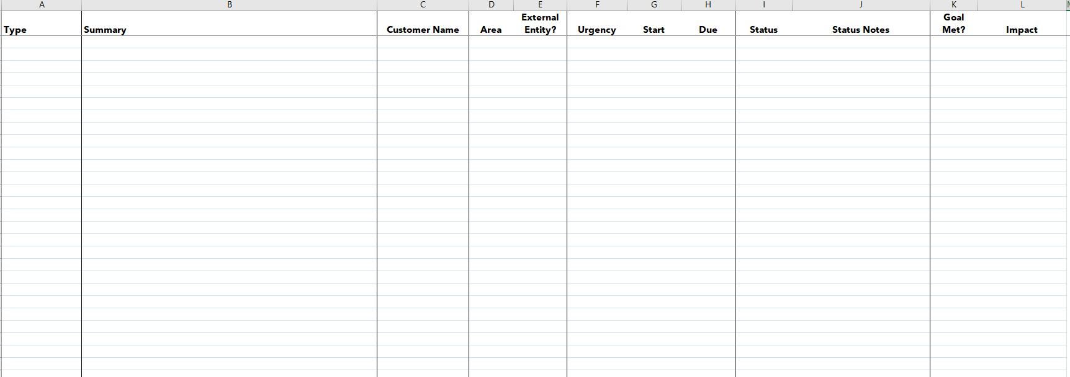
Other - example

Slide 17
Tools & Platforms I
PowerPoint
SharePoint
Excel
Word
Teams

Slide 18
Tools & Platforms II
PowerBI
Visio
Tableau
R
SPSS
Other

Slide 19
Data Entry & Retrieval
 | Manual | Automated
enter
Retrieve
Filling out a form
Typing information from another source
Importing spreadsheet into PowerBI
Cellular references in Excel
Business systems integration
Exporting SharePoint list to Excel
Setting up PivotTable
Exporting data from business system(s)
PowerBI system integration
Business systems integration

Slide 20
- My Data - Tools & Platforms
Go to workbook

Slide 21
Making Data Visual
Storytelling 101

Slide 22
No one ever made a decision because of a number. They need a story.
- Daniel Kahneman, author

Slide 23
Components
Relevant Content
Good Data
Clear Narrative

Slide 24
Structure
TO WHOM
WHAT
WHY
HOW OFTEN

Slide 25
Bringing Data to Life
People behind the data
Be curious
Share context
We should never let
data speak for itself

Slide 26
Quote 3

Slide 27
What story do you want to tell?
Go to workbook

Slide 28
Data Viz Examples
Visuals you could use to help tell your story

Slide 29
All graphs are charts
Not all charts are graphs
Graphs show a mathematical relationship

Slide 30
Pivot Tables
NO
YES
Histogram
Pareto
Funnel
Scatter
Bubble
Sunburst
Treemap
Area
Bar
Column
Line
Pie
Radar

Slide 31
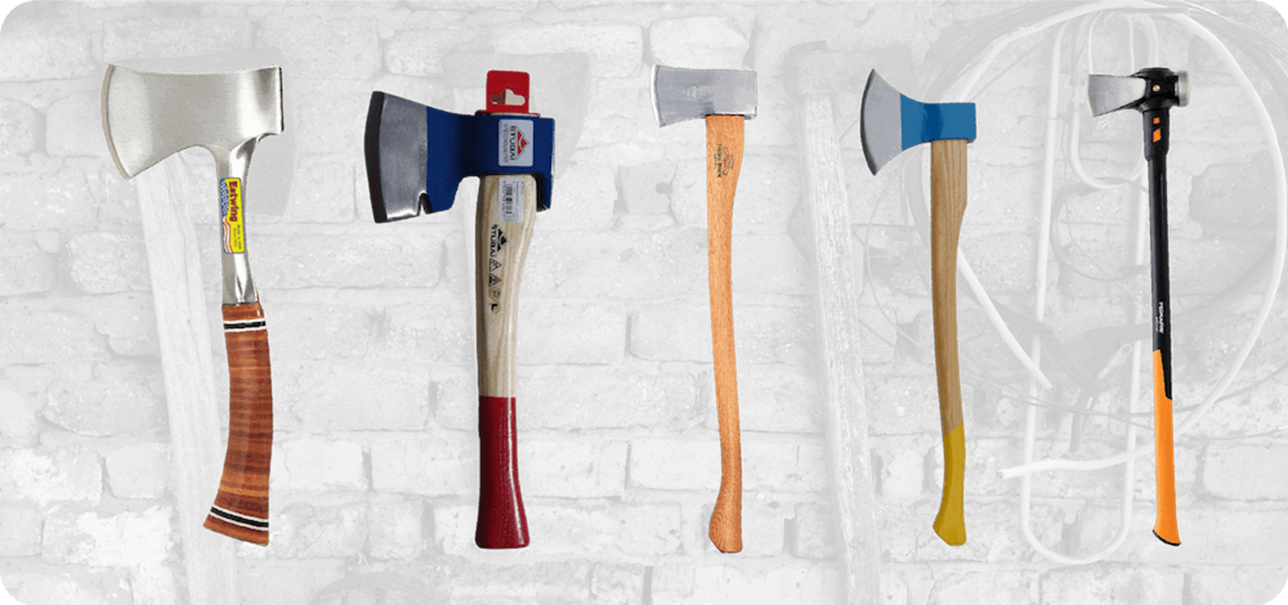
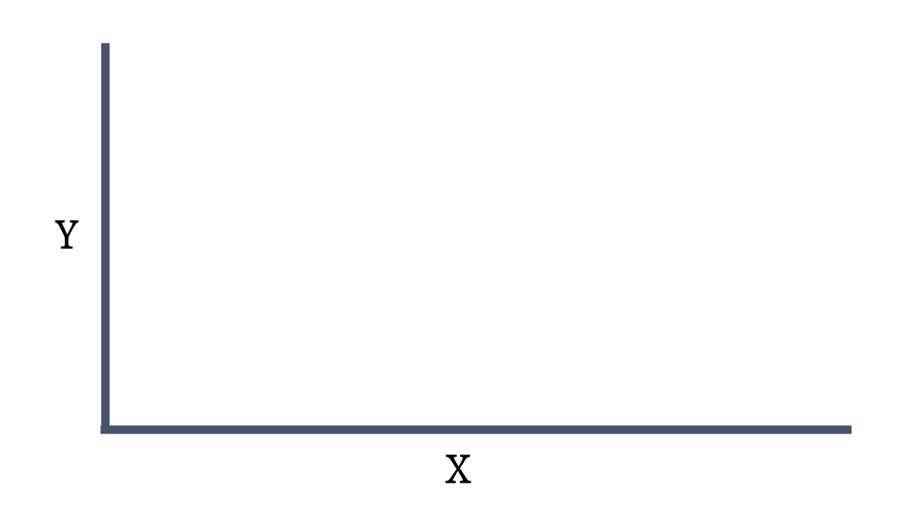
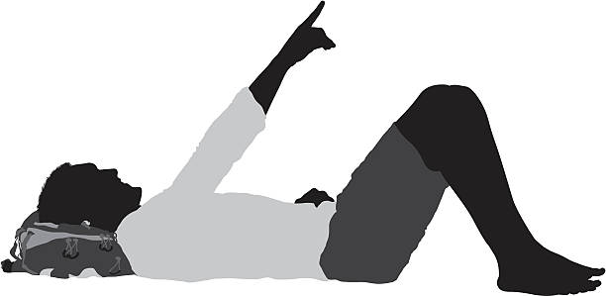
Axes/Axis
Reach up to the sky
Lay down to relax

Slide 32
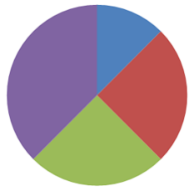
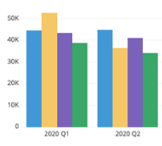
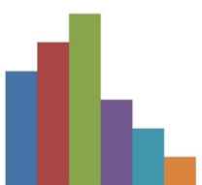
Which one?
COMPOSITION
COMPARISON
RELATIONSHIP
DISTRIBUTION

Slide 33
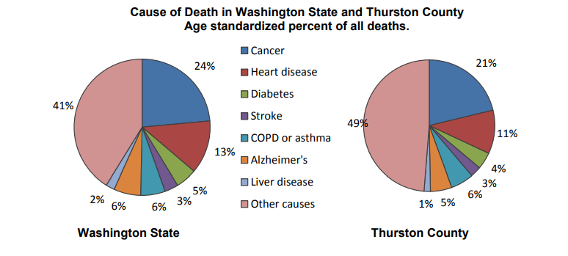
Composition: Pie Charts

Slide 34
Pie Charts
Use
Do not use
Single-choice for response
Part-to-whole comparison
Precise size of slice doesn’t matter
Discrete categories
Point in time
Negative values
Too many categories
Compare size of categories
Compare two data sets
Overlapping/hard to read labels
Change over time

Slide 35
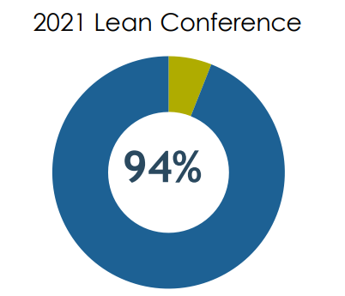
Pie Charts: How many slices?
a pie chart works well
if you can understand the story without numbers

Slide 36
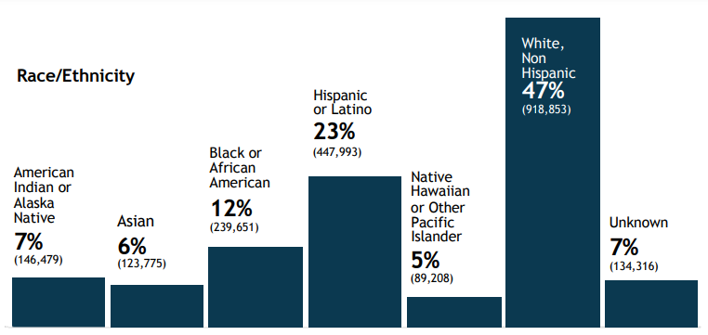
Comparison: Bar/Column
Use:
Discrete values
Compare two or more groups/ categories
Don’t use/Avoid:
Long category names
Different colors for same category

Slide 37
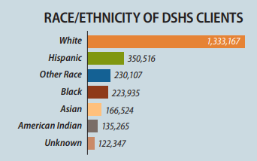
Comparison: Bar Graph
Use:
Long category names
Lots of categories
Rank order
Fits better in “real estate”
Don’t use/Avoid:
Arranging alphabetically (unless it makes sense)
Too many stacked/clustered categories

Slide 38
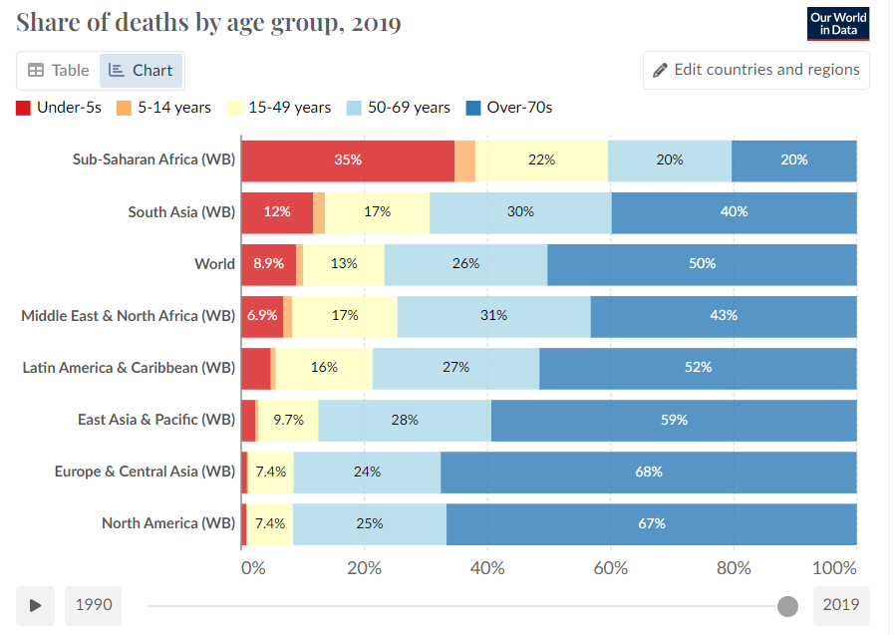
Comparison, Composition, or Relationship: Stacked
Use:
Side by side, Stacked, 100% stacked (composition)
Too many categories and variables for a pie chart
Don’t use/Avoid:
Too many categories/variables in cluster/stack

Slide 39
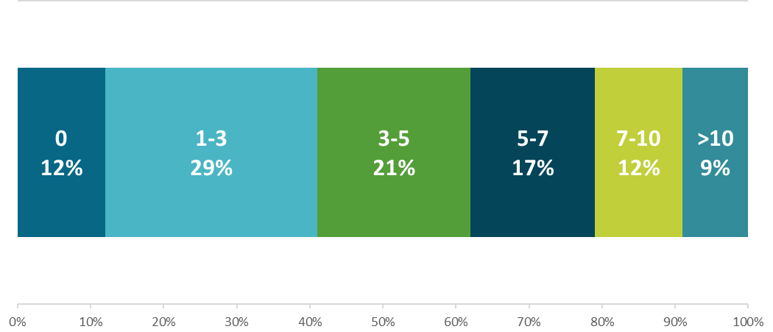
Composition: Stacked Option
Hours Saved (Weekly) by Not Commuting

Slide 40
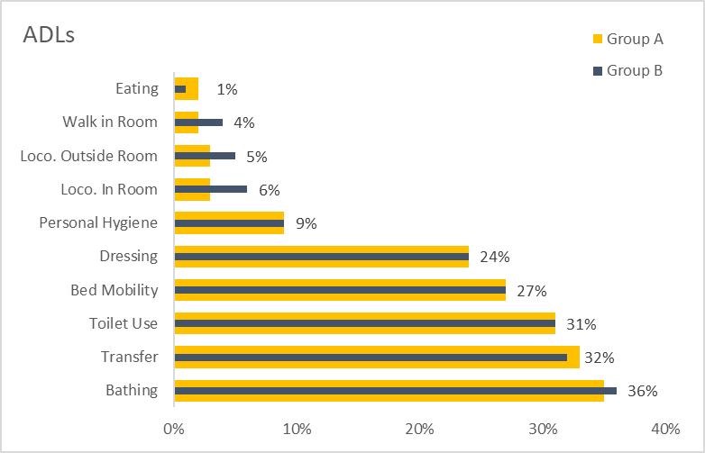
Comparison: Overlapping Bar Chart

Slide 41
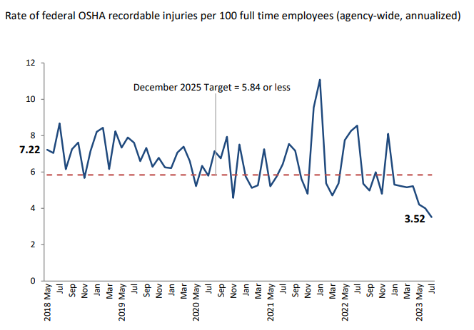
Comparison: Line Graphs
Use
Show change over time
Avoid/Limit
Too many lines
Lines bunched up (hard to see comparison)

Slide 42
Relationship: Clustered columns/bars
Solid fill
Pattern Fill

Slide 43
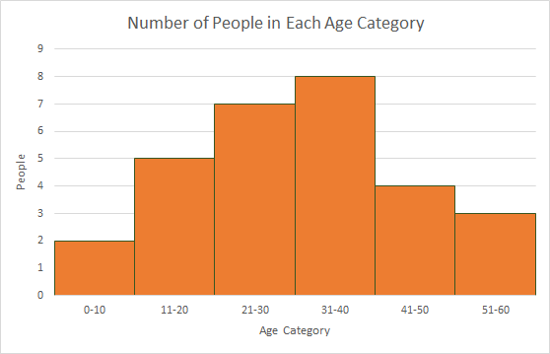
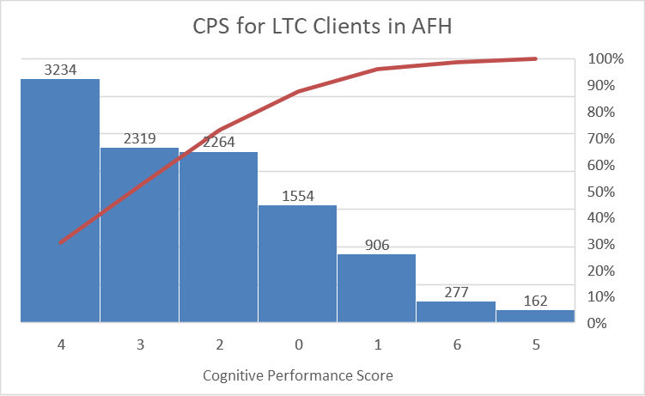
Distribution: Histogram & Pareto
Histogram
Pareto

Slide 44
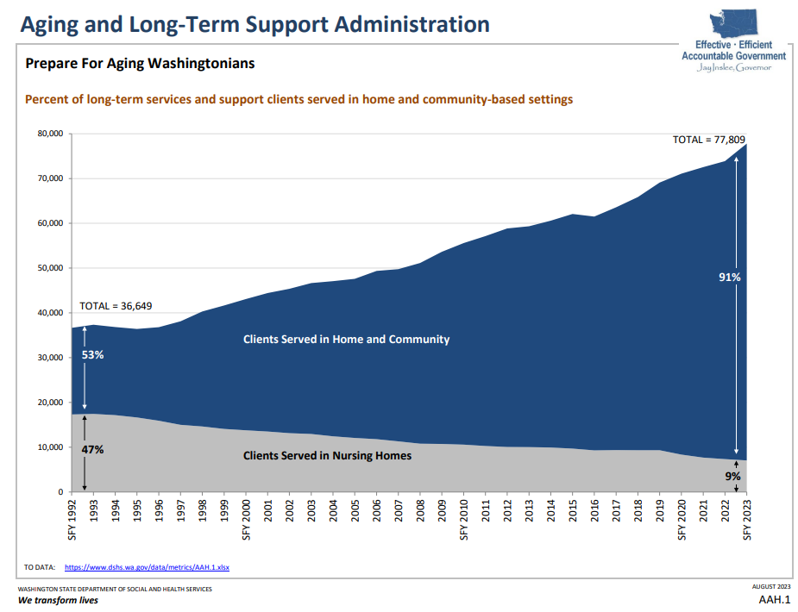
Composition: Stacked Area Chart

Slide 45
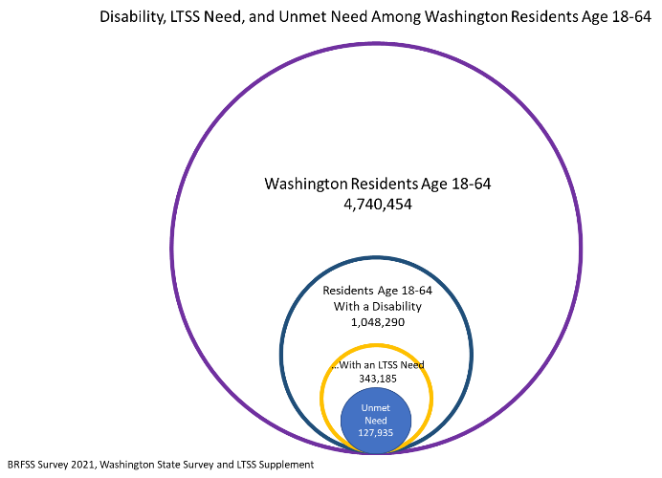
Relationship: Nested Circles
Subgroups within subgroups

Slide 46
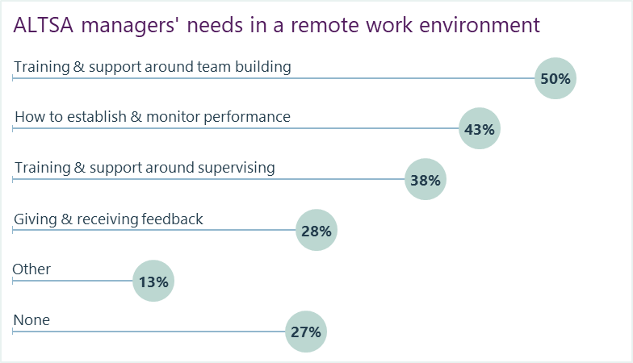
Comparison: Lollipops

Slide 47
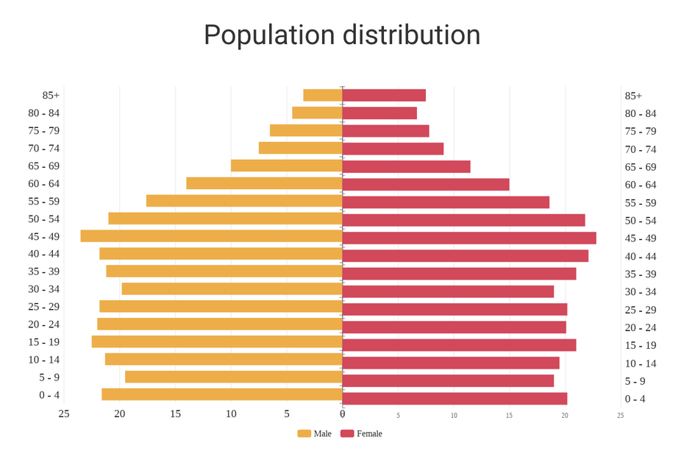
Comparison or Distribution: Butterfly

Slide 48
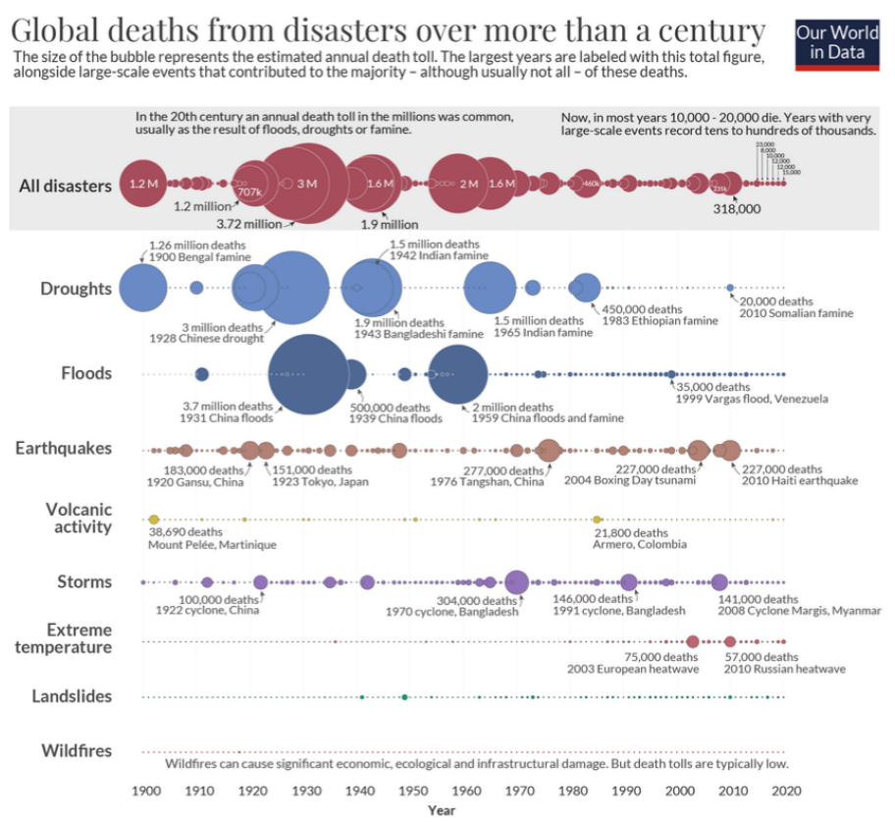
Relationship: Bubble

Slide 49
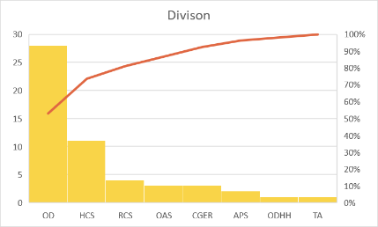
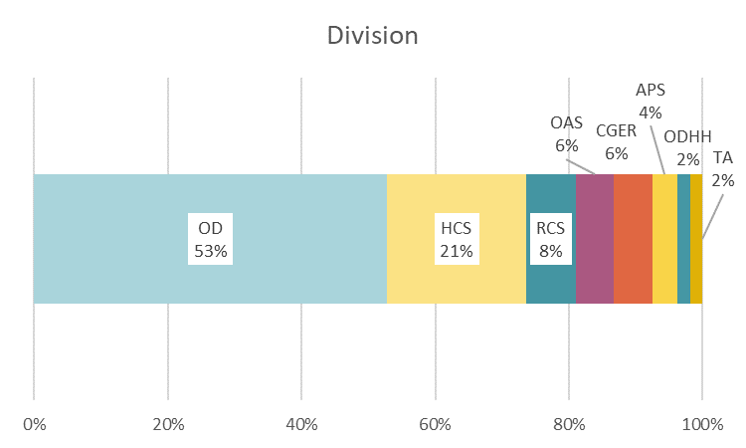
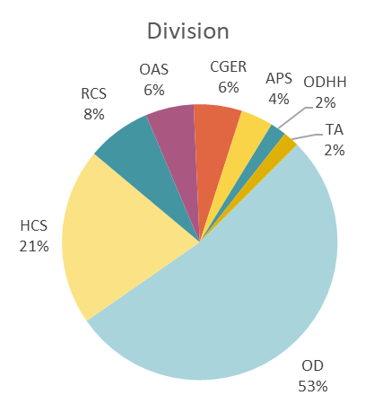
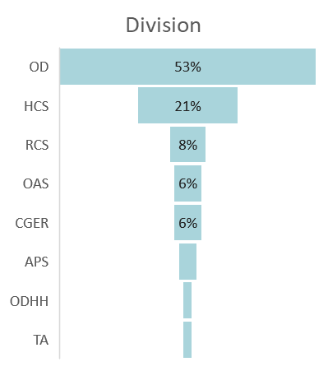
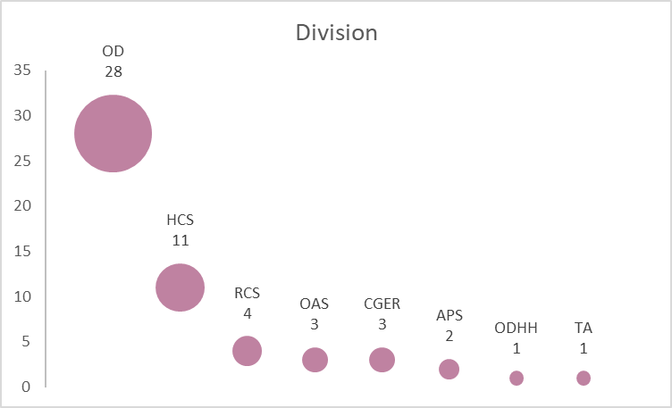
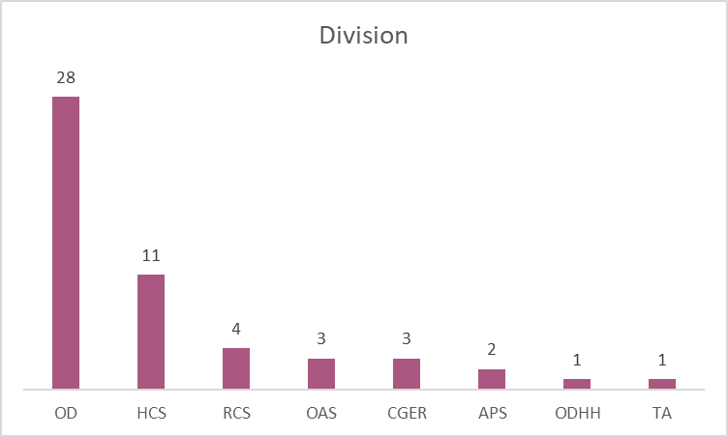
same data, different charts

Slide 50
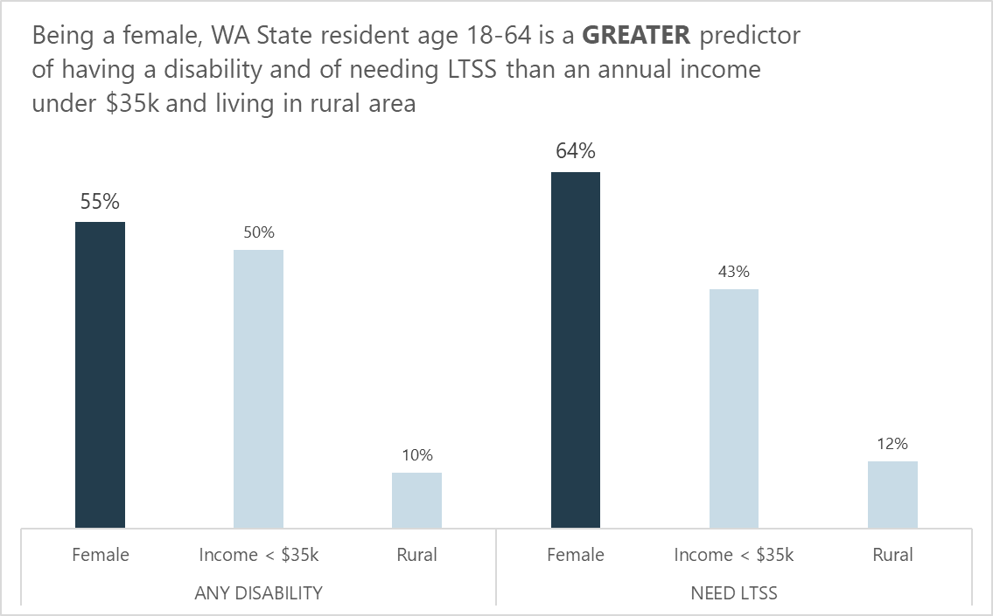
Provide the takeaway

Slide 51
What graph(s) will you use?
Go to workbook

Slide 52
Formatting
Accessibility, fonts, colors, etc.

Slide 53
Accessibility
Provide raw data tables (Excel, PowerBI)
Alternative text for images, icons, graphs
Presenting data

Slide 54
Font type: numbers & symbols
20-point font size
1 2 3 4 5 6 7 8 9 0 | @ # $ % & | Arial | 90%
1 2 3 4 5 6 7 8 9 0 | @ # $ % & | Calibri | 90%
1 2 3 4 5 6 7 8 9 0 | @ # $ % & | Candara | 90%
1 2 3 4 5 6 7 8 9 0 | @ # $ % & | Avenir Next Lt Pro | 90%
1 2 3 4 5 6 7 8 9 0 | @ # $ % & | Verdana | 90%
1 2 3 4 5 6 7 8 9 0 | @ # $ % & | High Tower Text | 90%
1 2 3 4 5 6 7 8 9 0 | @ # $ % & | Times New Roman | 90%
1 2 3 4 5 6 7 8 9 0 | @ # $ % & | Georgia | 90%

Slide 55
Font type: numbers & symbols (dark theme)
20-point font size
1 2 3 4 5 6 7 8 9 0 | @ # $ % & | Arial | 90%
1 2 3 4 5 6 7 8 9 0 | @ # $ % & | Calibri | 90%
1 2 3 4 5 6 7 8 9 0 | @ # $ % & | Candara | 90%
1 2 3 4 5 6 7 8 9 0 | @ # $ % & | Avenir Next Lt Pro | 90%
1 2 3 4 5 6 7 8 9 0 | @ # $ % & | Verdana | 90%
1 2 3 4 5 6 7 8 9 0 | @ # $ % & | High Tower Text | 90%
1 2 3 4 5 6 7 8 9 0 | @ # $ % & | Times New Roman | 90%
1 2 3 4 5 6 7 8 9 0 | @ # $ % & | Georgia | 90%

Slide 56
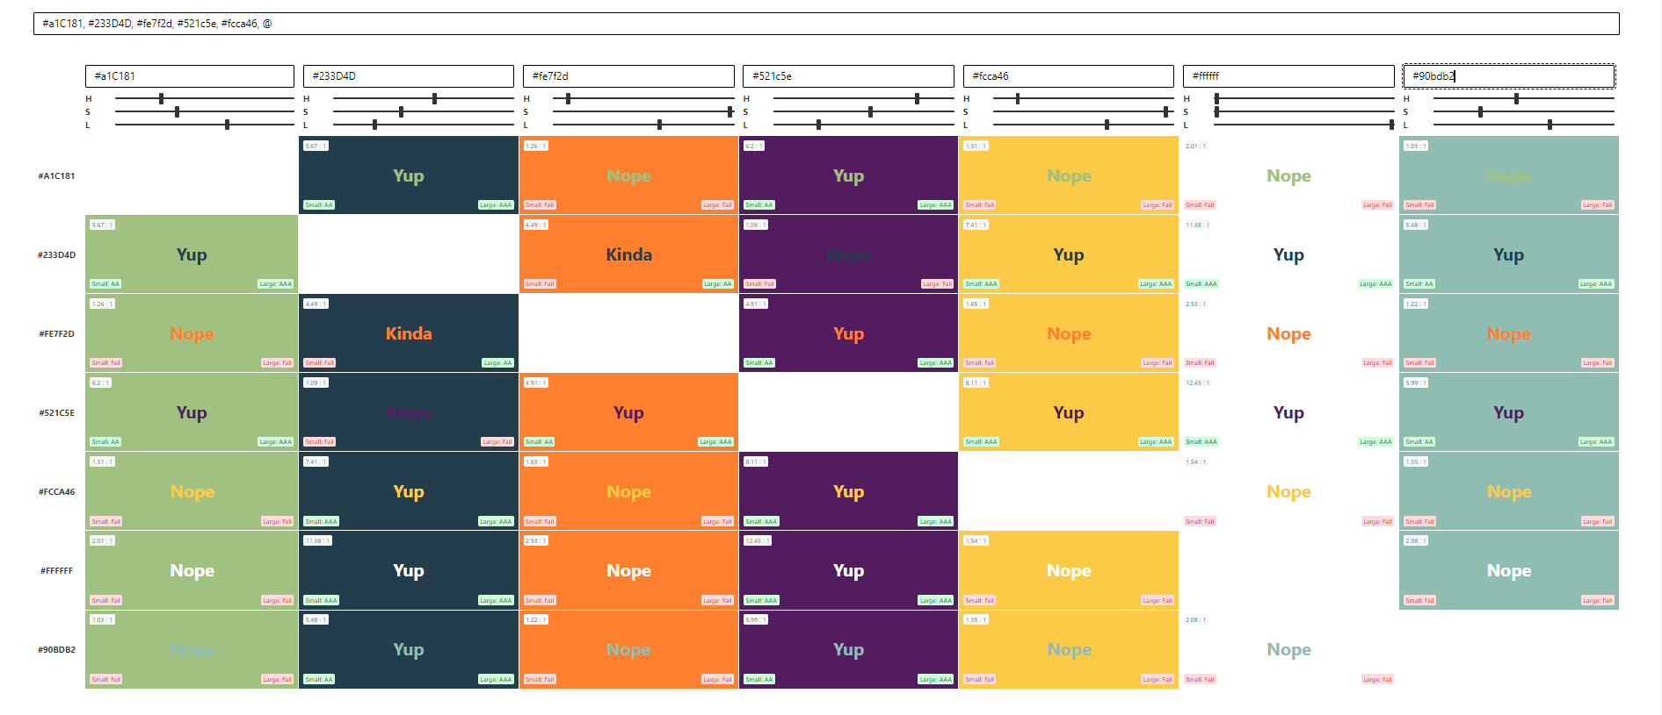
This presentation checked using:
https://www.aremycolorsaccessible.com/

Slide 57
Beth’s essentials: Modify when
Overlapping content
Hidden content
No contrast/variation
Hard to read/see
Font size too small
You want full control over how it looks

Slide 58
Questions?

Slide 59
One takeaway…..one aha…..one change….

Slide 60
Thank you!

