Slide 1
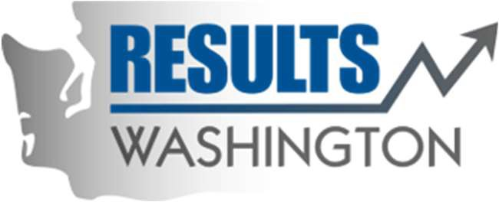
The Blast Newsletter
The blast
ENTERPRISE-WIDE LEAN AND CONTINUOUS IMPROVEMENT COMMUNITY OF PRACTICE
ISSUE NO. 15 | FEBUARY 2024
Transparency - Innovation - Results
WHAT YOU MISSED At our February CoP meeting, we were grateful to have Kelly Walk with DSHS share how she used the ADAPT and Leader Change Model to implement effective change, and Jeremy Walker with the Department of Commerce share how he used the DMADV methodology for actionable equity analyses and project implementation. For more information, see the recapped story on page 2!
LOOKING AHEAD Mark your calendars and check out what we have in store for you at our March CoP meeting on page 2.
Questions? For questions on The Blast, the CoP, or to present a teaching or project share this year, contact:
Talia Mazzara, Results WA Senior Performance Advisor
Theresa Dew, Results WA Senior Performance Advisor
Our CoP wants YOU!
Is there a continuous improvement tool or methodology we have yet to cover that you have used in the past and are excited about how well it works? You know, the kind of excitement you can’t contain until you share it with someone else?
If so, we would love to have you join our panel for a month and facilitate a topic teaching or share about a recent project that has brought value to your work and agency.
We currently have openings in our schedule from June through December 2024, and we are looking for experienced Lean and continuous improvement leaders who have the desire to teach, inspire, and share applied knowledge to join our forum.
If this sounds like something you’re interested in, reach out to Talia Mazzara by 3/31/24 to schedule a chat!

Slide 2
The Blast Newsletter – Page 2
ISSUE NO. 15 | FEBUARY 2024
Grass Roots Change Management: Empowering Change for the Individual
If you ever feel daunted by the thought of leading your team through a large-scale change and struggle with where to start, then February’s CoP is for you. For this month’s topic teaching, Kelly Walk with the Department of Health and Social Services (DSHS)’ Behavioral Health Administration demonstrated how she effectively used multiple models throughout a major process of change management (CM) within her agency. Her session gave an overview of the ADKAR, ADAPT, and LEADER models, as well as walked us through a 4-pronged, thoughtful approach that consisted of a CM Community of Practice, a training plan, a CM plan, and a messaging plan. A great teaching for all!
“Improvement usually means doing something that we have never done before.”
~ Shigeo Shingo ~
Click below to watch the CoP recording of Kelly and Jeremy’s presentations!
COMING UP NEXT
March 19, 2024
10:30 a.m. – 12:00 p.m.
Zoom Meeting
Topic Teaching:
Engaging Stakeholders: From Project to Embedded Workplace Culture Megan Schoor | OFM
Project Share: Organization Strategy & Performance Unit Customer Feedback Initiative Aunna Moss | OFM
Need an example of how to integrate Lean with equity work? Look no further!
Jeremy Walker with the Department of Commerce presented at our CoP this month and shared helpful information about a project he worked on using Lean DMADV (Define, Measure, Analyze, Design, and Verify) in equity analyses and project implementation. Through thoughtful and intentional energy put towards this work, 38,000 organizations were identified as possible applicants for the Building Community Funds (BCF) program, and 1200 of those were potentially BIPOC & By-and-For Led organizations. He covered many bases in this presentation on how to effectively use DMADV, but to name a few, he taught us:
The differences between DMADV and DMAIC
When and how to use DMADV
How to use DMADV as a Kanban
How multiple frameworks can be paired together for optimal and holistic results
Always keep your customers most impacted by the process in mind while using this tool

