Slide 1
Forces of Change: Too Much Change, Not Enough Direction
Jennifer Haury
CEO, Organizational Anthropologist
All Angles Consulting
10/24/2024

Slide 2
Who is in our audience?
1) I am in a leadership role (lead, supervisor, manager, director, etc.)
2) I am an independent contributor
3) I am a facilitator, consultant, project manager, or trainer
4) I am not one of the above

Slide 3
Rome wasn’t built in a day

Slide 4
What’s driving the pace of change?
Technology
Political Landscape
Disruptive Events
Competition
Impatience
Customer Demand

Slide 5
Speaking of change…
Think about workplace changes you anticipate experiencing in the next 3 months
Make a list of these changes. Try to produce at least 5
Can you identify what is driving these changes?
Lastly, WHO is driving these changes?

Slide 6
What will we work through today??
Daily Team-driven Change
Cross Functional Change
Strategic Change
“Who/What is Moving my Cheese?”

Slide 7
Not covering today….but important

Slide 8
Daily Team-Driven Change

Slide 9
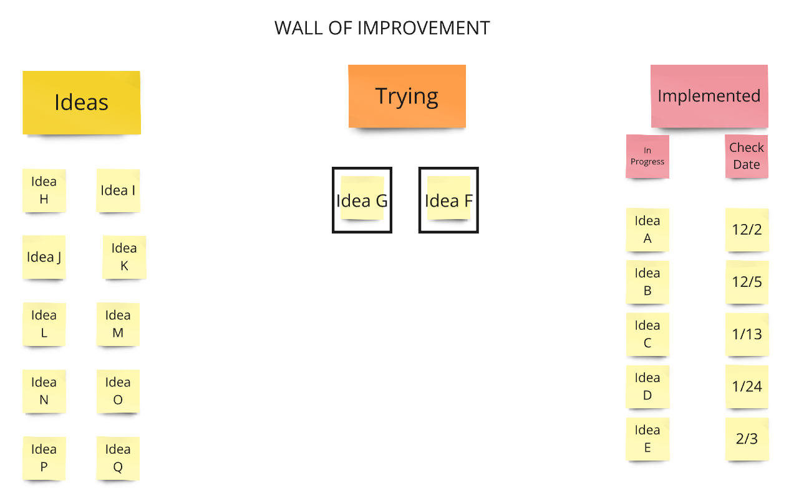
Strategies for Dealing with Team Driven Change
Tip #1
Stage Change:

Slide 10
Strategies for Dealing with Team Driven Change
Tip #2
Incorporate Change into
Known Demand/Capacity

Slide 11
Example- Heijunka
Consider using a Heijunka Board to make work visible AND level the work between different types of work needing to be produced and improvement work

Slide 12
Use your customer to Prioritize
Tip #3
What changes would your customer value most?

Slide 13
Cross Functional Change

Slide 14
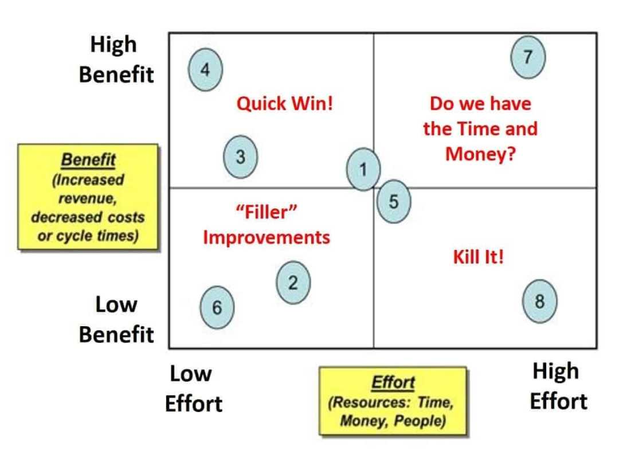
Value Stream Coordination
Tip #1: Pick work that will create capacity FIRST

Slide 15
Nemawashi
Tip #2: Do pre-work to drive consensus

Slide 16
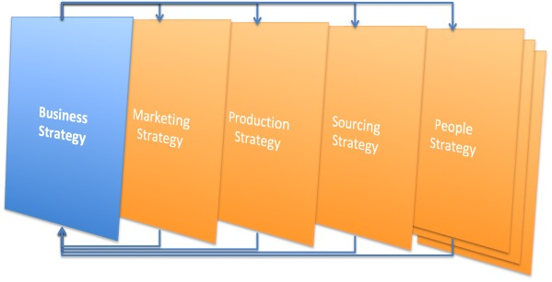
Strategic Change

Slide 17
Using Vision/Mission/Values
Tip #1
Say NO to
Good Work

Slide 18
Use your true North as a compass for your work

Slide 19
Prioritization
Tip #2
Use governance to prioritize the queue

Slide 20
Get Clear on What’s Day to Day
Tip #3
Separate Operational vs Strategic Work

Slide 21
Final Thoughts…

Slide 22
Q&A
Q&A
jennifer@considerallangles.com

Slide 23
Jennifer Haury
jennifer@considerallangles.com
(360) 810-2568

