Slide 1
Fostering Grace In The Workplace Results Washington Continuous Improvement Community of Practice Vanessa Palomino January 2024

Slide 2
Learning Objectives
Illuminate the concept of Gracious Space in the workplace.
Share tools to help professionals incorporate grace into their workplace.
Understand practical uses of fostering grace in the workplace.

Slide 3
Why Grace?
Invites differences and allows paradoxes.
Gracious Space is not a conflict-free space. As people work together in community, it is inevitable that conflict will occur.
Allows a more dynamic and comfortable place for all to succeed in.
It is important to have the space for conflicts to emerge and be addressed productively.
This is an open space for a conversation on how we can contribute to a healthy workplace during change by modeling grace

Slide 4
Building a gracious space in the workplace and at home is all about welcoming the stranger and inviting differences. It’s about allowing paradoxes to be, and working with difference to create a more dynamic and comfortable place for all to succeed in.
“It helped me keep our team unified during our recent pandemic. We applied our Book Club virtually. The book chosen during the pandemic was Gracious Space by Patricia Hughes. It helped us lay out the foundation to a collaborative workspace where differences in opinion and the unknown was the condition, and we approached it with open inquiry.”

Slide 5
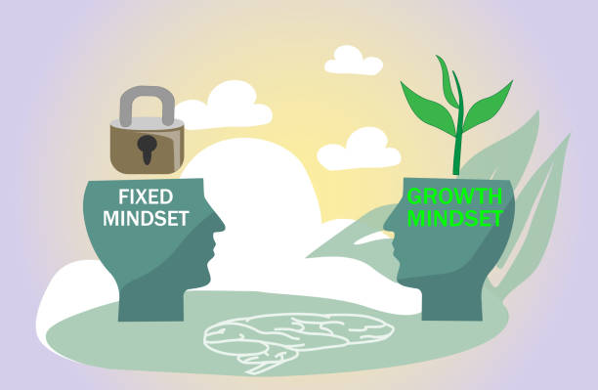
What does grace mean to you?
Think of a time when you have experienced Gracious Space -- whatever this means to you. What was the setting? What did you experience?

Slide 6
What are the signs we see in our workspace that indicate a need for gracious space?
This Photo by Unknown Author is licensed under CC BY-SA

Slide 7
Tool #1 The Johari Window
Johari Window.docx
Johari Window and Application (ethicalleadership.org)
TIPS
When completing a Johari window, we must approach it using grace, so that the feedback we are about to receive is beneficial.
Ensure you approach the person you wish to complete this with openly, where you give them the opportunity to opt in or share when would be a better time for them.
Share why you are seeking this feedback and how you hope to use it for your growth.
Offer to complete one with them on your feedback too, reciprocal two-way communication makes it easier to both send and receive feedback.

Slide 8
Tool #2 Invite the stranger
Think of a project you are working on at work, at home or in the community. We will learn how to “invite the stranger.”
1. Who is currently involved in the project?
2. Is this a club of like-minded people or a community with differences?
3. Whose voice is not represented?
4. Identify one or more individuals who would add a valuable perspective to this group.
5. How do you feel about including these different perspectives you just identified?
6. What is your tolerance for difference?
7. Do you truly believe in the gifts this person(s) could bring?
8. Is it going to be a chore to deal with them?
9. What resistance do you have, if any? How can you turn your resistance into an attitude of openness to surprise?
10. What do will you need to do differently (ahead of time or at the next meeting) to ensure this person(s) is heard, and can contribute their gifts and perspectives? Reflect on how others might feel when this person(s), “the stranger,” shows up. How can you help them see the value of the new perspective or the missing voice?

Slide 9
What not to do when trying to create a gracious space
Don’t be dishonest: It’s important to be truthful when selecting adjectives that describe yourself and when providing feedback to others or when reflecting and building self-awareness.
Don’t be defensive: Receiving feedback can be difficult, especially if it’s negative. However, it’s important to listen to what others have to say without becoming defensive. Remember that the goal of the exercise is to increase self-awareness and team awareness.
Don’t rush through the exercise: Take your time when selecting adjectives that describe yourself and when providing feedback to others. Rushing through the exercise can lead to inaccurate results.
4. Don’t forget to follow up: It’s important to follow up with your team members after the exercise to discuss what you learned and how you can work together more effectively ¹.

Slide 10
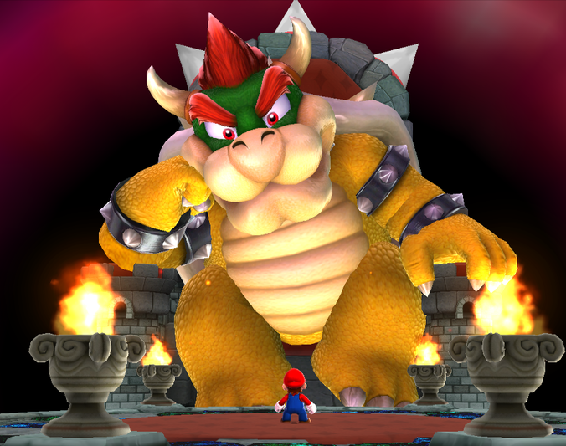
Let’s take some action and practice
Please write in the comments any words that come to mind when you think of yourself and how others may perceive you. This would go in the “Open” window.
Now let’s pretend we are filling a blank template on the Johari Window with Bowser from Mario World or Cobra Kai’s Jesse (two known bullies). What would their Johari Window look like based on what you know? Are there unknowns about their childhood which led to their evil behavior or feelings?
This Photo by Unknown Author is licensed under CC BY-SA
This Photo by Unknown Author is licensed under CC BY-SA

Slide 11
Johari Window
Role Play

Slide 12
Resources
Scott Mautz - Speaker, Author of Leading from the Middle, IU Faculty Exec. Ed. How to stay positive by keeping perspective (linkedin.com)
Hughes.P.M.,& Grace, B. (2010). Gracious Space: Working Better Together. https://youtu.be/ImQWIiLAUnA
Gracious Space Toolkit - Center for Ethical Leadership

