Slide 1
The Gray Notebook:
A journey of continuous improvement
Sreenath Gangula, Assistant Director –
WSDOT Performance Management
Transportation Safety & Systems Analysis Division
Performance Management Office

Slide 2
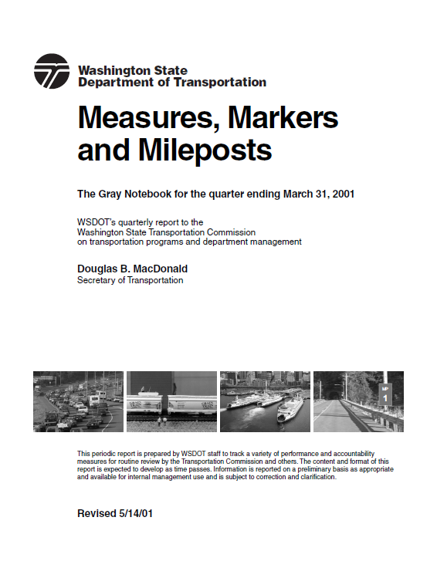
Gray Notebook origins
  Media and public confidence in WSDOT eroding
  Governor and committee voice accountability concerns
  Initiative-695 passes, cutting revenue by 30%
  10-year no new revenue drought continues

Slide 3
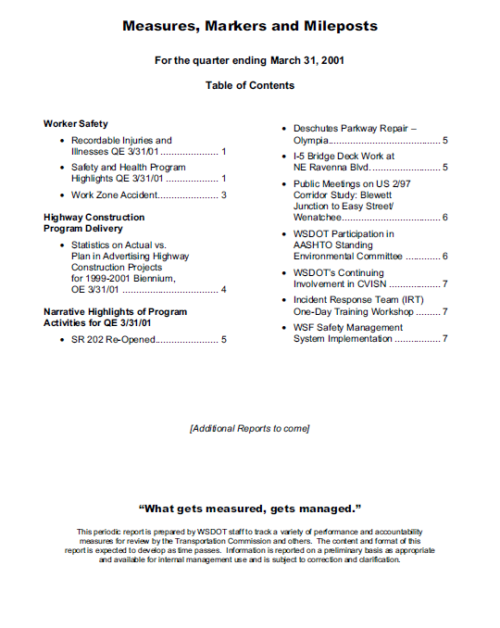
Gray Notebook origins
  Started small
  First edition was nine pages from start to finish (including the cover and table of contents)

Slide 4
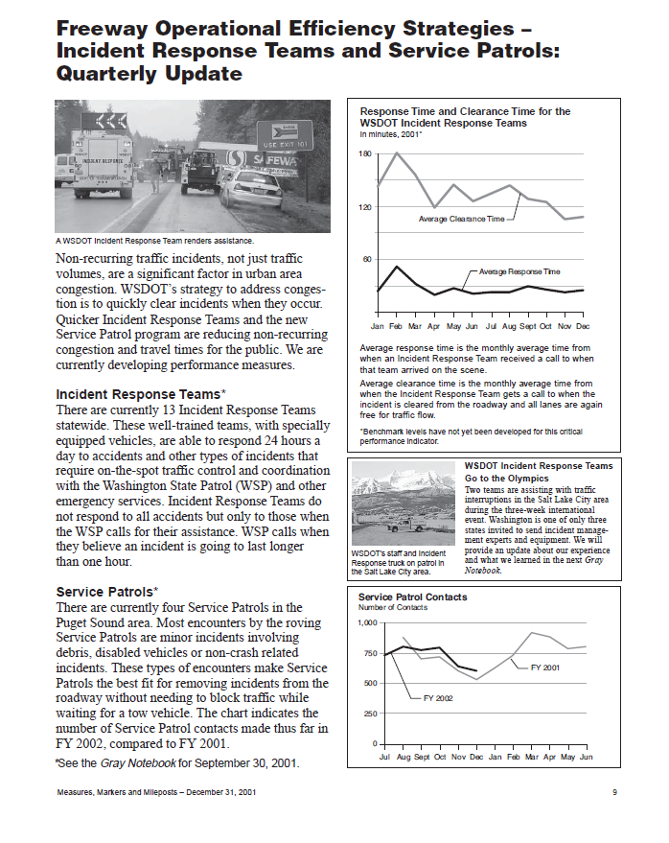
Gray Notebook origins
  Accountability, Credibility and Transparency began to grow at WSDOT and beyond
  Trust in the agency was renewed and support and funding followed

Slide 5
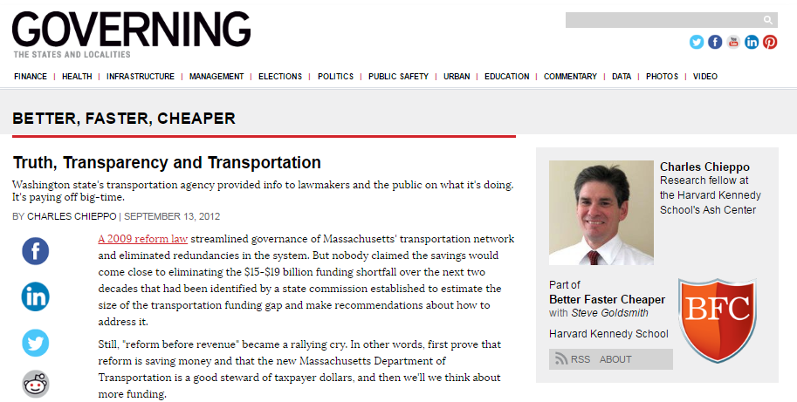
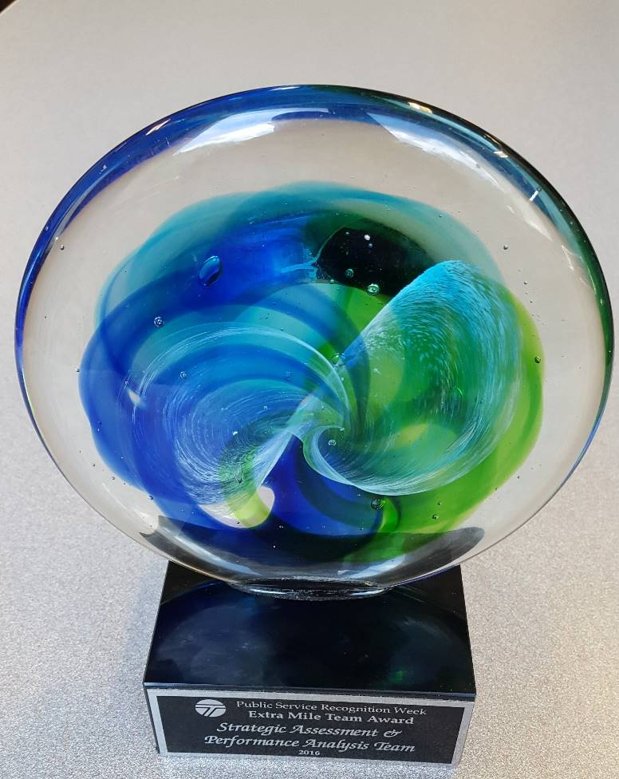
Gray Notebook past
The Gray Notebook has been recognized as the “gold standard” for data and performance reporting.
In 2016, our office won its first Extra Mile Award from the Governor.

Slide 6
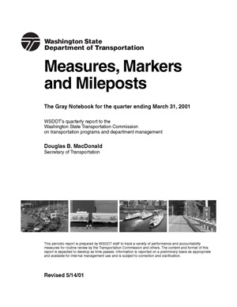
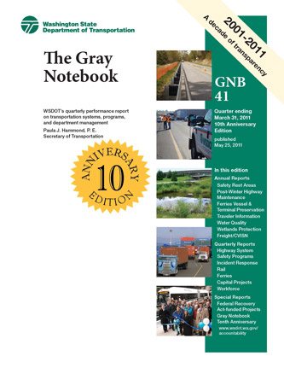
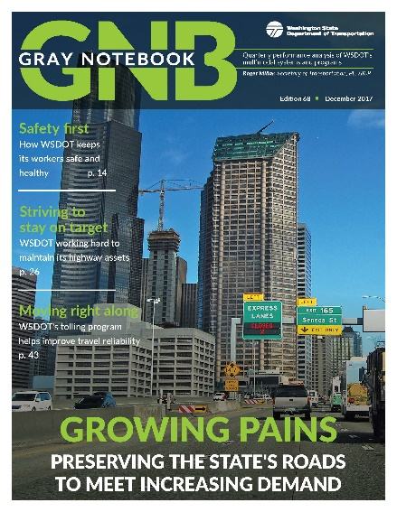
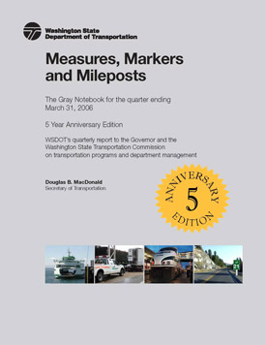
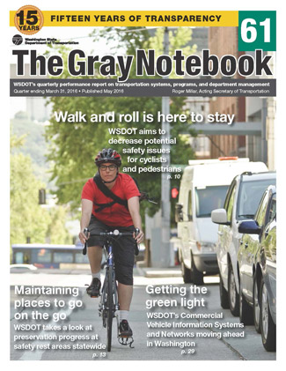
Gray Notebook past
The GNB has evolved over the years to continually improve, while keeping true to its original mission to promote agency-wide accountability, credibility and transparency

Slide 7
GNB continuous improvement
The GNB team surveyed the numerous programs it works about the publication. The vast majority of WSDOT programs that produce GNB articles use the vetted data and text for actions including:
Operational decisions
Investment decisions
Special requests
Internal meetings and reports
External outreach
State of Transportation
Legislative updates
Attainment Report
Results Washington
Transportation Asset Management Plan
Folios, brochures and news releases

Slide 8
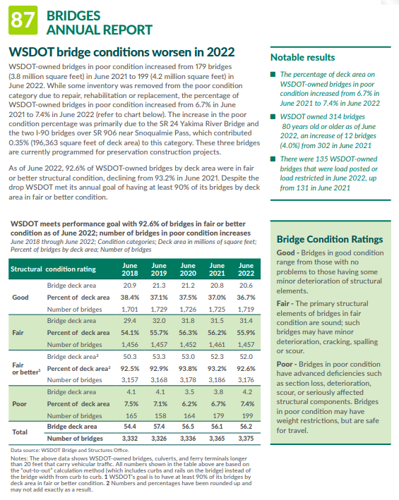
GNB continuous improvement
  Move toward a mentality that encourages people to work with us
  Create program-centric GNB partnerships
  Discuss data the subject matter experts use to manage their programs

Slide 9
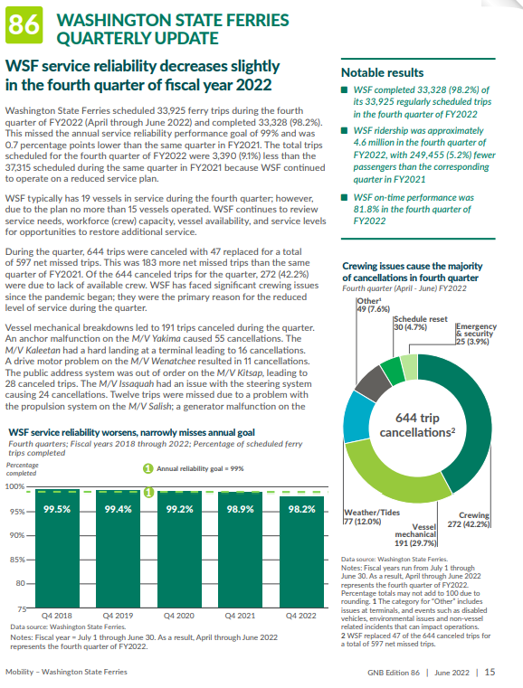
GNB continuous improvement
  Continuously improving a ground-breaking product
  Added Notable results boxes for quick information
  Created a color PDF for better online viewing
  Reduced article sizes and overall size of the GNB

Slide 10
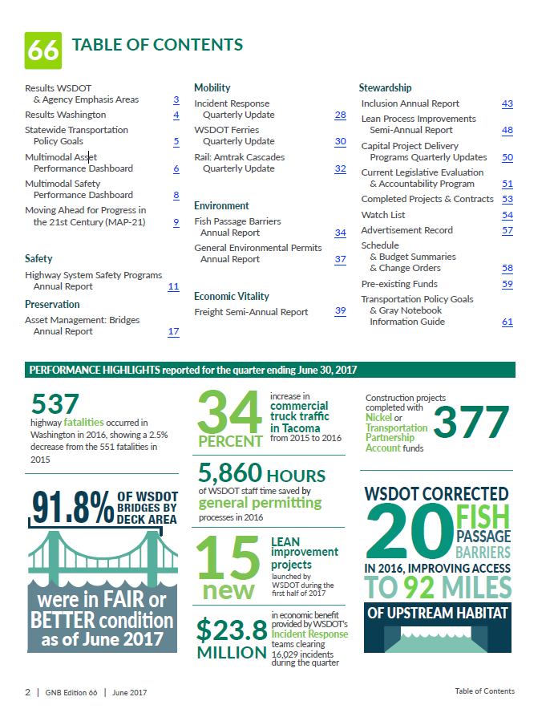
GNB continuous improvement
Linked the Table of Contents to articles and created quick access back to the Table of Contents
Added internal and external links, allowing readers to access additional information and reports on certain subjects
Made document much more accessible to all readers

Slide 11
GNB continuous improvement
  PDFs have extreme space issues and limitations
  Searching PDFs is difficult
  Online PDFs vs. print can result in inconsistencies
  PDFs do not work on smaller screens

Slide 12
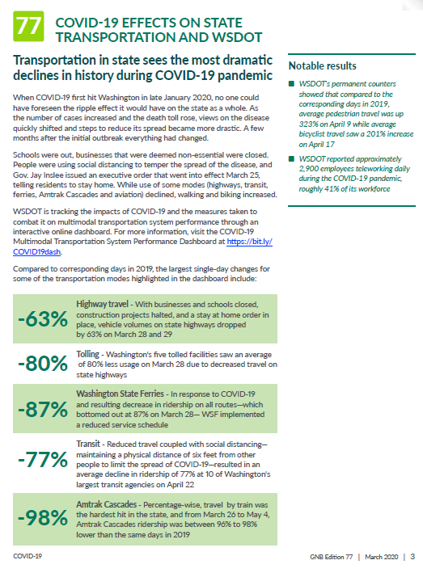
COVID-19 Dashboard
COVID-19 Dashboard paved the way for the Multimodal Dashboard
Success led to members of the office receiving their second Extra Mile Award in five years

Slide 13
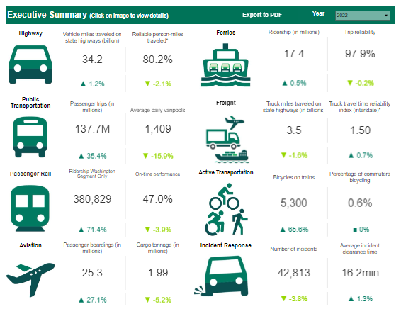
Multimodal Dashboard
Steep learning curve for the Multimodal Mobility Dashboard
Being part of this process, the GNB team was able to identify some pitfalls to avoid

Slide 14
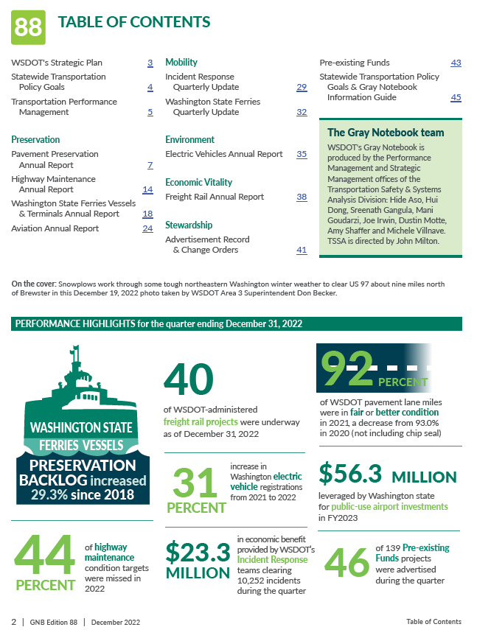
Transitioning the GNB
Before
InDesign and Illustrator used to create text and charts
Articles were attached to the edition
and based on when that edition was published
Extremely challenging to balance text and charts
Space issues commonplace

Slide 15
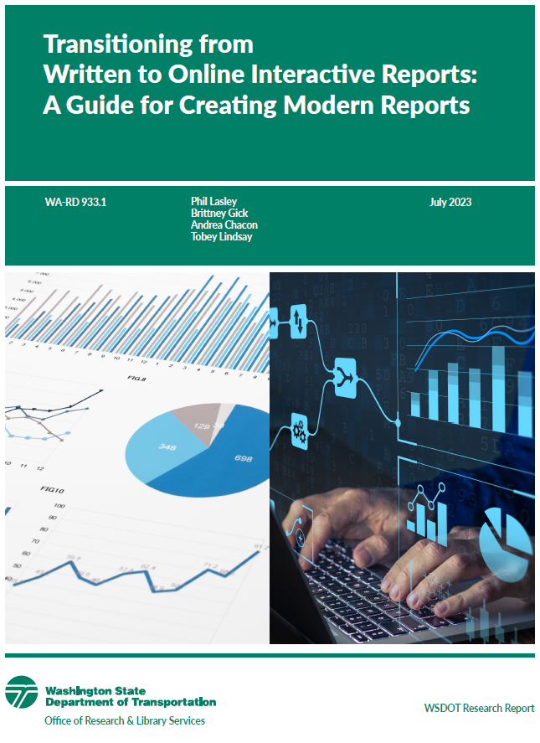
Transitioning the GNB
Now
Worked with the Texas Transportation Institute during the GNB transition
TTI’s findings validated the direction we were taking with the publication
The guide TTI created is a reference tool to help others make this change

Slide 16
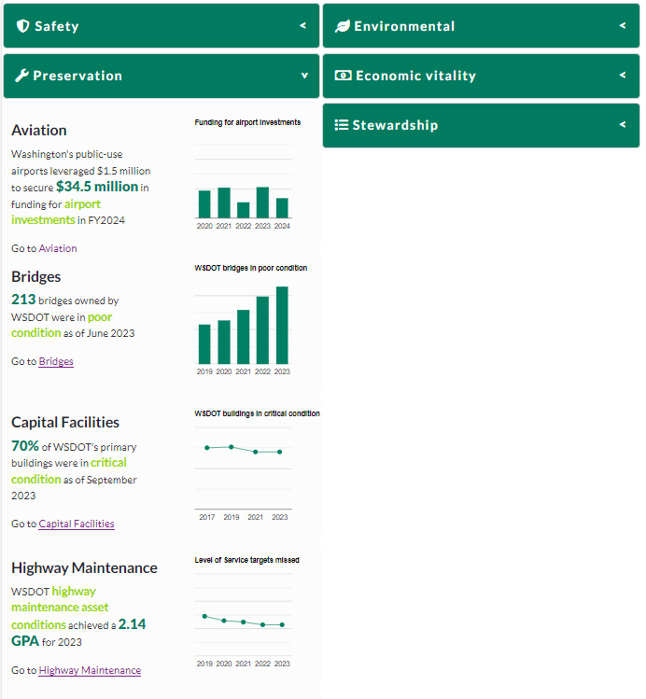
Transitioning the GNB
Now
Tableau and HTML used to create text and charts
Articles sorted by subject and analyses are reported according to data
Subtopics within articles are displayed in easy-to-find tabs
Five years of all data and all articles located in one place

Slide 17
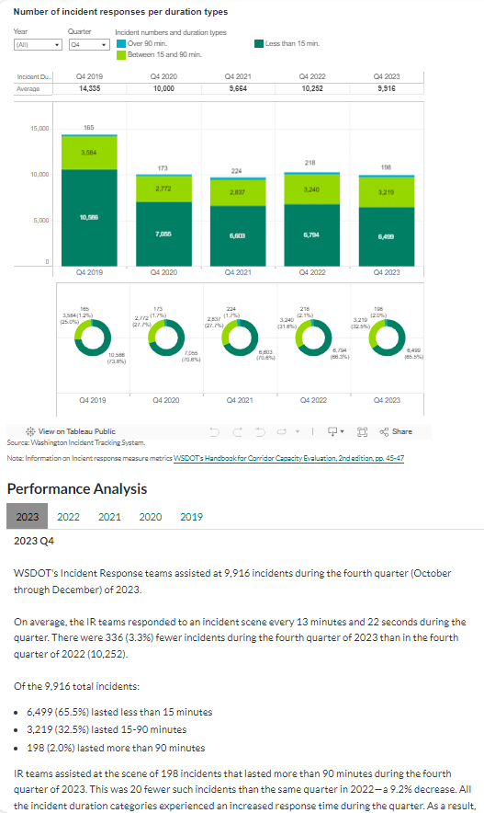
Transitioning the GNB
Now
Charts are dynamic
GNB data is more visual than ever
Maps are being used in new ways and are tied to data points to deliver additional information

Slide 18
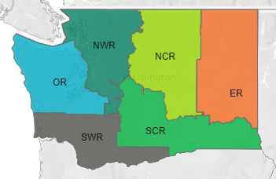
Interactive GNB
GNB is more than interactive, it’s now truly adaptive
Programs are seeing the benefits and using our expertise to help tell performance stories in new ways

Slide 19
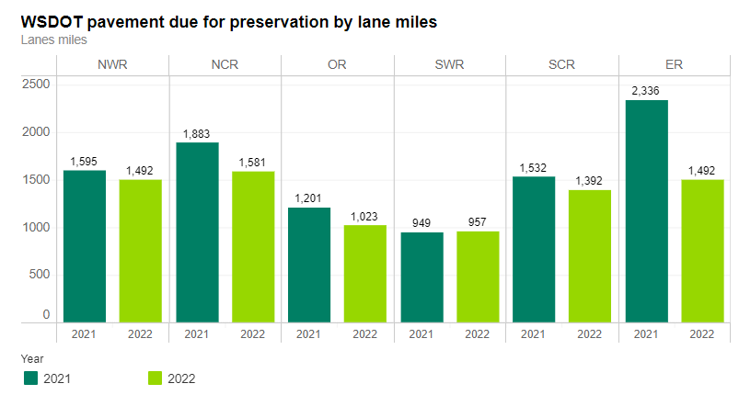
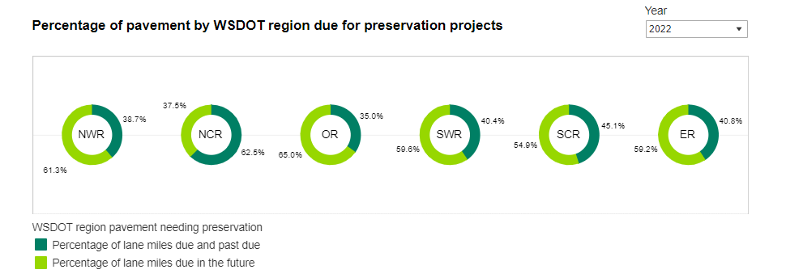
Interactive GNB
New format allows a broader, deeper analysis of pavement performance

Slide 20
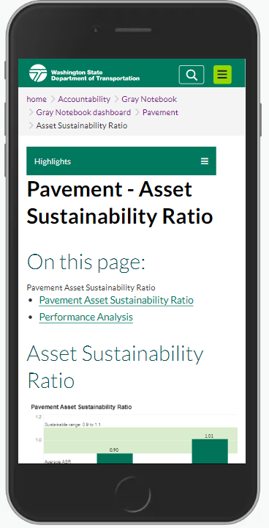
Interactive GNB
Analysis and data are more robust
Easier to navigate subjects
Ability to view all subjects in one place
Five years of data and articles
Data is downloadable in various formats
Much more accessible for all readers
Better readability on smaller screens
Support from programs
More options for improvements

Slide 21
GNB alignment
The GNB’s vetted data is used by programs throughout WSDOT in their own reports and communications ranging from internal and external presentations to media outreach. GNB data and messaging aligns with and informs:
State of Transportation
Strategic Plan
Statewide Transportation Policy Goals
Attainment Report
Results Washington
Summary of Public Transportation
Transportation Performance Management

Slide 22
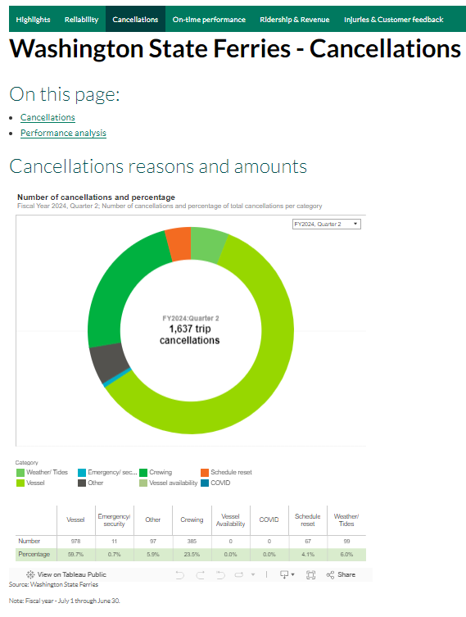
What’s next for GNB?
Integrate risk and strategic aspects
into performance analyses
Make GNB a centralized source for decision making
Integrate Data Governance and Performance Management
Continuous improvement
  Charts, maps and text
  Incorporate Work Zone Awareness
  into Worker Safety
  Consolidate TPM into the GNB

Slide 23
Questions?
Sreenath.Gangula@wsdot.wa.gov
Joe.Irwin@wsdot.wa.gov

