Slide 1
Hoshin Kanri: Establishing Organizational Alignment At All Levels
Ryan Zeng
May 20, 2025

Slide 2
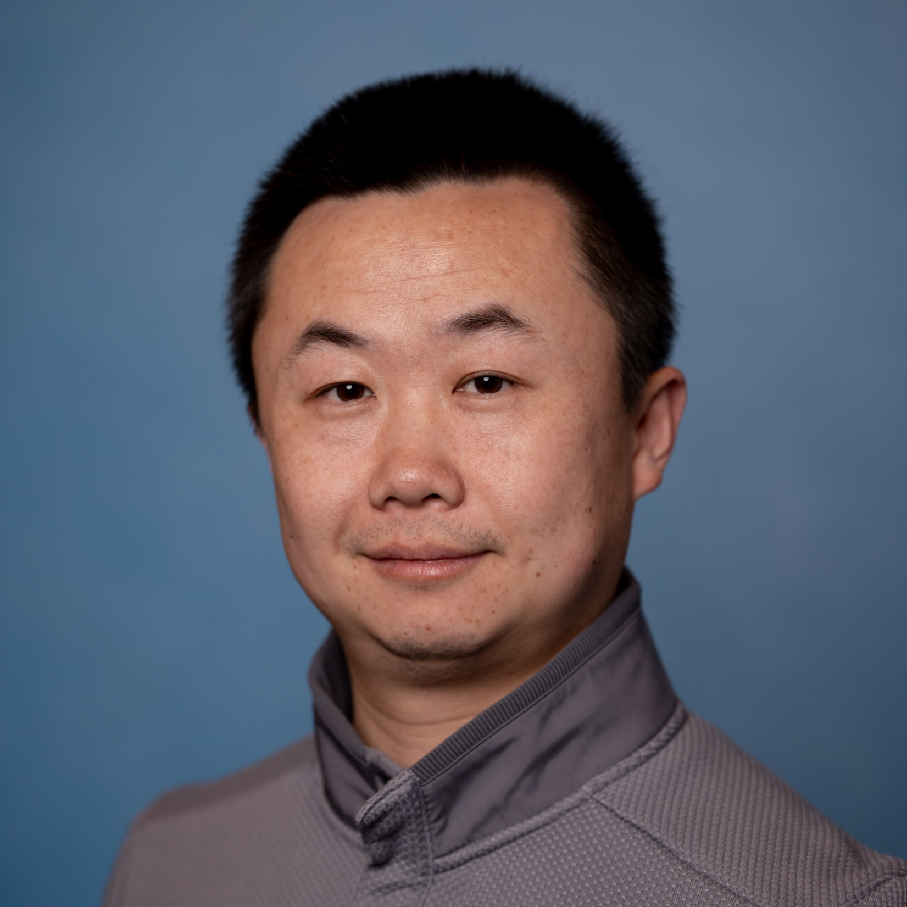
Experience:
Carlisle Interconnect Technologies, Global Director of Project Management and Continuous Improvement
AME, West Region President, Board Member, AME Excellence Award Assessor, Seattle Lean Consortium Leader
PMI, Puget Sound Chapter, VP of Membership & Community
ASQ, Seattle Chapter, Chair
Certification:
ASQ Certified Six Sigma Black Belt (CSSBB)
SME/AME/Shingo Lean Certification (LBC, LSC)
PMI Certified Project Management Professional (PMP, PgMP)
Prosci Certified Change Management Practitioner
Education:
MBA, Indiana University – Kelley School of Business, Bloomington, Indiana
MS in Strategic Management, Indiana University – Kelley School of Business, Bloomington, Indiana
RYAN Zeng
Stream Kaizen
Co-Founder, Consultant, Coach, Mentor
AME West Region
President, Board Member
AME Seattle Consortium
Executive Director
Ryan@AMESeattle.Org
Ryan@StreamKaizen.com

Slide 3
Learning Objective
Understand the organization’s vision, mission and value, and align the 3-5 year Strategic Breakthrough Objectives
Strengthen the organization’s ability to execute by selecting only the vital few objectives annually
Build lasting management buy-in and teamwork
Develop a process to measure monthly progress
No one should leave in silent disagreement

Slide 4

“Having no problems is the biggest problem of all.”
– Taiichi Ohno

Slide 5
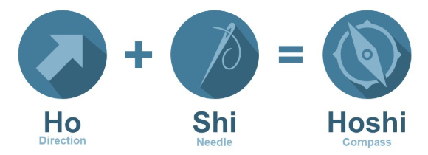
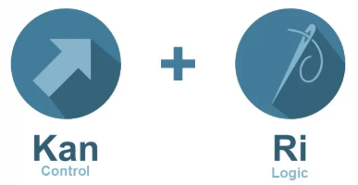
Hoshin Kanri
What does it mean?
Aka, Strategy Deployment, Strategy Alignment, Policy Deployment

Slide 6
Hoshin Kanri
What does it mean?
Hoshin Kanri
Strategy Alignment
Aka, Strategy Deployment, Strategy Alignment, Policy Deployment

Slide 7
What is Strategy Alignment?
Strategy Alignment is a systemic approach for:
  Ensuring that an organization’s strategic goals drive progress and action at every level within that company
Strategy Alignment strives to get every employees pulling in the same direction at the same time.
  It achieves this by aligning the goals of the organization (Strategy) with the plans of middle management (Tactics) and the work performed by all employees (Operations).
Aka, Strategy Deployment, Policy Deployment, Hoshin Kanri

Slide 8
The Why on Strategy Alignment (Hoshin Kanri)

Slide 9
Why Companies Fall Short
From: Strategic Performance Measurement & Management Business Intelligence / Renaissance Worldwide, 1997
Policy Deployment
Will Drastically Improve Execution
Clear Strategic Plans
Some Execution Success
Significant Execution Success
Vision
95% of the typical workforce doesn’t understand what their company's strategy is
Notes:
Over the past thirty years or so, they boil down to the following list of 20 key problems in strategy execution:
Unclear communication
No or insufficient communication
Lack of commitment
Insufficient or inadequate resources
Isolated and fragmented actions
Ambiguous or conflicting goals
No or unclear strategy
No clear priorities
Ambiguous responsibilities
Lack of performance information
Silo behavior and sub-optimization
Wrong or ineffective culture
Resistance to change
Over-complexity
Insufficient management capabilities
Delay, plans are not met
Budget is exceeded
Lack of middle management support
Strategy is not adapted to changes
Poor leadership
https://www.forbes.com/sites/jeroenkraaijenbrink/2019/09/10/20-reasons-why-strategy-execution-fails/?sh=2995ff201ebe

Slide 10
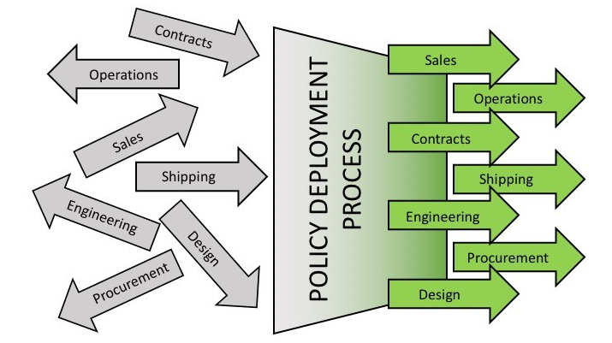
Strategy Alignment.
Focus, Alignment, and Quick Response!

Slide 11
The How on Strategy Alignment (Hoshin Kanri)

Slide 12
Strategy Alignment Process
1. Define True North
2. Develop business fundamentals
Catch Ball
3. Develop department/functional priorities
4. Deploy the plan
Lean
PDCA
5. Monitor the plan (Monthly, Annually)
6. Solve problems
Reflection
7. Improve the system
PDCA: an expression of the scientific method and the foundation of strategy deployment

Slide 13

Define True North
“True North” is an organization’s strategic and philosophical vision or purpose.
If we don’t know where we’re going, we’ll never get there.

Slide 14
True North Cont.
True North is a contract or a bond that may include “hard” business goals such as revenue and profits as well as “broad brush” visionary objectives that appeal to the heart.
  It expresses business needs that must be achieved and exerts a magnetic pull.
  Everything had to flow or branch and be connected to everything else – as well as aligned with True North.

Slide 15
This is our True North!!!
What is our purpose?
Build an engaged project community
Advance project management professions
Community – Professional Development – Career Development
Broad-brush goal
Targets:
Membership Growth: 3200 members
Membership Engagement: 50%
Member Events: 10 events/year
Professional Development: 90% Certification Pass Rate
Hard Business Goals
(end-of-pipe metrics)
No one should leave in silent disagreement

Slide 16
Develop Business Fundamentals
This is the 2nd level of branching (Planning & Execution Tree)
Must be connected/aligned with True North
Business priorities, aka business fundamentals, mother strategy, 2nd level of tree

Slide 17
Business Fundamentals Example
Community – PD – Career Dev
Targets:
Member Growth: 3200 members
Membership Engagement: 50%
Member Events: 10 events/year
PD: 90% certification pass rate
Mother strategies
Member Growth
Member Engagement
Member Events
Professional Dev
“True North” expresses business needs that must be achieved and exerts a magnetic pull.

Slide 18
Business Fundamentals Example Cont.
Community – PD – Career Dev
Targets:
Member Growth: 3200 members
Membership Engagement: 50%
Member Events: 10 events/year
PD: 90% certification pass rate
Mother strategies & corresponding process metrics
Member Growth
Current metrics:
Member net increase
New member
Member renewal
Member non-renewal
Member Engagement
Current metrics:
Volunteer engagement
Event attendance
Member Events
Current metrics:
Networking
Career
PD Events
Professional Dev
Current metrics:
Programs
Certification
“True North” expresses business needs that must be achieved and exerts a magnetic pull.

Slide 19
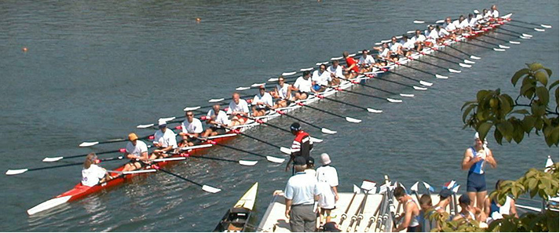
Deployment Leaders
In a rowing team: the coxswain ensures that each member is pulling at the right pace and intensity. Individual efficiency does not equal overall efficiency.
“True North” expresses business needs that must be achieved and exerts a magnetic pull.
Notes:
In a rowing team: the coxswain ensures that each member is pulling at the right pace and intensity. Individual efficiency does not equal overall efficiency.

Slide 20
Deployment Leaders Cont.
Community – PD – Career Dev
Targets:
Member Growth: 3200 members
Membership Engagement: 50%
Member Events: 10 events/year
PD: 90% certification pass rate
Mother strategies
Member Growth
Member Engagement
Member Events
Professional Dev
Assign deployment leader for each mother strategy
“True North” expresses business needs that must be achieved and exerts a magnetic pull.

Slide 21
The What on Strategy Alignment (Hoshin Kanri)

Slide 22



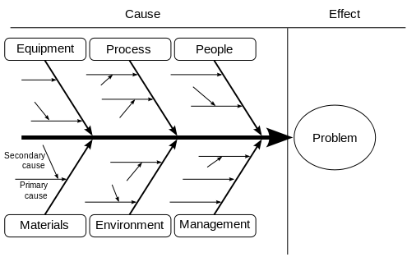
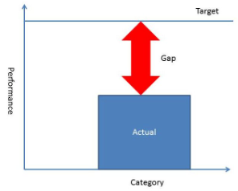
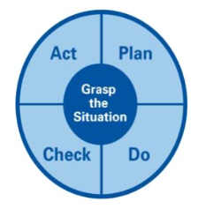


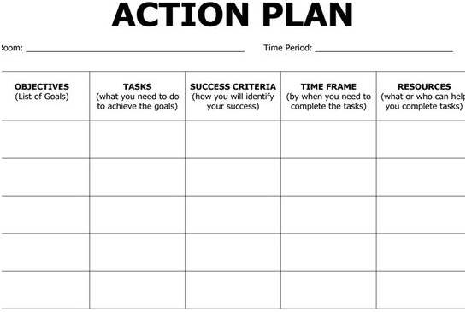
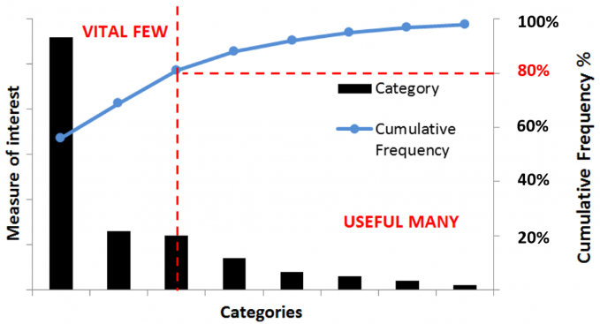
Strategy Alignment Mental Model
“True North” expresses business needs that must be achieved and exerts a magnetic pull.
Notes:
What is the gap? (What are we trying to improve?)
What’s preventing us from meeting our target? (A fishbone diagram shows causes contributing to the gap.)
What are the causes in order of importance? (Pareto chart ranks the causes)
What actions will address the most important causes? (The A3 sets up the course of action.)

Slide 23
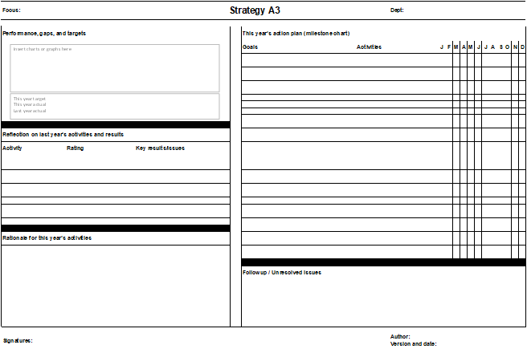
Step 1: Define the gaps
Step 4: Develop an action plan
Step 2: Reflect what happened
Step 3: Prioritize possible causes
Step 5: Document unsolved issues

Slide 24
A3s – Define the Gaps
What is the gap? (What are we trying to improve?)

Slide 25
A3s – Reflect What Happened
What’s preventing us from meeting our target?

Slide 26
A3s – Prioritize Possible Causes
What are the causes in order of importance?

Slide 27
A3s – Develop an Action Plan
What actions will address the most important causes?

Slide 28
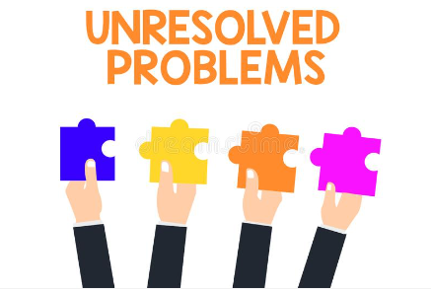
A3s – Document Unsolved Issues
Any unresolved issues, question marks, or support needed?

Slide 29
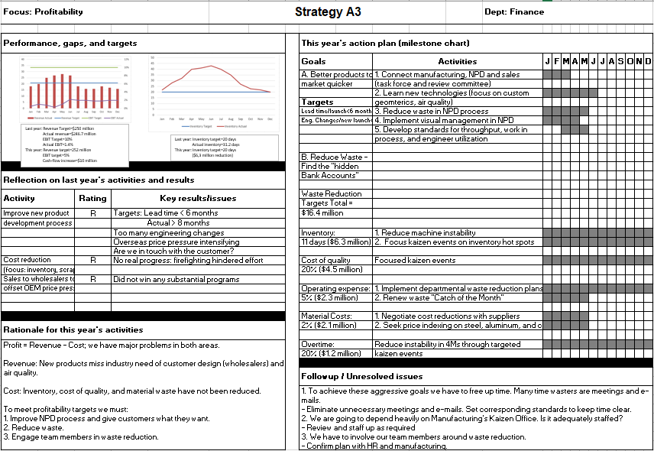
Telling Stories with A3s

Slide 30
Develop Departmental/Functional Priority
Manufacturing
Sales & Marketing
Engineering
Cascade to the next level down
Require cross functional collaboration
Reiterate the process to the lowest level possible
Department priorities, aka baby strategy, 3rd level of tree

Slide 31

Catchball
“True North” expresses business needs that must be achieved and exerts a magnetic pull.

Slide 32
Catchball Cont.
To translate the vision of senior management into concrete activities throughout the enterprise.
Catchball entails frank, reality-based discussions between and within management levels.
The leader normally defines the required results; the team members the means.
Catchball is a scrubbing process that helps management and employees understand what’s real.

Slide 33
Deploy the Plan
Manufacturing
Sales & Marketing
Engineering
Broad objectives have become narrow, while process-focused objectives are deeper down the tree.
Department priorities, aka baby strategy, 3rd level of tree

Slide 34
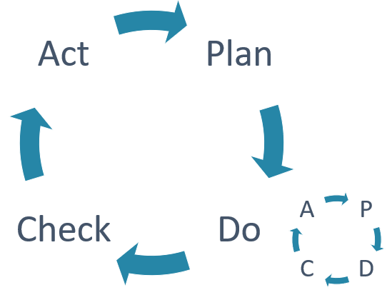
The Hard Work of “DO” Begins
Between the deploying and checking falls the doing – the hardest and most important work.
Do is our experiment and an iterative process.

Slide 35
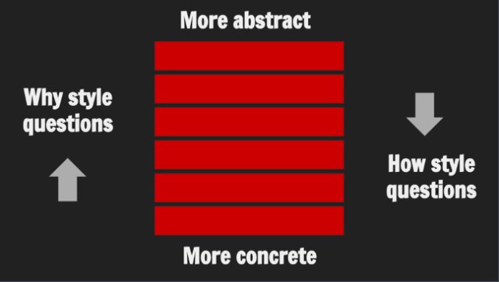
Deployment and the Ladder of Abstraction

Slide 36

Deployment and the Ladder of Abstraction Cont.
Long-term vision
CEO/COO
Three-to-five year strategy
Senior management team
Annual strategy
Department managers
Departmental plan
Group leaders
Kaizen events
Team leaders
Daily problem-solving
Team members

Slide 37
Monitor the Plan
Manufacturing
Sales & Marketing
Engineering
Checking is the ugly duckling of management.
Checking means comparing what should have happened with what actually happened.
Checking the quality of another’s work is a sign of respect.
No checking, no scientific method.

Slide 38
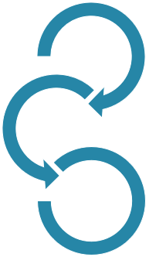
Connected Checking
Corporate
Check/adjust meeting
Thursday
Departmental
Check/adjust meeting
Tuesday
Team
Check/adjust meeting
Monday

Slide 39
The Great Detective cont.
Results
Meet plan/ standard?
Yes
Standardize
Look for improvements
No
Adjust hypothesis
Solve problems
Adjust challenges us, as a mystery challenges a great detective.
Adjust also means standardize if everything goes according to the plan, but that’s rare.
No checking, no scientific method.

Slide 40
Improve the System
Review progress; document lessons learned; start all over again!
To Change Culture change behavior!

Slide 41
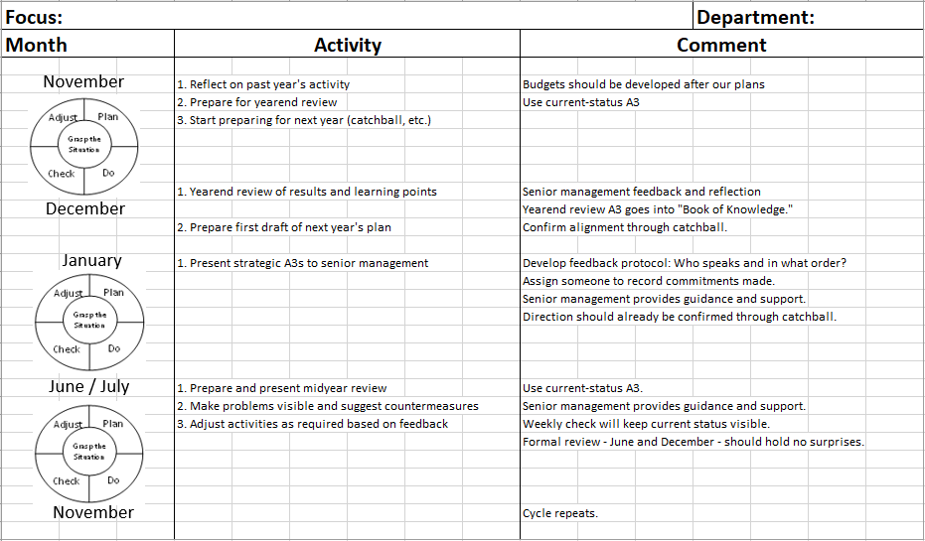
Annual PDCA Cycle

Slide 42

Strategy Alignment/Lean Production System
Nervous System:
Aligns activity.
Connects everything.
Responds quickly.
Brain:
Tells interesting stories
Applies scientific method (PDCA).
Reflects and learns
PDCA: an expression of the scientific method and the foundation of strategy deployment

Slide 43
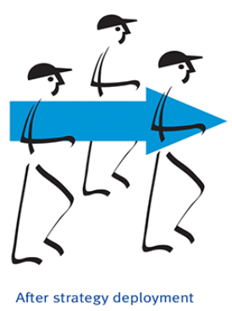
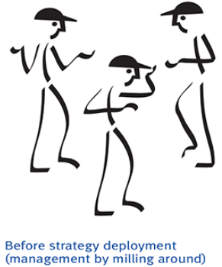
Focus, Alignment, Quick Response
We don’t want robots, moving in lock step. We want human beings, in all their creative cranky and eccentric glory, moving in the same direction, pulled by a shared vision.

Slide 44

THANKS
“Improvement usually means doing something that we have never done before”.
– Shigeo Shingo

Slide 45
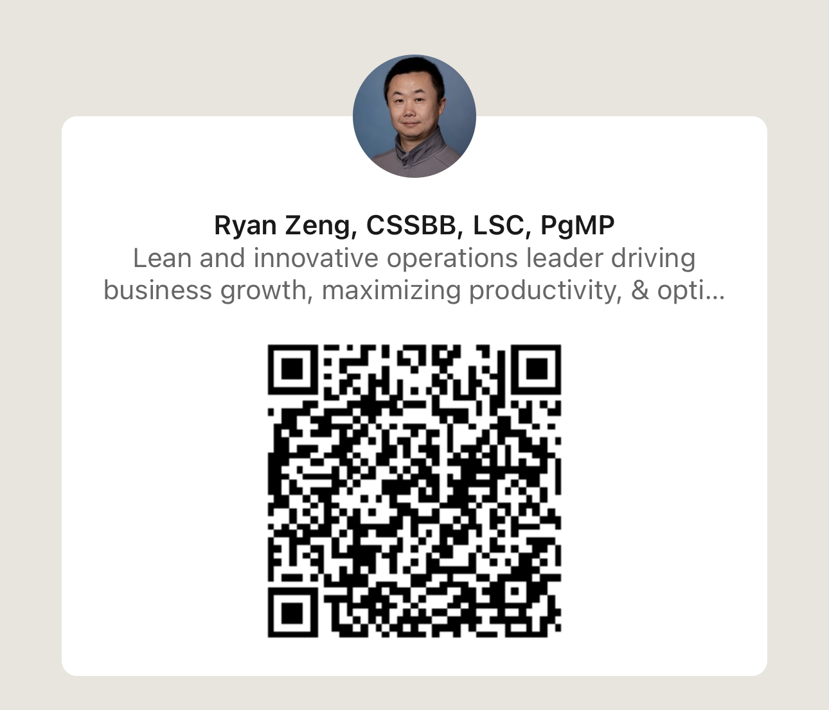

AME Seattle Lean Consortium
(scan me for more training)

