Slide 1
Disability Inclusion Network
A Washington State Business Resource Group

Slide 2
DIN – who are we?
DIN official launched in August of 2019 ​
DIN is supported by the governor’s Executive Order 13-02 which includes several directives including a Disability Employment Challenge that establishes a goal of five percent of Washington state government’s workforce being comprised of persons living with a disability. ​
DIN strategizes and guide state agencies on how to achieve employment goals in areas of recruiting, hiring, retention, and promotion of people with disabilities, while providing education and advocacy support ​
DIN provides consultation on accessibility, policies, public outreach as well has writing best practice for inclusion

Slide 3
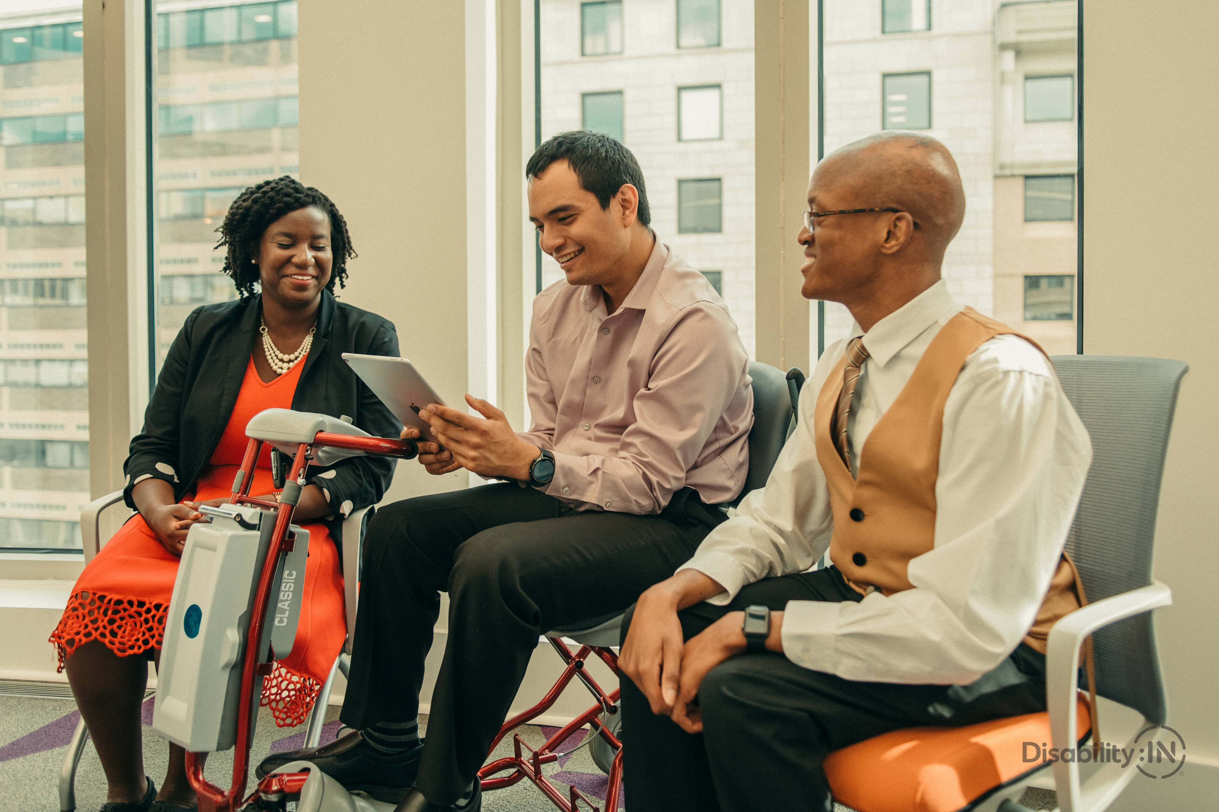
(DIN) Mission and Goals
We want Washington to be the employer of choice for people with disabilities. ​
We want to create an environment where people with disabilities can fully participate in all aspects of the workplace and have equitable access to opportunities and resources through recruitment, hiring, training, development, retention, and promotion. ​
Part of our goals for this year is to continue to provide support to state agencies when it comes to accessibility and provide education about the history of disabilities and what a disability is. ​

Slide 4
Values
Commitment to diversity and inclusion
Expanding resources and education about working with a disability
Commitment to employing people according to their skills and vision
Development of leadership opportunities for employees with a disability
Improving and influencing Washington state agency culture through increased awareness and open dialogue
Support and advocacy for Washington state service employees, allies, and caregivers

Slide 5
DIN Provides Opportunities
Networking ​
Professional Development​
Leadership Development ​
Provide Educational Resources ​
Diversity Awareness ​
Learn best practices ​
Advise on disability related policies and workgroups

Slide 6
Subcommittees
Resources, Education, & Policy
Partner with employees, leadership, agencies, and legislators to support people with disabilities in obtaining and maintaining employment within the state.
Consults with hiring managers on recruitment, training, and retaining employees with disabilities.
Create, source, and refine media and training materials that provide disability education and advocacy resources.
Provide resources including videos, trainings, and educational materials.
Consult with employees, leadership, agencies, and legislators on disability and inclusion policy, procedures, and training.
Disability Justice
Identify the gaps and barriers for persons with disabilities, including those in additional marginalized communities.
Increase awareness of the intersectionality of identity(s) for peoples with disabilities.
Provide trainings and educational materials on issues related to disability justice
Communications & Marketing
Provide an engaging and interactive website that is user friendly that provides valuable statewide information and resources and provide information about DIN and DIN activities.
Ensure that all forms of communication and marketing are accessible and promote universal access throughout the enterprise.
Provide technical assistance to other BRGs when needed.

Slide 7
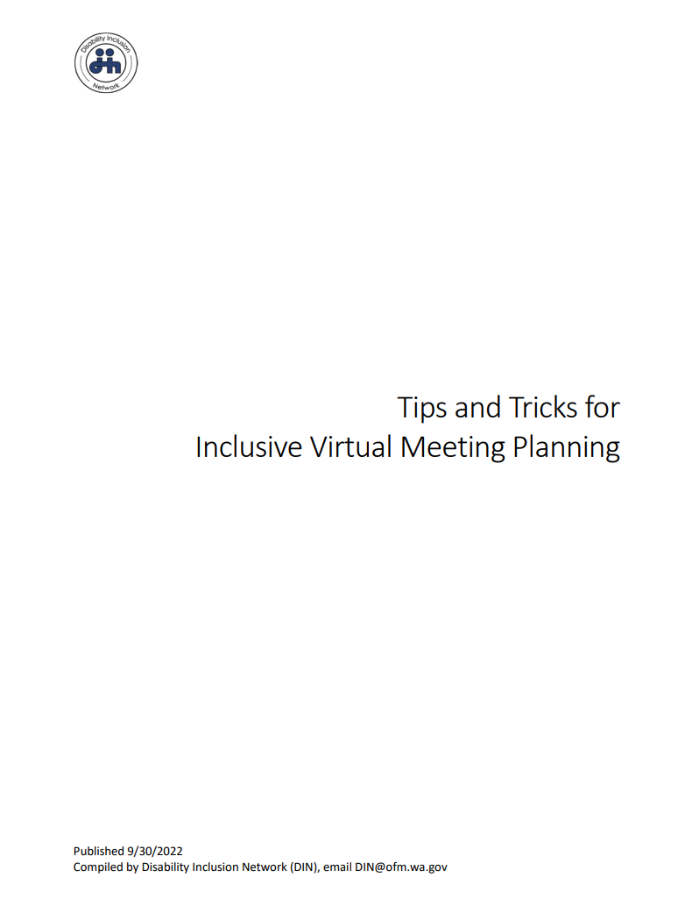
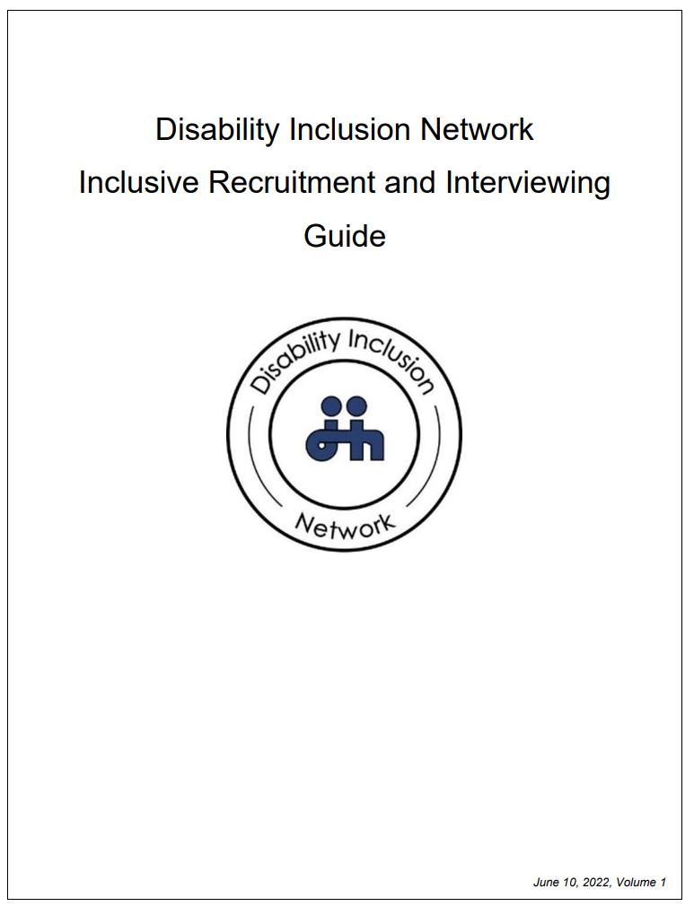
Guides and Materials
Notes:
DIN currently has 4 guides: Inclusion in virtual meetings, Inclusive Recruitment and Interviewing Guide, and Disability Inclusion in the Workplace.​
We have a fifth guide in final review process Reasonable Accommodations for Employees and Reasonable Accommodations for Employers

Slide 8
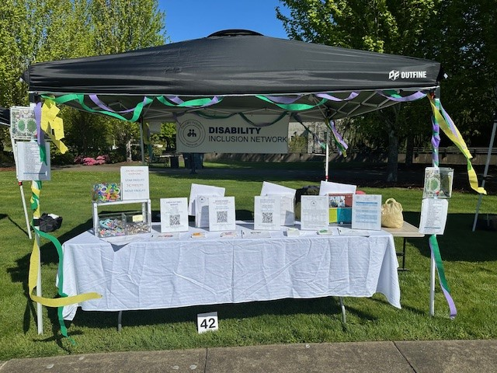
DIN Informational Booths
Public Service Recognition Week
Office of Equity Summit
OIG Employee Information Event
L&I Hiring Fair
Deaf Nation Annual Conference
We can come to your event! (we have fidget toys and candy!)

Slide 9
Presentations
Disability Justice
Accommodations
Veterans with Disabilities
National Human Rights Day
National Disability Employment Awareness Month
Black History Month
Women’s History Month
Native American Heritage Month
LGBTQIA+ Pride Month
Juneteenth
Disability Pride Month
Notes:
These are just a some of the many presentations we have done at DIN meetings and at other state agencies.

Slide 10
Guest Speakers and Special Events
Resistance and Wellness
Paid Family Medical Leave, Employment Security Department
Holocaust Remembrance Day
Creating Accessible Documents
ADA and Reasonable Accommodations
Medicare for yourself and family members
Legislation affecting people with disabilities in WA state
Notes:
We strive to have quest speakers and presentations both at DIN meetings and at other times throughout the year.
These are just some of the topics we have had people speak on.

Slide 11
Meetings
General Membership:
Odd months (Jan, Mar, May, Jul, Sept, Nov)
9am-11am via Zoom
Open to all WA state agency employees
ASL and CART provided by DIN
Subcommittee Meetings:
Even months (Feb, Apr, June, Aug, Oct, Dec)
9am-11am via Zoom
Open to all WA state agency employees
ASL and CART provided by DIN
ASL First! - Employee meeting sponsored by DIN
Bi - Monthly via Zoom, ASL and CART Provided, ASL if primary language, Interpreters/CART provided
A safe space for State Employees to network, share resources, and support each other
Education, outreach and advocacy related to challenges

Slide 12
Contact us:
DIN Email: DIN@ofm.wa.gov
Website: DINBRG.ORG
Co-Chairs: Linda Lohdefinck Linda.Lohdefinck@doh.wa.gov & Sarah Norton Sarah.Norton@dol.wa.gov (Past Chair)
Vice Chair: Jess Clayton jess.clayton@dshs.wa.gov
Secretary: Kim Harmon kimberly.harmon@des.wa.gov
Executive Sponsor: Michael MacKillop michael.mackillop@dsb.wa.gov

