Slide 1
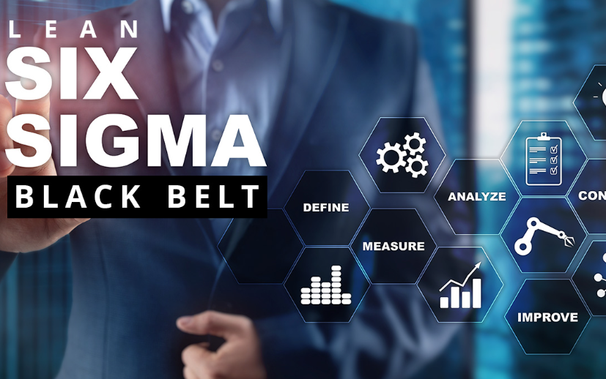
The Blast Newsletter
The blast
ENTERPRISE-WIDE LEAN AND CONTINUOUS IMPROVEMENT COMMUNITY OF PRACTICE
ISSUE NO. 20 | JULY 2024
Transparency - Innovation - Results
WHAT YOU MISSED At our July CoP meeting, we were joined by Missy Sterling with the Washington State Health Care Authority, who facilitated an interactive discussion on Leading without Authority. We also heard from John Cooper with Results Washington who gave an overview on Results Washington’s Lean journey. See page 2 for more! LOOKING AHEAD Mark your calendars and check out what we have in store for you at our July CoP meeting on page 2. Questions? For questions on The Blast, the CoP, or to present a teaching or project share, contact:
Talia Mazzara, Results WA Senior Performance Advisor
Theresa Dew, Results WA Senior Performance Advisor
This Fall: Lean Six Sigma Black Belt Course with Wendy Frasier
Do you already have your Green Belt certification and are now seeking a Black Belt course?
Exciting news! One of our esteemed community members has shared information about a Black Belt course starting this Fall at South Puget Sound Community College.
This instructor-led course will consist of 90 hours of classroom instruction and 30 hours of hands-on field experience in applying Lean Six Sigma methodologies.
With spots limited to just 12 participants a class, if you are interested in applying or finding out more information, you may contact info@center4ci.com.

Slide 2
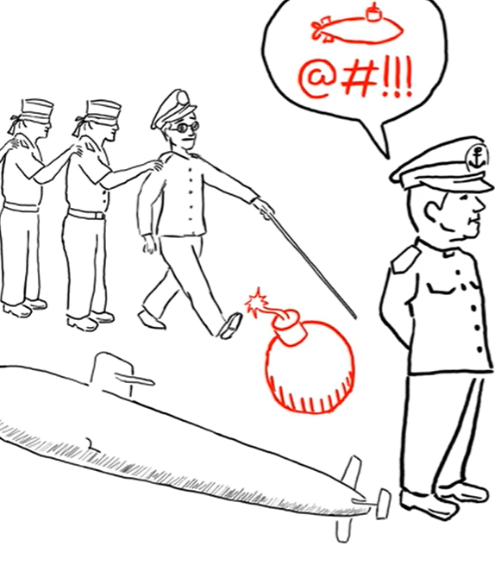
The Blast Newsletter – Page 2
Leading without Authority We had an excellent meeting where Missy Sterling from the Health Care Authority facilitated a dynamic and interactive session on leading without authority. Throughout the discussion, three of the twelve methods to influence were explored. These included the concepts of embracing change rather than resisting it, the significance of synthesizing your ideas for maximum effectiveness and results, and the power of demonstrating enthusiasm for your work.
To get a glimpse of this engaging conversation, be sure to check out the presentation, which includes the audience’s responses, or listen to the recording here!
Click the image to watch “Greatness” by David Marquet
“THE KEY TO SUCCESSFUL LEADERSHIP TODAY IS INFLUENCE, NOT AUTHORITY.”
~ Kenneth Blanchard
Click the play button below to learn more about Results Washington’s Lean journey!
COMING UP NEXT
August 20, 2024
10:30 a.m. – 12:00 p.m.
Zoom Meeting
Topic:
Compassion and Accountability
Presenters: Lenora Sneva & Amber Coleman | OFM
Results Washington Lean Journey Past, Present & Future
John Cooper with Results Washington shared an in-depth overview of the agency’s progress in adopting Lean practices, emphasizing the support and direction received from the last two governors.
He reiterated the agency’s strong commitment to fostering a lean culture across the enterprise, highlighting the ongoing initiatives in continuous improvement and performance management, along with efforts to provide a public platform for agencies to share their successes with the governor.
He also shared the agency’s vision for its future goals related to consultative services for small cabinet agencies and statewide performance management.
For more info on Results WA, visit Results Washington.

