Slide 1
We are experiencing technical difficulties
We will return at xx:xx AM

Slide 2
Just a moment,
Thank you for your patience!

Slide 3
Welcome! We will begin the meeting momentarily.

Slide 4
PUBLIC PERFORMANCE REVIEW
Healthcare Provider Credentialing
June 26, 2024

Slide 5
Welcome
Presented by:
Lisa van der Lugt, Executive Strategic Performance Advisor, Results Washington

Slide 6
Building Logistics
Emergency exits are located through the nearest exit; follow illuminated signs
Restrooms are located down the hall near the south and north exits
Please take side conversations outside the room
Attendees will find a QR code and a physical survey located on conference room tables
Our meeting is being live-streamed by TVW
Meeting materials are located at www.results.wa.gov

Slide 7
Topic Selection
Healthcare provider credentialing is tied to the Governor’s goal 4: Healthy and Safe Communities, and goal 5: efficient, effective, and accountable government
Recommended by leaders across the state to examine the status of the healthcare workforce and review improvement initiatives to address licensure needs and barriers for providers
Progress and initiatives presented by:
Department of Health

Slide 8
Governor’s Opening Remarks

Slide 9
Introduction to Healthcare Provider Credentialing
Presented by:
Sasha De Leon, Assistant Secretary, Health Systems Quality Assurance (HSQA) Division, Washington State Department of Health

Slide 10
A Brief Introduction to Health Provider Credentialing
Regulated process of assessing qualifications of specific types of providers
Important safety check which requires providers to show they have the proper education, training, and qualifications to care for patients
The goal of credentialing is to ensure that healthcare providers are competent and qualified to provide safe and effective care to patients

Slide 11
Credentialing by the Numbers
Credentialed Professionals
Credential Types/Class
Credentialing Staff
Applications per Day
General numbers:
365,000+
81/120
100+
Up to 400
Applications Submitted
Credentials Issued
Phone Calls
Emails
Per Year:
73,000+
59,000+
200,000+
80,000+

Slide 12
Applications Received and Credentials Issued (2013-2023)

Slide 13
Cumulative Growth in Professionals/Professions (2008-2023)
49 professions regulated (2008)
81 professions regulated (2024)

Slide 14
Credentialing Complexities
Submit application
Pay fee
Background check
Registrations:
Submit application
Pay fee
Background check
Education verification
Determine exception
Certifications:
Submit application
Pay fee
Background check
Education verification
Determine exception
Course review
License-specific exam
Licenses:

Slide 15
Avg. Days to Issue Initial Registrations (2013-2023)

Slide 16
Avg. Days to Issue Initial Certifications (2013-2023)

Slide 17
Avg. Days to Issue Initial Licenses (2013-2023)

Slide 18
Governor Q&A

Slide 19
Progress and Initiatives: Behavioral Health Professions
Presented by (in order of presentation):
Shawna Fox, Director of the Office of Health Professions, HSQA, Washington State Department of Health
London Breedlove, Psy.D., Director of Professional Affairs, Washington State Psychological Association
Joseph Barron, Ph.D., Psychologist, HealthPoint

Slide 20
Focus on Behavioral Health
Critical need for behavioral health professionals in Washington
Newly established behavioral health professions
Behavioral Health Support Specialists
Certified Peer Support Specialists and Advisors
Agency Affiliated Counselors, Licensed
Psychology Associates
Long wait times for credentialing
Unnecessarily complex processes
Extreme backlogs in some professions

Slide 21
Psychology Credentialing Challenges
The most complex behavioral health profession
Could require multiple DOH offices and the Examining Board of Psychology (EBOP) working simultaneously to license one applicant
EBOP has independent authority, DOH produces credentials on behalf of the board
Project Pathway – kickoff March 9th, 2023
Single leader and designated resources
Focus on culture, communication, and data
Approach:
Assign resources and tools to solve immediate issues
Create a Playbook for replication across other professions

Slide 22
Most Complex Psychology Applications Non-Routine Progress during Project Pathway

Slide 23
Project Pathway Psychology Licenses Issued
Application Date | Numbers of Licenses Issued by Project Pathway |  | Average Number of Days Between Application Date and License Issuance
 | Licenses | Temporary Permits | Licenses | Temporary Permits
12/29/2011 – 12/9/2022 | 131 | 3 | 647 | 188
12/9/2022 – 3/9/2023 | 43 | 25 | 173 | 63
3/10/2023 – 5/13/2024 | 156 | 162 | 102 | 35
Total Licenses Issued | 330 | 190

Slide 24
Cultural and Interpersonal Framework
How do we change and continuously improve?
How do we see our work?
Understand and reform systems, culture, and language
Take ownership of the entire application process from receipt of application to issuance of license
Focus on successes and innovations
Listen to customer feedback
Acknowledge long wait times and backlog of applications
Data-driven management
Measuring the right things
Language matters
deficient → incomplete
backlog → pending
Listen to staff
Maximize relationships
Evaluate challenges and implement improvements

Slide 25
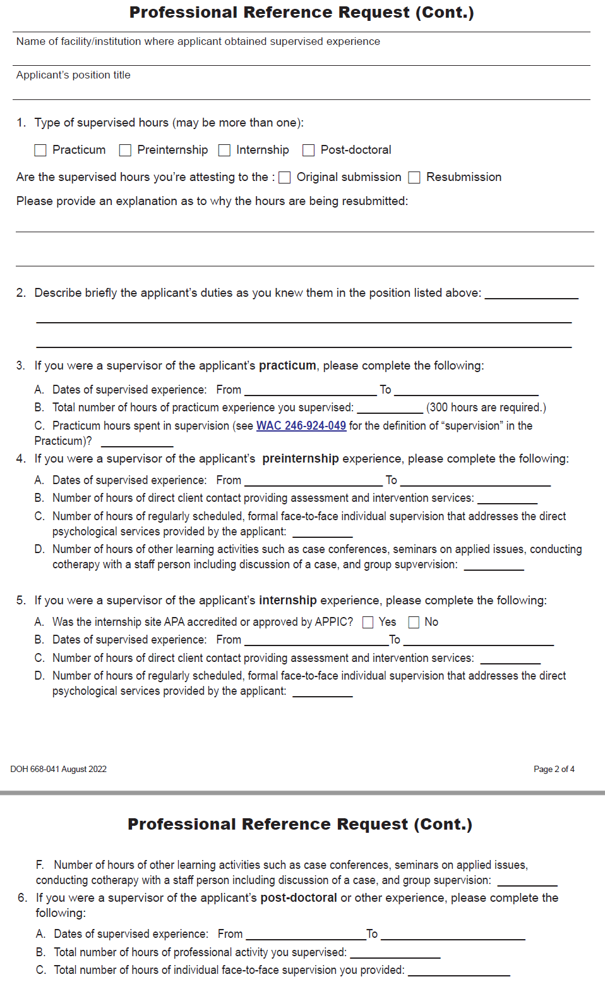
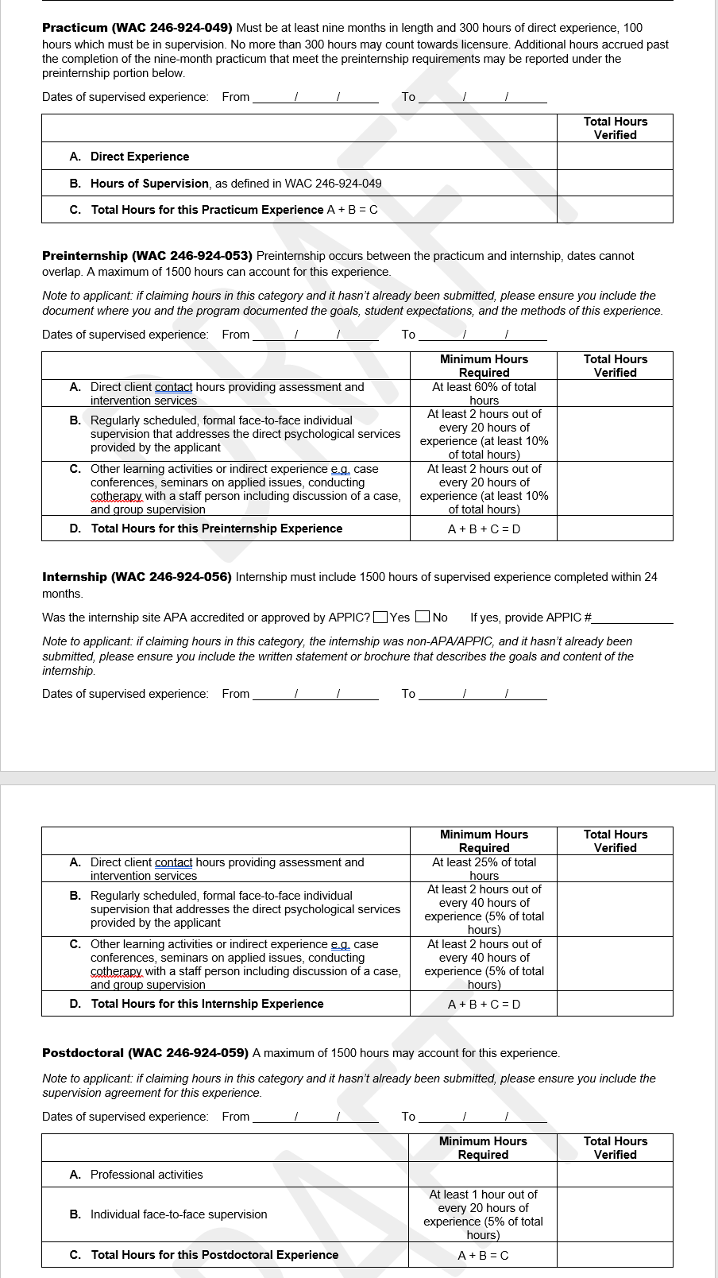
Professional Reference Request Form
Before
After

Slide 26
Early Accomplishments in Behavioral Health Pilot Expanded in March 2024 to Integrate all Behavioral Health
Total pending intake applications decreased by 46% between March and May 2024
Total pending emails decreased by 26.6% between March and May 2024
Morale and productivity continues to be high
Strengths, Weaknesses, Opportunities and Threats (SWOT) analysis completed
Staff share ideas and present possible solutions
Quick wins and innovative ideas
Daily huddles to improve communication
Phone pilot to improve efficiency

Slide 27
Expanding the Pilot to Include All Health Professions Next Steps
Constituent Engagement
Development of staffing model
Investing in leadership and staff
Predicting rather than reacting to workload variations
Creation of nimble, program-specific teams
Engaging with Interested parties
Finding out what customers need and want.
Responding quickly and honestly to concerns
Communicating clearly to re-establish credibility
Update written materials: applications, FAQ's and websites
Regular scorecard updates
Target setting
Staff-led improvement projects
Technology Improvements
Live Chat pilot
HELMS transition
Staffing and Resource Allocation
Data Driven Management

Slide 28
Voices of Project Pathway Customers
"I wanted to send a quick message to say THANK YOU for all of your hard work, follow-up calls and emails, and kind responses to my anxious questions. I can only imagine the amount of pressure you are under in your job with hundreds of people just like me eager for licensure. I am grateful for the role you played in this chapter of my career and I hope you know how much you are appreciated!"
"I wanted to send you an email to thank you for your guidance and support during the licensure process. I'm happy to share that I'm now fully licensed. I couldn't have done it without your suggestion to hang tight while a possible legislative change comes through. Your generosity of time and knowledge made a world of a difference for me. I'll be sure to pay it forward in the work that I do. Thank you again for you being you."

Slide 29
Customer Voice
London Breedlove, Psy.D.
Director of Professional Affairs
Washington State Psychological Association

Slide 30
Customer Voice
Joseph Barron, Ph.D.
Psychologist
HealthPoint

Slide 31
Governor Q&A

Slide 32
Progress and Initiatives: Credentialing Legislation and Improvements
Presented by (in order of presentation):
Sasha De Leon, Assistant Secretary, HSQA, Washington State Department of Health

Slide 33
Improvement Projects being Considered for All Credentials
Add resources and tools for credentialing staff and use existing staff more effectively
Improve the quality and availability of information for applicants
Streamline processes
Add resources and tools for program staff and use existing staff more effectively

Slide 34
Credentialing-Related Legislation
Increasing the trained behavioral health workforce
Second Substitute House Bill 1724 (2023)
Increased credential portability of all credentials through substantial equivalency
Instructed DOH to work with the public, associations, Boards and Commissions, and other interested parties to recommend changes to statute and rule that would lower barriers and improve equity in licensing
1st round of recs. to legislature – Dec. 2023
2nd round in progress – due Fall 2024
Addressing behavioral health provider shortages
Engrossed Second Substitute House Bill 2247 (2024)
Implemented all DOH recommendations from 2023 report. Includes:
Creates associate credential for psychologists completing their supervised training hours
Eliminates renewal limits for associate and trainee licenses
Allows agency affiliated counselors to practice in federally-qualified health centers
Removes practice site limitation on Substance use disorder professionals

Slide 35
Credentialing-Related Legislation
Collecting health care professionals' information at the time of license application and license renewal
Engrossed Substitute House Bill 1503 (2023)
Requires the department to collect demographic data from health care providers upon license application or renewal, including:
Race
Ethnicity
Gender
Demographic data collection will begin Jan. 1, 2025
Languages spoken
Specialty
Primary and secondary practice location

Slide 36
Healthcare Enforcement and Licensing Management System (HELMS)
Replaces the existing, outdated customer application portal
Rolling out in 3 releases:
R1 – April 24th, 2024
R2 – end of 2024
R3 – end of 2025
With R1, applicants now can:
Submit applications from their phone or mobile device
Update their profile (Locate and edit applications)
Significantly reduce paper applications, reduce call volumes, and streamline processes
Delete draft applications
Attach required documentation
Print payment confirmation and receipt

Slide 37
Thank You
All who supported – and continue to support – this improvement effort:
Legislators
Results Washington
Governor and gov’s office
HSQA staff/Project Pathway team
DOH leadership
Boards/Commissions/Advisory Committees

Slide 38
Governor Q&A

Slide 39
Future Commitments and Next Steps
Presented by:
Umair Shah, M.D., MPH, Secretary of Health, Washington State Department of Health

Slide 40
Next Steps
Continue to prioritize credentialing and ensure a strong healthcare workforce.
Strategize for the future potential of this work.
Improvements to processes and staffing, exploring technological advancements.

Slide 41
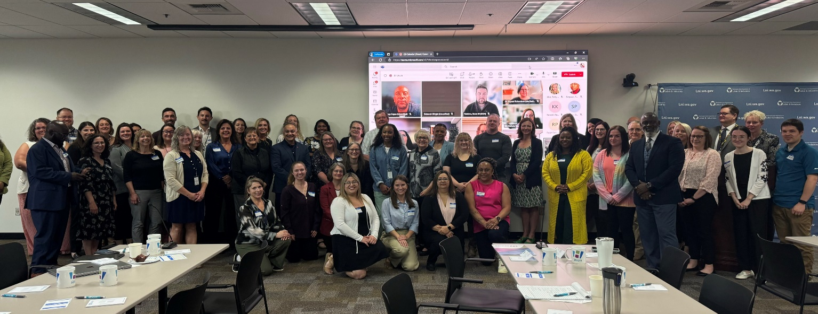
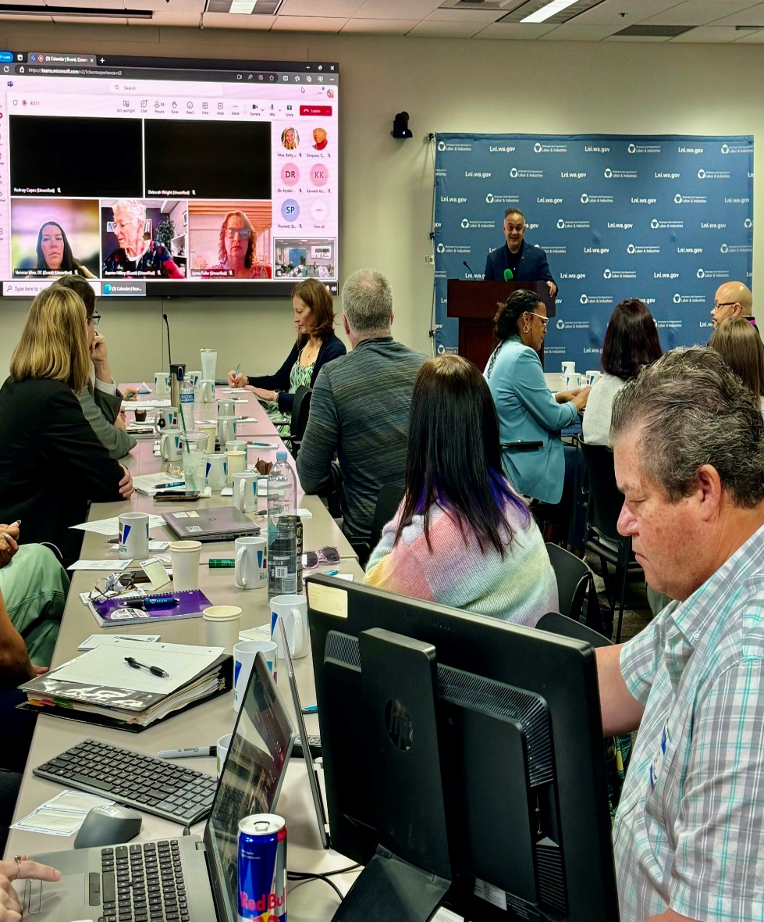
Supportive Partners
Appreciation for all who have supported this work: Gov. Inslee and his staff, the Legislature, sister agencies, partner Boards, Commissions and Advisory Committees.
@WaDeptHealth
@WaHealthSec
@Ushahmd
1

Slide 42
Governor Q&A

Slide 43
Governor’s Closing Remarks

Slide 44
Thank You for Attending Today!
Join us July 24th 10:30 a.m. – 11:45 a.m.
Topic: Poverty Reduction and Working Families Tax Credit
Please Take a Moment to Complete Our Brief Survey using the QR code below:
You can view the recording of today’s meeting at: https://results.wa.gov/measuring-progress/public-performance-reviews
Notes:
Thank you to all who attended this meeting today.
As a reminder, please take the time to complete the survey that will pop up at the end of this meeting.

