Slide 1
Lean Leadership Using the Situational Leadership Model
October 30, 2024
Jared Thatcher

Slide 2
AGENDA
What is Leadership?
Understanding the Situational Leadership Model™
Applying the Model with Lean

Slide 3
What is leadership?

Slide 4
What leadership is not

Slide 5
“Leadership is lifting a person’s vision to high sights, the raising of a person’s performance to a higher standard, the building of a personality beyond its normal limitations.”
—Peter Drucker
Notes:
There are a lot of definitions of Leadership, but I really like this one by Peter Drucker.

Slide 6
You don’t define your leadership
Your Leadership is Based on You:
Experiences
Charisma
Talents
Skills
Competencies
Vision
Your Success is
Based on
Your Followers
Leadership Style is defined not by the leader, rather it is the behavior of the leader as perceived by the followers.

Slide 7
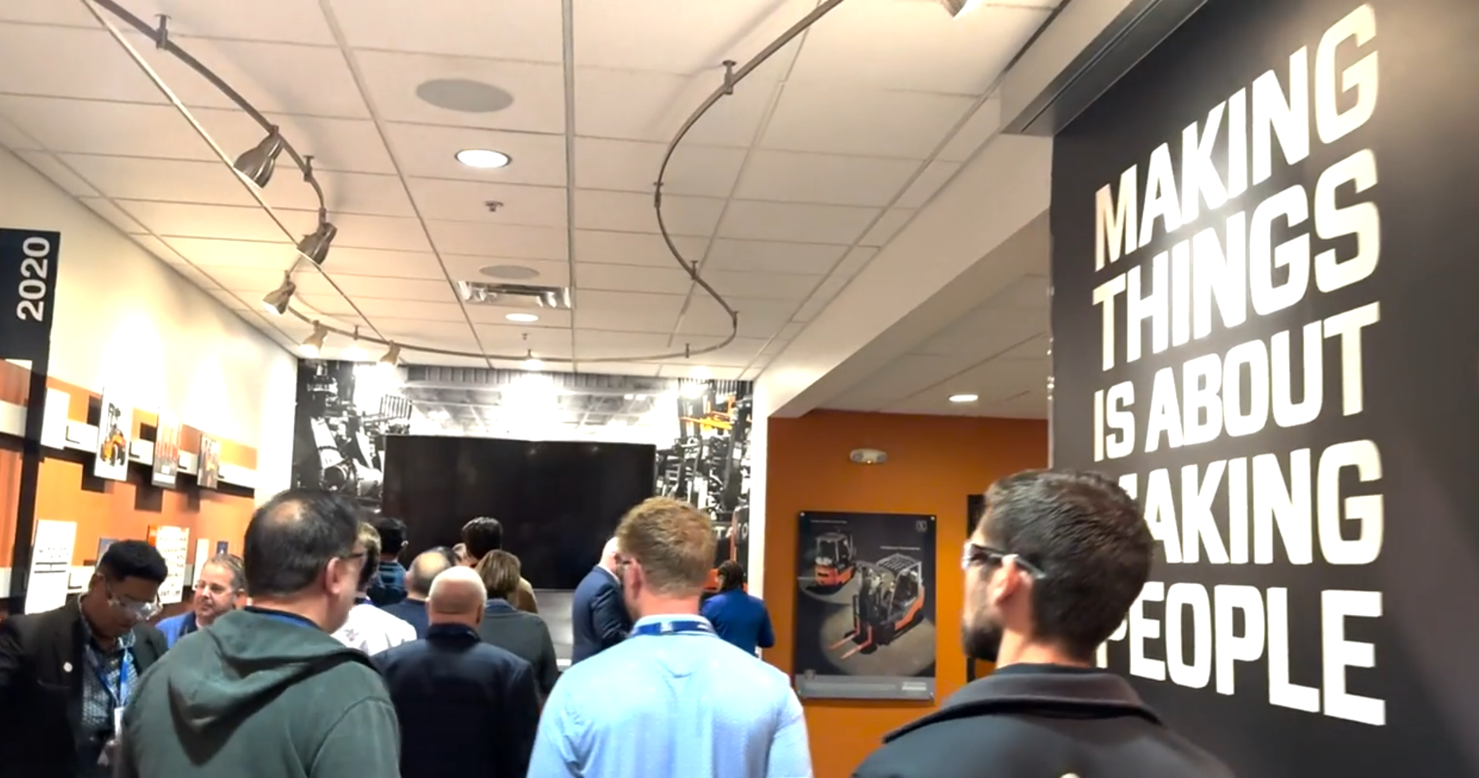
TOYOTA’s Perspective
“We build people, who build cars”
“Making things is about making people”

Slide 8
Traditional to Lean Leadership
Traditional Leadership | Lean Leadership
Fire fighting is rewarded | Fire prevention is rewarded
Improvements identified by management | Improvements identified by frontline, management supports
Hides problems | Sees problems as improvement opportunities & makes them visible
Focused on the silo | Focus across the entire value stream
Shifts blame | Takes responsibility
Blames the individual for issues | Examines the process for failures
Focuses improvement efforts on efficiency | Focuses improvement efforts on flow efficiency & effectiveness
KPIs & targets set on capability | KPIs & targets align to customer requirements
Decisions excessive reviews and leadership approvals | Decisions based on data, observations, and those closest to work
Management is secretive / the workplace is non-visual | Management is transparent / creates a visual workplace
Employees are seen as a resource | Employees are seen as treasures (individual potential)

Slide 9
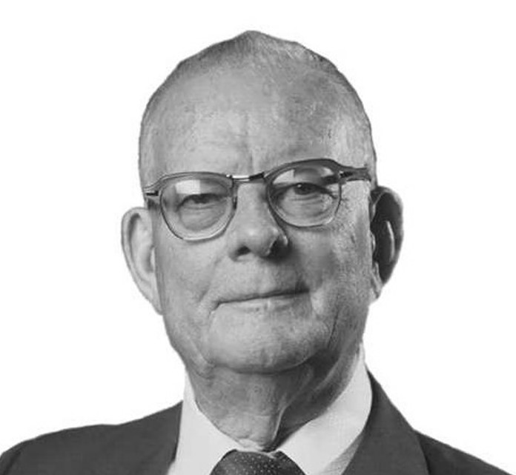
“The Greatest waste in America is failure to use the abilities of people.”
- W. Edwards Deming
Notes:
Source: quotes.deming.org/10158

Slide 10
Identifying your style of situational leadership

Slide 11
You have recently trained a new team member on how to perform a particular task to which they were initially meeting expectations, but over the past few weeks their performance has not been meeting the standard.
Do you…
Act quickly, emphasize the use of following standard operating procedures for achieving objectives and deadlines and then monitor progress.
Engage in friendly interaction, get team feedback on improvement ideas, incorporate recommendations, and emphasize that objectives must be met.
Encourage the team member to work on the problem and be supportive of their efforts.
Avoid confrontation by not applying pressure; they know the standards and will figure it out.
SITUATION 1:

Slide 12
Your internal customers have given you feedback that your team members have a poor attitude towards customer service. All team members have 3 or more years of experience and know their job, but they seem to struggle with more technical questions and are unconcerned that user complaints have increased.
SITUATION 2:
Do you…
Set the goal for the reduction of customer complaints. Give specific actions for the team members to take and monitor their progress to see that results are achieved.
Present the data to the team and lead them in developing solutions. Set performance expectations and follow-up to ensure actions are taken.
Discuss specific customer complaints and participate with the group at identifying solutions to avoid getting complaints in the first place. Encourage them to implement their ideas. Offer to provide whatever support the team needs.
Provide the customer complaint data and ask the team to solve the problem.

Slide 13
One of your direct reports has participated in several Kaizen events and has been tasked to lead an improvement event. They have visited you multiple times over the past few weeks to discuss the project. The frequent visits indicate to you that they lack confidence, but you've heard from a participant that the improvement is progressing nicely.
SITUATION 3:
Do you…
Give your direct report specific directions on how to manage the project
Provide specific suggestions and hints to help them complete the project and then listen to their reactions.
Listen to your direct report’s concerns, reassure them that they have the experience necessary to handle the project. Provide assistance where requested, but careful not to make any decisions for them.
Tell your direct report that they have this under control and reach out occasionally to see how things are going

Slide 14
One of your direct reports has a lot of experience, consistently shows up on time, and delivers outstanding results. Today they showed up 45 minutes late and failed to notify you that they wouldn’t make it to work on time.
Do you…
Tell your direct report that they are late, restate the rules and create a monitoring plan to stress the importance of being on time.
Have a friendly discussion with your direct report about why they were late. Develop some solutions for them to implement to ensure on-time arrival so they won’t be late in the future.
Tell them that you were worried about them and convince them of the importance of letting you know if they are running late. Listen to their side of the story but make sure they understand your expectations.
Let them know that you are happy they are okay. Explain that because they hadn’t called you were concerned something might have happened to them. Do not make a big issue out of the incident.
SITUATION 4:

Slide 15
What are your leadership style(s)
If you chose:
A) Style 1
B) Style 2
C) Style 3
D) Style 4
Most Leaders Have a Preferred Leadership Style:
54% use only one style
35% use two styles
10% use three styles
1% use all four styles
Leadership Style:
To be effective you need to use all four styles.
Notes:
Most leaders have a preferred leadership style. In fact, 54% of leaders tend to use only one style, 35% tend to use two styles, 10% tend to use three styles, and only 1% use four styles. To be effective you need to use all four styles.

Slide 16
Understanding the Situational Leadership Model™

Slide 17
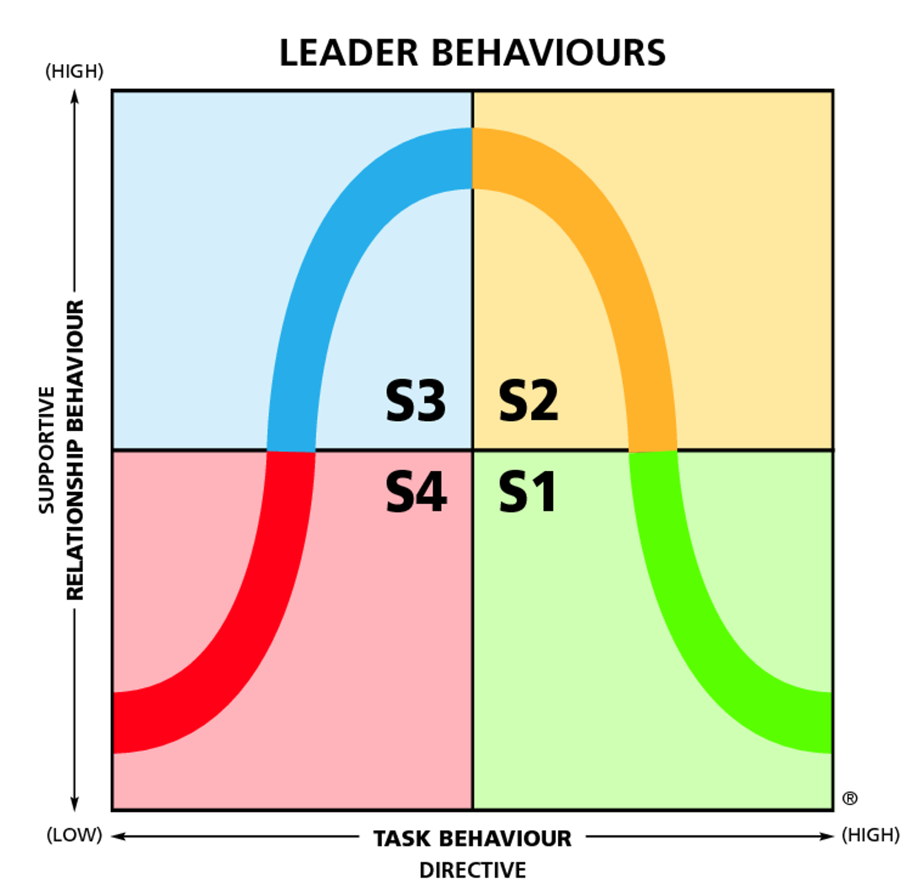
Situational Leadership Model™
Explaining
Problem
Solving
PARTICIPATING
COACHING
Encouraging
Persuading
Monitoring
Guiding
DELEGATING
DIRECTING
Observing
Directing
Notes:
How do these two models look when you put them together. A one-dimensional model on steroids

Slide 18
How are Leader Behaviors Classified?
There are two ways that leadership behaviors are classified: the identification of task and relationship behaviors.
Task Behavior –
The extent to which the leader engages in spelling out the duties and responsibilities of an individual or group.
Relationship Behavior –
The extent to which the leader engages in two-way or multiway communication.
Notes:
TASK BEHAVIOR – is characterized by one-way communication from the leader to the follower. The person is not so much concerned with your feelings, but with how to help you achieve your goal.
RELATIONSHIP BEHAVIOR – High amounts of relationship behavior might be required when you reach an impasse with an assignment. You basically know how to do the assignment but need some encouragement to get you over the hump. The listening, encouraging, and facilitating a leader does in this example is an illustration of relationship behavior.

Slide 19
Task Behavior Dimensions
TASK BEHAVIOR DIMENSION BEHAVIORAL INDICATOR The extent to which the leader: Goal Setting Specifies the goals people are to accomplish
Organizing Organizes the work situation for people
Setting Timelines Sets timelines for people
Directing Provides specific directions
Controlling Specifies and requires regular reporting on progress
Notes:
TASK BEHAVIOR – is characterized by one-way communication from the leader to the follower. The person is not so much concerned with your feelings, but with how to help you achieve your goal.

Slide 20
Relationship Behavior Dimensions
RELATIONSHIP BEHAVIOR DIMENSION BEHAVIORAL INDICATOR The extent to which the leader: Giving Support Provides support and encouragement
Communicating Involves people in “give-and-take” discussions about work activities
Facilitating Interactions Facilitates people’s interactions with others
Active Listening Seeks out and listens to people’s opinions and concerns
Providing Feedback Provides feedback on people’s accomplishments
Notes:
RELATIONSHIP BEHAVIOR – High amounts of relationship behavior might be required when you reach an impasse with an assignment. You basically know how to do the assignment but need some encouragement to get you over the hump. The listening, encouraging, and facilitating a leader does in this example is an illustration of relationship behavior.

Slide 21
Task & Relationship Behaviors are Separate and Distinct Dimensions:
(HIGH)
S3
S2
SUPPORTIVE
RELATIONSHIP BEHAVIOR
S4
S1
®
(LOW)
TASK BEHAVIOR
DIRECTIVE
(HIGH)
Notes:
It is always hard to “map” out human behaviors into a one-dimensional chart (because of the variables that exist in any human interaction) but here it is:
The Directive or Task Behaviors are ranked Low to High on the horizontal axis
The Supportive or Relationship Behaviors are ranked on the vertical axis, likewise Low to High
Each quadrant is assigned a Leadership Style: S1; S2; S3; S4 (Don’t go into depth as the next slide is for that purpose)

Slide 22
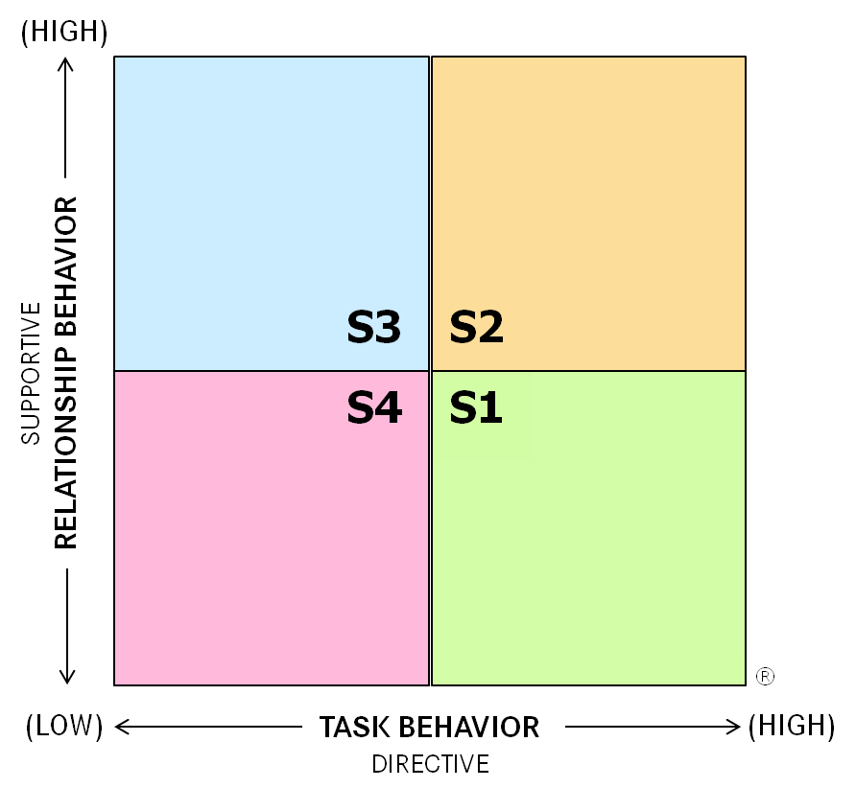
Four Leadership Styles
Style 1 – This leadership style is characterized by above-average amounts of task behavior and below-average amounts of relationship behavior.
Low Task and High Relationship
High Task and High Relationship
Style 2 – This leadership style is characterized by above-average amounts of both task and relationship behavior.
Style 3 – This style is characterized by above-average amounts of relationship behavior and below-average amounts of task behavior.
Low Task and Low Relationship
High Task and Low Relationship
Style 4 – This style is characterized by below-average amounts of both relationship behavior and task behavior.
Notes:
Go into a little bit of depth about each Leadership Style to explain the basics of task and relationship behavior impact roles in the model. Basic examples:
S1 – Provide specific instructions and closely supervise performance
S2 – Explain decisions and provide opportunity for clarification
S3 – Share ideas and facilitate in making decisions
S4 – Turn over responsibility for decisions and implementation

Slide 23
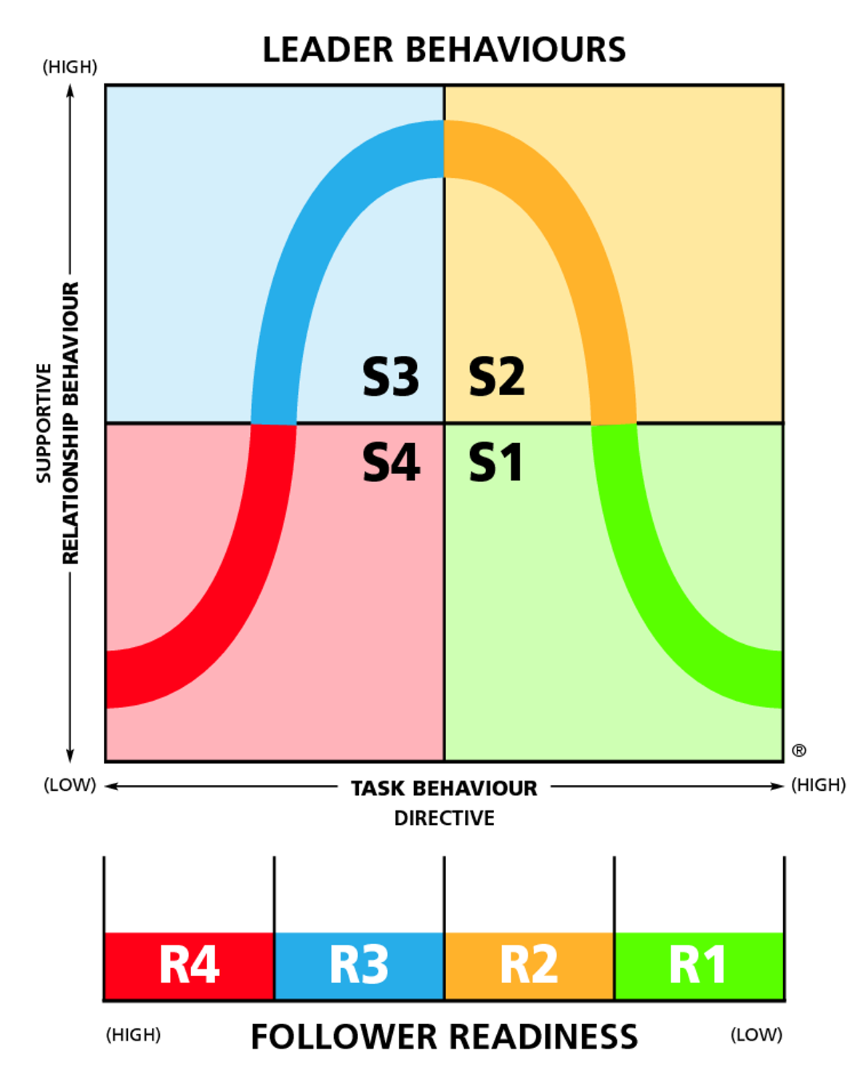
Leader Behaviors
PARTICIPATING
COACHING
DECISION STYLES
S1
Leader-Made Decisions
S2
DELEGATING
DIRECTING
Leader-Made Decision with Dialogue and/or Explanation
S3
Leader & Follower-Made Decision or Follower-Made Decision with Encouragement from Leader
S4
D4
D3
D2
D1
Follower-Made Decisions
(DEVELOPMENT LEVEL OF FOLLOWERS)

Slide 24
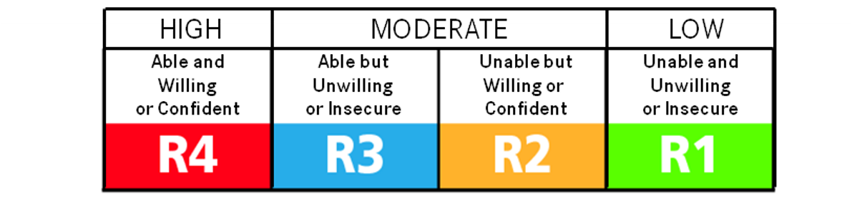
Follower Readiness Continuum OR Development Level
DEVELOPMENT LEVEL OF FOLLOWERS
D4
D3
D2
D1
Notes:
Follower Readiness Continuum – Think of it as the Development Level of Followers.

Slide 25
Matching Situational Leadership With Follower’s readiness level
Which leadership style a person should use with individuals or groups depends on the readiness level of the people the leader is attempting to influence.
Readiness – The extent to which a follower demonstrates the ability and willingness to accomplish a specific task.

Slide 26
Two Major Components of Readiness
There are two major components of readiness, they are ability and willingness.
Willingness – is the extent to which an individual or group has the confidence, commitment, and motivation to accomplish a specific task.
Ability – is the knowledge, experience, and skill that an individual or group brings to a particular task or activity.

Slide 27
Development Level 1 (D1)
HIGH
MODERATE
LOW
Able and Willing or Confident
Able but Unwilling or Insecure
Unable but Willing or Confident
Unable and Unwilling or Insecure
An Unable and Unwilling D1 would exhibit:
Defensive, argumentative, complaining behaviors
Late completion of tasks
Performance only to exact requests
Intense Frustration
An Unable and insecure D1 would exhibit:
Body language expressing discomfort: furrowed brow, shoulders lowered, leaning back
Confused, unclear behavior
Concern over possible outcomes
Fear of failure
D4
D3
D2
D1
Unable & Unwilling or Insecure Indicators:
Not Performing task to acceptable level
Being intimidated by task
Being unclear about directions
Procrastinating
Not finishing tasks
Asking questions about task
Avoiding task or “passing the buck”
Being defensive or uncomfortable
What Do They Need From Their Leader?

Slide 28
Needs of an D1 – The Enthusiastic Beginner
Recognition of enthusiasm and transferable skills
Clear goals and roles
Standards for what a good job looks like
Timelines
Priorities
Information on how data about performance will be collected and shared
Action plans – specific direction about how, when, and with whom
Boundaries and limits
Information about the goal or task and the organization
The unwritten rules on “how things work around here”
A step-by-step process for learning new skills
Hands-on Training – being shown and told how
Concrete examples of how others accomplish the goal or task
Opportunities to practice
Frequent feedback on results
Solutions to problems

Slide 29
Development Level 2 (D2)
HIGH
MODERATE
LOW
Able and Willing or Confident
Able but Unwilling or Insecure
Unable but Willing or Confident
Unable and Unwilling or Insecure
D4
D3
D2
D1
An Unable and Willing or Confident D2 would exhibit:
Speak quickly and intensely
Seek clarity
Nod head; make “yes, I know” type comments, seem eager
Listen carefully
Answer questions superficially
Accept tasks
Act quickly
Be preoccupied with end results rather than incremental steps
Unable but Willing or Confident Indicators:
Anxious or excited
Interested & responsive
Demonstrating moderate ability
Receptive to input
Attentive
Enthusiastic
New task, no experience
What Do They Need From Their Leader?

Slide 30
Needs of an D2 – The Disillusioned Learner
Clear goals
Perspective
Frequent feedback
Praise for making progress
Help in analyzing successes and failures; assurance that it is okay to make mistakes
Explanations of why the goal or task is important and explanations of “how’s”
Opportunities to discuss concerns and share feelings
Involvement and influence in decisions making and problem-solving
Encouragement
Advice and additional next steps and alternatives
Coaching to build and refine skills

Slide 31
Development Level 3 (D3)
HIGH
MODERATE
LOW
Able and Willing or Confident
Able but Unwilling or Insecure
Unable but Willing or Confident
Unable and Unwilling or Insecure
D4
D3
D2
D1
An Able but Unwilling D3 would exhibit:
Be hesitant or resistant
Feel over obligated and overworked
Seek reinforcement
Be concerned performance is somehow punishing
An Able but insecure D3 would exhibit:
Question own ability
Focus on potential problems
Lack self-esteem
Encourage leader to stay involved
Able but Unwilling or Insecure Indicators:
Has demonstrated knowledge and ability
Appears hesitant to finish or take next step
Seems scared, overwhelmed, confused
Seems reluctant to perform alone
Solicits frequent feedback
What Do They Need From Their Leader?

Slide 32
Needs of an D3 – The Capable, but Cautious Performer
An approachable mentor or coach
Opportunities to test ideas
Opportunities to express concerns and share feelings
Support and encouragement to develop self-reliant problem-solving skills
Help in looking at experience and skills objectively, so confidence is built
Praise and recognition for high levels of competence and performance
Obstacles to goal accomplishment removed
A kick-start to overcome procrastination

Slide 33
Development Level 4 (D4)
HIGH
MODERATE
LOW
Able and Willing or Confident
Able but Unwilling or Insecure
Unable but Willing or Confident
Unable and Unwilling or Insecure
D4
D3
D2
D1
An Able and Willing or Confident D4 would exhibit:
Keep boss informed of task progress
Make efficient use of resources
Be responsible and results-oriented
Be knowledgeable; share information to streamline operational tasks
Be willing to help others
Share creative ideas
“Take charge” of tasks
Complete responsibilities on time and perhaps early
Able & Willing or Confident Indicators:
Keeps boss informed of task progress
Can operate autonomously
Is results-oriented
Shares both good and bad news
Makes effective decisions regarding task
Performs to high standards
Is aware of expertise
What Do They Need From Their Leader?

Slide 34
Needs of an D4 – The Self-Reliant Achiever
Variety and challenge
A leader who is more of a mentor and colleague than a manager
Acknowledgment of contributions
Autonomy and authority
Trust
Opportunities to share knowledge and skills with others

Slide 35
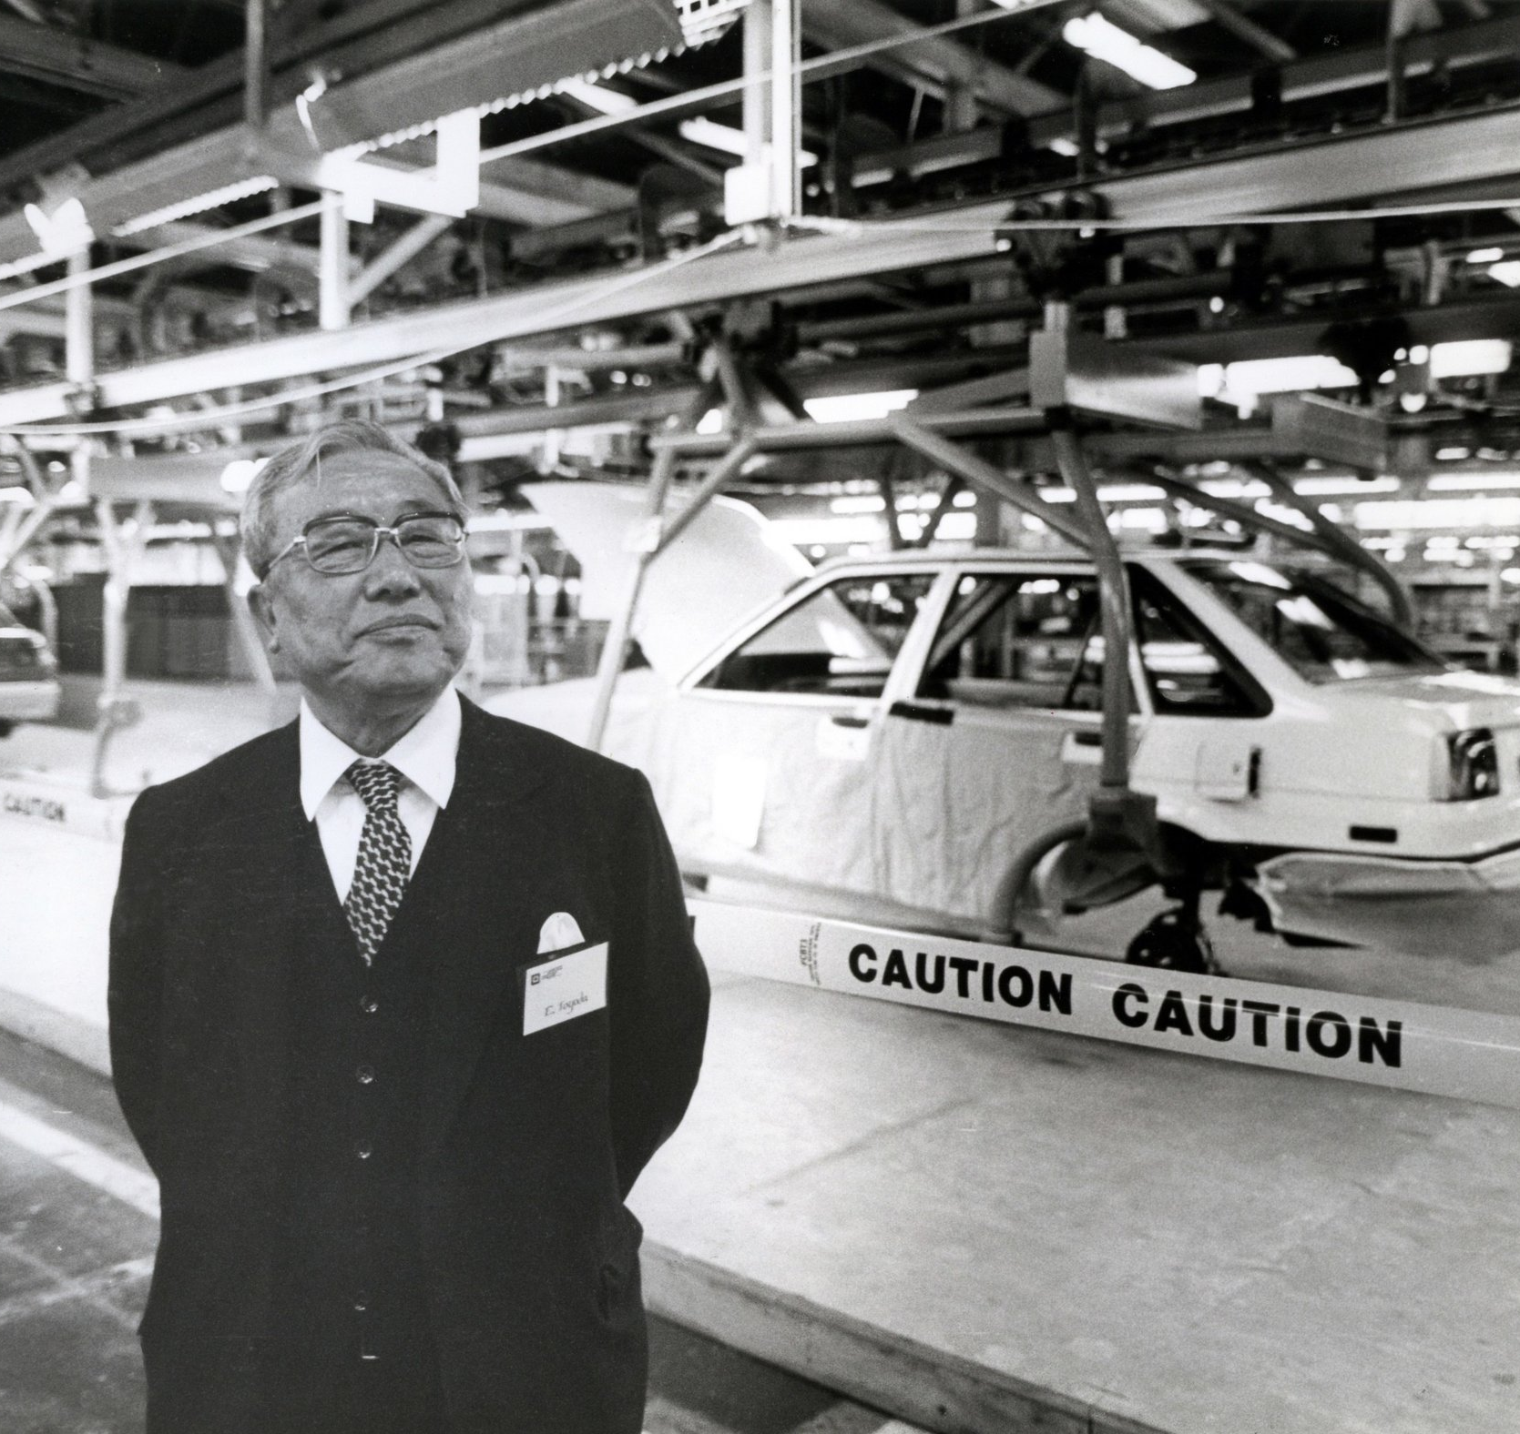
“人間の一生は時間の集まりだから、一時間という時間も一生・・・すなわち命だ。従業員は自分の一生のうちの大切な時間を会社に提供しているわけだから、有効に使わねば命を無駄使いすることになる。 ” 豊田英二 トヨタ自動車株式会社の社長 1967 - 1981
Respect for People

Slide 36
“A person’s life is an accumulation of time. Employees provide their precious hours of life to the company. We have to use it effectively, otherwise, we are wasting their life.” Eiji Toyoda President, Toyota Motor Company 1967 - 1981
Respect for People

Slide 37
Using the situational leadership model
The Three Steps of the Situational Leadership Model™
STEP 1: Identify the Most Important Tasks or Priorities
STEP 2: Diagnose the Readiness/Development Level of the Followers
STEP 3: Decide on the Matching Leadership Style
Notes:
Suggestions to consider when deciding your three most important tasks or priorities:
1. Focus your three priorities or tasks on big picture items that will require participation and
commitment from the entire chapter. This doesn’t mean you should eliminate a possible
priority just because you fear the chapter won’t go along with it; it simply means that your
priorities should be big enough that executing them will require the chapter’s involvement.
2. Your three priorities should be fundamental to the success of the chapter. For example,
“Creating a new recruitment slogan” is not as important as “Creating a working Kai
Committee.”
3. Whenever possible, be specific! For example, “Recruitment” is a vague priority, but “Create
and execute a year round recruitment model resulting in a 25 man pledge class next fall” is
specific.
4. Sometimes our best priorities are things we should STOP doing. For example, if your chapter
has high-risk social practices (i.e. providing hard alcohol to underage guests), it is a worthy
priority to “Eliminate high-risk social factors and create a new culture of social conduct in the
chapter.”
5. Don’t hesitate to go after bold tasks such as winning the “Top Chapter” award on campus,
achieving a 3.0 chapter GPA, or increasing your membership size to 75 men. All of these will
require participation and commitment from the rest of the chapter.
6. Don’t worry about how you will achieve the priorities just yet. Decide what they should be
first!
7. You may need to brainstorm a list of 5-10 priorities and then narrow the list to your top three.

Slide 38
STEP 1: Identify the Most Important Tasks or Priorities
Lean Leadership is a combination of aligning the organizational vision, goals, and priorities, with task/work to be done and the people doing the work.
Lean Tasks Required for Step 1:
Understanding of the Hoshin Kanri strategic vision & goals
Going to Gemba to understand the work
Tracking KPIs
Developing and challenging your people is the work of a Lean Leader.

Slide 39
STEP 2: Diagnose the Readiness/ Development Level of Your Followers
Diagnose Readiness/Development Level
COMPETENCE |  | COMMITMENT |  | LEVEL
TASK KNOWLEDGE & SKILLS | TRANSFERABLE SKILLS | MOTIVATION | CONFIDENCE
 |  |  |  | R4
 |  |  |  | R4/3
 |  |  |  | R3/4
 |  |  |  | R3
 |  |  |  | R3/2
 |  |  |  | R3/2
 |  |  |  | R2/3
 |  |  |  | R2
 |  |  |  | R1/2
 |  |  |  | R1/2
 |  |  |  | R2/1
 |  |  |  | R2
 |  |  |  | R1
 |  |  |  | R1/2
 |  |  |  | R2/1
 |  |  |  | R2
HIGH
LOW
HIGH
HIGH
LOW
HIGH
LOW
HIGH
HIGH
LOW
HIGH
HIGH
LOW
LOW
LOW
HIGH
HIGH
LOW
HIGH
LOW
Lean Tasks Required for Step 2:
Respect for People
Skills Matrix
LOW
HIGH
HIGH
LOW
LOW
HIGH
LOW
HIGH
LOW
LOW

Slide 40
STEP 3: Decide on the Matching Leadership Style
As a Lean Leader to show respect for people, we need to be able to adjust our leadership style to meet people where they are at. This means really getting to know those around us. Not just with assessments and tracking them on a skill matrix.
Lean Tasks Required for Step 3:
One-on-ones
Skills Matrix
Open Communications

Slide 41
Selecting Appropriate Styles: Matching Development Level 1 with Leadership Style 1 - Directing
Appropriate Leader Behaviors for an Unable and Unwilling D1 would be to:
Directly state specific facts
Positively reinforce small improvements
Consider consequences for nonperformance
Keep emotional level in check
For an Unable and Insecure D1:
Provide task information in digestible amounts
Be sure not to overwhelm follower
Reduce fear of mistakes
Help step by step
Focus on instruction
Providing specifics – who, what, when, where, & how
Role definition
Predominantly one-way communications
Leader-made decisions
Close supervision and accountability
Incremental instructions
KISS – Keep it simple & specific
Effective
Telling
Guiding
Directing
Establishing
Ineffective
Demanding
Demeaning
Dominating
Attacking
Notes:
Telling or Directing – This leadership approach is most appropriate when the followers have low
willingness and low ability for the task at hand. When the followers cannot do the job and
are unwilling or afraid to try, then the leader must take a highly directive role. Directing
requires those in charge to define the roles and tasks of the followers, and supervise them
closely. Decisions are made by those in charge and communication is one-way. If the leader focused
more on the relationship in this situation, the followers would become confused about what must be
done and what is optional. Directing is often used when the issue is serious or comes with drastic
consequences if not successful. The leader maintains a directive position to ensure all required actions
are completed.

Slide 42
Selecting Appropriate Styles: Matching Development Level 2 with Leadership Style 2 - Coaching
Appropriate Leader Behaviors for an Unable but Willing D2 would be to:
Seek “Buy-in” through persuading
Check understanding of the task
Encourage questions
Discuss details
Explore related skills
Explain “why”
Give follower incremental steps (not “run for it”)
Emphasize “how to”
Providing who, what, when, where, how & why
Explain decisions & allow opportunity for clarification
Two-way dialogue
Leader-made decisions
Explain follower’s role
Ask questions to clarify ability level
Reinforce small improvements
Effective
Selling
Coaching
Explaining
Clarifying
Persuading
Ineffective
Rationalizing
Manipulating
Preaching
Defending
Notes:
Selling or Coaching – This leadership approach is most appropriate when the followers
have high willingness but low ability for the task at hand. Like Directing,
Coaching still requires leaders to define roles and tasks clearly, but the leader
seeks ideas and suggestions from the follower. Decisions remain the leader's
prerogative, but communication is much more two-way. Followers needing
coaching require direction and supervision because they are still relatively
inexperienced, but they also need support and praise to build their self-esteem, and
involvement in decision-making to restore their commitment. While Coaching, the leader spends time
listening, advising, and helping the follower gain necessary skills in order to do the task autonomously
next time.

Slide 43
Selecting Appropriate Styles: Matching Development Level 3 with Leadership Style 3 - Supporting
Appropriate Leader Behaviors for an Able
but Unwilling D3 would be to:
Share responsibility for decision making with follower
Feed follower’s “need to know”
Focus on results
Involve follower in consequences of task to increase commitment and motivation
Combine leader-follower decision making
Determine next step
Encourage and support
Discuss apprehension
Encourage input
Actively listen
Follower-made decisions
Two-way communications and involvement
Support risk-taking
Compliment work
Praise and build confidence
Effective
Participating
Encouraging
Supporting
Empowering
Ineffective
Patronizing
Placating
Condescending
Pacifying
Notes:
Participating or Supporting – This leadership approach is most appropriate when the followers have
low willingness but high ability for the task at hand. Supportive leadership works when
the follower can do the job, but is refusing to do it or showing a lack of commitment. The
leader need not worry about showing them what to do, but instead should be concerned
with finding out why the followers are refusing and work to persuade them to cooperate.
The key to supportive leadership is motivating and building confidence in people! Clarification on the
details of the process won’t matter, as the follower already knows what to do but lacks the motivation
to act. Supportive leadership involves listening, giving praise and making the followers feel good when
they show the necessary commitments for success.

Slide 44
Selecting Appropriate Styles: Matching Development Level 4 with Leadership Style 4 - Delegating
Appropriate Leader Behaviors for an Able and Willing D4 would be to:
Listen to updates
Resist overloading
Encourage autonomy
Practice overall hands-off management; observe
Reinforce follower-led communications
Provide support and resources
Delegate activities
Encourage freedom for risk taking
Delegating tasks
Big picture
Follower-made decisions
Relatively light supervision
Monitor activities
Reinforce results
Remain accessible
Effective
Delegating
Observing
Entrusting
Assigning
Ineffective
Abandoning
Dumping
Avoiding
Withdrawing
Notes:
Delegating or Entrusting – This leadership approach is most appropriate when the followers
have high willingness and high ability. Leaders should rely on delegating when the
follower can do the job and is motivated to do it. There is a high amount of trust that
the follower will do well, and the follower requires little supervision or support.
Delegating still keeps the leader involved in the decisions and problem-solving, but
execution is mostly in the hands of the followers. Because the follower has the most
control, he is responsible for communicating information back up to the leader.
Followers at this level have less need for support or frequent praise, although as with
anyone, occasional recognition is always encouraged.

Slide 45
Leadership Model
Explaining
Problem
Solving
PARTICIPATING
COACHING
Encouraging
Persuading
3 Skills of a Situational Leader
1
Monitoring
Guiding
DELEGATING
DIRECTING
Observing
Diagnosis
2
Directing
Flexibility
3
D4
D3
D2
D1
Partnering for Performance
Follower Directed
Leader Directed

Slide 46
Applying the model with lean

Slide 47
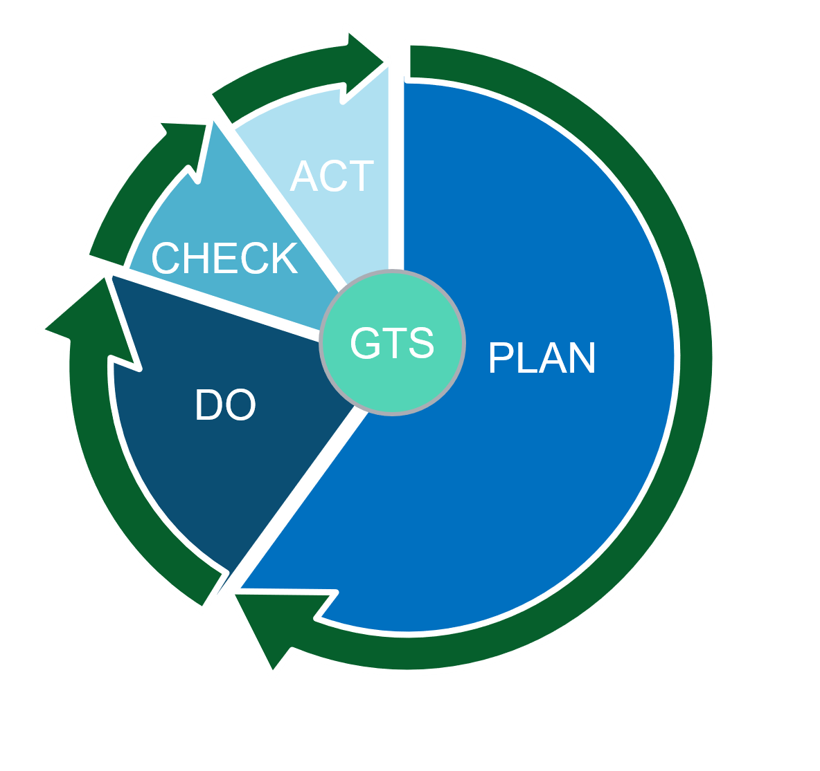
Situational Lean Leader Using the PDCA Framework*
The PDCA Cycle Framework:
Grasp the Situation (GTS)
Plan
Do
Check
Act/Adjust
*Concept Developed by Sam McPherson (The Lean Leadership Academy)

Slide 48
Step 1 (GTS) – Identify The Suitable Task/ Work To Challenge Your Team Member
Grasp the Situation (GTS)
Align Work & Vision - Be able to align the company vision & Hoshin Kanri to the ideal target state of work/task you are assigning
Align Work with Skills - Understand work content & skills necessary to be carried out by your team member
Diagnose Readiness Level - Collaboratively assess team member’s competence, commitment, condition to the specific goal/work/task

Slide 49
Step 2 (Plan) – Assign Work & Goal Setting and Contract for Performance
Plan
Grow Your People – choose the team members based on the On-the-Job Development Plan
Set Up For Success - Identify respectful work worthy of your team member’s ability & development
Set SMART Goals - Align what needs to be done, by when, and to what standard
Partner for Performance – Agree with team member about the leadership style they need and how you will use to help them achieve goals
Follow Up Plan - Determine the way you will follow up & share your observations with team member

Slide 50
Step 3 (Do) – Apply the Right Leadership Style: Direct, Coach, Participate, Delegate
Do
Assign Work - Leave space for team member to think and think thoroughly and grow
Explain Process and Standards
Match Leadership Style to provide team member with what they need
Build Mutual Trust & Respect
Provide Encouragement - Assess & maximize your team member’s motivation toward the work/task
Right Support – Provide what they need to succeed including being able to follow Job Instruction process

Slide 51
Step 4 (Check) – Mentor & Coach for Growth Create a Learning Environment
Check
Go to Gemba - Directly observe the way your team member carries out their daily work & understand their situation
Evaluate - Results & processes of task/work
Identify Root Cause Issues - If your team member is not meeting expectations, identify the root cause
Focus on Standard - Redirect team member to complete their work to standard when needed
Provide Space For Growth - Put team member on their own and taper off based on readiness level

Slide 52
Step 5 (Act/Adjust) – Give a Sense of Achievement & Growth
Act/Adjust
Provide Feedback – Recognize their efforts, evaluate performance and skills for further improvement opportunities
Reflect on Your Leadership - Evaluate your own ability to lead and motivate your team member to perform ‘good work’
Evaluate Readiness Level - For next work requirement or challenge

Slide 53
Q&A

