Slide 1
Getting Past Ready, Doing, Done:
Making your kanban work for you
Heidi Loveall
Strategy & Performance
October 2024
Notes:
From session proposal
Kanban is one of the most powerful tools in the Lean toolkit. It's simple, instinctive, and tremendously effective. So why do we occasionally get stuck or drop using it altogether?
In this session, I will go over:
what gets in the way of using personal kanban effectively,
practical tips for embedding the kanban practice seamlessly into your work, and
how to build a system that endures.
Even if you have tried and failed at using kanban before, at the end of this session, you should leave with the knowledge and inspiration you need to build a kanban system that truly works for you.
After this session, attendees will be able to :
Describe the core principles of kanban
Understand their personal tendencies and how those inhibit or enable good kanban practice
Effectively build a kanban system designed to endure

Slide 2
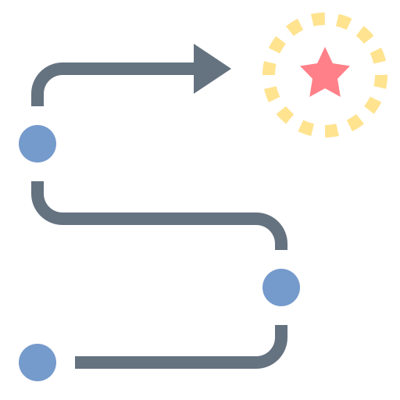
Agenda
Kanban principles
Format considerations
Making it work
Making it last
Questions
a little bit
TECHNICAL
a lot bit
HUMAN
all
PRACTICAL
Notes:
Housekeeping
- Questions in the Q&A, have asked moderator to stop me

Slide 3
Poll
When it comes to personal kanban, I would say:
I have not built one yet.
I built one and am still using it.
I built one but am no longer using it.
I built many and am still using my current one.
I built many but am no longer using one right now.

Slide 4
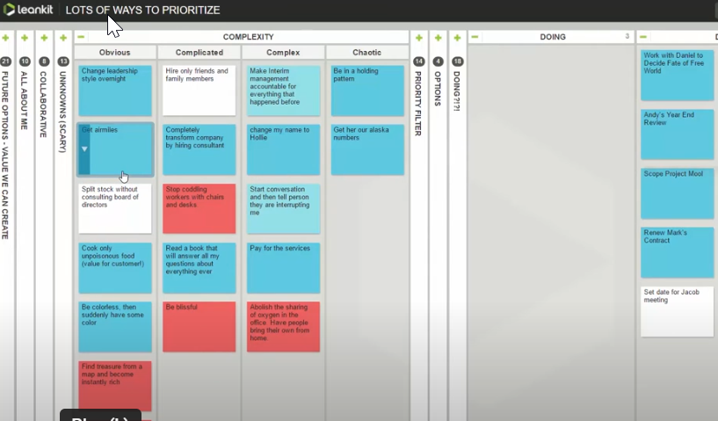
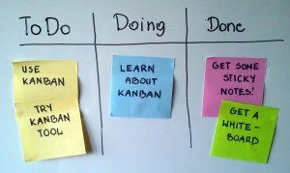
personal Kanban
A method for visualizing and managing your work.
Above images from Modus Institute

Slide 5


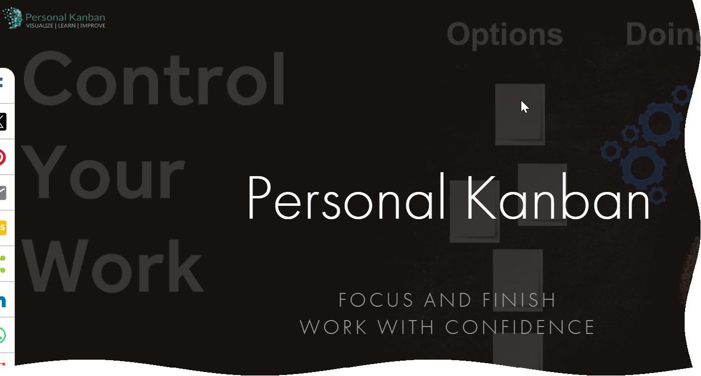
Credit where it’s due
Jim Benson

Slide 6
Why kanban?
“Kanban is one of the most powerful tools in the Lean toolkit. It's simple, instinctive, and tremendously effective.”
- me
Reduces cognitive load
Helps relieve the Zeigarnik effect
Lets us focus
Helps us visualize progress
Notes:
Made a claim.
Want to support it. Kanban is one of the most powerful tools in the Lean toolkit. It's simple, instinctive, and tremendously effective.

Slide 7
Kanban Principles
See all of your work at one time
Make it easy to see what to do next
Limit work in process

Slide 8
What gets in the way
Making it too complicated
Keeping it too simple
Failing to consider your beautiful brain
Habits are hard
Notes:
making it too complicated (color coding, type, level) or
keeping it too simple (r/d/d works for some folks)
Habits and habit formation
For those of you who have tried kanban unsuccessfully, what got it the way

Slide 9
Format considerations

Slide 10
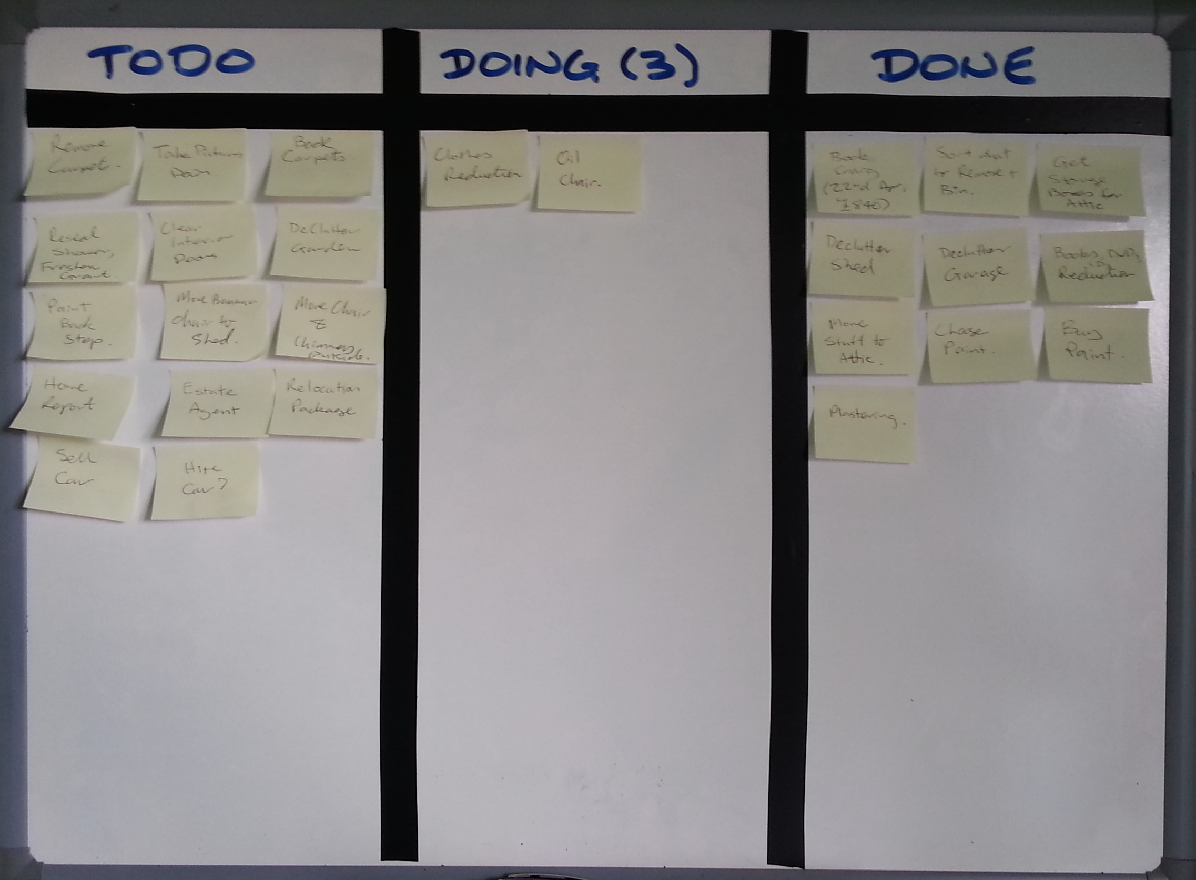
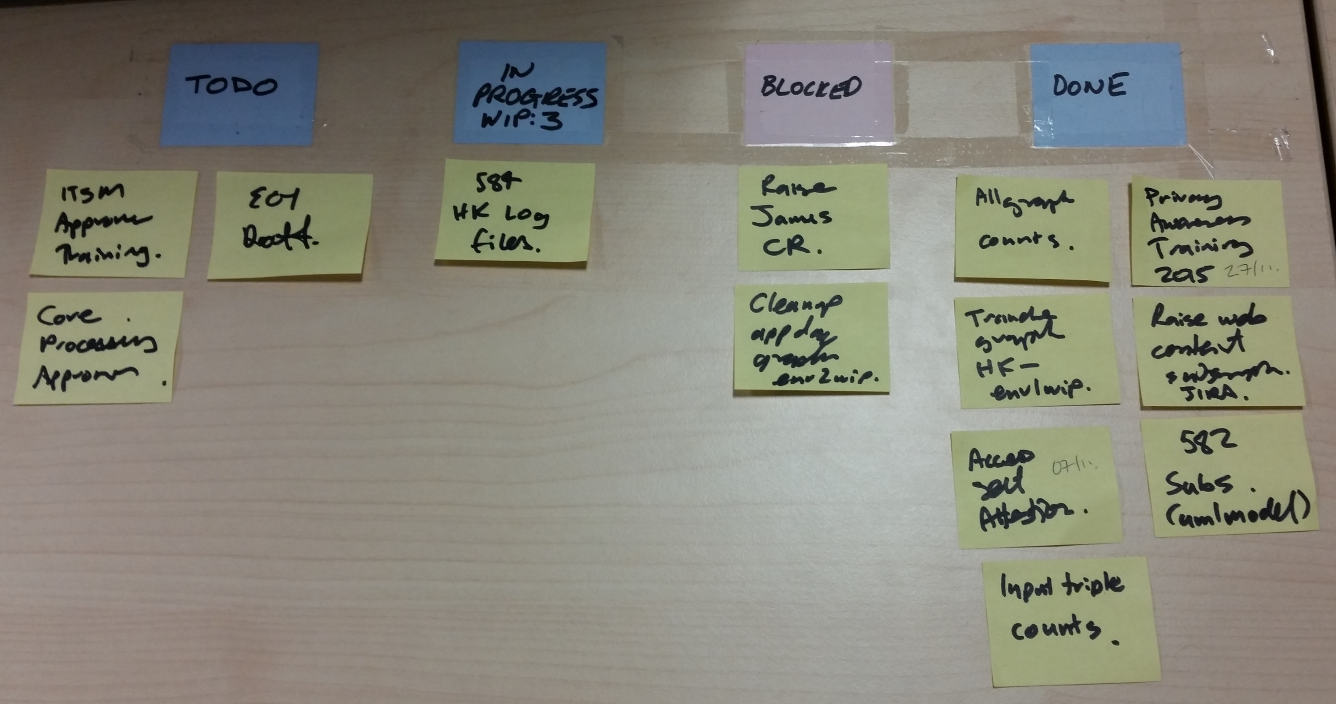
Physical
Bold declaration:
There is still nothing better than post it notes and a Sharpie.
Notes:
No screen size limits, physicality of moving notes is great, very easy to access and not hide
Lean conference banner example of movable physical kanban

Slide 11
Virtual
Check for the three principles
Make it easy to do the right thing
Make it a habit to check there next
The best kanban app is the one you will use.
Notes:
Check for the three principles
Seeing it all at once is the hardest (remember to say the other two)
Make it easy to do the right thing
Can you access it at all times?
Don’t overcomplicate it
Make it a habit to check there next
From SmartSheet:
What Is the Best Personal Kanban App?
The best Personal Kanban app is the one that provides all the functionality you need with few or no additional complicating features, is easy to use, and is cost effective. The right tool for you depends on your level of familiarity and comfort with technology. If technology often frustrates you, you may not want a digital tool at all. In fact, many Kanban practitioners favor a simple whiteboard.
Some basic To Do list apps can work as Personal Kanban boards. This would be a good way to start since the most minimal solution is often the best. If you need more functionality, you can experiment with spreadsheets or Kanban-specific software.
In short, the best Personal Kanban app is the one that you will use and stick with.

Slide 12
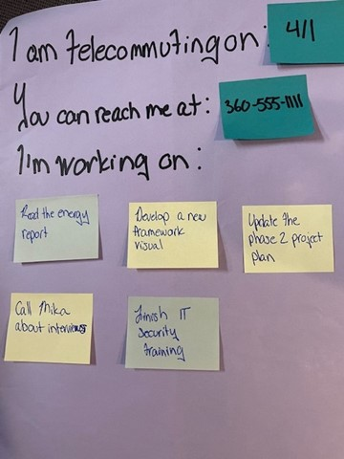
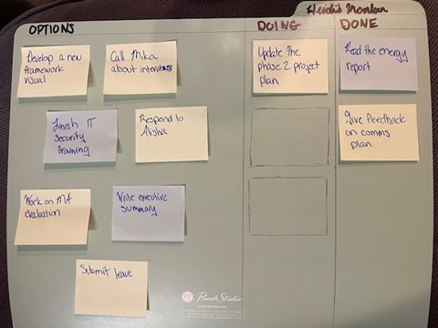
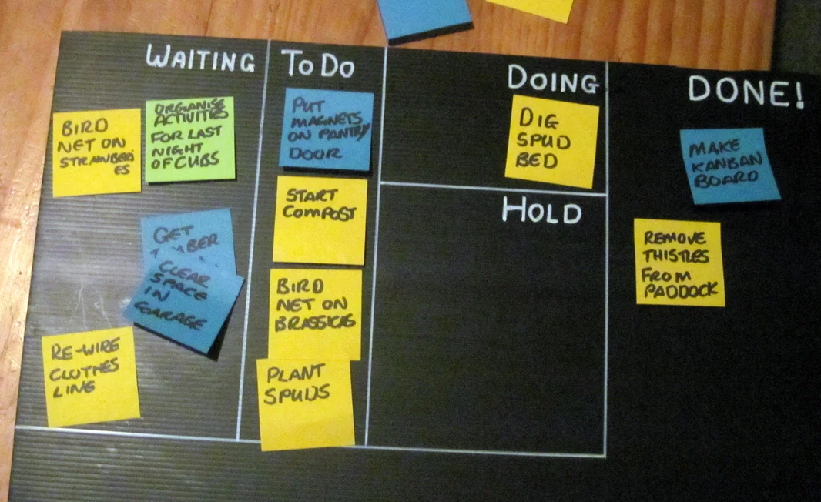
Hybrid
Be creative. Think about what you need where and when.
Notes:
keep notes with you, take photos, mix of physical & virtual

Slide 13
Heidi’s helpful hints

Slide 14
Making it work
Common Columns
Waiting
Paused/Blocked
This Week
Today
Assigned
Add the right columns.
They should:
  Make things clearer
  Help you prioritize
  Allow you to focus on one column when quickly selecting the next task
What do you need your board to show you?
Notes:
Add the right columns (why – make it clearer, help you prioritize)
Remember that to do is often called ready or options
Common ones (pros and cons)
Waiting
Paused/Blocked
This Week/Today
Assigned
What do you need it to show you?
Help for problem – too many things

Slide 15
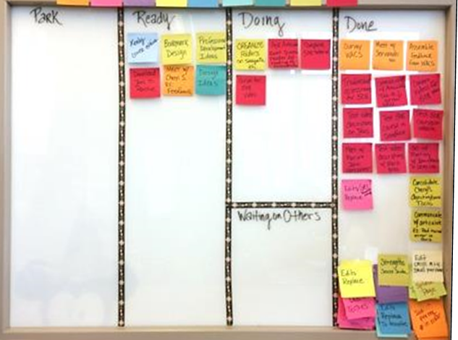
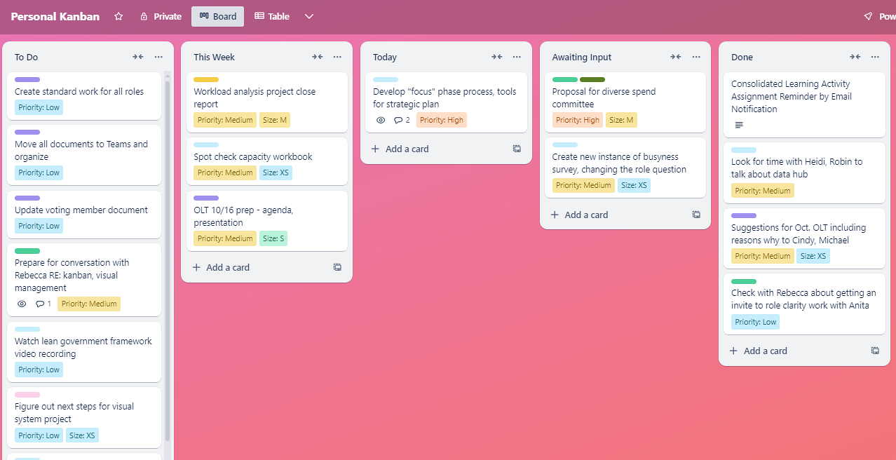
examples

Slide 16
Making it work
2. Add the right info to your cards.
But just enough!
Resist the human temptation towards complication.
Add slowly and only when needed.
What problem are you trying to solve with this info?
Notes:
Also add detail – due dates, time estimate – but just enough
Need to be able to flow quickly (in relationship to color coding and other stuff)

Slide 17
Making it work
3. Find your right level.
Think about your particular brain.
But always start with a verb!
Be ready to adjust.
What is your personal sweet spot of clarity vs effort?
Notes:
Find your right level (think about the way you work)
But always start with a verb

Slide 18
Making it work
4. Keep it real.
Include everything
Don’t hide work from the board.
Be diligent about “doing.”
Notes:
Don’t forget your calendar and email. Here’s how.
Include how to handle project plans
– move things back to to do when not actually doing – also write it down if you’re doing it!
UBS column
From Smartsheet:
What should I do if I’m working on a lot of stuff that isn’t on my board? It can take a while to get in the habit of turning all your work items into cards, so expect some transition time. But if you find a lot of your activity isn’t driven by the board after you are fully in the swing of Personal Kanban, you need a reset.
A common mistake is what practitioners call “hiding work from the board.” This happens when we create frameworks that look great on paper but don’t align with reality. We sweep all the workarounds and extra steps under the rug while our fantasy workflow remains on the board.
For Personal Kanban to help, you need to get real and make a concerted effort. Also, watch out for the human tendency to sneak back into the multitasking mindset and build another queue of chores in your head. If this happens, pile on the Kanban cards until you break the habit.

Slide 19
Build to last

Slide 20
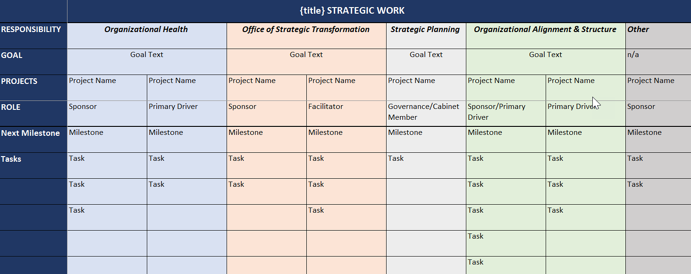
Making it last
Consider
Your Role
Expectations
Team Kanban
Agency Strategy
1. Aim it at something.

Slide 21
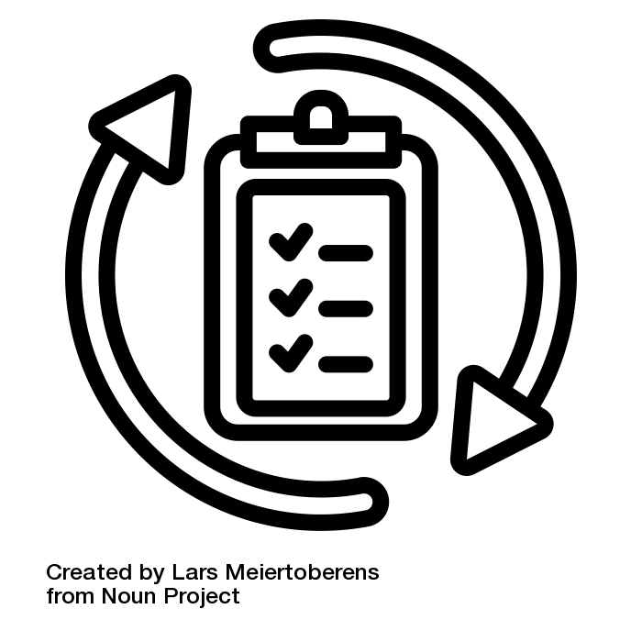
Making it last
2. Build good practices.
How you use the board is as important as how you set up the board.
Start with planning.
End with reflection.
Notes:
PLANNING practice and a reflection practice
Daily or weekly

Slide 22
Example: Planning practice
Look at the calendar for the upcoming week.
Check to see if any of the meeting require prep or other actions that are not already on my kanban. If so, add cards.
Scan my cards for any due dates that fall in the upcoming week. Move them to my This Week column.
Ask myself what are the most important to accomplish this week. Add them to my This Week column.
Block time on my calendar for the This Week tasks as needed.

Slide 23
Example: Reflection practice
Consider the following questions:
  What did I plan to accomplish this week? What did I actually accomplish? How do the two compare?
  What, if anything, got in my way?
  What did I learn?
  What should I celebrate?
  What is next?
Write down any learnings.

Slide 24
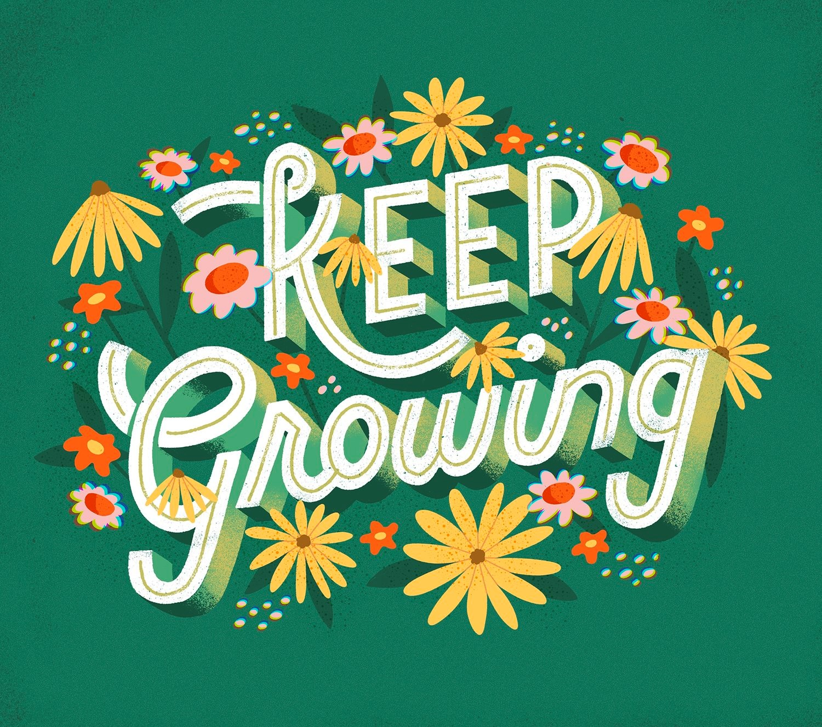
Making it last
3. Adapt, don’t abandon.
Use the Audit Checklist
How can I adjust the system to work better for me?
Notes:
If you abandon your system in times of stress, you haven’t found the right system yet
Use the audit checklist

Slide 25
Making it Last
4. Use what we know about habits.
Example: When I read an email but don’t have time to respond, instead of just trying to remember later, I will add responding as a task to my kanban board because it lets my brain focus on the task at hand without worrying that I’ll forget.
Notes:
Believe you can & should
Especially connect to the motivation

Slide 26
Tips overview
Making it work
Making it last
Add the right columns
Add the right info to your cards
Find your right level
Keep it real
Aim it at something
Build good practices
Adapt, don’t abandon
Use what we know about habits

Slide 27
My kanban evolution

Slide 28
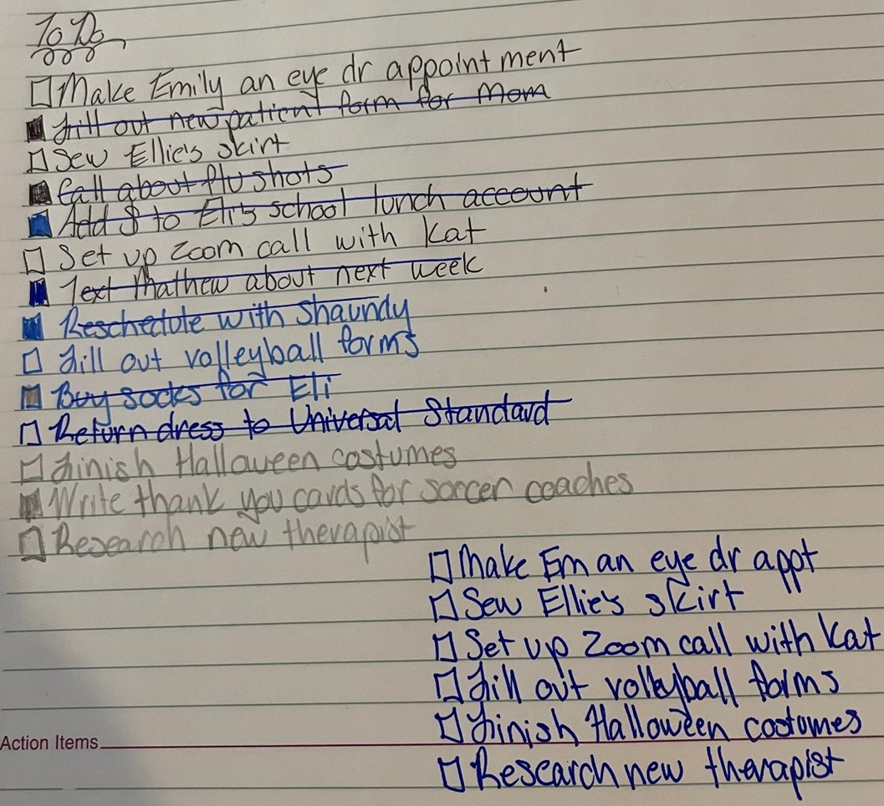
Pre Kanban

Slide 29
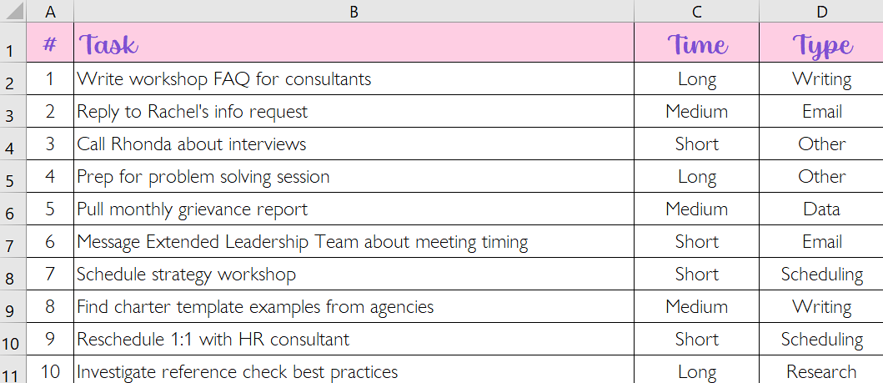
Almost Kanban

Slide 30
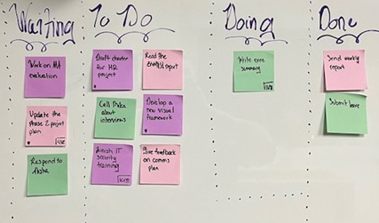
Early kanbans
*picture not available*

Slide 31
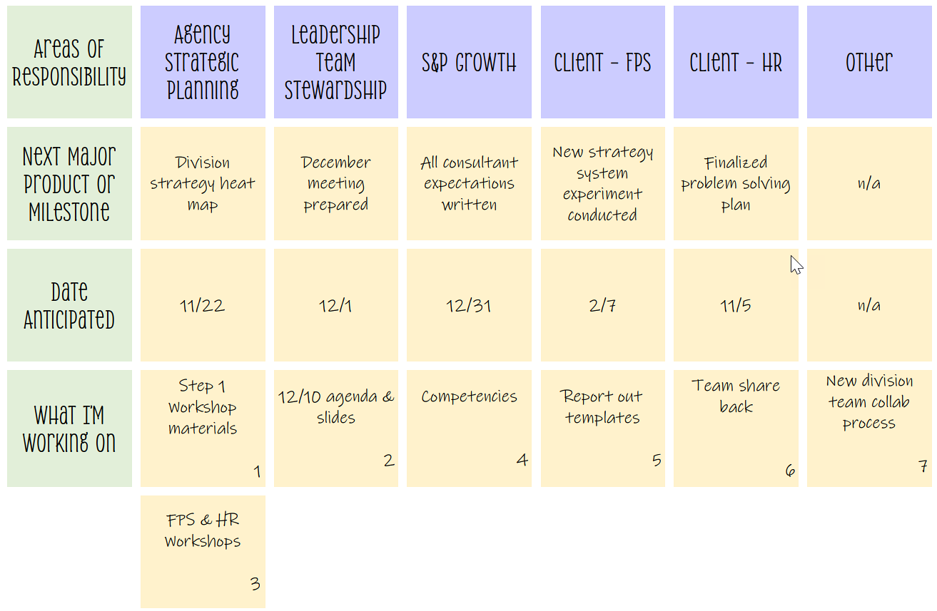
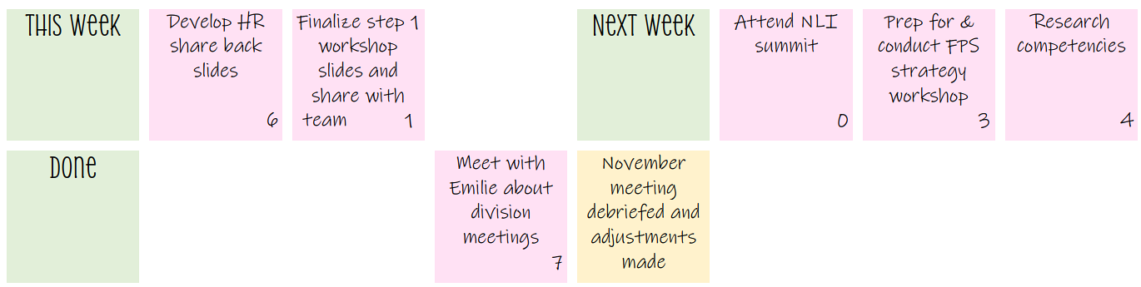
My perfect kanban

Slide 32

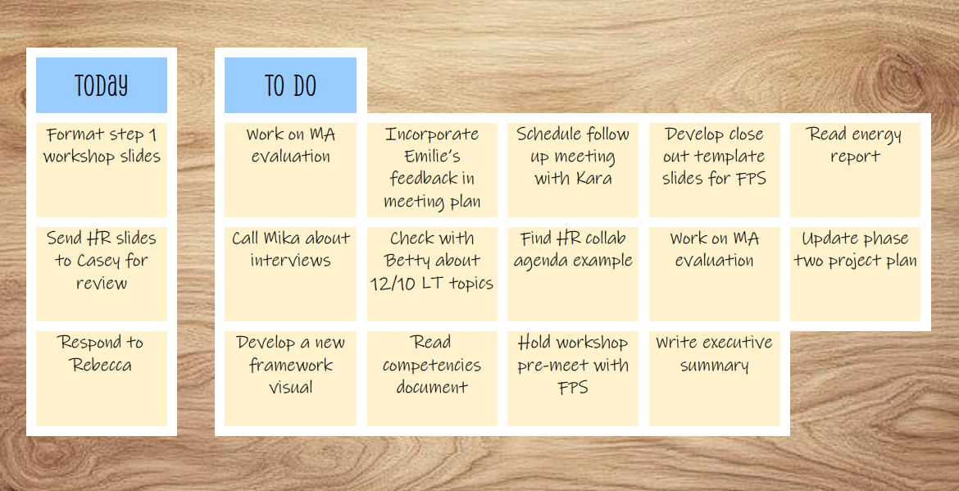
My perfect kanban, cont.
abc
Doing

Slide 33
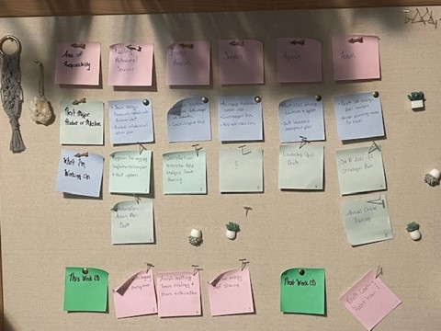


The transition Attempts
+

Slide 34
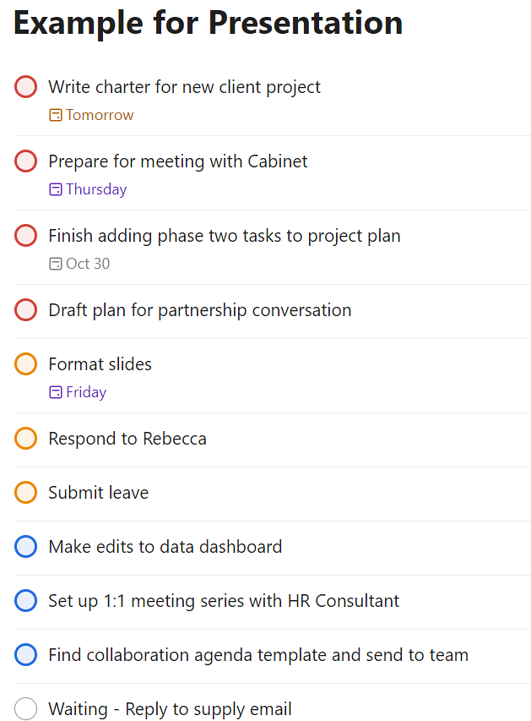
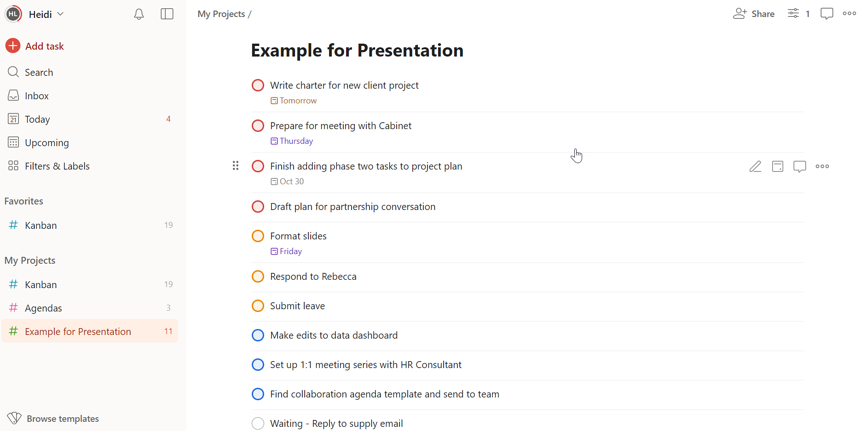
Current Experiment
Notes:
Wouldn’t advise for beginners – no doing or WIP limit
Talk about prioritization
How I use waiting

Slide 35
reflection

Slide 36

Point to ponder
What are you inspired to do next?
Notes:
If you have a kanban, what might you add? What might you take away?
If you plan to start one, which of these tips do you think will be most relevant to you?

Slide 37
Resources & questions

Slide 38
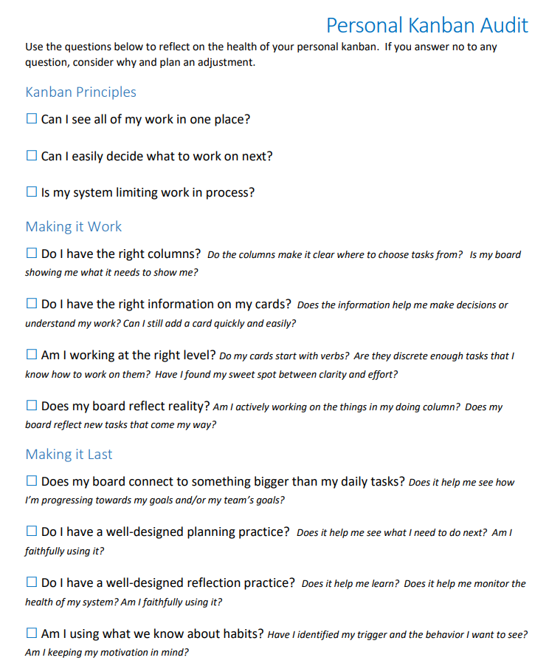
Resources
Check the conference website for a handout to help you audit your personal kanban.
Jim Benson’s Personal Kanban Introduction

Slide 39

Questions

Slide 40

thank you
heidi.loveall@des.wa.gov
Enter phone number here
Enter web address here
Notes:
Delete extraneous?

