Slide 1
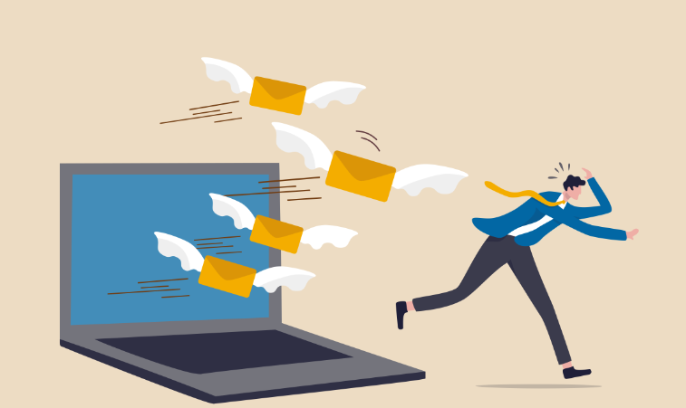
Cleaning up your Inbox Embarking on a metacognitive journey of self-awareness
Eric Stewart
Notes:
Introduction
Eric Stewart - Program Chair for HCI
Previously worked for Providence, GE Healthcare, IDX, Booz Allen Hamilton, Thinkbox, Boeing, The Everett Clinic, Computer Forensics
Teaching experience was Everett CC, Cascadia CC, UW, City U, PMI, Red Cross, JA, Cities of Renton, Yakima, Kennewick, and Snohomish County, Also Co-owner of a STEM learning center

Slide 2
Workshop Goals
Increase your productivity by cleaning up your inbox and creating a process that allows you manage your time more effectively
Review the emotional and cognitive process that promotes specific behavior and propose strategies to change behavior
Notes:
Metacognitive – moving toward what you want and moving away from what you don’t want

Slide 3
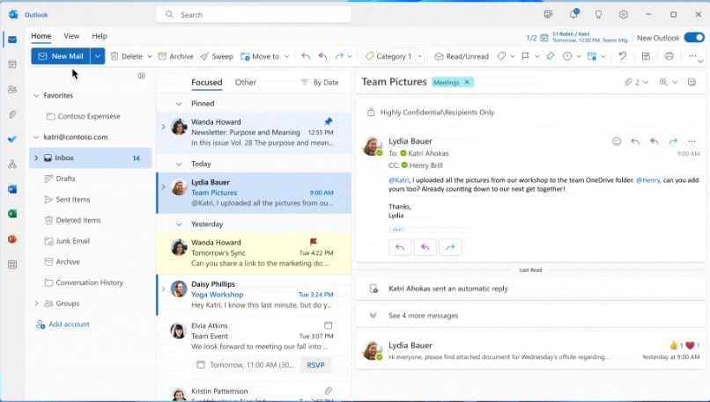
Email Inbox
https://insider.microsoft365.com/en-us/blog/new-outlook-for-windows-available-to-all-office-insiders
How Many Items Do You Have in Your Inbox?

Slide 4
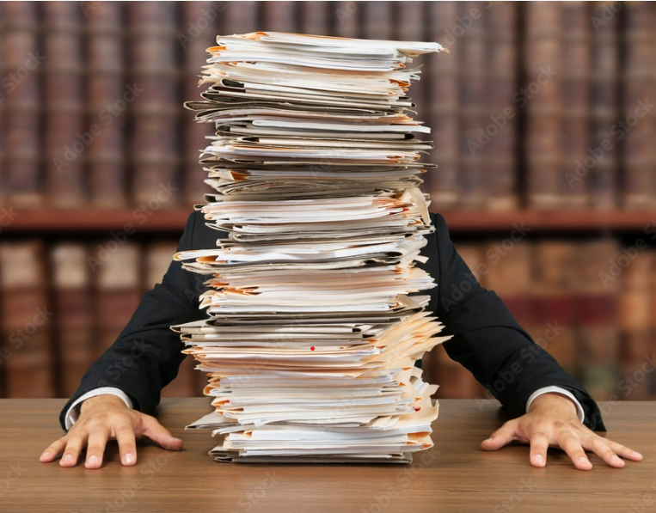
Do you feel like your inbox is out of control?

Slide 5
Cluttered Inbox
Think Lean:
What kinds of WASTE is there?
Problems:
Stress
Too many items to manage
Lack of focus
Things getting lost
Running out of space

Slide 6
What is the cost?

Slide 7
Cognitive Effects
Zygarnik Effect
Task Switching – Cognitive Shifting - Multitasking
Stress, Anxiety, Helplessness
image: Freepik.com
Notes:
Drucker’s focus on one big thing – focus on too many little things means that nothing is important.
Zygarnik – waiters – cliffhangers – Gottman – Jim Qwik

Slide 8
What is getting in our way?
Limiting Beliefs
There is too much info
Getting interrupted
Lack of discipline
Need to keep everything
Can’t find anything
Too much to do

Slide 9
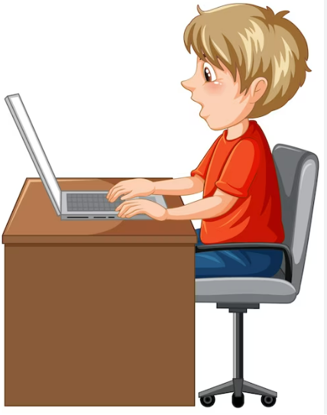
Possible Root Causes
Technology and Complexity
More Social Media Messages
Satisficing
Lack of Training or Awareness
“Reply All”
Misuse
https://www.freepik.com/vectors/computer-clipart
Notes:
Here are some possible root causes for an inbox getting filled up with too many messages:
1. **Subscriptions:** Subscribing to newsletters, mailing lists, or services that send regular updates.
2. **Spam:** Receiving unsolicited emails that clutter the inbox.
3. **Large Attachments:** Receiving emails with large attachments that consume inbox space.
4. **Multiple Accounts:** Managing multiple email accounts, each receiving its own set of messages.
5. **Email Forwarding:** Automatic forwarding of emails from other accounts or services.
6. **Email Overload:** Being included in too many email threads or group conversations.
7. **Lack of Filters:** Not using email filters to categorize and organize incoming messages.
8. **Unnecessary CCs and BCCs:** Being unnecessarily included in CC or BCC recipients lists.
9. **Reply-All Misuse:** Being included in reply-all chains that are not relevant to you.
10. **Overactive Notifications:** Receiving notifications for emails that could be managed with less frequent alerts.
11. **Unsubscribed Services:** Not unsubscribing from services or newsletters that are no longer needed.
12. **Shared Inboxes:** Using shared inboxes that receive messages meant for multiple people.
13. **Workload:** Having a high volume of work-related emails due to the nature of the job.
14. **Personal Communication:** Receiving a high volume of personal emails from friends, family, or social groups.
15. **Automatic Responses:** Receiving automatic responses or out-of-office replies from contacts.
Identifying the specific root causes can help in developing strategies to manage and reduce the influx of emails.

Slide 10
Benefits of Managed Inbox
Reduce Stress
Improve Focus
Increased Sense of Control
Better Time Management
Sense of Accomplishment
Maintain Motivation

Slide 11
How do we get there?
Process Change
Change Management
GAP
Managed
Inbox
Cluttered
Inbox

Slide 12
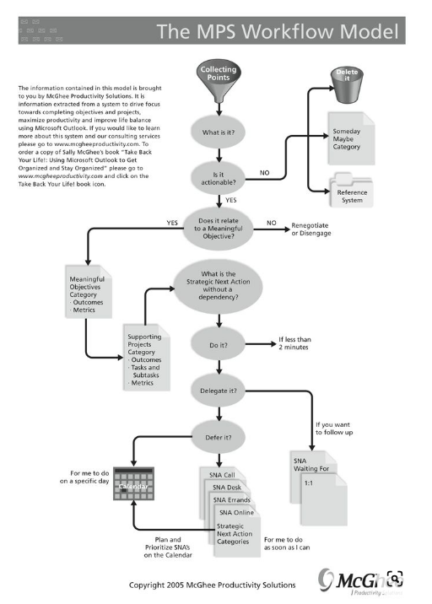
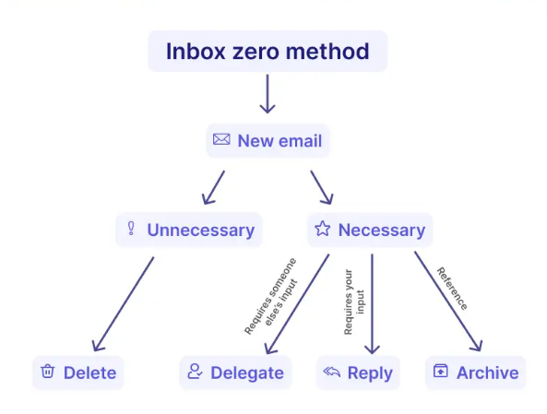
Process Models
“Take Back Your Life” Sally McGhee
“Inbox Zero” Merlin Mann
https://www.mailmodo.com/guides/inbox-zero/
https://www.pinterest.com/pin/workflow-diagram-for-dealing-with-emails-hint-create-folders--204913851770143962/

Slide 13
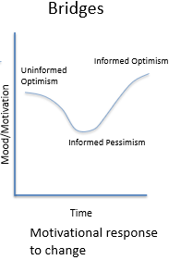
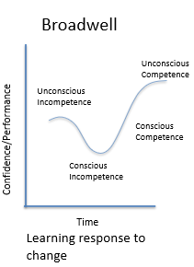
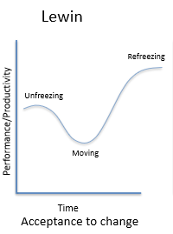
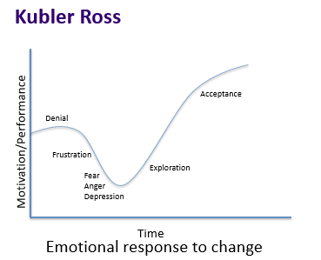
Change Models
It will be harder before it gets easier
Notes:
Lewin – “Unfreeze”
Kotter – “Create Urgency”
Utilitarianism – “Create a Good Argument”
Bridges – Identify endings, leverage why and what
ADKAR – Create compelling case for change
Prosci Practices – Overcome lack of understanding
Senge – Create the “open mind”

Slide 14
What is the Inbox?
“Inbox is the repository for incoming emails”
-PC Mag Encyclopedia
Current State:
Communication
Actions
Collection
Reference

Slide 15
Define Your Action List
Create your set of actions:
Actionable? Can you delete it?
Relevant? Is it a resource?
Can you do it right now?
Can you delegate it?
Can you schedule it?
Can you prioritize it?

Slide 16
Types of Action
Trash or Archive
Delegate – follow-up action
Respond – send a message
Schedule – calendar
Plan – task list or kanban board

Slide 17
Responding to Email Messages
Write to one reader
Put "you" in the first sentence
Get your message in 3 sentences
Read the email twice entirely before composing a reply
Put your "ask" up front, then give any details after that
Reply to angry emails by phone
Never write anything negative in an email

Slide 18
Define your actions
Actions | Types of Items | Rule to follow
Trash or Archive
Respond
Delegate
Schedule
Plan
File
Notes:
Actionable?
Relevant?
Can you do it right now?
Can you delegate it?
Can you schedule it?
Can you prioritize it?

Slide 19
Making Agreements
Define your actions with yourself and others
Respond to requests
Calendar invites
Documents
Block time to review inbox

Slide 20
Define Your Reference System
There are better places to store important resources
OneNote
Teams
SharePoint
Outlook folders

Slide 21
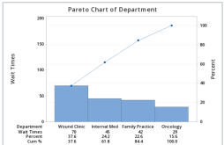
Reference System Categories
1. Classify and Categorize:
Create a set of categories
Example: Projects, programs, topics
2. Build Your Reference System
Create OneNote tabs or Email folders
Think “Pareto Chart”
Notes:
Note – have a demo ready
Note – 5S – set in order

Slide 22
Define Your Collection System
Suppliers:
Coworkers
Management
Customers
External Stakeholders
Social Media
Input:
Messages
Requests
Appointments
Important Resources
Advertising
What about:
- Voicemails
- Meeting Action Items
- Written lists
- Paper forms
Notes:
Clearing your mindVoicemail messages
Meeting action items

Slide 23
Clean up your Collection System
Add in anything that needs to be part of your action system
1
Remove or block anything that is not actionable and adds no value
2
Unsubscribe to sources that add no value
3

Slide 24
Unclutter Your Mind What else can you unload from your “mental hard drive”?
Projects started but not completed
Projects to be started
Commitments or promises to others
Communications to make or get
Meetings that need to be set up
Planning or organizing activities
Administrative activities
Professional development

Slide 25
Clean up email strategies
Method 1: Delete all old email (yikes)
Method 2:
Move all email more than 3 weeks old into folder
1
Filter for items to delete:
Calendar or Acknowledgements
2

Slide 26
Implementation
Clean up email
Create action plan
Set realistic goals and rewards
Execute process
Train yourself the process
Use change management to transform and sustain

Slide 27
Using Change Management
Limitation
Lack of Awareness
Resistance
Open Mind
Transition
Desired Behaviors
Build your Case
Plan to Motivate
Track Progress with Metrics
Make it Easy
Notes:
Address mindset

Slide 28
Build Your Case = Call to Action
Building a compelling case for change (WHY)
Build a purpose
Finding Alignment
Reframe to your story
Create your persona for success
Identity = What are my values?
Notes:
What would you refuse to tolerate?
Building a case for change
High hard goal
Create your purpose
A compelling business case for change communicates the organizational and personal motivations for change and the urgency for change.
What are we changing and what is not changing?
Why are we changing it?
What’s in it for me?
What are the consequences of not changing?
What is important to me? <> What is the purpose?
What is the rule that supports my value?

Slide 29
Plan to Motivate
What is my reward when I demonstrate the desired behavior?
What is my consequence when I demonstrate the old behavior?
Notes:
Need rules

Slide 30
Rewards and Consequences
 | Unfreeze old behavior | Refreeze new behavior
Rewards | Identify meaningful and motivating rewards | Use immediate and specific rewards and recognition to reinforce desired behavior
Consequences | Produce specific consequences to discourage old behavior and increase severity and strength of consequences | Make it difficult to succeed with old behaviors

Slide 31
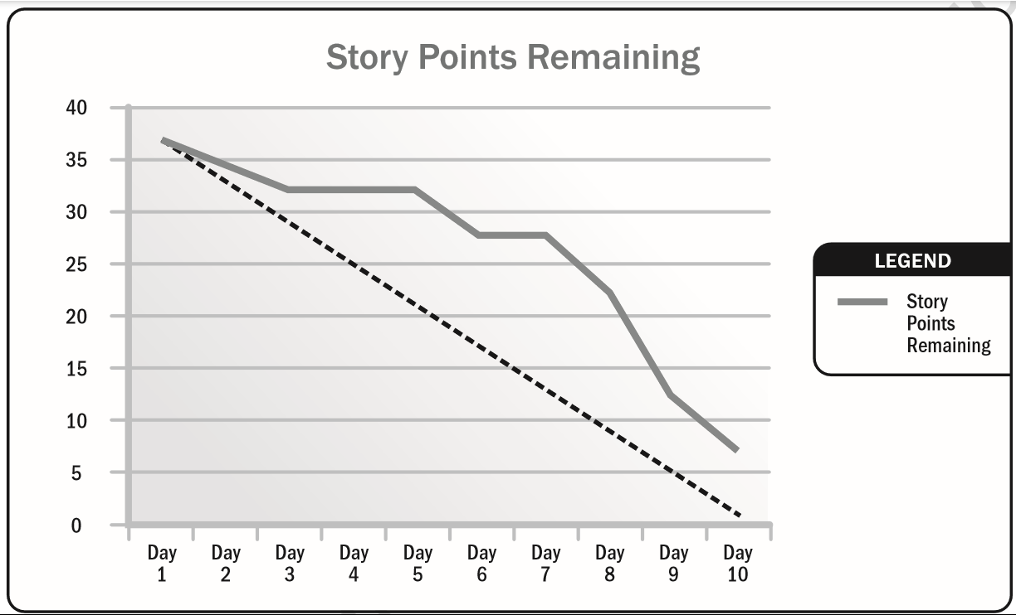
Track Progress Visual Management
Measure and Visualize Progress
Burn down chart
Thermometer
Progress Bar
Notes:
You can’t improve what you can’t measure
Data collection
Target – tolerance – metrics – data - reporting

Slide 32
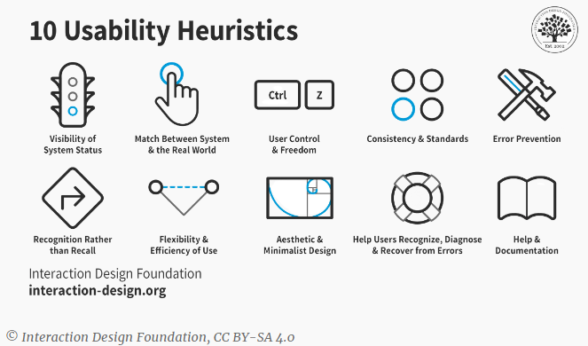
Make it Easy Using Heuristics
https://www.interaction-design.org/literature/topics/heuristic-evaluation
Notes:
Heuristics are the ways our brains are wired and affect our behaviors. The term heuristics is more like a tendency, which is called a "rule of thumb", which is not a strict set of requirements that happen every time, but a broadly defined guideline based on experience. An example of a heuristic is that right-handed people will have a bias to turn right when entering a room. The biases that we talked about in creativity for people to think a certain way are also heuristics. According to the Neilsen Norman Group, these are 10 heuristics that should be considered when designing anything. The first is that you should keep users informed on what is going on and where they are in the process. The second is that terms, concepts, icons, and images should be understandable to the user. Users should be able to tell when they have made an error, and the design should allow the user to correct mistakes, like an undo button and the design should be engineered to prevent as many mistakes as possible. There should be consistency within the design and information to use the object should be clearly marked. Useful design includes some flexibility in how the user's needs are met, and irrelevant information should be eliminated if possible. The design should include the means of getting more information for understanding through documentation and help guides.

Slide 33
TAKE ACTION!
What | Who | When
Notes:
Define actions
Setting the dates is important
How will you hold yourself accountable?

