Slide 1
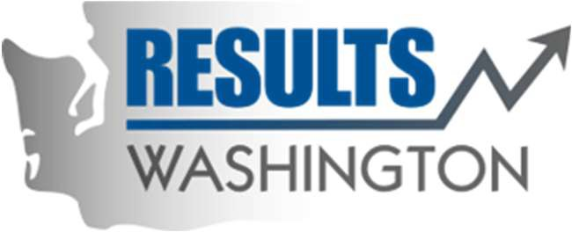
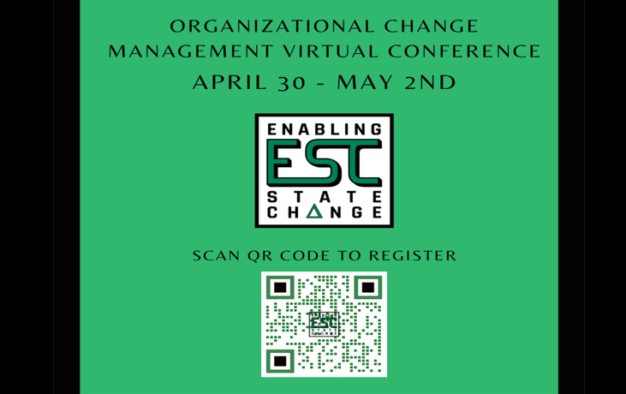
The Blast Newsletter
The blast
ENTERPRISE-WIDE LEAN AND CONTINUOUS IMPROVEMENT COMMUNITY OF PRACTICE
ISSUE NO. 16 | MARCH 2024
Transparency - Innovation - Results
WHAT YOU MISSED At our March CoP meeting, we were grateful to have Dr. Megan Schoor with the Washington State Office of Financial Management (OFM) share how to engage stakeholders and utilize their feedback throughout a project effectively, and Aunna Moss, also with OFM, share how her Organization Strategy and Performance unit used customer feedback to improve their performance, strategies, and value. See page 2 for more! LOOKING AHEAD Mark your calendars and check out what we have in store for you at our April CoP meeting on page 2.
Questions? For questions on The Blast, the CoP, or to present a teaching or project share this year, contact:
Talia Mazzara, Results WA Senior Performance Advisor
Theresa Dew, Results WA Senior Performance Advisor
Calling all change managers, culture officers, engagement professionals, state agencies & partners of state agencies!
Mark your calendars!
On behalf of Washington State’s Organizational Change Management Community of Practice, we invite you to this year's Enabling State Change Virtual Conference.
Listen to speakers discuss working through resistance, changing the world one (MS) form at a time, implementing a Change Agent Network, being an “accidental” change manager, and more!
Don’t miss it. Registration is available now.
To register, scan the QR code above or visit the registration page on our website.
We hope to see you there!

Slide 2
The Blast Newsletter – Page 2
ISSUE NO. 16 | MARCH 2024
Engaging Stakeholders: From Project to Embedded Workplace Culture
Dr. Megan Schoor with the Office of Financial Management shared a helpful teach-back that focused on how to identify stakeholders and understand their interests & influence, as well as how to gather their feedback for projects by using reflection questions and discovery sessions. As she talked us through the what, why, and how’s, Megan demonstrated how using stakeholder feedback in a project with the Education and Research Data Center‘s (ERDC) system, which provides analysis focusing on student transitions, helped them to identify and meet strategic goals in addition to identifying potential solutions and next steps for future phases. She also shared two helpful templates with us, which can be found here!
Support Systems Worksheet & System Mapping
“Fundamentally, at the heart of stakeholder engagement, is inclusion and equity.”
~ Dr. Megan Schoor
Click below to watch the CoP recording of Megan and Aunna’s presentations!
Organization Strategy and Performance Unit Customer Feedback Initiative
COMING UP NEXT
April 16, 2024
10:30 a.m. – 12:00 p.m.
Zoom Meeting
Topic Teaching & Activity:
Managing Your Inbox: Eliminating Time Waste Eric Stewart| Bellevue College
Aunna Moss, with the Organization Strategy and Performance Unit within the Office of Financial Management, presented a project share that focused on gathering customer’s feedback to help understand what current actions and possible future actions would help increase the value of their services. Through the work done with this project, OFM had many successful outcomes.
To name a few, OFM used the work from this initiative and the feedback to:
Help create strategic priorities
Clearly define services offered
Standardize work and deliverables
Adjust customer outreach approach
Identify core competencies for their work portfolio
Establish regular check-ins with OFM directors

