Slide 1
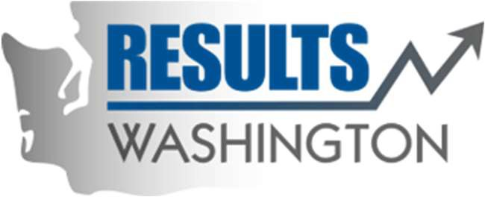
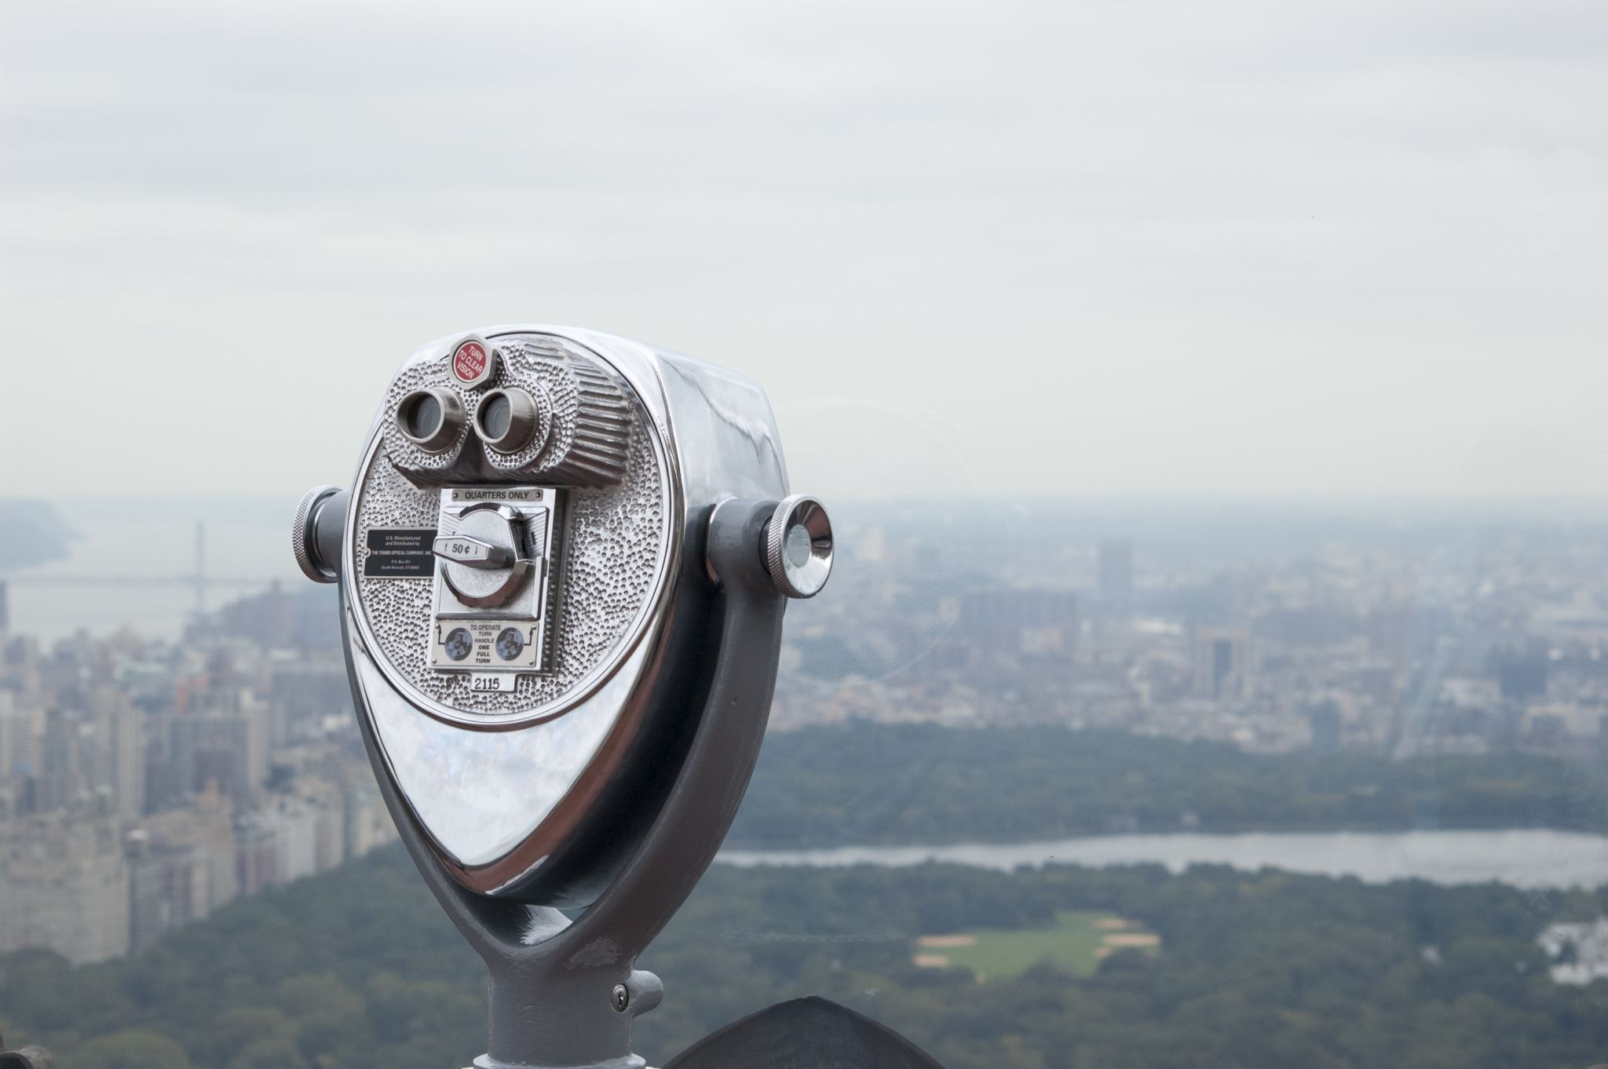
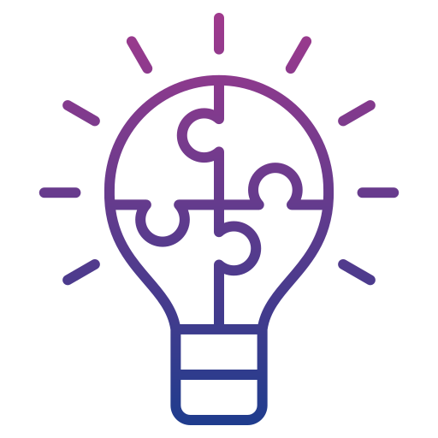
The Blast Newsletter
The blast
ENTERPRISE-WIDE CONTINUOUS IMPROVEMENT COMMUNITY OF PRACTICE
ISSUE NO. 29 | MAY 2025
Transparency - Innovation - Results
WHAT YOU MISSED At our May CoP, Ryan Zeng with the AME Seattle Consortium shared his knowledge and experience with Hoshin Kanri to strategically align at all levels of an organization. See page 2 for more! REFLECTIONS SERIES Click here to watch our Reflections Series featuring Marie Burrows with the Employment Security Department and how their agency is applying an equity lens to their employee engagement data to enhance their overall satisfaction and experience. Questions? For questions on The Blast, the CoP, or to present a teaching or project share, contact:
Talia Mazzara, Results WA Senior Performance Advisor
Theresa Dew, Results WA Senior Performance Advisor
Loading: Results Washington’s bright future! As most of you know, Results Washington is currently undergoing some rebranding to align with our new strategic direction and focus on customer experience in Washington state. We’ve been going through an internal transformation over the last few months, and we are so close to share what we’ve been working on!
While most of our work has been driven by performance management and continuous improvement, we’re so excited to include human-centered design practices into our way of thinking and operating to ensure we’re putting those we serve at the center of everything we do while making those improvements. These are still important pieces of work that we plan to carry with us!
It’s been exciting to put our own customer-centered practices to the test by inviting some of our state agency partners to review and provide feedback on our performance tools as well as our upcoming, rebranded website. We’re patiently waiting for the green light so we can go forth and conquer, but we will be sure to keep you updated!

Slide 2
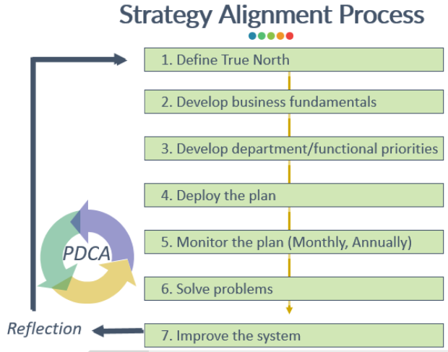
The Blast Newsletter – Page 2
Issue No. 29 | Page 2
Hoshin Kanri: Establishing Organizational Alignment At All Levels
At our recent meeting, Ryan Zeng with the Association of Manufacturing Excellence (AME) Seattle Consortium shared on Hoshin Kanri, a systematic approach for strategy alignment. Beginning with the understanding of their “true north”, deployment leaders help teams understand their current gaps, determine and prioritize the root cause(s) preventing them from reaching their target, and develop an action plan to address the most important causes. Once the plan is implemented, it’s important to continue validating the action plan and adjusting as necessary so you can continue to improve your system.
Strategy Alignment Mental Model:
Define the gaps
Reflect what happened
Prioritize possible causes
Develop an action plan
Document unsolved issues
Key Takeaways:
Get alignment on your organization’s true purpose
Use a strategy A3 to document the steps of your improvement
Continue checking your progress and adjusting as needed
Click the play button below to watch the May CoP presentation!
Presenters needed for August, November and December!
Do you have a successful project or teaching on a continuous improvement methodology that could inspire and empower others? We’re looking for passionate individuals to present and share their knowledge with our community!
This is a fantastic opportunity to: ✅ Showcase your expertise and accomplishments. ✅ Connect with like-minded professionals. ✅ Contribute to our shared growth and success.
If you’re interested, please take a moment to fill out this form, and we’ll be in touch!
Let’s learn and grow together by sharing what works. Your experience could be the key to someone else’s success!
COMING UP NEXT
June 17th, 2025
10:30 a.m. – 12:00 p.m.
Zoom Meeting
Topics:
Thriving through Uncertainty
Presenter: Talia Mazzara, Results Washington

