Slide 1
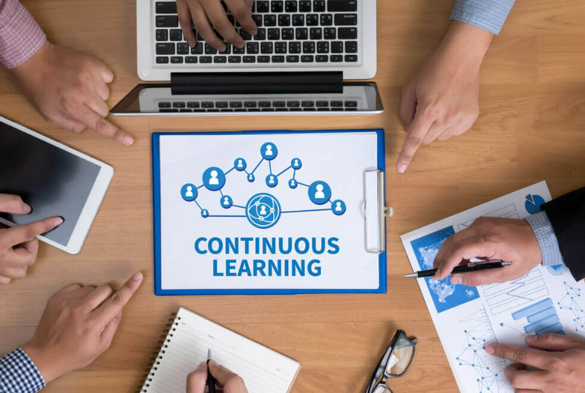
The Blast Newsletter
The blast
ENTERPRISE-WIDE LEAN AND CONTINUOUS IMPROVEMENT COMMUNITY OF PRACTICE
ISSUE NO. 23 | NOVEMBER 2024
Transparency - Innovation - Results
WHAT YOU MISSED At our November CoP meeting, we were joined by Sarah Norton and Jess Clayton with the Disability Inclusion Network, who shared an overview of the business resource group. We also heard from Vic Vong with the Office of Equity, who presented on Digitally Accessible Presentations. See page 2 for more! REFLECTIONS SERIES Click here to watch our Reflections Series featuring Beth Adams, as she speaks on Efficiency for Better Care.
Questions? For questions on The Blast, the CoP, or to present a teaching or project share, contact:
Talia Mazzara, Results WA Senior Performance Advisor
Theresa Dew, Results WA Senior Performance Advisor
Unlock Amazing Learning Opportunities Are you looking for an exciting learning opportunity? One of our community members and Lean Conference presenter, Eric Stewart with Bellevue College, has shared a fantastic course with us. He’s offering the "Usability and User-Centered Design" course, which covers essential topics like design thinking, innovations, building requirements, and agile methods.
Classes start on January 6th and run for 11 weeks. Even better, Washington State employees can enroll in this course for just $5 through a special tuition waiver program.
Don’t miss out on this amazing opportunity to expand your skills and knowledge. For more details, visit: State Employee Tuition Waiver Program

Slide 2
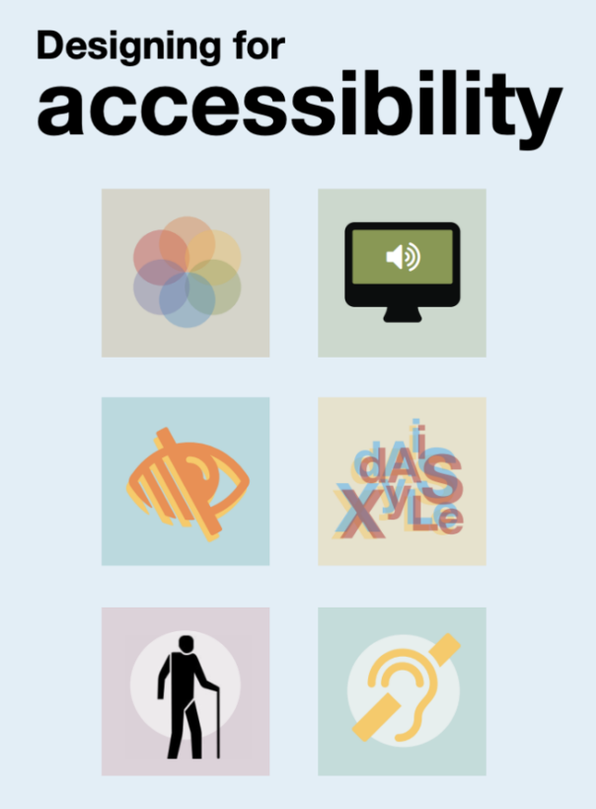
The Blast Newsletter – Page 2
ISSUE NO. 23 | NOVEMBER 2024
Digitally Accessible Presentations
This month, we had the opportunity to hear a presentation by Vic Vong from the Office of Equity, where they emphasized the critical importance of creating digitally accessible presentations. Vic highlighted the need for intentionality in our slide creation process, urging us to consider the diverse audience who will receive the information. They provided valuable insights into several key aspects of accessibility, including the significance of effective color contrast, the proper use of alt text for images, and the importance of maintaining a logical reading order. Through practical tools and examples, Vic equipped us with the knowledge to ensure our presentations are inclusive and considerate of all recipients. EQUITY’s Accessibility Checklist: External Checklist for PowerPoint Accessibility | Office of Equity
“Accessible design is good design- It benefits people who don’t have disabilities as well as people who do. Accessibility is all about removing barriers and providing the benefits of technology for everyone..”
- Steve Ballmer
Click the play below to watch the November CoP presentation!
The Disability Inclusion Network Sarah Norton and Jess Clayton represented the Disability Inclusion Network (DIN), a vital business resource group dedicated to supporting individuals with disabilities, who make up 5% of our state’s workforce. They outlined DIN’s mission of providing education, advocacy, and agency consultation to promote accessibility and inclusive policies. During their presentation, they discussed various subcommittees, the resources and guides available to members, and the engaging events featuring guest speakers that DIN hosts. Their efforts not only empower individuals but also enhance overall organizational performance by fostering a diverse and inclusive workplace. See their presentation here!
COMING UP NEXT
December 17, 2024
10:30 a.m. – 12:00 p.m.
Zoom Meeting
Topics:
Redesigning Quality Indicators to Improve Treatment Outcomes and Job Satisfaction
Rain Carei| Department of Corrections

