Slide 1
POWER UP Your PowerPoint
Tips and Tricks for creating visually appealing PowerPoints
Notes:
This presentation is designed to give you some tips and tricks for using PowerPoint so you can get the most out of your presentations. I am not an expert in PowerPoint and many of you may have skills that far exceed mine, but over the years I have challenged myself to create more visually appealing PowerPoints to try to engage virtual audiences better. Since COVID and moving to into a virtual work world, I feel PowerPoint is more relevant now than ever. I like to use PowerPoint as a visual anchor - whether that’s for a presentation, an agenda, or meeting facilitation. I believe, when used to its capacity, PowerPoint is an incredible tool to keep audiences engaged. I began my journey of learning more when a colleague of mine started creating amazing PowerPoints and she inspired me to up my game.
Before we get int the PowerPoint presentation, I want to let you know that I have tried to provide all the instructions on how to do what I’m showing you and have put a lot of information and context in the slide notes. You shouldn’t have to furiously take notes. Everything is here.
Before we get started, I want to check in and see where you feel your PowerPoint knowledge and skills are.
Beginner - Can create a basic presentation with text and images, but may struggle with formatting or organizing slides.
Intermediate: Can use more advanced features and understand slide design principles.
Advanced: Comfortable using custom slide layouts, multimedia elements, know how to manipulate themes and templates
Expert: Skilled in creating interactive presentations, integrating external data or custom visualizations
Where do you feel your skill level with PowerPoint is?

Slide 2
Follow the Rules!
1
Get permissions to use websites and download images
Please ensure you have permissions from your supervisor/IT department to use websites and download images!
Terms and Conditions may apply!
2
Ensure you attribute
Ensure you properly attribute free content you download.
3
Involve your communications team
Work with your communications team to determine when it is necessary to loop them in.
4
Use your organization's branding standards
Adhere to your organization’s branding requirements.
Review your organization’s style guide.
Notes:
Before we dive into creating visually compelling designs, it’s important to acknowledge some key constraints. While I’ll be sharing a variety of resources that I’ve personally used, it's crucial that you confirm you have the appropriate permissions to use these materials. Always ensure you have approval from your supervisor and IT department before using or downloading any external web content.
I'll also introduce several excellent sources for free visuals, but it’s important to note that many of these require you to attribute the artist. Be mindful of this when incorporating visuals into your work.
Additionally, depending on how widely your PowerPoint will be distributed, it may be necessary to consult with your communications team. Be sure to follow your organization's policies in this regard.
Lastly, don’t forget that your organization may have specific branding standards that you’ll need to adhere to, so be sure to review those before finalizing your design.

Slide 3
Accessibility Resources
Consider accessibility from the beginning!
Building in accessibility as you set up your PowerPoint will save you time in the end.
Resources for accessibility:
Results Washington Community of Practice November 2024 – Digitally Accessible Presentations
Presentation
Recording
Results Washington Community of Practice November 2023 – Data Visualization
Presentation
Recording
OFM Resources:
Making accessible documents and presentations (University of Washington DO-IT)
Presentation Accessibility Expectations for OFM DEI Conference
Notes:
While this presentation won't delve into accessibility in detail, it's important to recognize its significance from the start. There are plenty of resources available to help you ensure your presentation is accessible, and I’ve included some great links here for you.
The key takeaway is that considering accessibility early in the design process will save you time and effort in the long run. It can be challenging to go back after completing your presentation and run the accessibility checker. By building accessibility into your presentation from the beginning, you'll avoid unnecessary revisions and make the process much smoother.

Slide 4
Setting Up Your PowerPoint

Slide 5
How to Select Slide Size
Consider Your Needs
Training
Report out
Updates
Length of presentation
Tip: If you plan to print your slides, or think others may want to print them, choose a standard paper size. For digital viewing, stick with the default 16:9 ratio.
Consider Your Target Audience
Team
Office
Organization
Statewide
HOW TO
“
Select Slide Size
Go to the Design Tab
Select Slide Size on the far right
Choose Custom Slide Size
PowerPoint allows for flexible slide sizes, making it a great alternative to Word. I often use it for documents, as I can easily export my presentation to PDF or Word when finished.
Notes:
When creating a PowerPoint presentation, it's important to choose the right slide size based on your needs and your audience.
First, consider the purpose of your presentation. Are you delivering training? Is it a report-out or an update? The length of your presentation can also influence the size. For shorter, more focused presentations, the default slide size works fine, but for something like a detailed report or training session, you might want to adjust the size to fit more content.
Next, think about your audience. If you're presenting to a small team, the default size is usually fine, but if you're sharing with a larger group, such as your entire office, organization, or even on a statewide level, adjusting the size could help ensure better readability and alignment with the viewing format.
A quick tip I have is that since PowerPoint allows you to create slides in any size, I often use it for documents instead of Word. It’s much easier for me, and I can quickly export my presentation to PDF or Word if needed.
One important note to keep in mind: if your presentation will be printed, you’ll want to size your slides to match standard paper dimensions, like 8.5 x 11 inches. But, if it’s going to be viewed digitally, it's best to stick with the default 16:9 slide ratio, which is designed for most screen sizes.
To adjust the slide size in PowerPoint, go to the Design tab at the top of your screen, select Slide Size on the far right, and choose Custom Slide Size.
From there, you can set the dimensions that fit your needs.
This will help ensure your presentation is optimized for your specific purpose and audience."

Slide 6
Choosing the Right Fonts
Best Font Choices
Sans serif fonts are the most readable.
Recommended Fonts: Arial, Calibri, Century Gothic, Tahoma, and Verdana.
Font Use Guidelines
Limit to 2 fonts per presentation or stay within a font family.
Using multiple fonts can make your presentation look cluttered and distract the audience from the message.
Accent Fonts
Use accent fonts for headings or non-essential content.
Example accent fonts: Dreaming Outland Pro, and Ink Free.
Tip: Less is more. Too many fonts, or excessive use of bold, italics, or underlines, can overwhelm your audience.
HOW TO
“
Change the default font
Go to the View tab
Select Slide Master
Click Fonts, then choose Customize Fonts
Created for headlines, messages, punch
Sans serif versus Serif
Created for text blocks, quick reading
Notes:
When it comes to selecting fonts for your PowerPoint presentation, it’s important to choose options that are easy to read and visually appealing.
Let’s start with the best font choices. Sans-serif fonts, like Arial, Calibri, Century Gothic, Tahoma, and Verdana, are the most readable and work well for most presentations. These fonts don’t have the small decorative strokes at the ends of letters, making them cleaner and more legible, especially on screens.
Next, when it comes to font usage, I recommend limiting the number of fonts you use. Ideally, stick to two fonts—one for headings and one for body text. You can also use fonts from the same family, which ensures your presentation looks consistent. The goal is to keep things visually cohesive. If you use too many fonts, it can make your slides look cluttered and distract from your message.
Now, for something a bit more creative: accent fonts. These can add visual interest to your presentation, especially in headings or for non-essential content. However, be careful not to overdo it. Fonts like Dreaming Outland Pro and Ink Free can be fun to use, but they work best when used sparingly and in larger sizes.
A key tip to remember is that less is more. Using too many fonts or overusing formatting options like bold, italics, and underlines can make your presentation feel chaotic and distract your audience. Keep it simple and focused on the content.
Finally, if you want to change the default font for your entire presentation, just go to the View tab, select Slide Master, click on Fonts, and choose Customize Fonts. This allows you to set a consistent font style across all slides.
By following these guidelines, you’ll ensure that your presentation is visually appealing, easy to read, and not overwhelming to your audience."

Slide 7
Choosing Font Size
Follow the 30% Rule
Slide Title: 32-60 pt font size (largest for visibility).
Headers: 30% smaller– 20-32 pt font size.
Text: 30% smaller than headers - no smaller than 18 pt font size.
Adjust Font Size Based on Room Size
Larger rooms require larger fonts for readability.
Consider Viewing Conditions
Will your audience be viewing on a monitor or projector screen? This impacts the font size choice.
Tip: Before presenting in a conference room, test your presentation in that room to ensure the font size and color contrast are readable from the farthest seats.
HOW TO
“
Go to View tab
Select Slide Master
Scroll to slide layout (e.g., ‘second level’) and adjust font sizes for each level.
Consistency is key – ensure uniform font sizes throughout your presentation. If necessary, reduce content to maintain a clean, readable layout.
Notes:
When choosing font sizes for your PowerPoint presentation, it’s important to follow a few guidelines to ensure your content is readable and effective, regardless of the size of the room or the screen.
First, let's talk about the 30% rule. The title of your slide should be 32 to 60 point font size—this makes it large enough to grab attention. The headers should be 20 to 32 point font size, about 30% smaller than the title. Your text should be no smaller than 18 point—again, about 30% smaller than the header. This ensures that your content is easy to read, even from the back of the room.
Next, you should adjust your font size based on the size of the room. The larger the room, the larger your font needs to be. If you're presenting in a small room, a smaller font may work, but for larger conference rooms, you'll want to go bigger to make sure everyone can read your slides.
You also need to consider how people will be viewing the presentation. Are they looking at it on a monitor or a projector screen? If it’s on a projector, you’ll want to increase the font size because the image might not be as sharp. For monitors, standard font sizes usually work fine, but always check before presenting.
A helpful tip is to test your presentation in the actual conference room beforehand. Check the color contrast and the font size to make sure your slides are readable from the farthest seats. This gives you the opportunity to adjust things if needed.
Finally, when choosing your font size, remember that consistency is key. It’s important to maintain the same font sizes throughout the presentation to keep things clean and cohesive. If necessary, reduce the amount of content on the slide to keep your font size consistent.
To adjust font sizes across your presentation, go to the View tab, select Slide Master, and then scroll to the specific slide layouts (like the 'Second Level' slide) to change the font sizes for each level of text.
By following these guidelines, you'll ensure that your slides are easy to read and look professional, no matter where you're presenting.

Slide 8
Creating Your Color Palette
Determine Your Color Palette
Use your organization’s branding colors.
Gather inspirations from the graphics or images you are using in the presentation.
Use free color palette generators, such as:
Coolors - The super fast color palettes generator!
Color palette generator | Canva Colors
Color theme from image | Adobe Color
Design Seeds
Accessible color palette builder
Create Your Custom Color Palette
Draw several squares: Go to the Insert Tab, select Shapes, then choose Square
Select your shape: Click on the square.
Go to the Shape Format tab
Click on Shape Fill and use the Eye Dropper tool to copy colors from your graphic
Find the HEX Code by selecting More Fill Colors
Copy the hex code and paste it into the square for your Custom Colors.
#186889
#3BA7B6
#FCBA4C
#FC9224
HOW TO
#E18171
#F03E62
#F66175
#FF9FCD
Create a Custom Palette
Go to the Design Tab
Click on Variants
Select Colors
Choose Customize Colors
Notes:
Now, let's talk about choosing and creating your color palette for your presentation. Color plays a huge role in setting the tone and making your content visually appealing, so it’s important to pick the right colors and use them effectively.
First, start by determining your color palette. A great place to begin is by using your organization’s branding colors. If you're working on a organization-wide presentation, it’s important to stay consistent with your brand’s established color scheme. If you’re using images or graphics in your presentation, you can gather inspiration from those as well. Look at the colors in your visuals, and pull from them to create a cohesive look.
If you're looking for more variety or inspiration, there are several free color palette generators that can help you out. Some popular tools include Coolors, Canva Colors, Adobe Color, and Design Seeds. These can generate color palettes that work well together and can save you time in the design process.
Once you’ve chosen your colors, you might want to create a custom color palette. To do this, follow these simple steps. First, draw several squares on your slide by going to the Insert tab, selecting Shapes, and choosing Square. After that, click on the square and go to the Shape Format tab. From here, click on Shape Fill and use the Eye Dropper tool to select colors directly from your images or graphics. Then, find the HEX code for the color by selecting More Fill Colors. Copy that HEX code and paste it into your square, so you have an accurate representation of that color.
Finally, if you want to customize colors for your entire presentation, go to the Design tab, click on Variants, select Colors, and then choose Custom Colors. This allows you to set a consistent color scheme across all your slides.
By following these steps, you’ll be able to create a color palette that’s not only visually appealing but also consistent and aligned with your brand or message."

Slide 9
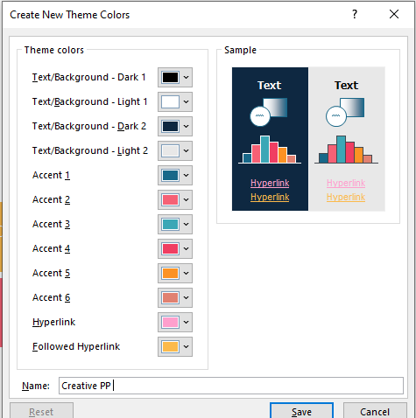
Custom Colors
#186889
#3BA7B6
#FCBA4C
#FC9224
#E18171
#F03E62
#F66175
#FF9FCD
Tip: When you create a custom color theme in PowerPoint, it automatically provides you with various gradient shades of those colors for use in shape fills, shape outlines, text fills, and more.
Notes:
Chat Question: These tips in selecting slide size and pre-loading the presentation with the desired font, font size and color palette, have saved me countless hours. In the past, I would spend a lot of time reviewing the presentation and going through each slide to ensure the same font was used, and the font size was consistent across the presentation. I have fought against the default color palette, going in and recoloring many shapes and images to match.
I want to know from you, between selecting slide size, pre-loading font types, preloading font size, or preloading a custom color palette, what are you most excited to try in your next PowerPoint?

Slide 10
PowerPoint Design

Slide 11
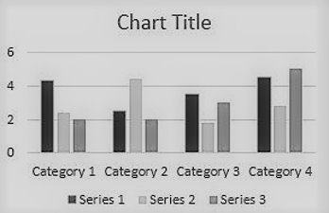
Effective Use of Color In Presentations
Test in Greyscale
Check how your slides look in black and white to ensure the content makes sense without relying on color.
Consider Color Accessibility
Remember, some audience members may be color-blind. Use color combinations that are distinguishable to everyone. Check out: National Eye Institutes Color Blindness page.
Tip: Avoid using red and green together in lists and charts as color-blind individuals may struggle to differentiate them. Consider adding labels or icons to indicate positive/negative terms. Check out: Harvard University Digital Accessibility page.
Notes:
Let's now dive into the effective use of color in your PowerPoint presentations. Color is an incredibly powerful tool for conveying your message, but it’s essential to use it wisely so that it’s accessible and clear to all members of your audience.
First, a key principle: Don’t rely on color alone to tell your story. While color can enhance your presentation, it should be complemented by labels, icons, or other visual markers to make sure your message is clear, even for those who might have difficulty perceiving certain colors.
One helpful tip is to test your slides in greyscale. PowerPoint allows you to do a print preview in black and white, so you can check whether your slide still makes sense without the use of color. This ensures that even if someone is viewing your presentation in a setting where color is lost (like a black-and-white printout), they will still be able to understand the key points.
Another important consideration is color accessibility. Some members of your audience may be color-blind, meaning that using certain color combinations—like red and green—can make it difficult for them to distinguish between positive and negative items, especially if you’re using colored text in a list. To help with this, try adding icons or labels alongside your colored text. For example, you could use a green checkmark for positive items and a red ‘X’ for negative ones. This ensures that your message is still clear, regardless of color perception.
Lastly, remember to check out resources on using color to convey information. This will help you better understand how to choose color combinations that are visually distinct and accessible for all audiences.
In summary, color is a great tool to enhance your presentation, but it’s important to be mindful of how you use it to ensure clarity and accessibility for everyone in your audience.

Slide 12
Choosing Free Graphics
Free sources for pictures and images
Freepik | Create great designs, faster
Great for vector graphics and collections of graphics – works best with Chrome.
5.1 million+ Stunning Free Images to Use Anywhere – Pixabay
Comprehensive content (photos, videos, illustrations) with no attribution needed.
Beautiful Free Images & Pictures | Unsplash
High-quality, artistic photography for creative projects.
Great for finding Washington landscapes.
Flat Icon: Vector Icons and Stickers - PNG, SVG, EPS, PSD and CSS
Great for icons & vectors and getting ideas on what images to use to represent different words or concepts.
Noun Project: Free Icons & Stock Photos for Everything
Icon-focused design, ideal for simple and clear visual communication.
Free Stock Photos, Royalty Free Stock Images & Copyright Free Pictures · Pexels
Modern, high-quality stock photos and videos, especially for commercial use.
Notes:
Now let’s talk about choosing graphics for your presentation. Graphics can make your slides much more engaging, but it’s important to use them effectively and source them from reputable, high-quality places. Fortunately, there are several free resources available to help you find the perfect images, icons, and illustrations. Let me walk you through six trusted sources for free graphics that you can use in your presentations:
I have more information about each of these in the slide notes that you can review later.
Freepik: Best for customizable graphics, vectors, and design elements.
Unique Offerings: Freepik is a comprehensive resource that offers not only free images but also a wide range of vectors, illustrations, PSD files, and icons. This makes it particularly useful for users looking for customizable graphics and design elements.
Use Case: Ideal for graphic designers who need high-quality visuals, icons, and templates that can be edited in design software (e.g., Photoshop or Illustrator).
Attribution: Free for personal and commercial use with attribution required unless you have a premium subscription.
Pixabay: Comprehensive content (photos, videos, illustrations) with no attribution needed.
Unique Offerings: Pixabay offers a vast library of free images, videos, illustrations, and vectors. All content is released under a Creative Commons Zero (CC0) license, which means you can use them for personal and commercial purposes without attribution.
Use Case: Great for general use and quick access to a variety of content types, especially when you need high-quality images without worrying about licensing.
Attribution: No attribution required, even for commercial use.
Unsplash: High-quality, artistic photography for creative projects.
Unique Offerings: Unsplash is known for its high-quality, artistic photos. The platform has a curated collection of photography, mostly focused on lifestyle, nature, and architecture.
Use Case: Best suited for users looking for photography-style images with a more artistic and polished feel.
Attribution: Free for commercial and personal use, with no attribution required, though attribution is appreciated.
Flaticon: Icons and vectors for UI/UX design and presentations.
Unique Offerings: Flaticon specializes in icons and vector-based illustrations. It has one of the largest collections of free icons available in multiple formats (SVG, PNG, etc.).
Use Case: Ideal for finding icons to complement your PowerPoint presentations, websites, or applications.
Attribution: Free with attribution, or you can remove the attribution with a premium subscription.
The Noun Project: Icon-focused design, ideal for simple and clear visual communication.
Unique Offerings: The Noun Project offers an extensive library of icons and symbols for almost any concept. Their icons are simple and universally recognizable, making them ideal for communication-focused projects.
Use Case: Perfect for icon-based design and presentations where visual simplicity and clarity are key.
Attribution: Free with attribution, or you can use them without attribution with a paid plan.
Pexels: Modern, high-quality stock photos and videos, especially for commercial use.
Unique Offerings: Pexels offers high-quality photos and videos with an emphasis on contemporary and creative visuals. Their collection is also known for its diversity, including people, landscapes, and professional settings.
Use Case: Best for users looking for modern, high-quality stock photos and videos that are free for commercial use.
Attribution: No attribution required, even for commercial use.

Slide 13
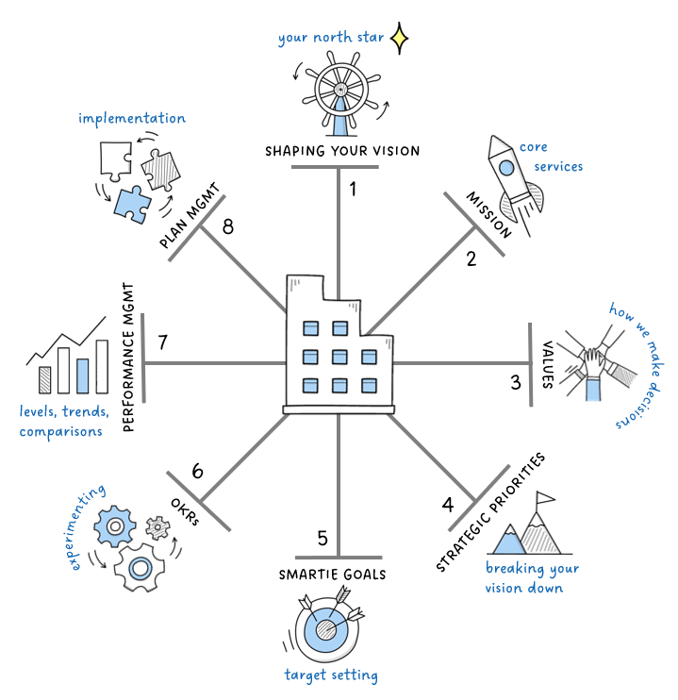
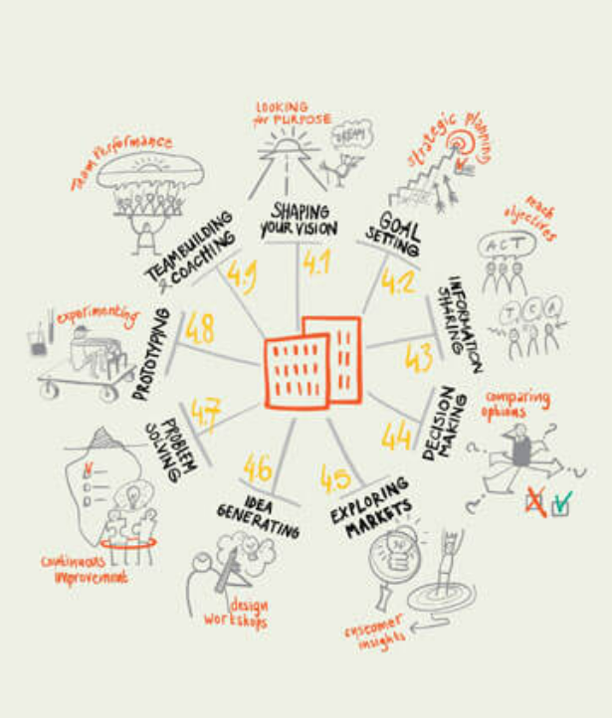
Finding Your Inspiration
Books
Magazines
Online images
RW CoP presentations
Lean Conference presentations
Canva
24Slides
Notes:
Inspiration for your PowerPoint design can come from a wide variety of sources. Personally, I've drawn ideas from books, magazines, online images, other people’s presentations, and even platforms like Canva. Even if you don’t have a Canva account or the ability to create content there, you can still browse the site for great design ideas to adapt and recreate on your own.
For example, I found inspiration in the book Visual Thinking, where there’s a page featuring a wheel design that outlines different business settings where visual thinking can be applied. I was drawn to the concept of the wheel, so I adapted it to create my own version, illustrating the 8 steps of strategic planning that I presented at the RW CoP in November 2022.

Slide 14
Great Design Practices
Golden Ratio or Fibonacci Sequence
Symmetrical vs. Asymmetrical Balance
Visual Hierarchy & Size Relationships
Harmony Repetition
Grouping Elements
Visual Echoes
Notes:
Great design isn’t just about making slides look pretty—it’s about organizing your content in a way that’s both visually appealing and easy for your audience to understand.
Design principles like the Golden Ratio or Fibonacci Sequence can help you create balanced, harmonious compositions by guiding where to place elements.
Harmony and repetition help create consistency and flow, making your design feel cohesive.
Grouping elements helps organize content logically, while deciding between symmetrical or asymmetrical balance allows you to create either a more formal, structured look or a dynamic, modern one.
Another key element is visual hierarchy, which guides the viewer’s eye through the slide in a logical order based on size, position, and importance of elements.
Lastly, visual echoes—subtle repetitions of shapes or colors—create a sense of unity and reinforce the design. By applying these principles, you can create slides that are both functional and aesthetically pleasing, leading to clearer communication and more engaging presentations.“
Using the Golden ratio or Fibonacci Sequence
Ever wonder why something just “feels” right? It may have to do with mathematics and how that melds with art to create the golden ratio in design. This ancient formula, dubbed the “divine proportion is the invisible force behind visually pleasing arrangements for centuries. From the spirals of galaxies, to the petals on a flower – and yes, right down to that PowerPoint slide that you admire. This sequence is a mathematical ratio, approximately 1.618:1 suggests an inherent balance. If you divide a number in a sequence, by its predecessor, as you move along, this ratio gets closer to a magical number of roughly 1.618.
Without getting into all the math, lets consider a typical face, the forehead constitutes 1/3 of the face and the rest of the face constitutes the remaining 2/3. This is a pleasing design for people.
Harmony Repetition
Repetition helps establish visual harmony and it’s a great attention attractor.
Repeat colors, themes, styles
Some of the harmony repetitions I have used are, the lightbulb to represent a tip, the bell to represent a “how to”, the same banner on every page. Branding is also one of the most common harmony repetitions.
Grouping elements
At the heart of grouping and proximity lies the human brain’s innate ability to recognize patters and relationships. This cognitive function, often referred to as Gestalt psychology, explains how we perceive visual elements as part of a whole rather than as isolated components. According to Gestalt principles, our brains naturally group objects that are close to each other or similar in appearance, allowing us to make sense of complex visual information quickly.
By strategically placing elements in close proximity, you can guide viewers to perceive them as related, helping them to process and understand the information more efficiently. Conversely, spacing elements further apart can signal a lack of relationship, enabling you to delineate different sections of your design clearly.
Grouping can be achieved through various means, including consistent use of color, shape, size, or style. Be careful to maintain balance through, over-grouping can lead to visual clutter, making the design overwhelming and difficult to navigate.
Symmetrical vs. asymmetrical balance
Symmetrical design offers order and predictability, while asymmetrical design provides creativity and intrigue.
Symmetry repeats parts of an image across an axis, along a path, or around a center. It fosters balance and cohesion.
Asymmetry can draw attention, convey dynamism, or create movement.
Visual hierarchy and size relationships
Visual hierarchy is the principle of arranging elements to show their order of importance. Designers structure visual characteristics so users can understand information easily. By laying out elements logically and strategically, designers influence users’ perceptions and guide them to desired actions.
Visual hierarchy controls the delivery of the experience. If you have a hard time figuring out where to look on a page, it’s more than likely that its layout is missing a clear visual hierarchy.
Follow a person’s natural way of taking in information – left to right and top to bottom. Size and placement on the slide will tell the audience what is most important.
Visual echoes
A visual echo establishes an attractive sense of unity between design elements in a layout. One easy way to achieve a visual echo is to reuse or echo the colors in a photograph or illustration in the colors, typography and styles of your layout.
The eyedropper tool here is your best friend. You can pick a color from your image and use that for other elements on your slide.

Slide 15
Golden Ratio or Fibonacci Sequence
Selecting Slide Size
Golden Ratio or Fibonacci Sequence
Consider your needs
Training
Report out
Updates
Length of presentation
Tip: Since you can create PowerPoints in any size, I rarely use Word anymore, I find PowerPoint much easier to use. I can export to a PDF or Word Doc when I’m done.
Consider your target audience
Team
Office
Organization
Statewide
“
HOW TO
If you think people might want to print your PowerPoint, you will want to size your slide to a typical paper size. However, if your PowerPoint will only be viewed digitally, you will likely want to keep it at the default 16x9 ratio.
Select Slide Size
Design tab
Slide size at far right
Custom size
Notes:
Now, let’s take a closer look at how the Fibonacci Sequence can be applied to a slide layout. In this example, I’ve overlaid the Fibonacci sequence, which is often referred to as the Golden Ratio, onto one of the slides we’ve already discussed. The Fibonacci sequence follows a specific pattern and is known for creating balanced, aesthetically pleasing compositions.
As you can see, the spiral guides your eye toward the most important elements of the slide, helping to ensure that key information is placed in positions where your audience will naturally focus. By aligning elements along the curve of the sequence or within its boxes, we can create a visually balanced layout that feels natural and harmonious.
This technique isn’t something you need to use in every slide, but it’s a great tool to keep in mind when trying to design a layout that’s both pleasing to the eye and effective in directing attention to the most important areas of the slide. The Fibonacci sequence helps ensure your design isn't just random but follows a pattern that our brains find aesthetically appealing."

Slide 16
Design Practices
Visual Hierarchy top down, left to right
Selecting Slide Size
Grouping Elements such as placing examples under headings
Tip: Since you can create PowerPoints in any size, I rarely use Word anymore, I find PowerPoint much easier to use. I can export to a PDF or Word Doc when I’m done.
Consider your needs
Training
Report out
Updates
Length of presentation
Harmony Repetition with theme colors & icons
Symmetry - order and predictability
Asymmetry - creativity and intrigue
Consider your target audience
Team
Office
Organization
Statewide
Visual Echoes – color of type font and quotation matching theme colors
“
HOW TO
If you think people might want to print your PowerPoint, you will want to size your slide to a typical paper size. However, if your PowerPoint will only be viewed digitally, you will likely want to keep it at the default 16x9 ratio.
Select Slide Size
Design tab
Slide size at far right
Custom size
Notes:
On this slide, I’ve highlighted several key design principles that come together to create a balanced, engaging, and organized layout. Let’s walk through how each of these elements is applied.
First, notice how I’ve used visual hierarchy. By organizing the content top to bottom and left to right, I’m guiding your eye through the slide in a logical order. This is important because our brains naturally read in that direction, so placing the most important information at the top or to the left ensures it grabs attention first.
Next, take a look at how I’ve grouped elements. See how I placed the examples under the corresponding headings to help the viewer easily connect related pieces of information. Grouping similar items together enhances comprehension and makes the content easier to navigate.
I’ve also applied harmony and repetition in several places. The use of consistent theme colors and icons throughout the slide creates a cohesive look and helps reinforce the overall message. This consistency makes the slide feel unified and easier to follow.
Now, look closely at the visual echoes. I’ve matched the color of the type font and quotation marks to the theme colors. This repetition not only ties the elements together but subtly reinforces the visual identity and theme of the presentation, making it feel cohesive and intentional.
When it comes to symmetry and asymmetry, I’ve intentionally created a symmetrical layout for the text—this gives the slide a sense of order and predictability. However, I’ve also introduced some asymmetry in the design image to add a touch of creativity and intrigue. This combination of symmetry and asymmetry keeps the design both structured and visually interesting, giving the slide a dynamic, engaging feel.
By applying these principles—visual hierarchy, grouping, harmony and repetition, visual echoes, and a balance of symmetry and asymmetry—I’ve designed a slide that’s not only aesthetically pleasing but also effective in communicating information clearly.“
These design principles have helped me immensely in creating more visually appealing PowerPoints.
Chat: Which of the previous design principles, use of color, free sites for graphics and images, where to find your inspiration, or great design practices are you most excited to try in your next PowerPoint?

Slide 17
Tips and Tricks

Slide 18
Isolating Your Images
After downloading into your PowerPoint:
1
Crop the Image: Start by cropping the image as closely as possible to the part you want to keep.
2
Open the “Picture Format” Tab: Click on the image to reveal the “Picture Format” tab in the top ribbon.
3
Select “Crop”: – In the Picture Format tab, locate the “Crop” button at the far right of the toolbar.
4
Remove the Background: While still in the Picture Format tab, go to the far left on the toolbar and click on “Remove Background.”
5
Mark Areas to Keep: PowerPoint will highlight areas to remove in purple. Click on the areas you want to keep and adjust as needed.
6
Refine the Selection: Use the “Mark Areas to Keep” option to ensure the image looks as you want it by coloring and additional areas to retain.
Notes:
Now let’s talk about isolating images. This technique is useful when you want to make an image stand out from its background or remove unnecessary elements. To isolate an image, simply follow these steps: First, select the image you want to edit. Then, go to the Picture Tools tab and click Remove Background. PowerPoint will automatically detect the background and highlight areas to remove. You can adjust the selection using the Mark Areas to Keep or Mark Areas to Remove options for more precision. Once you're happy with the selection, click Keep Changes. This method helps focus attention on the subject of your image, making it cleaner and more professional for your slide design. By following these steps, you will have an image with great quality that you can size and layer as needed.

Slide 19
Aligning Your Images
1
Select the Items: Click to select the shapes, pictures, or text boxes you want to align. To select multiple items, hold the Shift key while clicking each one.
2
Open the Format Tab: Once your items are selected, go to the Shape Format or Picture Format tab (depending on the type of content you’re working with.
3
Click on “Align”: In the toolbar, find and click the Align button.
4
Choose Your Alignment: From the alignment options, select the alignment that suits your needs (e.g., align left, center, top, etc.
“
Aligning images is quick and easy and saves so much time! Get your images close to where you want them and then let the alignment function snap them into a perfect order.
Notes:
Now, let's walk through the process of aligning images to make sure everything is neat and properly organized. Aligning your images, shapes, and text boxes is a simple but powerful way to improve the professional look of your slides.
First, you'll need to select the items you want to align. You can click on each one individually, or if you're selecting multiple items, just hold the Shift key while clicking each one.
Next, head over to the Format Tab. Depending on the type of content you're working with, you'll use either the Shape Format or Picture Format tab.
Once your items are selected, click the Align button in the toolbar. This gives you several alignment options such as align left, center, top, and more.
A helpful tip: aligning images is not only quick but also saves a lot of time! Just get your images close to where you want them, and then let PowerPoint’s alignment function snap them into place, giving your slide a clean, polished look."

Slide 20
Setting Your Shape Size
1
Select the Shape: Click on the shape you want to resize.
2
Open the Shape Format Tab: Go to the Shape Format tab in the top ribbon.
3
Adjust the Size: On the far right of the tab, you’ll see the Height and Width options. Enter the desired values for each to set the shape’s size.
“
50%
I use this function most often when trying to draw a perfect circle or ensuring icons or pictures are set at the same size.
Notes:
Let’s go over how to set the size of your shapes. This is particularly useful when you need precise dimensions, like creating a perfect circle or ensuring that multiple icons or images are the same size.
First, click on the shape you want to resize. Then, go to the Shape Format Tab in the top ribbon. On the far right of the tab, you’ll find the Height and Width options. Simply enter your desired values for each to adjust the size.
I use this feature most often to ensure consistency in size, like when I'm creating uniform icons or adjusting shapes to exact proportions. It’s a great way to keep your design neat and professional."

Slide 21
Grouping Images
1
Select the Items: Click to select the shapes, text boxes, or images you want to group. To select multiple items, hold down the Shift key while clicking each one.
2
Right-click: Once all items are selected, right-click on one of them.
3
Choose “Group”: From the context menu, select Group to group the items together.
“
Grouping is one of the tools that can make your accessibility review MUCH easier!
Notes:
Grouping images, shapes, and text boxes together is a simple but powerful technique that can greatly improve your workflow. It allows you to move, resize, or format multiple elements as a single unit, which saves you time and effort compared to adjusting each item individually.
Grouping also helps maintain a consistent layout, ensuring that the relative positioning of elements stays intact, even when you need to make adjustments later. This is especially valuable when working with complex slides.
Additionally, grouping makes your presentation more accessible, as it ensures consistency for screen readers and simplifies adding uniform alt text. It also reduces the risk of misalignment during editing, keeping your design neat.
Lastly, if you need to make updates, grouping means you can make changes to all items at once, streamlining the process and saving time.
Chat: We’ve just gone over 4 of my top tips/tricks that I find the most value in: Isolating images, aligning images, setting shape size, and grouping images. Which of these are you most excited to try in your next PowerPoint?
Why Grouping Images is Beneficial:
Improves Workflow Efficiency: Grouping images, shapes, and text boxes together makes it much easier to move, resize, or format multiple elements at once. Instead of adjusting them individually, grouping allows you to work with all selected items as a single unit, saving you time and effort.
Maintains Consistent Layout: When you group items, their relative positioning is preserved. This ensures that your design stays aligned and organized, even when you need to move or adjust the elements later. This is particularly helpful when working with complex slides that require precise placement.
Enhances Accessibility: Grouping elements also plays an important role in making your presentations more accessible. When elements are grouped, it’s easier to ensure they stay consistent when screen readers interpret the content. Additionally, grouping makes it simpler to apply uniform alt text descriptions to all elements in the group, which improves the experience for visually impaired users.
Reduces the Risk of Misalignment: By grouping your images and objects, you ensure they remain aligned and properly positioned relative to each other, avoiding any accidental shifts or misplacement during editing.
Streamlines Editing and Updates: If you need to make changes to the design later, having elements grouped together means you only have to make adjustments once, rather than editing each individual element separately. This makes updating your design much quicker and easier.
Chat: Which of the Tips and Tricks I went over: Isolating images, aligning images, setting shape size, or grouping images are you excited to try in your next PowerPoint?

Slide 22
Creating Infographics

Slide 23
Stock Photos and Icons
1
Access Stock Images and Icons: PowerPoint offers a wide variety of stock phots and icons that you download directly without visiting another website.
2
Go to “Insert” Tab: In the top ribbon, click on the Insert tab.
3
Select Pictures: In the Insert tab, click on Pictures to open the options.
4
Choose Stock Images: From the dropdown menu, select Stock Images to browse and insert stock photos or icons.
5
Open the Graphics Format Tab: Once your image or icon is inserted, click on it, then go to the Graphics Format tab in the top ribbon.
6
Adjust Fill and Outline: In the Graphics Format tab, use the options to change the Fill and/or Outline of your graphic to customize it to your needs.
Notes:
Next I’m going to show you how to create infographics using only stock photos and icons that everyone should have available to them. To access stock photos and icons, follow these steps.

Slide 24
Light Bulb Infographic
New Concept
Some info here
Main Concept
Some info here
Main Concept
Some info here
Inspiration
Main Concept
Some info here
Main Concept
Some info here
Notes:
To use this for your own PowerPoint, follow these steps:
Right click on the slide in the view layout to the left
Copy slide
In your presentation, find the location you wish the slide to appear, e.g. between slides 10 and 11
Right click and choose the middle paste option (clipboard with paint brush) which is “keep source formatting”
Delete the inspiration picture, inspiration text box, and arrow
Download appropriate icons: insert tab/pictures/stock images
Then search for your image and choose the icon tab
Click the graphic you want and then click insert button at the bottom

Slide 25
Combining Stock Images
+
+
=
Layer a shape over part of the image, and give it a white fill, to create a break in the image
Recolor the shape outline and increase the weight of the outline
Duplicate (Cntl + D) image, resize, recolor
+
+
=
+
=
Insert shape - Arc
Shape outline - Arrow
Flowchart terminator shape – resize, recolor, and rotate

Slide 26
Process Layout
Inspiration
TYPE YOUR TITLE
Text here for additional context
TYPE YOUR TITLE
Text here for additional context
TYPE YOUR TITLE
Text here for additional context
02
04
06
01
03
05
TYPE YOUR TITLE
Text here for additional context
TYPE YOUR TITLE
Text here for additional context
TYPE YOUR TITLE
Text here for additional context
Notes:
To use this for your own PowerPoint, follow these steps:
Right click on the slide in the view layout to the left
Copy slide
In your presentation, find the location you wish the slide to appear, e.g. between slides 10 and 11
Right click and choose the middle paste option (clipboard with paint brush) which is “keep source formatting”
Delete the inspiration picture, inspiration text box, and arrow
Download appropriate icons: insert tab/pictures/stock images
Then search for your image and choose the icon tab
Click the graphic you want and then click insert button at the bottom

Slide 27
Shape Outline Options
1
Weight: Use heavier weights for main shapes or objects that need to stand out, and lighter weights for the background or supporting items.
2
Dash: Great for adding variety to your design – Use dashed or dotted lines for informal settings and solid lines for professional, clean layouts.
3
Sketch: Perfect for informal, creative, or artistic presentations that want a casual, hand-drawn effect.
4
Color and Gradient: Choose colors that align with your design’s tone, purpose, and brand identity. Gradients can add a polished or sophisticated look, while solid colors ensure clarity and emphasis.
Notes:
Weight:
What it is: The weight option controls the thickness of the outline around a shape.
How it works: You can adjust the weight to make the outline thicker for more emphasis or thinner for a more subtle look. A heavier outline draws more attention to the shape, while a lighter weight might be better for more delicate or subtle designs.
When to use: Use heavier weights for emphasis (e.g., on key shapes or titles) and lighter weights for secondary or supporting elements.
Dash:
What it is: The dash option lets you choose different line styles for the outline, such as solid, dashed, or dotted lines.
How it works: A solid outline is continuous, while dashed or dotted outlines are made up of short lines or dots.
When to use: Dashed or dotted lines are great for informal, creative, or design-centric presentations. Use a solid line for a clean, professional look, and a dashed line for a more dynamic or playful feel.
Sketch:
What it is: The sketch outline style mimics a hand-drawn look, creating a more organic, casual appearance for your shapes.
How it works: It adds a rough, imperfect edge to your shape's outline, resembling the feel of a hand-drawn sketch.
When to use: Use sketch outlines for more creative or informal presentations where you want a relaxed or artistic vibe, such as in educational or creative fields.
Color:
What it is: The color option allows you to change the color of the outline, giving you full control over the visual appearance.
How it works: You can choose any color that matches your design, from bold, attention-grabbing hues to subtle, complementary tones.
When to use: Use contrasting colors for high-impact visuals or branding colors to maintain consistency with your organization’s theme. Lighter shades are better for softer, more neutral designs.
Gradient:
What it is: Gradient outlines offer a gradual transition from one color to another, giving your shapes more depth and dimension.
How it works: You can choose a color gradient that gradually shifts from one color to another, creating a more dynamic, multi-dimensional effect.
When to use: Gradients are great for adding a more sophisticated or modern look to your shapes, particularly for design-heavy presentations or when you want to create a sense of depth.

Slide 28
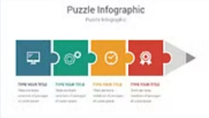
Puzzle Infographic 1
Inspiration
TITLE HERE
Content & Info
TITLE HERE
Content & Info
TITLE HERE
Content & Info
TITLE HERE
Content & Info
Notes:
To use this for your own PowerPoint, follow these steps:
Right click on the slide in the view layout to the left
Copy slide
In your presentation, find the location you wish the slide to appear, e.g. between slides 10 and 11
Right click and choose the middle paste option (clipboard with paint brush) which is “keep source formatting”
Delete the inspiration picture, inspiration text box, and arrow
Download appropriate icons: insert tab/pictures/stock images
Then search for your image and choose the icon tab
Click the graphic you want and then click insert button at the bottom

Slide 29
Using Shapes to Create Images
Puzzle Piece
+
=
Square
Oval
Puzzle Piece
=
+
=
=
+
Increase weight of shape outline and color it white
Add a rectangle to hide the outline on the square, then remove the outline
Add another square to the end and continue with desired puzzle pieces
Add two triangles to make the pencil point

Slide 30
Infographic Templates

Slide 31
Copying Slides Between Presentations
1
Open both presentations
2
Select the slides to copy
3
Copy the slides
4
Paste the slides
5
Adjust slide order
Notes:
1. Open Both Presentations:
Open the PowerPoint presentation that contains the slides you want to copy.
Then, open the destination presentation where you want to paste the slides.
2. Select the Slides to Copy:
In the Slide Sorter view (in the left panel), click on the slide you want to copy.
To select multiple slides, hold down the Ctrl key while clicking on each slide you want to copy
3. Copy the Slides:
Once the slides are selected, right-click on one of the slides and select Copy from the context menu.
4. Paste the Slides:
In the Slide Sorter view (left panel), click where you want to insert the slides (either between two existing slides or at the end of the presentation)
Right-click and select Paste from the context menu.
5. Adjust Slide Order:
If needed, you can click and drag the slides in the left panel to reorder them within the destination presentation.

Slide 32
Slide Paste Options
Choose Paste Options:
After pasting, a small Paste Options button may appear near the slides. Click it to choose how the slides are pasted.
Keep Source Formatting: Retains the original design, layout, and formatting of the copied slides.
Use Destination Theme: Adapts the slides to match the theme of the destination presentation.
Picture: Pastes the slide as a picture.
All images by Stephanie2212 via Freepik

Slide 33
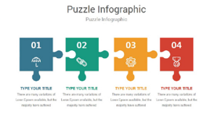
Puzzle Infographic 2
Inspiration
01
02
03
04
TITLE HERE
CONTENT & INFO
TITLE HERE
CONTENT & INFO
TITLE HERE
CONTENT & INFO
TITLE HERE
CONTENT & INFO
Notes:
To use this for your own PowerPoint, follow these steps:
Right click on the slide in the view layout to the left
Copy slide
In your presentation, find the location you wish the slide to appear, e.g. between slides 10 and 11
Right click and choose the middle paste option (clipboard with paint brush) which is “keep source formatting”
Delete the inspiration picture, inspiration text box, and arrow
Download appropriate icons: insert tab/pictures/stock images
Then search for your image and choose the icon tab
Click the graphic you want and then click insert button at the bottom

Slide 34
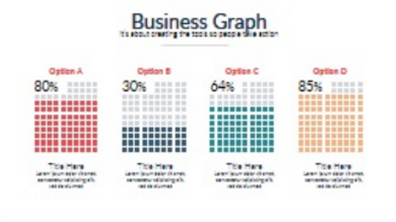
Chart Infographic
Inspiration
Option A
Option B
Option C
Option D
80%
30%
64%
85%
Title
Subtext
Title
Subtext
Title
Subtext
Title
Subtext
Notes:
To use this for your own PowerPoint, follow these steps:
Right click on the slide in the view layout to the left
Copy slide
In your presentation, find the location you wish the slide to appear, e.g. between slides 10 and 11
Right click and choose the middle paste option (clipboard with paint brush) which is “keep source formatting”
Delete the inspiration picture, inspiration text box, and arrow
Download appropriate icons: insert tab/pictures/stock images
Then search for your image and choose the icon tab
Click the graphic you want and then click insert button at the bottom

Slide 35
Circle Infographic
Put some text here
03
Put some text here
Put some text here
02
04
Put some text here
01
Put some text here
05
Notes:
To use this for your own PowerPoint, follow these steps:
Right click on the slide in the view layout to the left
Copy slide
In your presentation, find the location you wish the slide to appear, e.g. between slides 10 and 11
Right click and choose the middle paste option (clipboard with paint brush) which is “keep source formatting”
Delete the inspiration picture, inspiration text box, and arrow
Download appropriate icons: insert tab/pictures/stock images
Then search for your image and choose the icon tab
Click the graphic you want and then click insert button at the bottom

Slide 36
Step-by-Step Infographic
1
2
3
4
TYPE YOUR TITLE
Text here
TYPE YOUR TITLE
Text here
TYPE YOUR TITLE
Text here
TYPE YOUR TITLE
Text here
Notes:
To use this for your own PowerPoint, follow these steps:
Right click on the slide in the view layout to the left
Copy slide
In your presentation, find the location you wish the slide to appear, e.g. between slides 10 and 11
Right click and choose the middle paste option (clipboard with paint brush) which is “keep source formatting”
Delete the inspiration picture, inspiration text box, and arrow
Download appropriate icons: insert tab/pictures/stock images
Then search for your image and choose the icon tab
Click the graphic you want and then click insert button at the bottom

Slide 37
Services Infographic
Main Service
Sub Text
Main Service
Sub Text
Main Service
Sub Text
Main Service
Sub Text
Notes:
To use this for your own PowerPoint, follow these steps:
Right click on the slide in the view layout to the left
Copy slide
In your presentation, find the location you wish the slide to appear, e.g. between slides 10 and 11
Right click and choose the middle paste option (clipboard with paint brush) which is “keep source formatting”
Delete the inspiration picture, inspiration text box, and arrow
Download appropriate icons: insert tab/pictures/stock images
Then search for your image and choose the icon tab
Click the graphic you want and then click insert button at the bottom

Slide 38
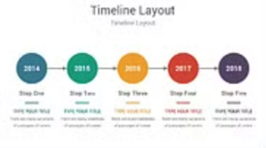
Timeline Layout
Inspiration
2020
2021
2022
2023
2024
Step One
Step Two
Step Three
Step Four
Step Five
Type Your Title
Content here
Type Your Title
Content here
Type Your Title
Content here
Type Your Title
Content here
Type Your Title
Content here
Notes:
To use this for your own PowerPoint, follow these steps:
Right click on the slide in the view layout to the left
Copy slide
In your presentation, find the location you wish the slide to appear, e.g. between slides 10 and 11
Right click and choose the middle paste option (clipboard with paint brush) which is “keep source formatting”
Delete the inspiration picture, inspiration text box, and arrow
Download appropriate icons: insert tab/pictures/stock images
Then search for your image and choose the icon tab
Click the graphic you want and then click insert button at the bottom

Slide 39
Business Vision Infographic
MAIN CONCEPT
Sub text
MAIN CONCEPT
Sub text
MAIN CONCEPT
Sub text
MAIN CONCEPT
Sub text
Notes:
To use this for your own PowerPoint, follow these steps:
Right click on the slide in the view layout to the left
Copy slide
In your presentation, find the location you wish the slide to appear, e.g. between slides 10 and 11
Right click and choose the middle paste option (clipboard with paint brush) which is “keep source formatting”
Delete the inspiration picture, inspiration text box, and arrow
Download appropriate icons: insert tab/pictures/stock images
Then search for your image and choose the icon tab
Click the graphic you want and then click insert button at the bottom

Slide 40
Presentation Graphics You Must Attribute!! Stephanie2212 via Freepik.com

Slide 41
Images with Background Removed

Slide 42
Images 2

Slide 43
Images 3

Slide 44
Images 4

Slide 45
Images 5

Slide 46
Images 6

Slide 47
Images 7

Slide 48
Images 8

Slide 49
Images 9

Slide 50
Images 10

Slide 51
Images 11

Slide 52
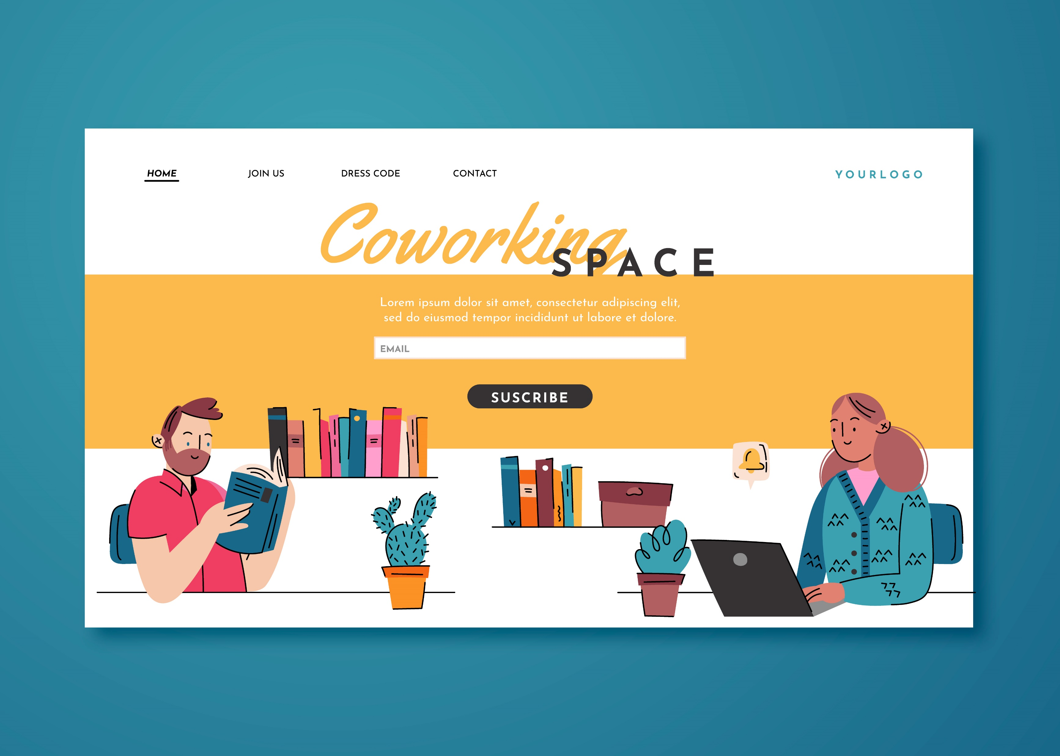
Images 12

Slide 53
Images 13

Slide 54
Images 14

Slide 55
Web Inspiration

Slide 56
Inspiration graphics 1

Slide 57
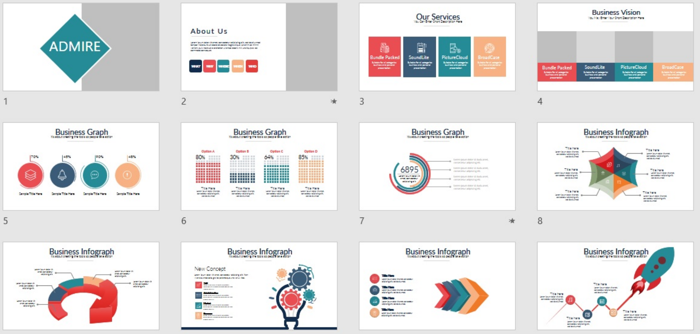
Inspiration graphics 2

Slide 58
Inspiration graphics 3

