Slide 1
DMADV
Using LEAN DMADV in Equity Analyses and Project Implementation
Jeremy Walker
Equity Analyst, Office of Equity And Belonging at Commerce
11/30/2023
Notes:
This is a presentation on using LEAN Define, Measure, Analyze, Design, and Validate approach to conduct Equity Analyses and Project Implementation. This presentation provides examples from recent work done in collaboration with the Building Community Facilities program. Nothing in this presentation should be confused as mandatory practices in Equity Analyses as there is no perfect way to conduct equity analysis. Each equity analysis should be conducted in close coordination with the people who are affected by the program outcomes and done according to all federal and state laws that apply. In addition the tools discussed within this project are still in draft and not finalized or considered a final product.

Slide 2
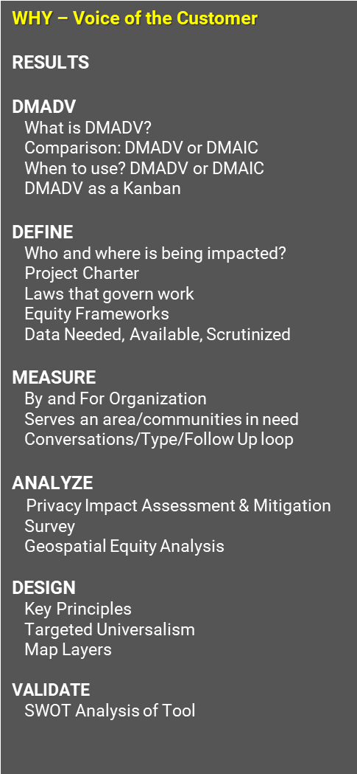
Intro
WHY – Voice of the Customer
RESULTS
DMADV
What is DMADV?
Comparison: DMADV or DMAIC
When to use? DMADV or DMAIC
DMADV as a Kanban
DEFINE
Who and where is being impacted?
Project Charter
Laws that govern work
Equity Frameworks
Data Needed, Available, Scrutinized
MEASURE
By and For Organization
Serves an area/communities in need
Conversations/Type/Follow Up loop
ANALYZE
Privacy Impact Assessment & Mitigation
Survey
Geospatial Equity Analysis
DESIGN
Key Principles
Targeted Universalism
Map Layers
VALIDATE
SWOT Analysis of Tool
Step up engagement with Black, Indigenous, People of Color (BIPOC) Led , By-and-For Led organizations and Tribal Governments
Expand the overall number of organizations applying for BCF grant program.
Who and where are these organizations across Washington State?
What are their barriers to applying? (Expand on existing research)
Create new tools and environments to build meaningful relationships with organizations so they can decide whether to apply or not.
Notes:
When working in LEAN you’ll often hear the term “Voice of the Customer” who is the customer? Who are we serving? Who is being impacted? In Equity work you’ll often hear who are we centering? Which communities are most impacted by the programs or legislation? In my work the voice of the customer are the people who are most impacted by the programs or legislation, which tends to be Black, Indigenous, People of Color and the many intersections of people who have been historically and currently underserved by government. LEAN and Equity are complimentary as long as the voice of the customer is aligned with who is most impacted by the work being done.
The Building Community Fund reached out to me to conduct an equity analysis and process improvement. Recent studies that were sponsored by program staff showed a need to step up engagement with Black, Indigenous, People of Color Led organizations, By and For Led organizations and Tribal governments. The overarching goal was to expand the number of organizations applying for the BCF grant program. However, in order to achieve this information, key questions needed to be answered. Who and where are these organizations across Washington State? What are their barriers to apply? And, Create new tools and environments to build meaningful relationships with organizations so they can decide whether to apply or not.

Slide 3
Successful Intersectional Lenses Design: BDF Outreach Tool
WHY – Voice of the Customer
RESULTS
DMADV
What is DMADV?
Comparison: DMADV or DMAIC
When to use? DMADV or DMAIC
DMADV as a Kanban
DEFINE
Who and where is being impacted?
Project Charter
Laws that govern work
Equity Frameworks
Data Needed, Available, Scrutinized
MEASURE
By and For Organization
Serves an area/communities in need
Conversations/Type/Follow Up loop
ANALYZE
Privacy Impact Assessment & Mitigation
Survey
Geospatial Equity Analysis
DESIGN
Key Principles
Targeted Universalism
Map Layers
VALIDATE
SWOT Analysis of Tool
Notes:
This slide shows the success of the project. At the end of the project, 38,000 organizations were identified as possible organizations that can apply for BCF funding. 1,200 of these organizations were possibly By and For Led organizations. The project also designed a multi-layered prototype outreach tool that allowed staff to filter by different priority areas to see where staff could plan in-person and virtual community engagements about the program. The map of Washington is lit up in highlight yellow showing the richness of opportunities and opportunities that exist with organizations across the state!

Slide 4
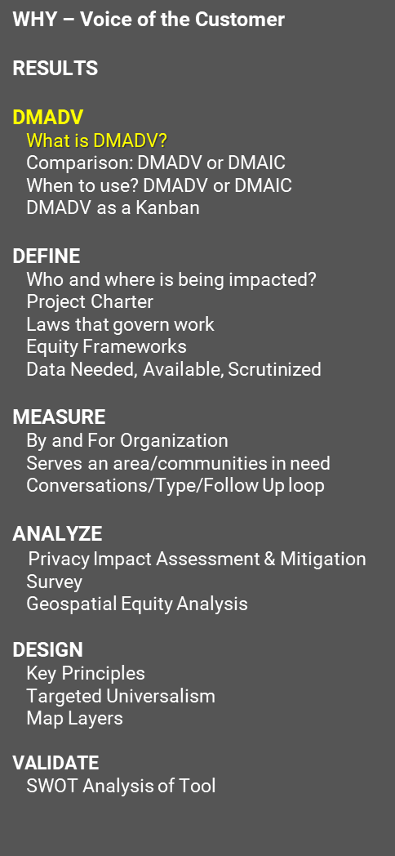
What is DMADV?
WHY – Voice of the Customer
RESULTS
DMADV
What is DMADV?
Comparison: DMADV or DMAIC
When to use? DMADV or DMAIC
DMADV as a Kanban
DEFINE
Who and where is being impacted?
Project Charter
Laws that govern work
Equity Frameworks
Data Needed, Available, Scrutinized
MEASURE
By and For Organization
Serves an area/communities in need
Conversations/Type/Follow Up loop
ANALYZE
Privacy Impact Assessment & Mitigation
Survey
Geospatial Equity Analysis
DESIGN
Key Principles
Targeted Universalism
Map Layers
VALIDATE
SWOT Analysis of Tool
Define
Measure
Analyze
Design
Verify
DEFINE purpose and goals that include high level voice of the customer.
MEASURE detailed understanding of customers’ critical to quality deliverables, data sets, frameworks and methodologies for analysis.
ANALYSE internally apply multiple approaches and methodologies of analysis to discern best one that fulfills customer’s required deliverables.
DESIGN co-create new process or tool with customers most impacted by it and staff administering process or too.
VERIFY Does the new process or tool meet the customers’ critical to quality deliverables? Customers and staff administrators test process or tool.
Analyze new data and adjust.
Notes:
What is DMADV? DMADV is a LEAN approach. D stands for Define. Define the purpose and goals that include high level voice of the customer. M stands for Measure, detailed understanding of customers’ critical to quality deliverables, data sets, frameworks and methodologies for analysis. A stands for Analysis. The LEAN approach requires you to internally apply multiple approaches and methodologies of analysis to discern which approach/methodology is the best one that fulfills customer’s required deliverables. D stands for Design. Design is not an individual only process, it is co-creative in nature and should be done with the customers most impacted by the product or services. V stands for Verify, does the new process or tool meet the customers’ critical to quality deliverables? Analyze new incoming data and make adjustments to verify that the process or tool meets the customers’ critical to quality deliverables.

Slide 5
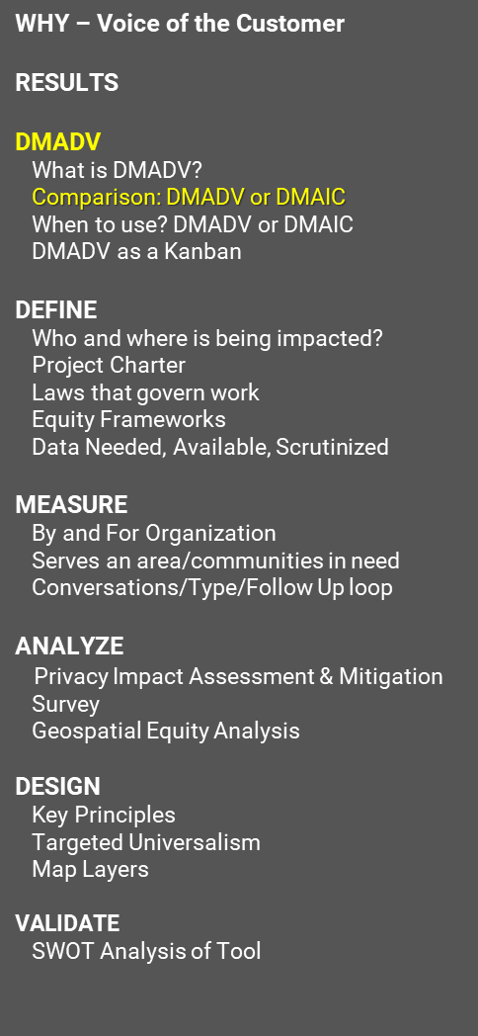
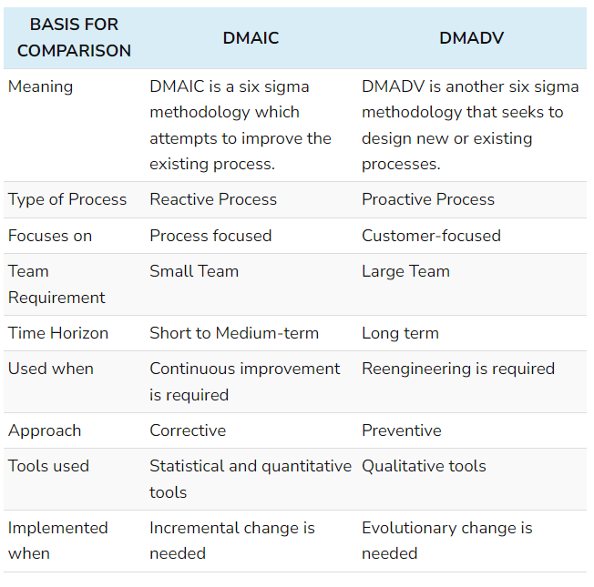
What’s the Difference?
WHY – Voice of the Customer
RESULTS
DMADV
What is DMADV?
Comparison: DMADV or DMAIC
When to use? DMADV or DMAIC
DMADV as a Kanban
DEFINE
Who and where is being impacted?
Project Charter
Laws that govern work
Equity Frameworks
Data Needed, Available, Scrutinized
MEASURE
By and For Organization
Serves an area/communities in need
Conversations/Type/Follow Up loop
ANALYZE
Privacy Impact Assessment & Mitigation
Survey
Geospatial Equity Analysis
DESIGN
Key Principles
Targeted Universalism
Map Layers
VALIDATE
SWOT Analysis of Tool
Credit: Surbhi S, March 2022
Notes:
Many have heard of DMAIC, which is different from DMADV. Author Surbhi, a LEAN practitioner established 9 differences between DMAIC and DMADV.
Meaning: DMAIC is meant to improve existing processes while DMADV is used to design new processes.
Type of Process: DMAIC is a reactive process which relies on past outcomes and DMADV is a proactive process that looks towards creating new possibilities.
Focus: DMAIC is meant to focus on processes while DMADV is better at co-creating with customers or communities.
Team Size: DMAIC teams are often small, 1 to 7 people. DMADV teams can be very large because you have a lot of customers and communities.
Approach: DMAIC’s approach is to correct a process by controlling outcomes. DMADV is an approach to prevent good intentions turn into bad outcomes.
Tools Used: DMAIC relies more on statistical and quantitative tools. DMADV relies more on qualitative tools that collect voice of the customers.
Implemented when: DMAIC is implemented when small changes are needed to an existing process. DMADV is used when big changes are needed to design new products or services.

Slide 6
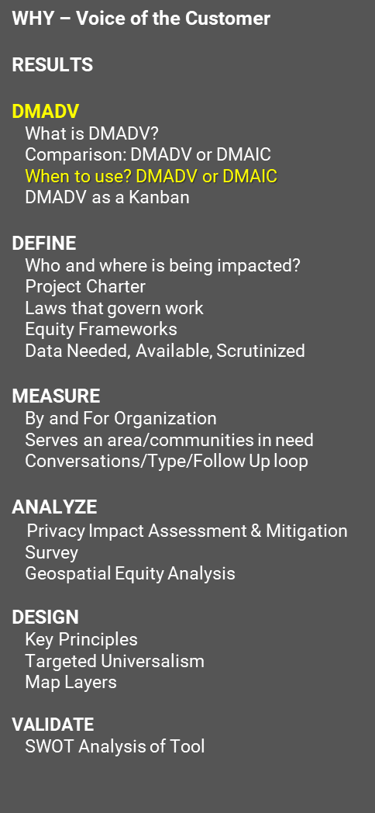
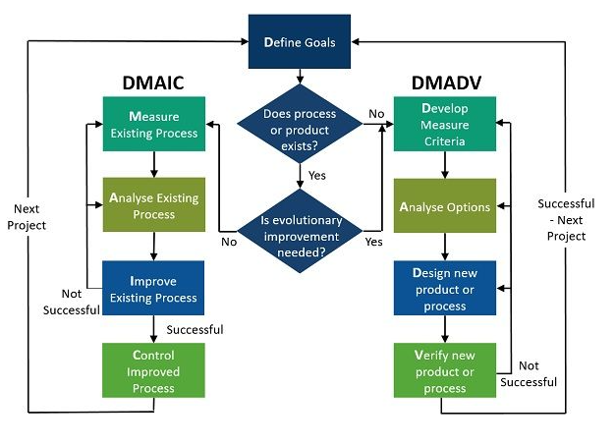
Decision making process
WHY – Voice of the Customer
RESULTS
DMADV
What is DMADV?
Comparison: DMADV or DMAIC
When to use? DMADV or DMAIC
DMADV as a Kanban
DEFINE
Who and where is being impacted?
Project Charter
Laws that govern work
Equity Frameworks
Data Needed, Available, Scrutinized
MEASURE
By and For Organization
Serves an area/communities in need
Conversations/Type/Follow Up loop
ANALYZE
Privacy Impact Assessment & Mitigation
Survey
Geospatial Equity Analysis
DESIGN
Key Principles
Targeted Universalism
Map Layers
VALIDATE
SWOT Analysis of Tool
Credit: Surbhi S, March 2022
Notes:
This is a diagram that shows the decision making process of when to use DMAIC or DMADV. There are essentially two questions that you should ask yourself. Does the process or product already exist and is the evolutionary improvement needed? If the process or product doesn’t exist and a big change is needed, then use DMADV. Otherwise, DMAIC will work for you most of the time. Both DMAIC and DMADV processes during project close out will bring you back to defining goals.

Slide 7
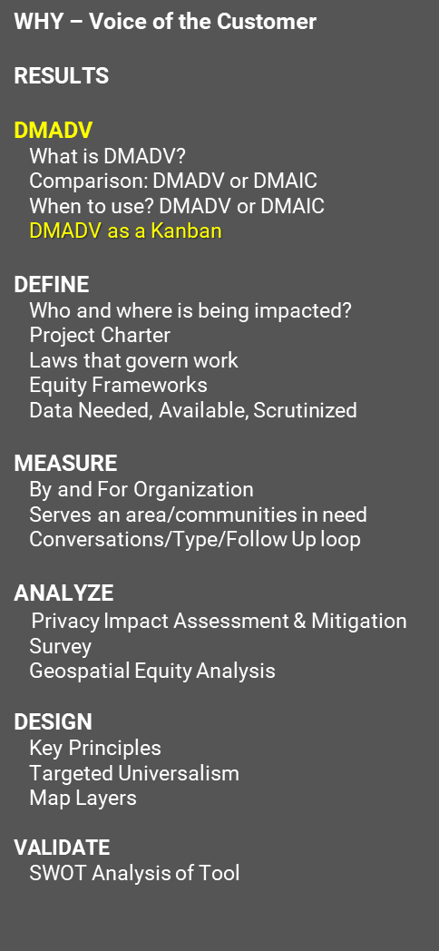
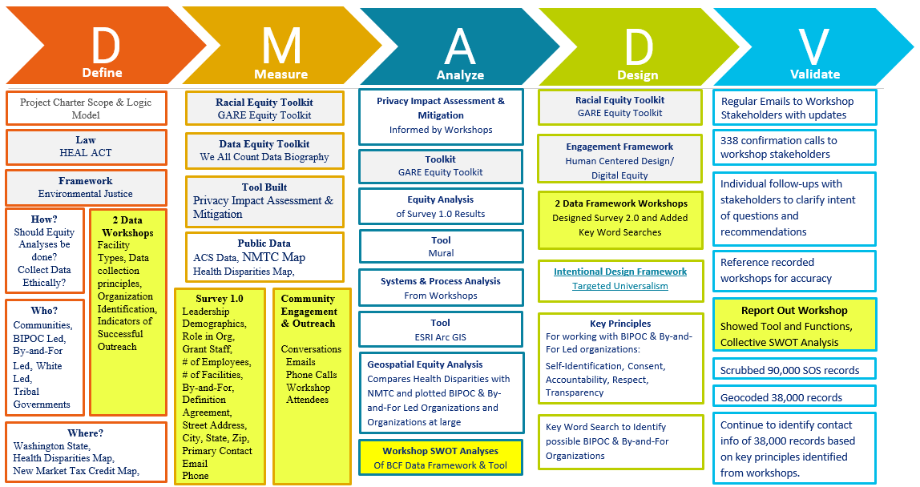
DMADV as Kanban
WHY – Voice of the Customer
RESULTS
DMADV
What is DMADV?
Comparison: DMADV or DMAIC
When to use? DMADV or DMAIC
DMADV as a Kanban
DEFINE
Who and where is being impacted?
Project Charter
Laws that govern work
Equity Frameworks
Data Needed, Available, Scrutinized
MEASURE
By and For Organization
Serves an area/communities in need
Conversations/Type/Follow Up loop
ANALYZE
Privacy Impact Assessment & Mitigation
Survey
Geospatial Equity Analysis
DESIGN
Key Principles
Targeted Universalism
Map Layers
VALIDATE
SWOT Analysis of Tool
Notes:
This slide shows a picture of a Kanban Board. Each column header has an acronym level of DMADV, below each column header are a list of activities.
The define column lists: Project Charter Scope & Logic Model, HEAL Act Law, Environmental Justice Framework; How should Equity Analysis be done? Collect Data Ethically? Who should be included in this work? Communities, BIPOC Led Organizations, By and For Led organizations, white led organizatons, tribal governments. In order to answer these questions two data workshops were held that went through the detailed data collection of facility types, data collection principles, organization identification, and indicators of successful outreach by these different customers and communities. The define column also included defining geographical boundaries using Washington State ESRI GIS map, the Health Disparities Map from the Department of Health, and the New Market Tax Credit Map which was currently in use by the BCF program.
The Measure column includes the use of the GARE Racial Equity Toolkit, the Data Equity Toolkit from We All Count, a Quantitative Privacy Impact Assessment & Mitigation tool, Collection of Publicly available data like ACS Data, NMTC Map and Health Disparities Map. In addition to these toolkits and frameworks, a demographic and geographic survey was issued to recent BCF applicants and known By and For organizations across Commerce. Those organizations who RSVPd for workshops were called and thanked for signing up. This allowed for greater trust and conversation to occur during the project.
The Analyze column included assessments of the data included in the measurement column. A workshop was held with surveyed organizations to conduct a strengths, weaknesses, opportunities and threats (SWOT) analysis of the existing data and report. This primarily covered the mapping of the data which is the first iteration of how the BCF Outreach tool might look like and the privacy impact assessment & mitigation tool. The SWOT Analysis was used to adjust the BCF Tool and the privacy impact assessment and mitigation tool so that information could be collected more securely while protecting privacy and collecting information in an equitable way.
The design column includes applying multiple toolkits, methodologies and frameworks including Human Centered Design, GARE Racial Equity Toolkit, and Targeted Universalism. This is the operationalization of multiple analyses. You might note that this may sound like the Analyze step, however it is important to understand that analysis could not be done without applying the principles and questions under each of these frameworks and methods, which meant the design of the tool had to occur first. These different approaches resulted in the development of a formula that could be used to identify possible By and For Organizations from the publicly available Secretary of State organization registration data.
The Validate column includes many efforts to validate that the formula and process up to this point meet different communities and organizations needs. This included 338 confirmation calls with workshop stakeholders over the course of the project and reporting out in written and oral presentations to workshop attendees what the BCF tool prototype looked like.
It is not incorrect to believe that many of the activities listed under each of the DMADV columns is a project of itself. You would not be incorrect. However, this work was conducted by me, a Senior Project Manager with assistance from my team and additional staff who were pre-identified in the project charter under step 1. Most of the methods and frameworks were not known or assured to be used. Using DMADV and a Kanban project management approach allowed me to simplify the complexity of the project, center communities and share power with communities on how the Commerce program can engage with communities.

Slide 8
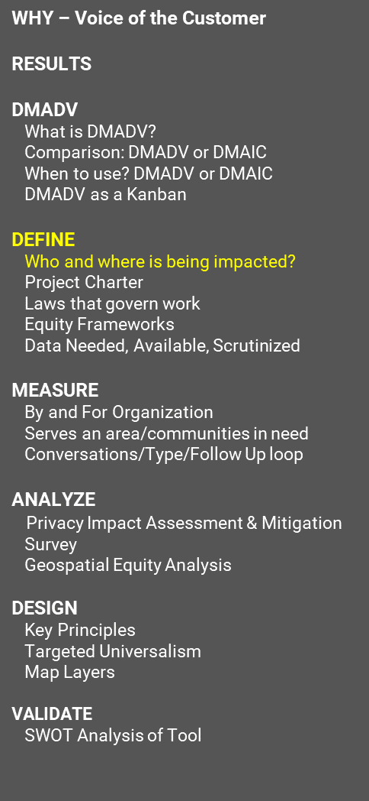
Who and where is being impacted?
WHY – Voice of the Customer
RESULTS
DMADV
What is DMADV?
Comparison: DMADV or DMAIC
When to use? DMADV or DMAIC
DMADV as a Kanban
DEFINE
Who and where is being impacted?
Project Charter
Laws that govern work
Equity Frameworks
Data Needed, Available, Scrutinized
MEASURE
By and For Organization
Serves an area/communities in need
Conversations/Type/Follow Up loop
ANALYZE
Privacy Impact Assessment & Mitigation
Survey
Geospatial Equity Analysis
DESIGN
Key Principles
Targeted Universalism
Map Layers
VALIDATE
SWOT Analysis of Tool
Step up engagement with Black, Indigenous, People of Color (BIPOC) Led , By-and-For Led organizations and Tribal Governments
Expand the overall number of organizations applying for BCF grant program.
Non-housing capital projects
Across Washington in Distressed Communities
Notes:
This slide talks about who and where is being impacted. Remember, it’s important to know who the voice of the customer is. It’s likely that there are more customers or communities. That’s ok. By identifying as many voices of the customer you can plan for more diverse and inclusive approaches to collecting the information you need to design the service or product. In the BCF Tool Project, the goal was to increase engagement with all organizations who are pursuing non-housing capital projects with an emphasis on increasing the number of Black, Indigenous, People of Color led organizations and By and For led organizations within Washington’s distressed communities.

Slide 9
By-and-For Led
WHY – Voice of the Customer
RESULTS
DMADV
What is DMADV?
Comparison: DMADV or DMAIC
When to use? DMADV or DMAIC
DMADV as a Kanban
DEFINE
Who and where is being impacted?
Project Charter
Laws that govern work
Equity Frameworks
Data Needed, Available, Scrutinized
MEASURE
By and For Organization
Serves an area/communities in need
Conversations/Type/Follow Up loop
ANALYZE
Privacy Impact Assessment & Mitigation
Survey
Geospatial Equity Analysis
DESIGN
Key Principles
Targeted Universalism
Map Layers
VALIDATE
SWOT Analysis of Tool
“A by-and-for organization is an organization that is part of the unique community where leadership and staff belong to the same community they serve and promote and preserve community member’s identities, traditions, and values. By-and-for organizations build trust, advocate, respond, and solve problems specific to community members. By-and-for organizations have roots in their respective communities as change agents, mitigating systems of community service, investing, and working with community members to improve their quality of life.”
Notes:
This slide defines By and For Led Organizations as follows: “A by-and-for organization is an organization that is part of the unique community where leadership and staff belong to the same community they serve and promote and preserve community member’s identities, traditions, and values. By-and-for organizations build trust, advocate, respond, and solve problems specific to community members. By-and-for organizations have roots in their respective communities as change agents, mitigating systems of community service, investing, and working with community members to improve their quality of life.”
It is important to note that the By and For led organization definition is evolving. This is the definition that was used at the time of the project.

Slide 10
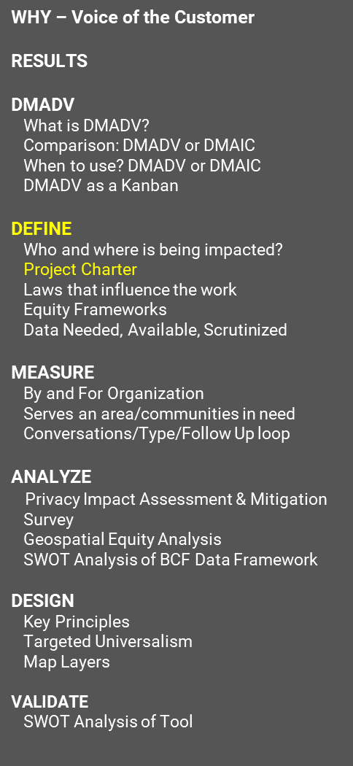
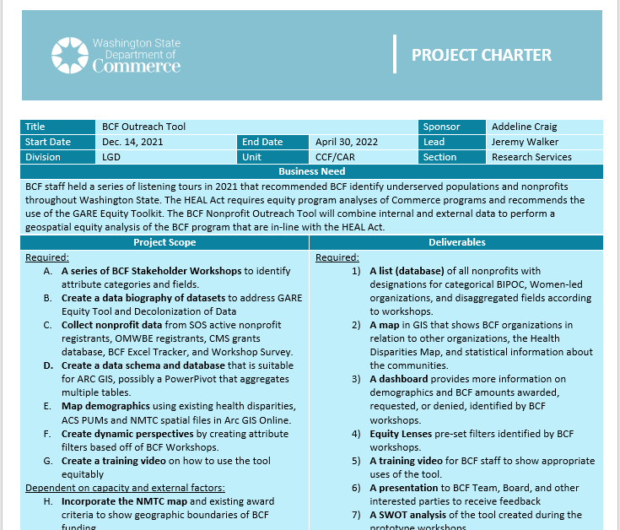
Project Charter
WHY – Voice of the Customer
RESULTS
DMADV
What is DMADV?
Comparison: DMADV or DMAIC
When to use? DMADV or DMAIC
DMADV as a Kanban
DEFINE
Who and where is being impacted?
Project Charter
Laws that influence the work
Equity Frameworks
Data Needed, Available, Scrutinized
MEASURE
By and For Organization
Serves an area/communities in need
Conversations/Type/Follow Up loop
ANALYZE
Privacy Impact Assessment & Mitigation
Survey
Geospatial Equity Analysis
SWOT Analysis of BCF Data Framework
DESIGN
Key Principles
Targeted Universalism
Map Layers
VALIDATE
SWOT Analysis of Tool
Notes:
This slide shows a screen shot of a Project Charter. Project Charters are a critical first step in identifying who is sponsoring the project, who is leading the project, what the business need is, what the scope of the project is and what deliverables are expected from the work. Additional parts of a project charter can include high level risks, assumptions and dependencies, high level milestones, and identification of costs including software, infrastructure and staffing, and an identification of additional team members, stakeholders and communities who should be involved in the project.
One tip to developing your project charter is to apply the approach you are primarily using. In this case it is DMADV. If I had put this in, the project charter would have been even more clear.

Slide 11
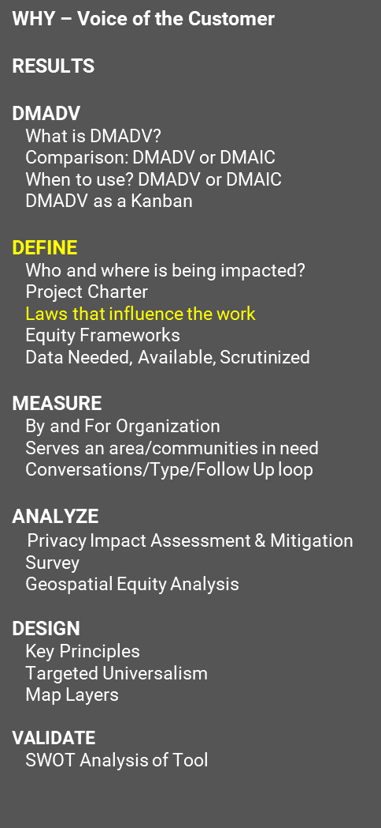
RCW’s & Executive Orders
WHY – Voice of the Customer
RESULTS
DMADV
What is DMADV?
Comparison: DMADV or DMAIC
When to use? DMADV or DMAIC
DMADV as a Kanban
DEFINE
Who and where is being impacted?
Project Charter
Laws that influence the work
Equity Frameworks
Data Needed, Available, Scrutinized
MEASURE
By and For Organization
Serves an area/communities in need
Conversations/Type/Follow Up loop
ANALYZE
Privacy Impact Assessment & Mitigation
Survey
Geospatial Equity Analysis
DESIGN
Key Principles
Targeted Universalism
Map Layers
VALIDATE
SWOT Analysis of Tool
RCW 43.63A.125 – Building Community Facilities
RCW 70.02 – HEAL Act - Environmental Justice
RCW 43.03.220 – NEW - Compensation of Class One Groups & 2SSB 5793
EO 22-04 – NEW – PEAR - Establishes Washington State Pro-Equity Anti-Racism (PEAR) Plan & Playbook
Notes:
One significant area that should always be covered in government projects is to better understand what laws may be in effect as part of your project. These can be found during the Define period. At the time of the BCF Tool project, RCW 43.63A.125 established the program; RCW 70.02 established the use of Environmental Justice as a framework for analysis and RCW 43.03.220 was just coming into effect by requiring compensation of class one groups. EO 22-4 established PEAR groups which were not implemented at the time of this work, but for any future equity work this RCW is in place.

Slide 12
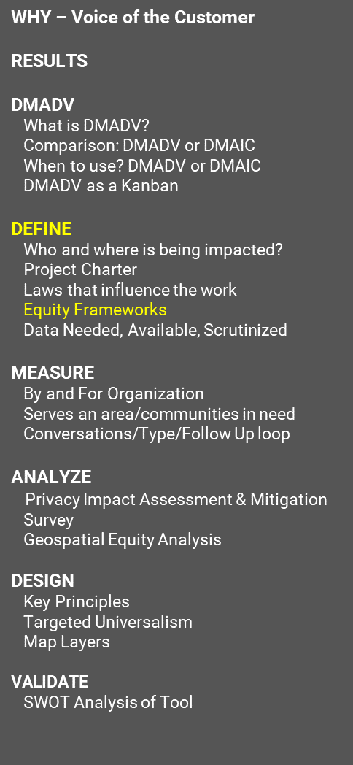
Frameworks
WHY – Voice of the Customer
RESULTS
DMADV
What is DMADV?
Comparison: DMADV or DMAIC
When to use? DMADV or DMAIC
DMADV as a Kanban
DEFINE
Who and where is being impacted?
Project Charter
Laws that influence the work
Equity Frameworks
Data Needed, Available, Scrutinized
MEASURE
By and For Organization
Serves an area/communities in need
Conversations/Type/Follow Up loop
ANALYZE
Privacy Impact Assessment & Mitigation
Survey
Geospatial Equity Analysis
DESIGN
Key Principles
Targeted Universalism
Map Layers
VALIDATE
SWOT Analysis of Tool
*Some* Equity Frameworks
Environmental Justice ~ 1983 Dr. Robert Bullard
GARE Racial Equity Toolkit ~ 1991
Targeted Universalism
Data Equity Framework from We All Count–2017 Dr. Heather Krause
State Agency HEAL Teams – NEW ~ 2023
PEAR – NEW –Establishes Washington State Pro-Equity Anti-Racism (PEAR) Plan & Playbook
*Some* Design Frameworks
Human Centered Design
Design Thinking
User Centered Design
Lean UX
Notes:
There are many equity frameworks to choose from and it depends on many factors one which you should use. Some of these are Environmental Justice, the GARE Racial Equity Toolkit, Targeted Universalism, Data Equity Framework, and recent HEAL Team publications. The Office of Equity also has some approaches within their PEAR teams depending on what agency you work at.
You can pair some of these frameworks with design frameworks, like Human Centered Design, Design Thinking, User Centered Design, and Lean X. In my case I chose LEAN DMADV because I was most familiar with it and it is the least restrictive to integrating additional methods and approaches.

Slide 13
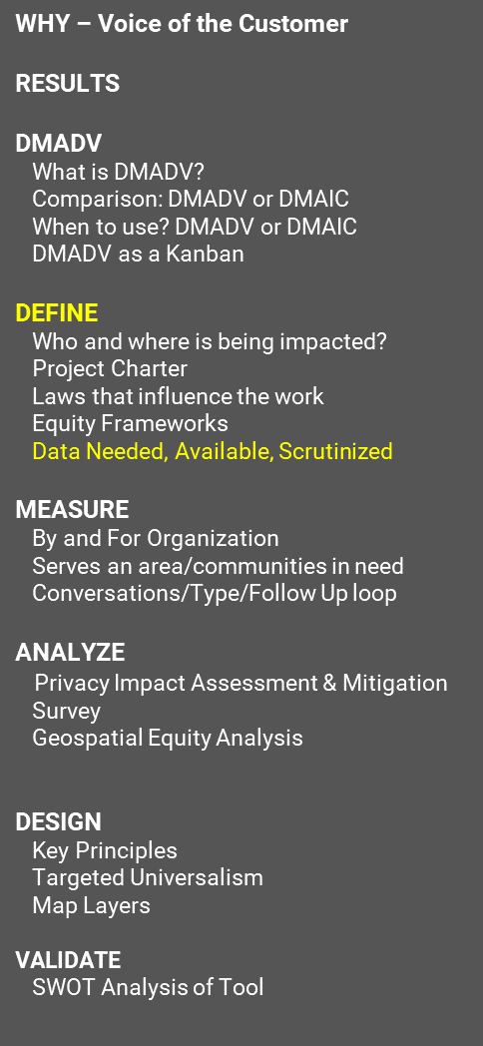
Data
WHY – Voice of the Customer
RESULTS
DMADV
What is DMADV?
Comparison: DMADV or DMAIC
When to use? DMADV or DMAIC
DMADV as a Kanban
DEFINE
Who and where is being impacted?
Project Charter
Laws that influence the work
Equity Frameworks
Data Needed, Available, Scrutinized
MEASURE
By and For Organization
Serves an area/communities in need
Conversations/Type/Follow Up loop
ANALYZE
Privacy Impact Assessment & Mitigation
Survey
Geospatial Equity Analysis
DESIGN
Key Principles
Targeted Universalism
Map Layers
VALIDATE
SWOT Analysis of Tool
Data Needed
Nonprofits in Washington State with:
Physical Address where appropriate
Types of services offered
Services offered to
Staff Size
Do they self-identify as By and For?
Data Available
Secretary of State registration data with limited financial information.
Physical Address
Website
Email
Phone
Financial Information
Notes:
Something that often gets missed is understanding what data is needed and what data is already available. By identifying what is needed and what is available, you can reduce the number of things you’re asking from communities or organizations. This reduces the workload on communities significantly.

Slide 14
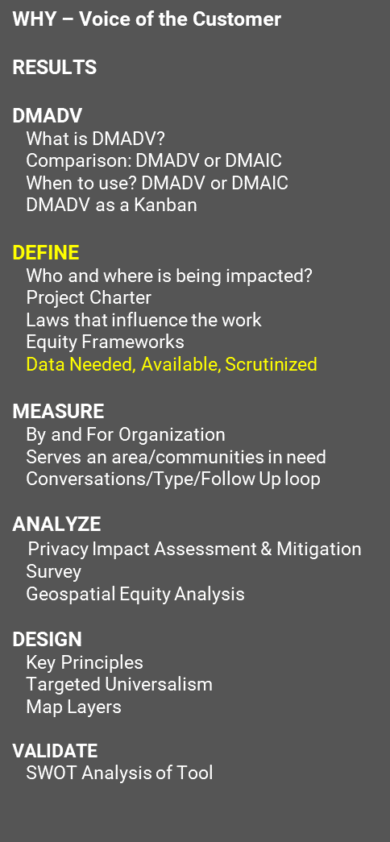
Data Scrutinized
WHY – Voice of the Customer
RESULTS
DMADV
What is DMADV?
Comparison: DMADV or DMAIC
When to use? DMADV or DMAIC
DMADV as a Kanban
DEFINE
Who and where is being impacted?
Project Charter
Laws that influence the work
Equity Frameworks
Data Needed, Available, Scrutinized
MEASURE
By and For Organization
Serves an area/communities in need
Conversations/Type/Follow Up loop
ANALYZE
Privacy Impact Assessment & Mitigation
Survey
Geospatial Equity Analysis
DESIGN
Key Principles
Targeted Universalism
Map Layers
VALIDATE
SWOT Analysis of Tool
Consider Informed Consent Communication for both quantitative and qualitative data
Is the information subject to public disclosure?
Is the information personally identifiable on its own, in combination with other data collected or if it is mapped and layered with public data?
How well does your data represent your population impacted by your program? Does it really capture all voices or simply those who already operate in government already?
How should data be collected in a cultural appropriate way?
Respectful – understand before being understood by facilitating workshops
Outreach & Engagement – break out by social groups and pay people for their Lived Experience
Accountable – answer why the data must be collected and what decisions are being made using the data
Data collection is not free
Transparent – Backup findings with data, provide translations of reports, recordings and other materials.
Notes:
When collecting data and receiving data, it’s important to look carefully at the data. Consider how the information will be collected. Do you assume that if they gave you the data then you have the right to use it? If so, that could be problematic. It is always better to have written informed consent that addresses how the data will be collected, used and what decisions will be made as a result of the data. The best written informed consent also creates a method for survey respondents to have ownership of their data and be notified if there is a public records request or an internal request has been made to use the data for purposes other than what it was originally intended for.

Slide 15
Quantitative Surveying & Data Analysis
WHY – Voice of the Customer
RESULTS
DMADV
What is DMADV?
Comparison: DMADV or DMAIC
When to use? DMADV or DMAIC
DMADV as a Kanban
DEFINE
Who and where is being impacted?
Project Charter
Laws that influence the work
Equity Frameworks
Data Needed, Available, Scrutinized
MEASURE
Quantitative
Qualitative
Continuous Feedback Loop
ANALYZE
Privacy Impact Assessment & Mitigation
Survey
Geospatial Equity Analysis
DESIGN
Key Principles
Targeted Universalism
Map Layers
VALIDATE
SWOT Analysis of Tool
Establish a Baseline
How many organizations currently work with the program? How many organizations self-identify as By and For organizations?
How many of these organizations operate in areas of the state that the Legislature and/or the Health Disparities Map identify as high priority?
Each question assumes that this includes all organizations who applied.
Identify Possibilities
How many organizations exist that could use this program?
How many organizations possibly identify as By and For organizations?
How many of these organizations operate in areas of the state that the Legislature and/or the Health Disparities Map identify as high priority?
Notes:
Quantitative data is a part of the DMADV approach as well, it tends to be less than in the DMAIC structure because you do not have an established process, service or procedure, so you don’t have data to collect from the thing you’re building. However, establishing what it will collect is important.

Slide 16
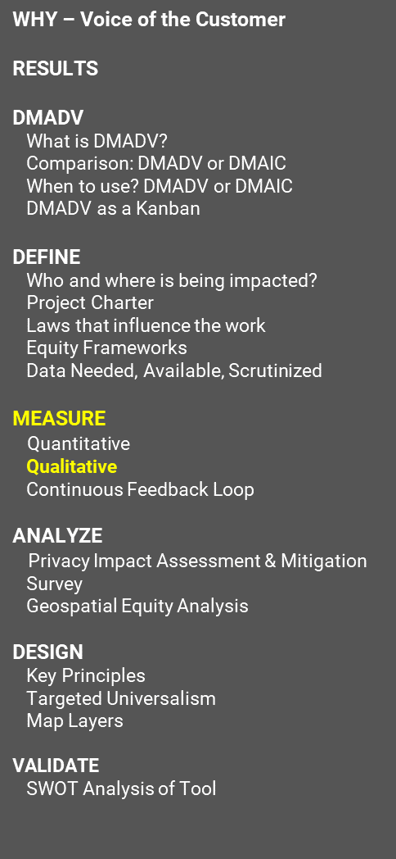
Qualitative Workshops with organizations
WHY – Voice of the Customer
RESULTS
DMADV
What is DMADV?
Comparison: DMADV or DMAIC
When to use? DMADV or DMAIC
DMADV as a Kanban
DEFINE
Who and where is being impacted?
Project Charter
Laws that influence the work
Equity Frameworks
Data Needed, Available, Scrutinized
MEASURE
Quantitative
Qualitative
Continuous Feedback Loop
ANALYZE
Privacy Impact Assessment & Mitigation
Survey
Geospatial Equity Analysis
DESIGN
Key Principles
Targeted Universalism
Map Layers
VALIDATE
SWOT Analysis of Tool
Identify what goes well with the program from the perspective of
successful grant applicants
unsuccessful grant applicants
Grant staff
Notes:
Qualitative data is really important because it speaks the voice of the customer and can influence the analysis significantly. Regardless of the project management style you adopt, customer/community input has the best chance of success at the earliest stages of project planning and research.

Slide 17
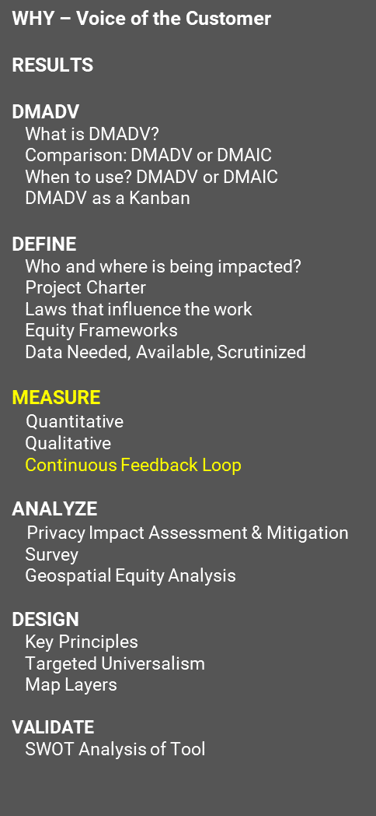
Continuous Feedback Loops
WHY – Voice of the Customer
RESULTS
DMADV
What is DMADV?
Comparison: DMADV or DMAIC
When to use? DMADV or DMAIC
DMADV as a Kanban
DEFINE
Who and where is being impacted?
Project Charter
Laws that influence the work
Equity Frameworks
Data Needed, Available, Scrutinized
MEASURE
Quantitative
Qualitative
Continuous Feedback Loop
ANALYZE
Privacy Impact Assessment & Mitigation
Survey
Geospatial Equity Analysis
DESIGN
Key Principles
Targeted Universalism
Map Layers
VALIDATE
SWOT Analysis of Tool
Asynchronous Communication Spaces
Intrapersonal – email and phone calls
Virtual spaces
Scheduled opportunities for reporting out and receiving feedback
Notes:
When creating your measures you should establish how you will receive feedback and give updates from and to customers, communities and stakeholders. Holding a singular open meeting, even if it is recorded is not as equitable as we may think. Consider scheduling and attendance challenges and how traditional organizational structures favor people who are more extroverted than people who are more introverted. By sharing information in advance and creating virtual spaces where participants can ideate on their own ahead of time, they can think and contribute more deeply to the need. Additional considerations should be made like translation services and payment for expertise. At the time of the BCF project, there were no funds for translation or for paying individuals for their expertise, but it was noted for future iterations.

Slide 18
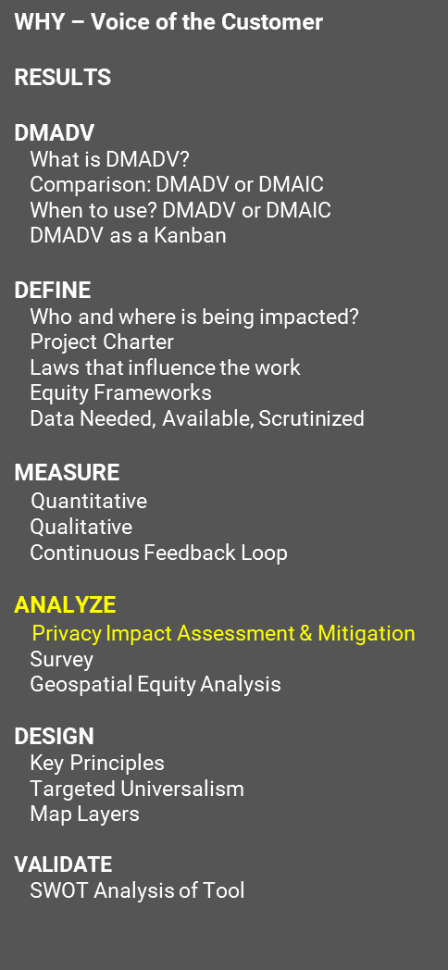
Privacy Impact Assessment & Mitigation
WHY – Voice of the Customer
RESULTS
DMADV
What is DMADV?
Comparison: DMADV or DMAIC
When to use? DMADV or DMAIC
DMADV as a Kanban
DEFINE
Who and where is being impacted?
Project Charter
Laws that influence the work
Equity Frameworks
Data Needed, Available, Scrutinized
MEASURE
Quantitative
Qualitative
Continuous Feedback Loop
ANALYZE
Privacy Impact Assessment & Mitigation
Survey
Geospatial Equity Analysis
DESIGN
Key Principles
Targeted Universalism
Map Layers
VALIDATE
SWOT Analysis of Tool
Notes:
The slide shows a screenshot of a custom Privacy Impact Assessment & Mitigation Tool. This tool was developed according to Washington Privacy Impact Assessment standards. Most PIAs are written, take a long time to write and are best used for when significant detail and review is needed. However, all of the perceived data being collected fell under category 1, publicly available data. While that would usually not require further analysis this tool was developed to address concerns that if used in combination with other publicly available data could lead to harmful outcomes. For example most Domestic Violence Nonprofits do not list their physical address on their website or in Secretary of State Registration. However, the project team took additional steps to ensure that domestic violence nonprofits information is protected by scrubbing the data before putting it into the prototype tool.
The snapshot of the tool shows the risks identified by staff and communities as the first step and assigning a weighted score for severity or risk on a scale of 1 to 5. A 5 is the highest level or risk while a 1 is the lowest. A score of 0 means there is no risk and no need to add it to the model. The second step is to assign an individual likelihood of risk for each data field collected. The likelihood of occurance in this model is 1 to 3. 1 means relatively low likelihood, 2 is likely, and 3 is very likely to occur. This second step is the most time consuming and should be discussed with communities and staff, especially those who work in data governance or public disclosure. Once the second step is completed the overall Likelihood and Risk Assessments are auto calculated. The third step is to liste out the mitigation techniques for each risk as they relate to the data fields collected as a whole. Some common mitigation techniques are conducting a data biography and validate with customers or stakeholders, collect and save the data behind a firewall, restrict access using permissions, and allow survey respondents to opt-out of specific data to be collected. Accepting the risk is also a possibility. The amount of the reduction of the risk is often subjective and negotiated between your data project team and community. Using research about specific use cases or precedence of risk is always encouraged. Estimating these reductions will automatically calculate after mitigation risk levels and the bar chart will show easy comparisons between original risk scores and risk scores after mitigation.

Slide 19
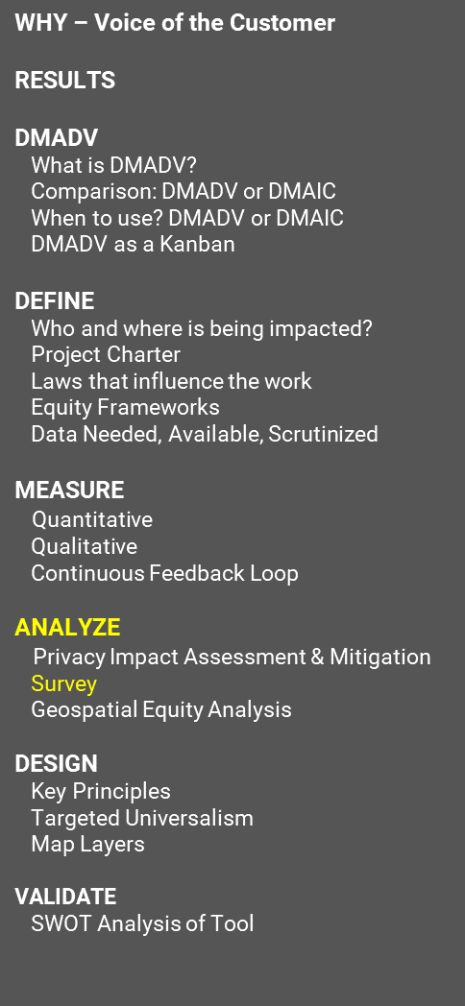
Surveys
WHY – Voice of the Customer
RESULTS
DMADV
What is DMADV?
Comparison: DMADV or DMAIC
When to use? DMADV or DMAIC
DMADV as a Kanban
DEFINE
Who and where is being impacted?
Project Charter
Laws that influence the work
Equity Frameworks
Data Needed, Available, Scrutinized
MEASURE
Quantitative
Qualitative
Continuous Feedback Loop
ANALYZE
Privacy Impact Assessment & Mitigation
Survey
Geospatial Equity Analysis
DESIGN
Key Principles
Targeted Universalism
Map Layers
VALIDATE
SWOT Analysis of Tool
Avoid making surveys generalizable knowledge
Statistically significant and generalizable surveys are very expensive to run
Focus surveys on specific audiences and disaggregate demographics where possible,
especially as it relates to race and ethnicity. Additional demographics may apply.
Translate your survey
if at all possible into languages where your program is active or plans to be active.
Make sure to reverse translate documents back into English to ensure intent. It is best to have community members test translations before they go out.
Always include an informed consent question that states:
what information is being collected,
what it will be used for,
how decisions will be made and who will be making them by when
How long the data will be a public record
That the data is likely accessible by public records request
That respondents should not enter any information that may lead to harm or embarrassment of themselves or others, especially in open text questions.
Notes:
Surveys are easily mistaken as being the easiest format to collect information. Surveys often lead to confirmation bias and miss important nuanced information that communities have to share that would be easier to understand in listening sessions, workshops, interviews or other more engaging types of information collection. That said, there is a limited and very focused space for surveys when doing analysis and it requires significant time and money to do correctly. Because most agencies and programs lack significant funding, generalizing information to a larger population should be done only by experts in the fields of statistical analysis.

Slide 20
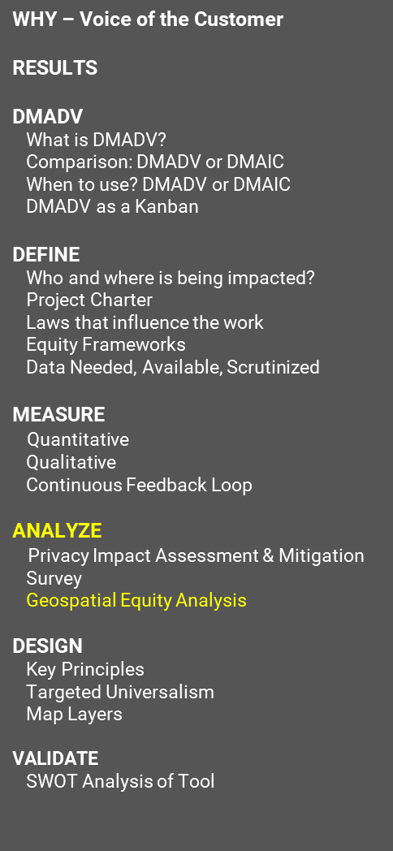
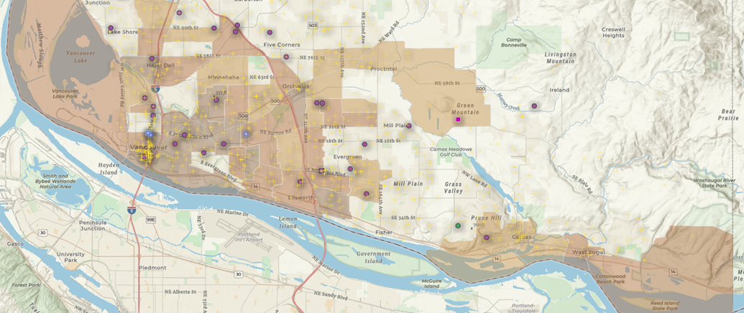
Geospatial Equity Analysis
WHY – Voice of the Customer
RESULTS
DMADV
What is DMADV?
Comparison: DMADV or DMAIC
When to use? DMADV or DMAIC
DMADV as a Kanban
DEFINE
Who and where is being impacted?
Project Charter
Laws that influence the work
Equity Frameworks
Data Needed, Available, Scrutinized
MEASURE
Quantitative
Qualitative
Continuous Feedback Loop
ANALYZE
Privacy Impact Assessment & Mitigation
Survey
Geospatial Equity Analysis
DESIGN
Key Principles
Targeted Universalism
Map Layers
VALIDATE
SWOT Analysis of Tool
Notes:
Geospatial Equity Analysis is relatively new and has its roots in Environmental Justice and Dr. Bullard’s methodology. There are many different types of geospatial equity analyses. This is one example. The screenshot on this slide shows the greater Vancouver, Washington area with the Environmental Health Disparities Map layer that colors in census tracts based on the Health Disparities index. The higher the index the darker shade of brown the census tract gets. The higher index indicates that these census tracts require more investments to address the socio-economic and environmental disparities experience by people in the census tract. The bright white-purplish dots are another layer that show existing capital grants that have been awarded in recent years by the BCF program. The purple dots show organizations that have a high probability of being By and For Organizations. The yellow pluses show additional organizations that are operating in the greater Vancouver area. When communities and staff look at this map it is possible to have a more in-depth conversation about who to reach out to and let them know that BCF funding is available. 73% of workshop attendees did not know that BCF funding was even available. This information allows the BCF team to market the program in areas where there are higher levels of health, environmental and social disparities. Note, that this is not used to make decisions about who receives awards or how much money gets awarded. The purpose of this tool is to identify areas where there are high health disparities index ratings with no to few BCF grant awards.

Slide 21
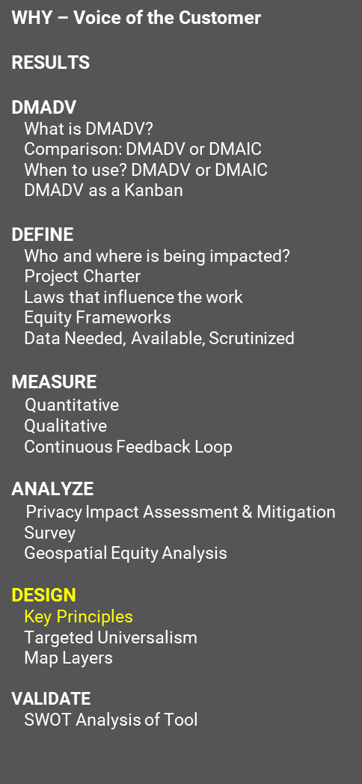
Design Principals
WHY – Voice of the Customer
RESULTS
DMADV
What is DMADV?
Comparison: DMADV or DMAIC
When to use? DMADV or DMAIC
DMADV as a Kanban
DEFINE
Who and where is being impacted?
Project Charter
Laws that influence the work
Equity Frameworks
Data Needed, Available, Scrutinized
MEASURE
Quantitative
Qualitative
Continuous Feedback Loop
ANALYZE
Privacy Impact Assessment & Mitigation
Survey
Geospatial Equity Analysis
DESIGN
Key Principles
Targeted Universalism
Map Layers
VALIDATE
SWOT Analysis of Tool
Depends on the frameworks you choose
DMADV does not have specific design principles, but rather encourages experimentation
Principles don’t mean much unless you build them with the communities you are trying to serve and you operationalize them.
Environmental Justice Principles
Use intersectional lenses to address disproportionate environmental and health impacts by prioritizing impacted populations, equitably distributing resources and benefits, and eliminating harm.
Focus on racial equity and recognition of ways in which systemic racism leads to disproportionate environmental impacts and health disparities in Black, Indigenous, and Communities of Color.
Meaningful engagement with impacted communities about the development of the tool
Self-determination is a core principle of tribal sovereignty
Operationalize these through Accountability of staff, Respect for Communities and Tribes, and Transparency in information, communication, and decision-making.
Notes:
There are many design principles that can be followed and you would likely not be wrong to pick any framework and run with it. However, a framework that does not center those who are impacted by the program the most neither achieves the intended outcomes or creates for efficient processes. Operationalizing principles is difficult and require staff in particular to model the behavior even under stressful conditions. You cannot simply pick a framework and then stick to those principles either, it has to be checked with the people you are working with and the communities being served, or organizations providing services. It was not enough to adopt the Environmental Justice Principles to achieve the results of the BCF project. Accountability of staff, Respect for Communities and Tribes and Transparancy in information, communication and decision making also had to occur.
Respect looked like making phone calls to Community Organization leaders and introducing myself, listening to their concerns even if it was not my focus, and owning my mistakes, like if information wasn’t being released in a timely manner or if someone was accidentally left off of an invitation for a workshop. Respect also looks like learning to stop when Community leaders tell you to stop. In the case of the BCF Outreach, certain activities that were looked as positive by staff were not implemented because communities had concerns about how the data might be misused. Creating spaces where communities had transparency into how staff will use the data created greater trust and respect for Commerce staff.

Slide 22
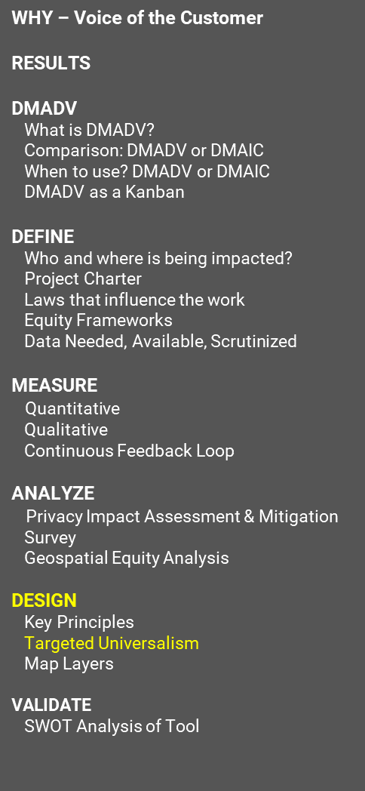
Targeted Universalism
WHY – Voice of the Customer
RESULTS
DMADV
What is DMADV?
Comparison: DMADV or DMAIC
When to use? DMADV or DMAIC
DMADV as a Kanban
DEFINE
Who and where is being impacted?
Project Charter
Laws that influence the work
Equity Frameworks
Data Needed, Available, Scrutinized
MEASURE
Quantitative
Qualitative
Continuous Feedback Loop
ANALYZE
Privacy Impact Assessment & Mitigation
Survey
Geospatial Equity Analysis
DESIGN
Key Principles
Targeted Universalism
Map Layers
VALIDATE
SWOT Analysis of Tool
Establishes a universal goal
everyone is aware of BCF funding
Measure overall population
average awareness among all organizations
Measure each grouping of organizations –
what are By and For organizations awareness relative to the total population and the universal goal?
Understand group based factors
BCF workshops allowed staff to understand what specific barriers exist for By and For organizations compared to rural, urban and specific BIPOC Led organizations.
Notes:
Targeted Universalism is an incredible strategic and analytical tool. In the case of the BCF Equity Tool, it was not fully realized due to challenges around data. That said, applying a Targeted Universalist approach to programs is a great tool to merge with DMADV or DMAIC LEAN approaches.

Slide 23
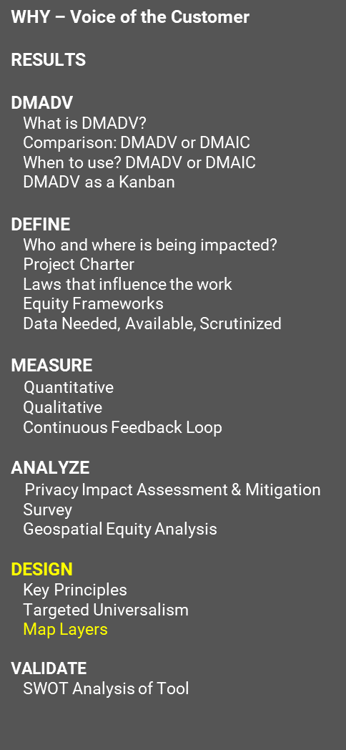
Map Layers
WHY – Voice of the Customer
RESULTS
DMADV
What is DMADV?
Comparison: DMADV or DMAIC
When to use? DMADV or DMAIC
DMADV as a Kanban
DEFINE
Who and where is being impacted?
Project Charter
Laws that influence the work
Equity Frameworks
Data Needed, Available, Scrutinized
MEASURE
Quantitative
Qualitative
Continuous Feedback Loop
ANALYZE
Privacy Impact Assessment & Mitigation
Survey
Geospatial Equity Analysis
DESIGN
Key Principles
Targeted Universalism
Map Layers
VALIDATE
SWOT Analysis of Tool
Notes:
Map layers are the operationalization of the first principle from Environmental Justice. By including multiple layers in the prototype tool it allows for intersectional analysis to address disproportionate environmental and health impacts by prioritizing impacted populations, equitably distributing outreach and benefits and eliminating harm. The layers used in the BCF Outreach Prototype tool are: Past BCF Grant Address data, Organization demographic data, organization staffing size data, a custom Secretary of State Registered Organizations table that uses community developed method of identifying potential By and For Organizations , American Community Survey Demographics, Health Disparities Map, New Market Tax Credit Data, a Base Map that includes cities, topography, roads and reservations and a legislative, county and zip code boundaries.

Slide 24
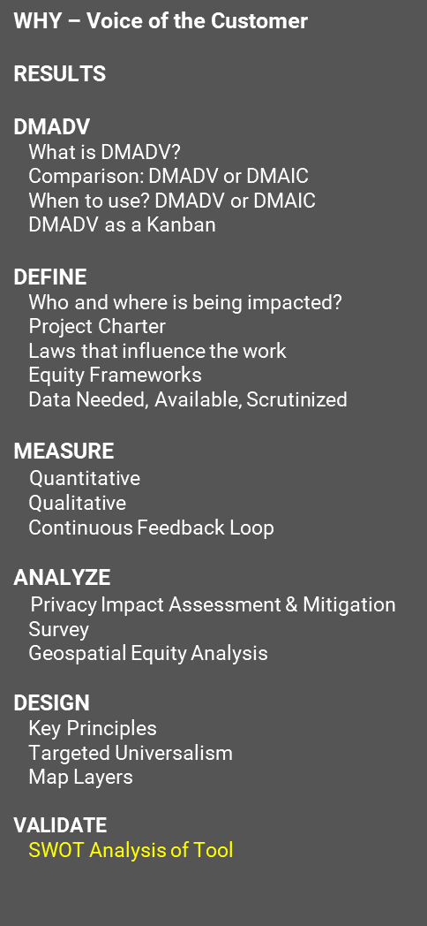
Strengths, Weaknesses, Opportunities & Threats Analysis
WHY – Voice of the Customer
RESULTS
DMADV
What is DMADV?
Comparison: DMADV or DMAIC
When to use? DMADV or DMAIC
DMADV as a Kanban
DEFINE
Who and where is being impacted?
Project Charter
Laws that influence the work
Equity Frameworks
Data Needed, Available, Scrutinized
MEASURE
Quantitative
Qualitative
Continuous Feedback Loop
ANALYZE
Privacy Impact Assessment & Mitigation
Survey
Geospatial Equity Analysis
DESIGN
Key Principles
Targeted Universalism
Map Layers
VALIDATE
SWOT Analysis of Tool
Strengths
Weaknesses
Staff can now see where organizations may exist across Washington
Data is imperfect
No staff or budget to maintain or build dataset
Opportunities
Threats
Very real opportunity to increase the number of organizations, including By and For Organizations who are aware of BCF funding.
Could be misused to drive decision making for who receives grants
Could provide organizations a way to network with each other!
Notes:
A strengths, weaknesses and Opportunities & Threats Analysis was conducted to analyze both the tool prototype and the underlying data structure. This slide represents summarize findings. The main strength of the tool prototype is that staff can now see where organizations may exist across Washington. This made outreach and in-person visits more viable by specifying which areas of the state needed more BCF outreach presence. The weaknesses of the prototype tool were that the data was imperfect and that there is no staff or budget to maintain or build the dataset. Those following Agile methods might be thinking this why the tool should have never been pursued in the first place, but Commerce is often seen as an incubator for innovation. The opportunities were numerous. Two of the main opportunities were that for the first time BCF had a clearer understanding of organizations that exist throughout the state. The Secretary of State’s registration list is very large, in excess of 90,000, so to identify 38,000 as potentially eligible with 1,200 of them being possibly By and For Organizations is a significant finding. One of the use cases identified by community based organization leaders was that the tool could be very useful in networking locally to share resources and address complex problems in a more strategic way. That being said, Community Based Organizations voiced considerable concern around the use of the tool by program staff. Use of the prototype tool was clearly established by workshop participants that the prototype tool should only be used for strategizing outreach and not used for deciding grant awards.

Slide 25
Thank you for the opportunity to strengthen communities!
Jeremy Walker
Equity Analyst
equityandbelonging@commerce.wa.gov
Notes:
This work was performed by Jeremy Walker when working as the Senior Project Management Analyst as an MA4 in the Local Government Division Research and Development Services Unit. Since this projects completion, Jeremy has taken a new position as an MA 5 Equity Analyst in the Office of Equity and Belonging. To reach Jeremy about this presentation or data equity type questions please email equityandbelonging@commerce.wa.gov.

