Slide 1
Results Washington’s Lean Journey
Past, Present, and Future

Slide 2
Today’s focus
Provide insight on our agency’s history
Discuss our Lean journey and the lessons we’ve learned along the way
Highlight opportunities we provide across the state to expand our continuous improvement culture

Slide 3
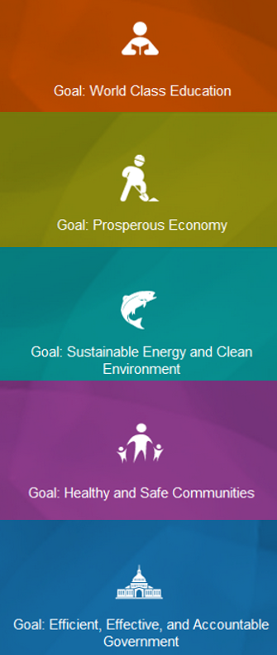
1985-1993
Gov Booth Gardner
Efficiency Commission Established
Enacted budgeting system that tracked activities and performance with a focus on overall quality improvement
1997-2005
Gov Gary Locke
Adopted a Balanced Score Card to measure progress
Implemented Priorities of Government
A results-based performance and budgeting approach
1993-1997
Gov Mike Lowry
Washington Performance Partnership Council
Set statewide performance measures around customer service, cost-effectiveness, and productivity
2005-2013
Gov Christine Gregoire
Established Governor’s Management, Accountability, and Performance (GMAP)
Data Management and Performance metrics were used while publishing public performance dashboards and holding public forums to discuss performance gaps and opportunities
Implemented the training and use of Lean tools and created the Lean Practitioner Path
2013- current
Gov Jay Inslee
Launched Results Washington
Built on past efforts of tracking progress, adjusting accordingly, and involving front-line employees in improvement work
Monthly Public Performance Reviews with Governor Inslee to discuss performance measures, improvements and opportunities to better serve the public
Focus is on including more voices at the table to ensure all perspectives and lived experiences are included
The evolution of performance management in Washington State government

Slide 4
Who we are
Established in 2013 by Governor Inslee as the state’s performance management agency
Track and highlight how our state is performing in achieving outcomes under the governor’s five goal areas
Lead and support Lean efforts and training to help deepen the state’s continuous improvement culture
Assist agencies and foster cross-agency partnerships to help problem solve and improve services
OUR VISION
Driving transparency, igniting innovation, and delivering
the best results for the great state of Washington.

Slide 5
Our services
Public Performance Reviews
Lean Transformation Conference
Consultative Services
Results through Performance Management (RPM) System
Lean and Continuous Improvement Community of Practice
Performance Audit Liaison

Slide 6
Continuous Improvement
Performance Management
Strategic Planning
Lean
Training and Development
Our interdisciplinary
approach

Slide 7
What continuous improvement method or activity have you found to be the most successful within your organization?
Let us know in the chat!

Slide 8
Our Lean journey

Slide 9
What we’ve learned
Engage leaders early and often
Start small, get wins, and grow
Partner with experts while investing in your people
Grow informal networks
Experiment!

Slide 10
What are some lessons you’ve learned on your Lean journey so far?
Let us know in the chat!

Slide 11
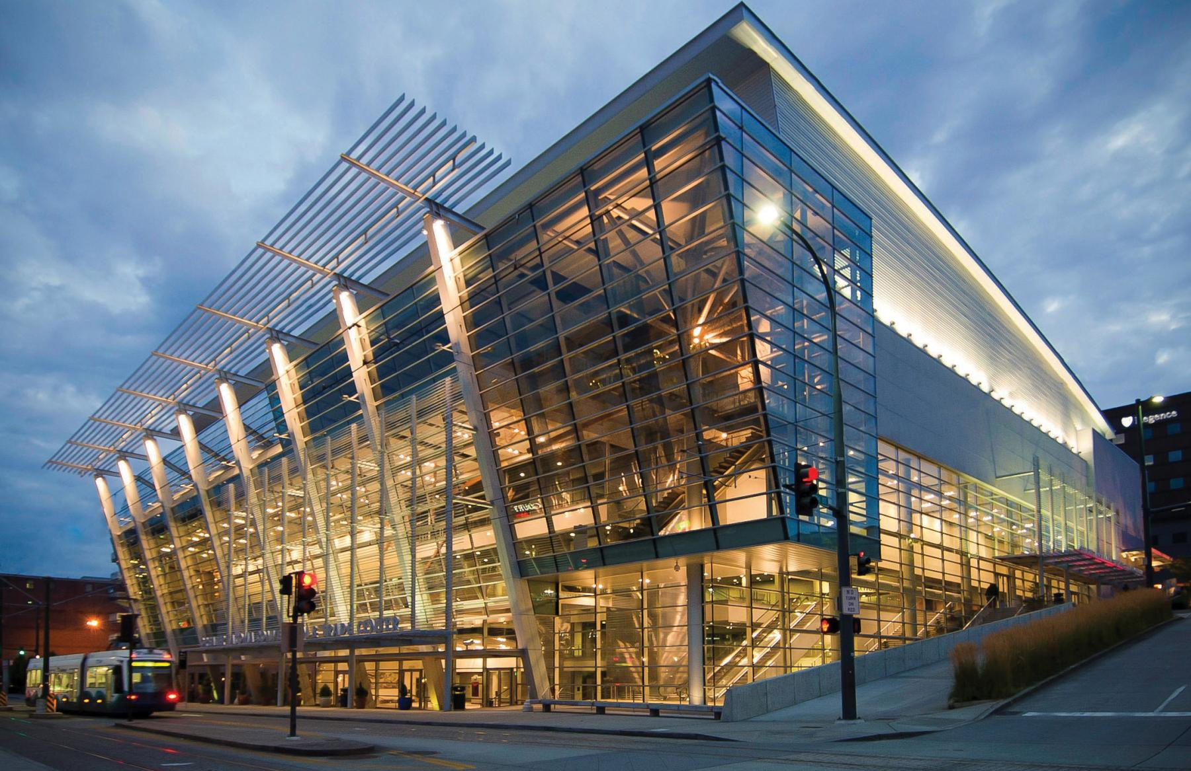
Embedding Lean
Annual Lean Transformation Conference
Last two weeks of October
24 sessions over six days with content covering:
Lean/continuous improvement
Change management
Strategic planning
Performance management
Design thinking
Diversity, equity, inclusion, and belonging
Emotional intelligence
Project examples
100% virtual
Free for all attendees
Photo credit: www.TacomaConventionCenter.org

Slide 12
Embedding Lean cont.
Enterprise-wide Lean and Continuous Improvement Community of Practice
Monthly, optional meetings
Open to the public and private sector employees in and out of state!
Includes topic teachings on various methodologies and real project implementations
Our goals include:
Expand or refresh knowledge and skillset
Learn from and share experiences with others
Obtain continuous improvement strategies and resources
Receive support on improvement efforts

Slide 13
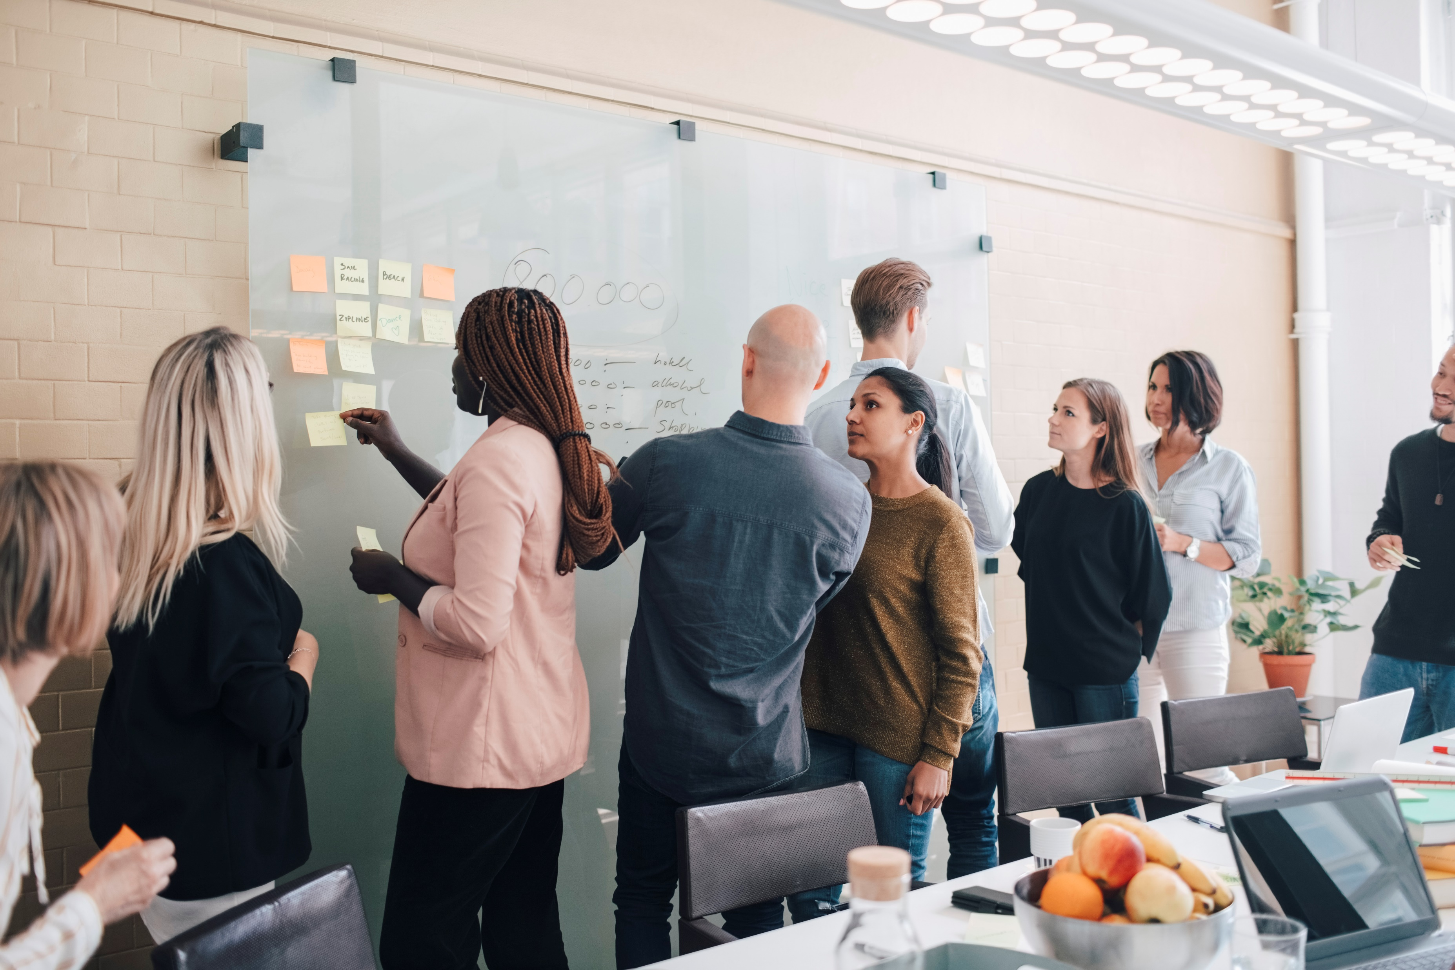
Embedding Lean cont.
Consultative Services
Direct requests from state agencies or out-of-state partners to consult, lead, and/or provide expertise on:
Kaizen events
Process mapping
Change management
Strategic planning
Assist with external conference planning, logistical troubleshooting, and execution needs

Slide 14
Future endeavors
Reflection Series
Monthly video interview series
Highlights individuals within a project or process improvement
Spotlights the project, its successes, barriers and lessons learned
Continuous Improvement Workshops
Implementing two pilot workshops in 2024
In-person
Hands-on, activity-based learning experience on various methodologies

Slide 15
Questions?

Slide 16
Thank you!
Contact us:
John Cooper – John.Cooper@gov.wa.gov
Website:
https://results@gov.wa.gov
Lean Transformation Conference:
https://results.wa.gov/improving-government/lean/lean-conference
Lean and Continuous Community of Practice:
https://results.wa.gov/community-practice
Notes:
[ME]
Thanks again for having us here today. If you have additional questions for John or me, our virtual door is always open and we’d love to hear from you. If you’d like to learn more about some of our services, including the annual Lean Conference, the mini-Change Management Conference, and our Community of Practice, please feel free to visit our website for more information.

