Slide 1
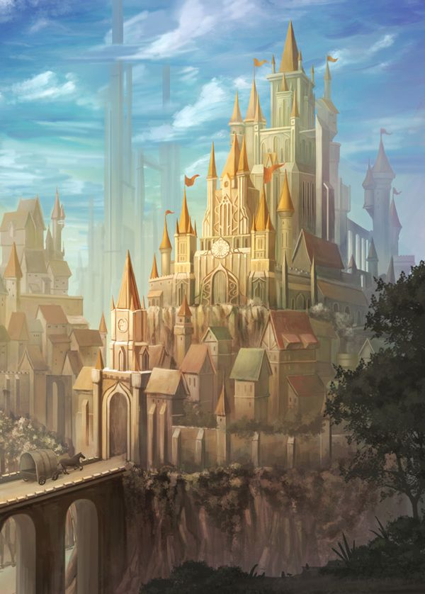
STEEPLE Analysis
By: Brittany Wilhelme, (They/Them) M.B.A., L.S.S.B.B., P.N.P.L
July 2025

Slide 2
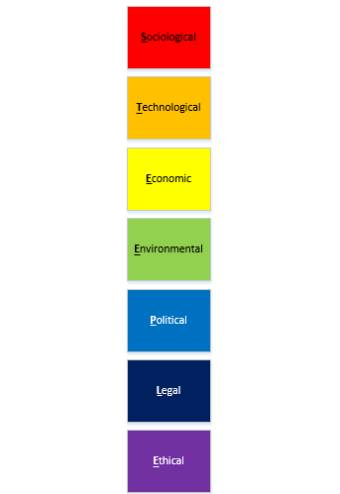
Objectives
When we finish today you should:
Know what STEEPLE stands for
Know when to use a STEEPLE analysis
Know why you would use a STEEPLE analysis
Know how a STEEPLE analysis can help you close gaps
Have a list of similar tools

Slide 3
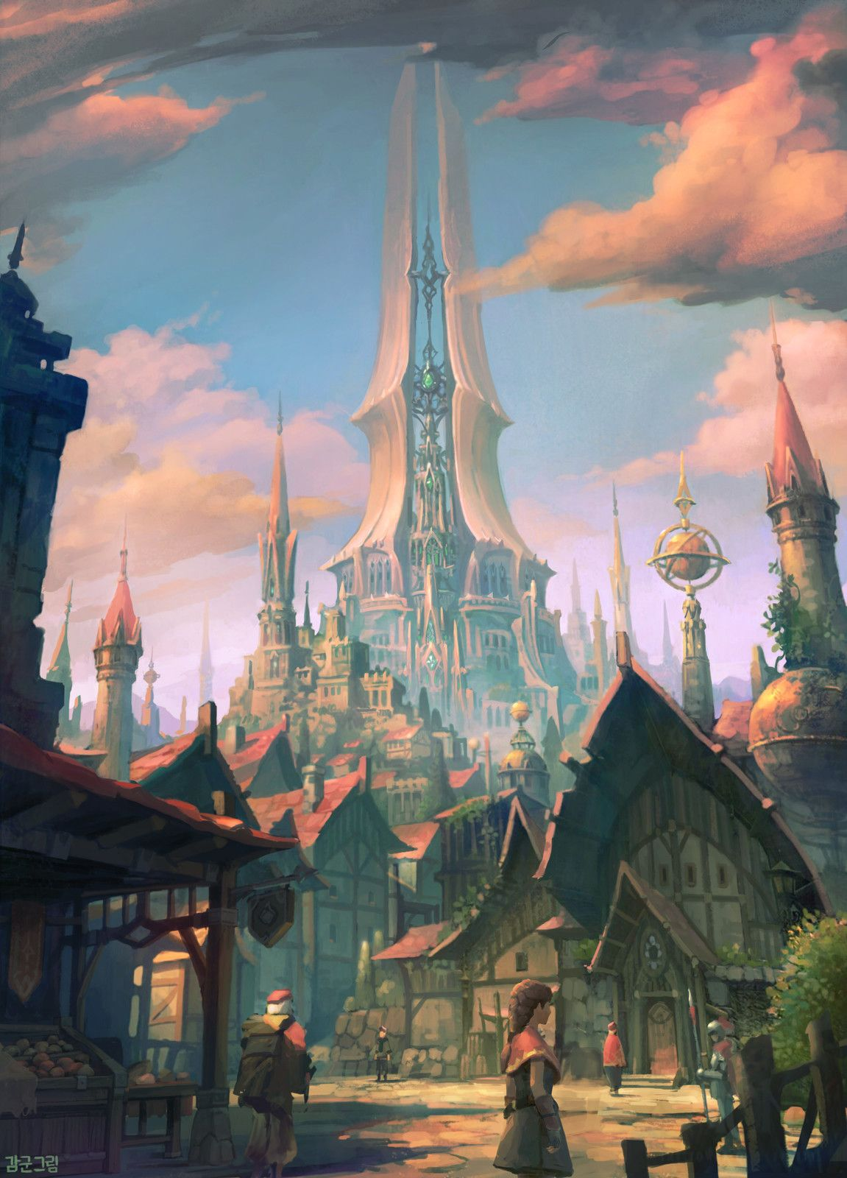
What is a STEEPLE Analysis?
Operates as a SWOT with more detail, where a SWOT may work best for private sector a STEEPLE is ideal to address those factors that influence and dictate government, nonprofit, or public work
STEEPLE stands for
  Sociological
  Technological
  Environmental
  Economic
  Political
  Legal
  Ethical
  Can sometimes include: ‘I’ for Inclusivity, ‘S’ for Safety, and/or ‘D’ for Demographics
Scans the Macro and Micro Environments of a problem, project or opportunity
Gages internal and external factors
Used to track the environment an organization is operating in or intends to operate in
Can be used in all areas of work from Marketing, to project management, finance, Lean and Business Analysis
May be referred to as a PESTLE/PEST analysis
Can be used to track trends, directions, performance, positions, roadblocks, opportunities and threats

Slide 4
When to Use a STEEPLE analysis
Plan Do Check Act (PDCA)
Define Measure Analyze Improve Control (DMAIC)
Planning: can help the project team understand the climate they are about to work in.
Doing: shows roadblocks, fence sitters and resistors, bottle necks, market position, and resource needs
Checking: helps uncover other hidden risks and show how far the project has come if there was a baseline STEEPLE
Acting: shows bottlenecks and barriers in new processes along with new risks, resource needs, and opportunities.
Define: help understand what the problem is, where it came from, and what affects it
Measure: help baseline some of the barriers and roadblocks that exist, help find bottlenecks, and measure where the organization and the market is currently at
Analyze: look at the whole problem from a Micro and Macro standpoint to find what affects the problem and establish project locus of control.
Improve: to see what areas have improved, where barriers still exist, and where things can still improve.
Control: to continue to measure and control the new process.
Notes:
A STEEPLE during planning can help the team understand the climate a project is about to operate in and help with an early definition of risks, stakeholders, and research preparation
During the Doing stage a STEEPLE can help to show roadblocks, change agents, and other industry information
In the Check stage a STEEPLE can uncover risks and help establish progress from baseline
A STEEPLE during the Act stage will help to show what occurs in the new process
In the DMAIC process a STEEPLE can be used to help Define aspects of the problem and what is affecting it
A STEEPLE during the measure phase can help provide a baseline and establish initial risks, it can also show where the organization is at and where the industry is at
Analysis with a STEEPLE means being able to scan the micro and macro environments to see what affects the project and what is in the locus of control
As with the Check stage the STEEPLE in the improve phase can show where you have come from baseline and where you may still need to go
Finally, Control with a STEEPLE can be done by continually updating the STEEPLE to control and measure the new processes and plan the recycle

Slide 5
Why use a STEEPLE analysis
When conducted with interested parties of projects or problems, can generate an idea of missing visible and invisible stakeholders.
Uncover risks in various aspects of projects.
Provide guidance on legal and political constraints.
Produce information on the change climate and behaviors of affected parties.
Provide consideration on resourcing specific needs (land surveyor, scientist, specialist in a field).
Reveal that now is not the right time for a project or that the project is as efficient as possible due to certain non negotiable constraints.
Provide information on market, financial, and risk analysis up front allowing for proper planning.

Slide 6
How to use a STEEPLE analysis
Can be conducted at any time during a project, though it is most effective the earlier it is performed.
After an initial stakeholder analysis is complete, a facilitator gathers a group of subject matter experts (SMEs)
Split into manageable parts and share with SMEs what the project or problem is and what information you need. Share some factors and examples in the meeting request.
Conduct one factor at a time and move to the next factor when conversations seem to ebb.
Allow SMEs to send additional information on factors they hadn’t considered, remembered, or thought of during the meeting to the facilitator or analyst after the meeting has concluded.
Split meetings into manageable chunks of time and plan for additional meetings in case the time spent on some factors exceeds the agenda, try not to cut off thoughts as they flow.
Ask participants to bring a notepad and pens so they can write down thoughts as others speak so they can share later (or have someone monitoring and copying chat in virtual meetings)
After all factors have been discussed and the deadline for submissions has ended analyze and categorize, risks, barriers, constraints, opportunities, assumptions, resources, concerns, and additional information in a risks, assumptions, issues, and decisions (RAID) log, or other log where lessons learned can be tracked.

Slide 7
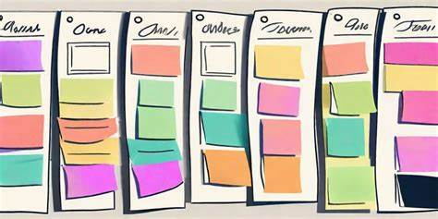
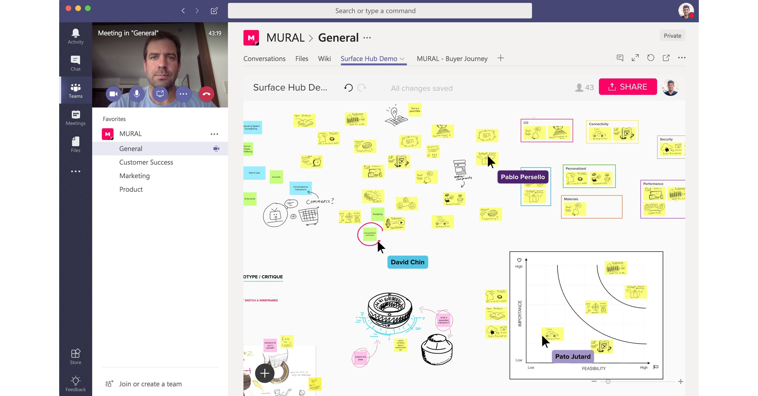

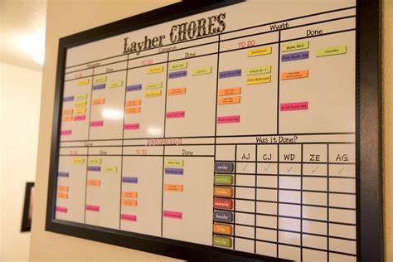
Ways to track the STEEPLE data

Slide 8
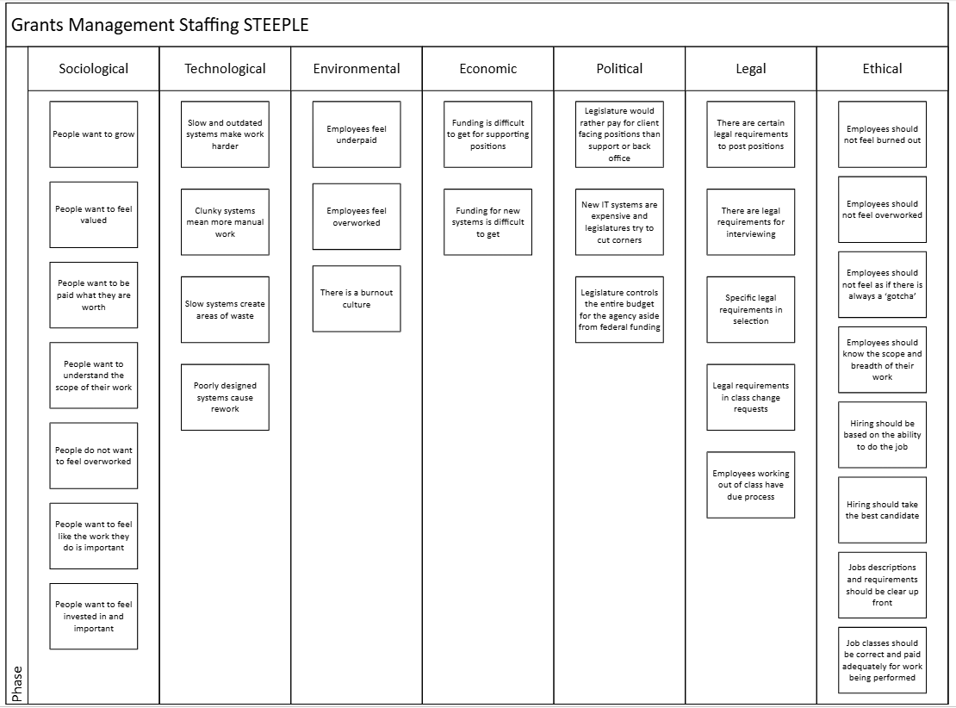
Ways to track the STEEPLE Data using Visio

Slide 9
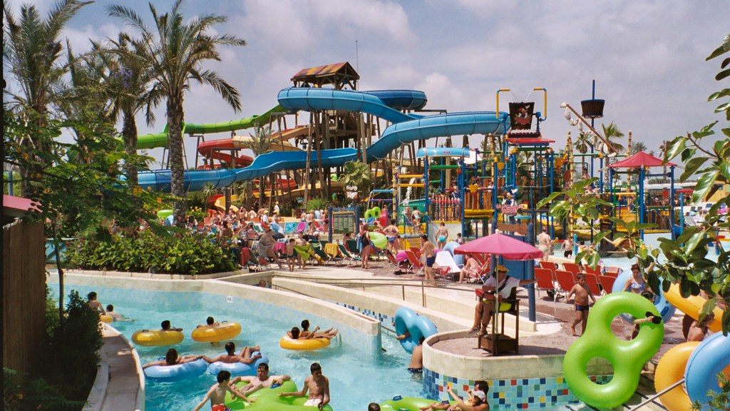
Let’s put a waterpark in your community!
Imagine you are on the city council and have been tasked with determining the feasibility of a waterpark in your community.
First: Identify Visible and Invisible stakeholders
You are also a stakeholder, you live and work in the community, your children go to school in the community, your partner works in or near your community as well.
Next: send a communication about your needs to your stakeholders.
Then: meet with you stakeholders

Slide 10

Sociological
Age distribution: Are there enough families with young kids to support a waterpark?
Also known as socio-cultural factors, social factors involve the demographics, beliefs, attitudes and traditions of a region’s inhabitants. These factors help businesses understand the profiles and motivations of their potential customers. Businesses can use these insights to develop marketing strategies that align with customers' needs and behaviors. Examples of social factors include:
Cultural trends
Population growth rates
Education levels
Emotional stance and feelings related to conditions
Mental Health capacity
Income levels
Age distribution
Health consciousness
Lifestyles
Career attitudes

Slide 11

Technological
Technological factors represent how businesses and industries utilize technology to produce and sell products and services or run operations. Businesses that stay updated on technological advancements can use them to develop and improve their strategies and processes. Beyond advancements, technological factors may also include consumers' access to the following:
Technology
Software and Hardware
Capability and Capacity
Technological infrastructure
Emerging technologies
Automation
Research
For example, if consumers find it easier or preferable to purchase items online, a business may decide to refocus its efforts toward an online store rather than a physical storefront. Alternatively, advancements in automation can help manufacturers streamline production processes and produce more goods at a time.
Emerging technologies: Are there ways to count capacity to ensure you have enough staff available?

Slide 12
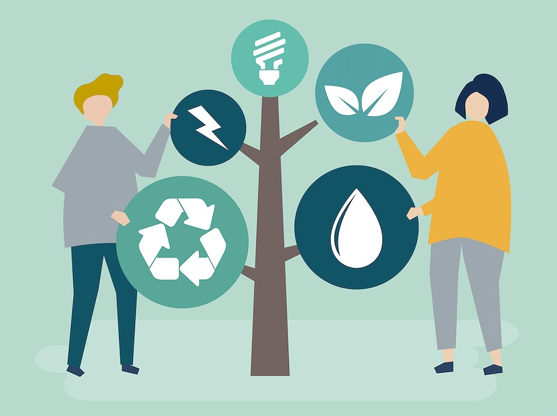
Environmental
Sustainability: How will we recycle or reclaim water?
Environmental factors involve the impacts that changes in the natural environment can have on businesses. This includes factors such as:
Weather
Scarcity of raw materials
Pollution
Climate change
Waste disposal
Agriculture
Sustainability practices
For example, a scarcity of timber due to deforestation may affect businesses in the construction and real estate industries because timber, a crucial construction material, will become more expensive. Environmental factors may also overlap with social factors. For example, if customers care more about recycling, businesses that use recyclable materials in their products may encounter more success.

Slide 13

Economic
Economic factors can directly impact businesses' operations and profits. Economic and political factors may overlap, such as monetary policies that governments establish. Economic factors typically include:
Economic growth
Interest rates
Employment rates
Foreign exchange rates
Supply and demand
Cost of raw materials
Inflation rates
Consumer spending power
For example, a rise in inflation may result in a business laying off its workers to save money. This action may lead to an increase in unemployment. Another example is a decrease in the cost of raw materials that allows a business to increase its manufacturing production, letting it sell more products.
Consumer Spending Power: Do families have the disposable income to afford the costs of waterpark tickets?

Slide 14
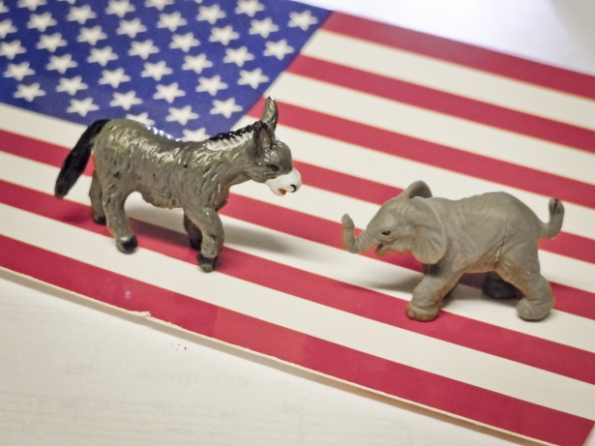
Political
Tax Polices: Consider the tax costs of the waterpark property, water, water reclamation, employees, and the city in which you would operate.
Political factors involve the ways and extent to which a government intervenes in economies or industries. A government can impact an economy through legislation and policies or through its political stability and the status of its relations with other nations. Here are several examples of political factors:
Trade barriers: Trade barriers are regulations that governments put in place to protect domestic businesses from international competition. Governments may impose tariffs on imports or provide subsidies to help boost support and sales for domestic businesses.
Tax policies: Businesses must follow numerous tax regulations, such as obtaining an Employer Identification Number. Governments may also establish policies that increase or decrease the taxes corporations pay.
Political stability: The political stability of a government can affect businesses in that country. For example, if there are protests and strikes against government actions, businesses may see a temporary lull in consumer support.
International relations: A country's relationships with other nations can directly impact a business' ability to export and import goods and services. For example, during a trade war, a company may not be able to import materials they need from the other nation involved in production.
Election Years
Legislation Cycle
Legislative Intent

Slide 15
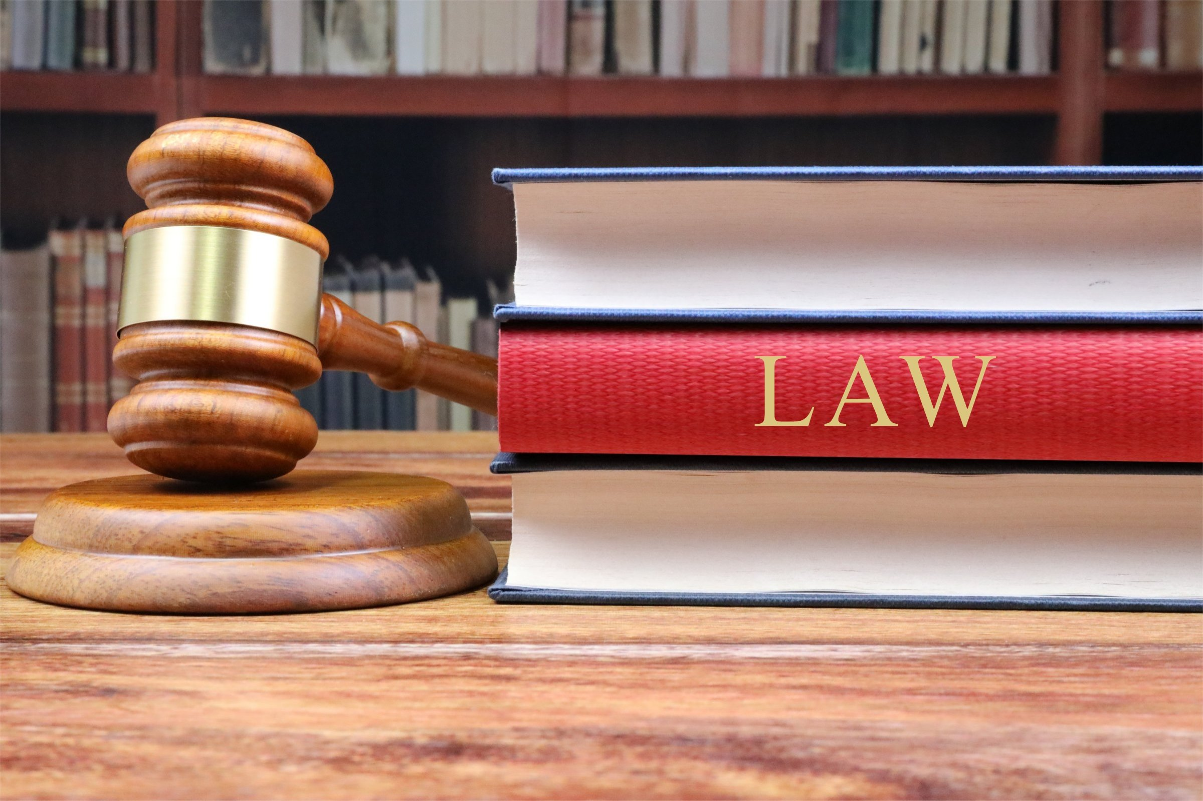
Legal
Legal factors are the laws of the country in which a business resides. These laws may overlap with other factors, particularly political factors, and can impact how businesses in that country operate. As a result, businesses must stay updated on legislation changes to ensure adherence to local and national laws. Here are some examples of legal factors:
Health and safety: Health and safety laws and regulations require businesses to follow practices that ensure the health and safety of employees and customers.
Equal opportunities: Equal opportunity laws prohibit discrimination during the hiring process or in the workplace.
International trade: International trade laws may regulate what businesses can import from and export to other countries.
Advertising standards: Advertising laws set standards for how businesses advertise their products or services, such as requirements that these ads must contain truth or evidence to support claims.
Consumer rights: Consumer rights laws hold businesses accountable for maintaining consumers' rights, such as information privacy and safety.
Product labeling: Product labeling laws require businesses to label food and medicinal products accurately and notify consumers of their contents.
Product safety: Product safety laws require businesses to ensure their products are safe for consumer use and provide warnings as needed.
Labor laws: Labor laws might include things like minimum age and minimum wage for employees, as well as the maximum number of hours an employee can work in a shift. Businesses must adhere to labor laws to ensure they provide proper treatment to their employees.
Environmental laws: Governments usually require that businesses, especially those in the automotive, agriculture and chemical industries, adhere to regulations that protect the environment from toxins and pollution. For example, an environmental law for clean air may push a company to limit its emissions.
Health and Safety: How will you protect customers and yourself?

Slide 16

Ethical
Morality: what are your personal and cultural values? Will your values negatively affect your customers or employees?
Social values are an integral part of the ethical aspects of an organization that governs their behavior. Ethical elements determine what is correct and what is not. The common ethical factors for the STEEPLE analysis are:
The tendency of the people
The value of the culture of the people
Morality
Integrity
Duties
Behavior of the employees towards the society
Whether the practices in sales and advertising are ethical or not;
Is everyone getting a fair end of the deal?
Standards with accounting, management, and marketing are acceptable or not
The attitude of the organization towards counterfeiting and breaking patents
The recruitment process and the standards of employment are ethical or not (for example hiring children to do the work is not acceptable).
Affiliation between corporations and charities

Slide 17
Inclusivity, Safety & Demographics
Inclusivity & Safety Factors
Inclusive
Safe
Demographics
Cultural norms that affect inclusivity
Current climate toward different ethnic groups
Company culture
Recruitment process
Affiliations
ADA
What keeps the company safe
What does safe look like for each employee
What is the threshold of safety
Would the organization flout safety for productivity
Impacts of demographic traits
Population size
Ages
Trends
Education
Urbanization
Any characterization of a studied population that could have a business impact
ADA: How will people access the waterpark?
Safety Threshold: How much risk will you take on vs. your customers
Demographics: Do people in the city know how to swim or like to swim?

Slide 18
Other tools
SWOT analysis
    Strengths, Weaknesses, Opportunities, and Threats
PEST analysis
    Political, Economic, Sociological, and Technological
PESTLE analysis
    Political, Economic, Sociological, Technological, Legal, and Environmental
STEEPLES analysis
    Sociological, Technological, Economic, Environmental, Political, Legal, Ethical, and Safe
STEEPLED analysis
    Sociological, Technological, Economic, Environmental, Political, Legal, Ethical, and Demographics
STEEPLIE analysis
    Sociological, Technological, Economic, Environmental, Political, Legal, Inclusivity, and Ethical

Slide 19
Ways to use a STEEPLE
Financial analysis
Risk analysis
Strategic planning
With or instead of a SWOT
Stakeholder analysis
Acceptance and Evaluation
Market analysis
Brainstorming
Data mining
Focus groups
Lessons learned
Metrics and KPIs
Scope Modelling

Slide 20

THANK YOU!
Questions?
Recommendations to make this more valuable:

