Slide 1
Team Resilience 2.0: Heightened Capacity Beyond Recovery​ RESULTS WA 2024 Lean Conference
Jason D. Feldman, MPH
Michelle Yingyi Zou, MBA/MSF/MAHS

Slide 2
Agenda
What is Resilience and Resilience 2.0?
Why does it matter?
Practice some techniques (The HOW)
Interactive session
Be prepared to chat

Slide 3
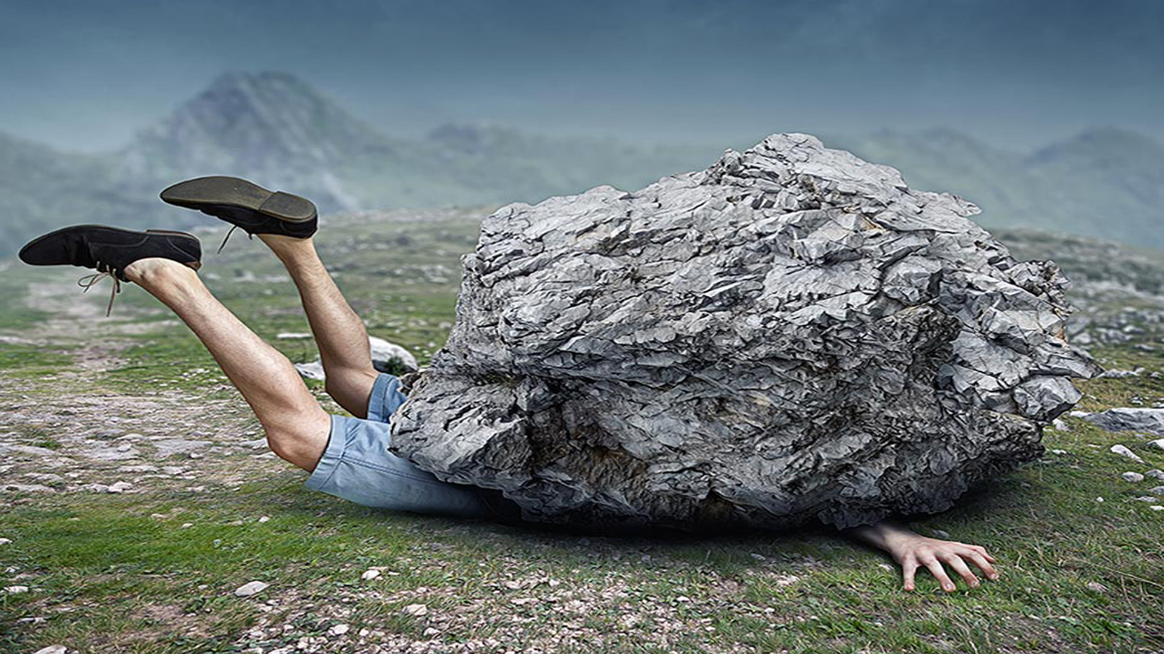
What choices do you have?
A real story:

Slide 4
Resilience 1.0 = Bounce back Resilience 2.0 = Antifragility / Post-Traumatic Growth

Slide 5
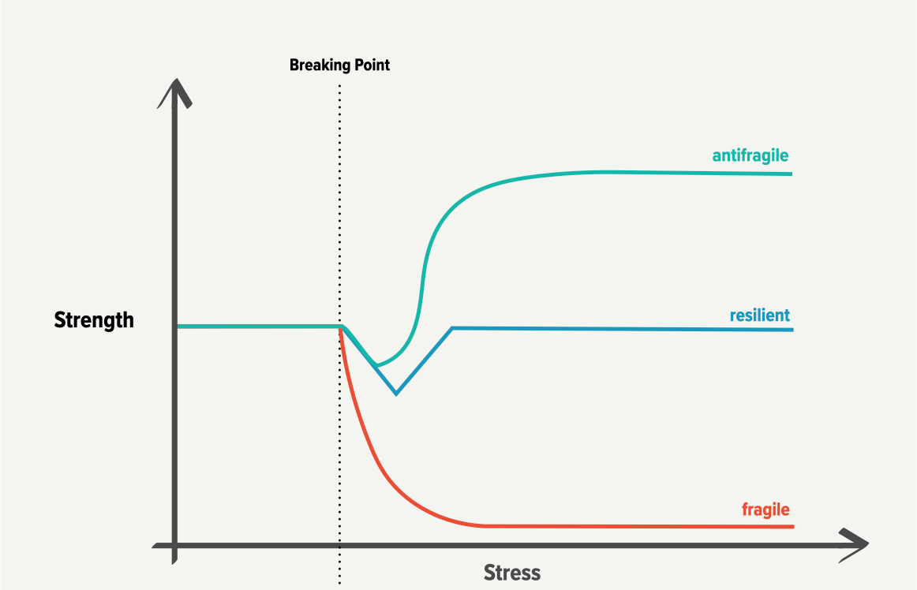
Resilience 1.0 and 2.0
Resilience 1.0 = Bounce back Resilience 2.0 = Antifragility / Post-Traumatic Growth

Slide 6
Why resilience is important at workplace?
On the individual level:
Better cope with stress
Less likely to suffer from burnout
Adaptive workplace behaviors
Buffer against workplace stresses
Better physical wellbeing
=> Better Performance
Source: Resilience in the Workplace: How to Be Resilient at Work

Slide 7
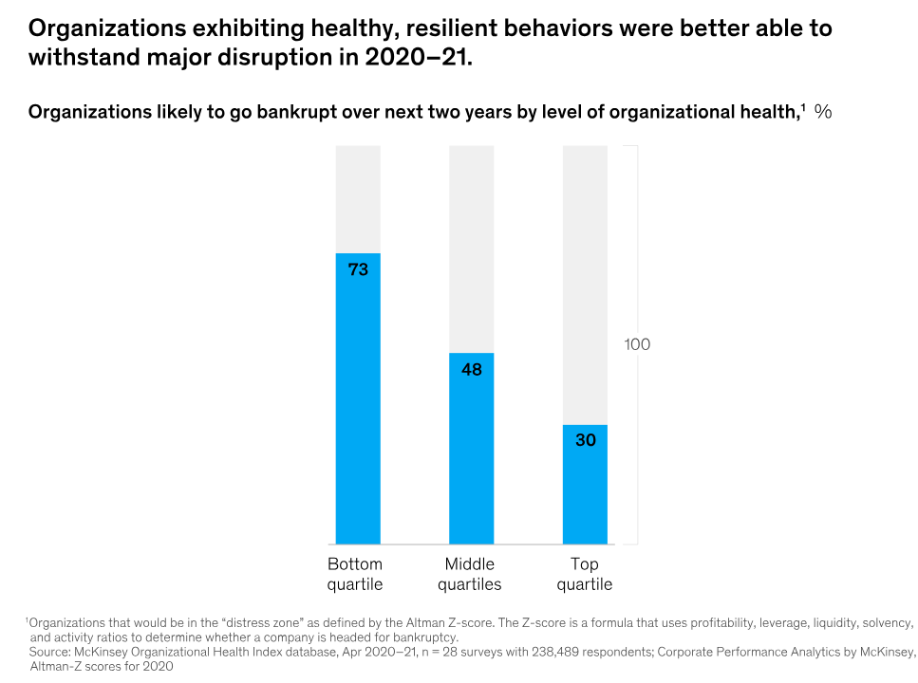
Why resilience is important at workplace?

Slide 8
Employee Happiness
Employee happiness & wellbeing has been defined as a TOP strategic post- pandemic corporate agenda priority

Slide 9
Employee well being
Employee happiness & wellbeing intersect w/ WA Dept. of Health’s Strategic Priorities. Recent launch of Be Well WA centered on:
Emotional Wellbeing
Movement
Nourishment
Social Connection.

Slide 10
What factors (variables) contribute to a person's resilience?
Biology
Self-awareness
Self-regulation
Mental agility
Optimism
Self-efficacy or mastery
Connection
Positive institutions
Source: ”Positive Psychology: Resilience Skills”, University of Pennsylvania

Slide 11
What factors (variables) contribute to a team’s resilience?
High levels of confidence in their abilities
Disciplined routines for their work
Social and family support
Source: Build Your Team’s Resilience — From Home (hbr.org)

Slide 12
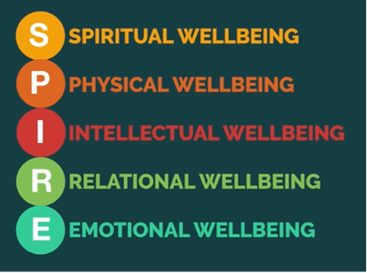
How to increase resilience?
A framework:
The SPIRE model
By Dr. Tal Ben-Shahar

Slide 13
Wellbeing/Happiness becomes a new field of study
Courses in Happiness at:
Certificate Training Programs:
Fla. Int’l Uni. “Chief Happiness Officer”
→ World Happiness Summit (WOHASU)
World’s first
Master of Arts
in Happiness Studies

Slide 14
Introduce some techniques through the SPIRE framework
S Spiritual Wellbeing
P Physical Wellbeing
I Intellectual Wellbeing
R Relational Wellbeing
E Emotional Wellbeing

Slide 15
Techniques to increase resilience
1. Mindful breathing
S Spiritual Wellbeing
P Physical Wellbeing
I Intellectual Wellbeing
R Relational Wellbeing
E Emotional Wellbeing

Slide 16
Techniques to increase resilience
What are some common stressors you have noticed in your workplace?
2. Better handle stress
S Spiritual Wellbeing
P Physical Wellbeing
I Intellectual Wellbeing
R Relational Wellbeing
E Emotional Wellbeing

Slide 17
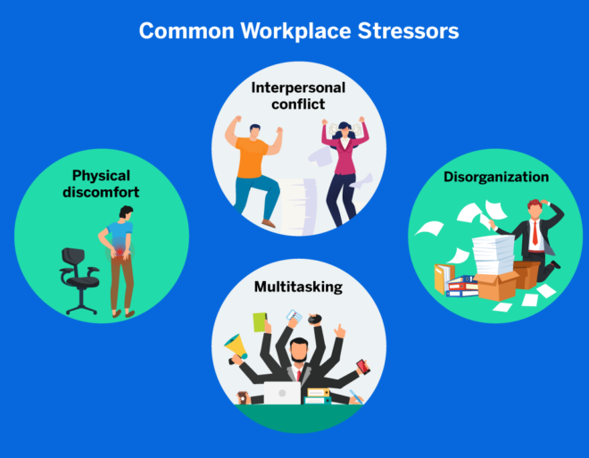
Techniques to increase resilience
What are some techniques you have used to help destress?
2. Better handle stress
S Spiritual Wellbeing
P Physical Wellbeing
I Intellectual Wellbeing
R Relational Wellbeing
E Emotional Wellbeing

Slide 18
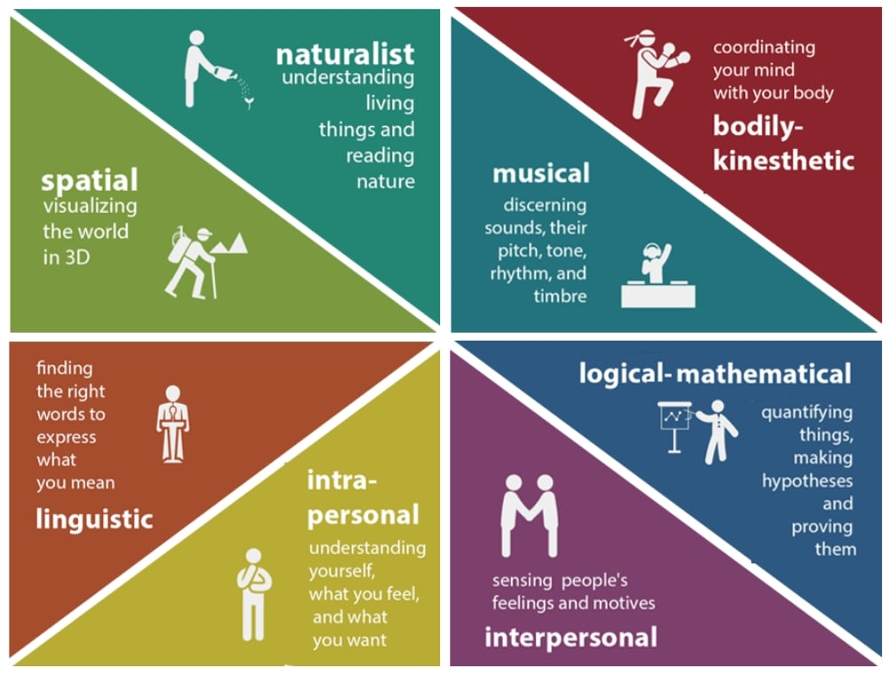
Techniques to increase resilience
3. Use your strengths (your strong types of intelligence)
S Spiritual Wellbeing
P Physical Wellbeing
I Intellectual Wellbeing
R Relational Wellbeing
E Emotional Wellbeing
Howard Gardner (1983), Frames of Mind

Slide 19
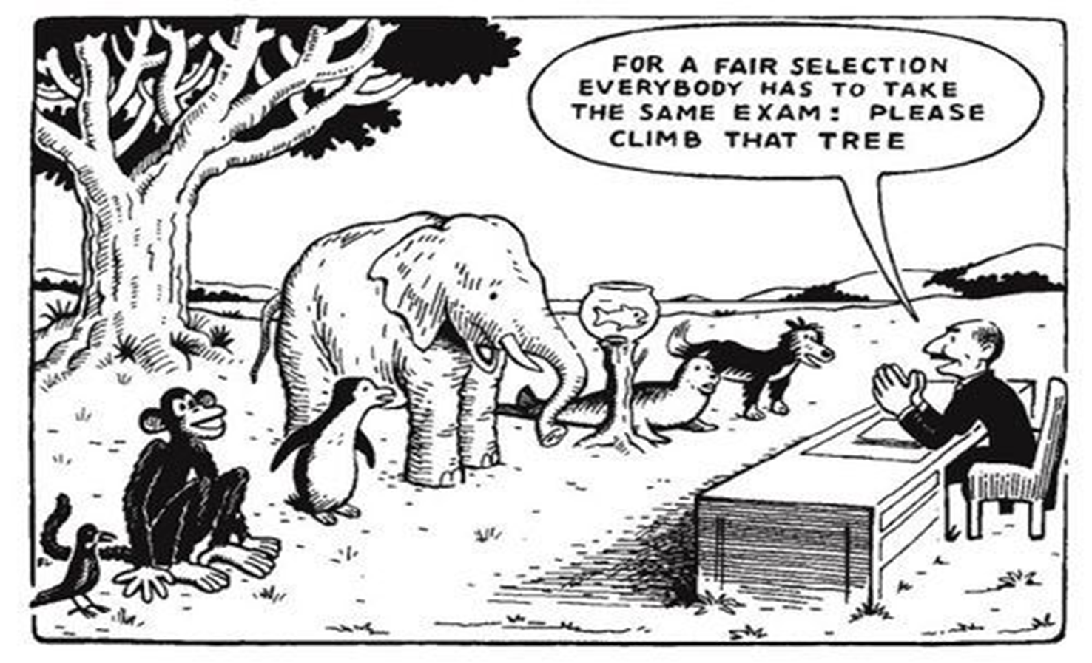
Albert Einstein quote
"Everyone is a genius. But if you judge a fish by its ability to climb a tree, it will live its whole life believing that it is stupid."
- Albert Einstein

Slide 20
Techniques to increase resilience
What do you do to strengthen relationship at work?
4. Strengthen relationships at work
S Spiritual Wellbeing
P Physical Wellbeing
I Intellectual Wellbeing
R Relational Wellbeing
E Emotional Wellbeing

Slide 21
Techniques to increase resilience
What do you do to increase positive emotions at work?
5. Increase positive emotions
S Spiritual Wellbeing
P Physical Wellbeing
I Intellectual Wellbeing
R Relational Wellbeing
E Emotional Wellbeing

Slide 22
Summary
Resilience 1.0 = Bounce back & unaffected; Resilience 2.0 = Antifragility
Why resilience is important at workplace?
How to increase resilience? The SPIRE model and some techniques:
Mindful breathing
Better handle stress
Use your strengths (your strong types of intelligence)
Strengthen relationships at work
Increase positive emotions
S Spiritual Wellbeing
P Physical Wellbeing
I Intellectual Wellbeing
R Relational Wellbeing
E Emotional Wellbeing

Slide 23
Frames of Intelligence
Linguistic Intelligence (word smart)
Logical-Mathematical Intelligence (number/reasoning smart)
Spatial Intelligence (picture smart)
Bodily-Kinesthetic Intelligence (body smart)
Musical Intelligence (music smart)
Interpersonal Intelligence (people smart)
Intrapersonal Intelligence (self-smart)
Naturalist intelligence (nature smart)
Critical Evaluation

Slide 24
Selected References & Resources:
Anti-Fragile (publication): Systems which thrive as a result of stressors, shocks, volatility, noise, mistakes, faults, attacks, or failures... (Nassim Nicholas Taleb).
Build Your Team’s Resilience — From Home (hbr.org)
WA State Dept. of Health Be Well WA initiative: https://doh.wa.gov/you-and-your-family/be-well-wa
SPIRE Model (Tal Ben-Shahar).
”Positive Psychology: Resilience Skills”, University of Pennsylvania.
Forms of human intelligence – Frames of Mind, Howard Gardner, 1983.
Growth Mindset techniques for coaching colleagues, Grit, Angela Duckworth, 2016.
RAIN meditation and mindfulness talks (www.tarabrach.com).
Results WA, WA State 2023 Lean Conference: Applying the Science of Happiness to Enhance Efficiency of Teams (Feldman & Zou).

Slide 25
Thank you
Thank you!!!
Fellow Happiness Journeyers
Gov. Jay
Inslee
Kim
Concepcion
(WA DOH)
Tal Ben-Shahar
(HSA)
Joanne Lee
(WA DES)
Results WA 2024 Conference organizers
Work Best Friend
Cheri Levenson
Professional coaches & therapists
Authentic, caring leaders
Melanie Gonzalez (BSRI Team!)
…Teachers & Students

Slide 26
Presenters' Contact Info:
Jason Feldman, MPH
Project Manager
Behavioral Science Research
Institute (BSRI)
JasonDFeldman@gmail.com
Miche Zou, MBA/MSF/MAHS
Michelle Zou, MBA, MSF, MAHS
Coach, Leadership Consultant,
Founder of Pacific Technologies
michelle.zou@hotmail.com

