Slide 1


Value Stream Mapping
An Introduction to
Presented by
Beth Adams, MA, LSSBB
HCLA Lean Continuous Improvement Manager
HCLA Organizational Development Office
Department of Social and Health Services
Notes:
HCLA is the newly formed Home and Community Living Administration, was formed May 1, and is comprised of what was formerly ALTSA and the community-side of DDA.

Slide 2
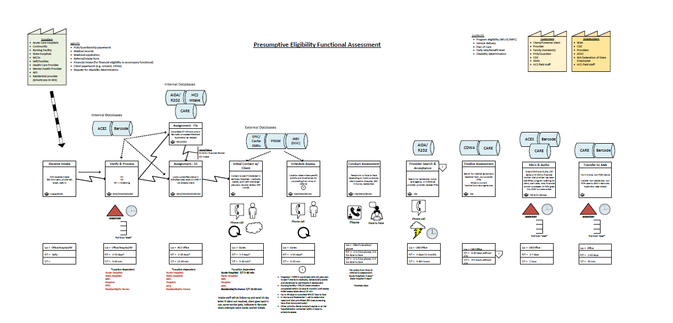
VSM example
(draft)

Slide 3

Agenda
What & Why
Components
How
Questions

Slide 4
What & Why
What Is a value stream map?
Why DO WE DO VSMs?

Slide 5
What is a value stream?
All the activities or steps an organization must do to develop, produce, and deliver a service, product, or experience to a customer.

Slide 6
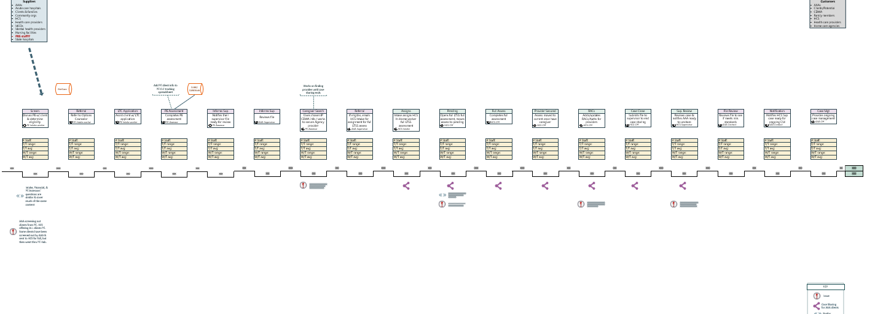
Value stream maps (VSM)
A visual, high-level ‘map’ of the value stream

Slide 7
VSM v Process Map
There is a greater degree of intentionality
behind a VSM than a process map

Slide 8
VSM v Process Map, cont.
Process map/Flow chart
Value stream map
How something works
Effectiveness/efficiencies
Can include decision points
Standard or swimlane
Level of detail can vary
Process needs improving
Eliminate waste
Linear
Interactions within each step & between steps
Big picture
Data-driven
Charter

Slide 9





VSMs
Create a shared understanding of a process
Improve process flow, effectiveness, and efficiency
Help us to identify waste
Foster a continuous quality improvement mindset
Involve both a current state and future state map

Slide 10
Why do a VSM?
10
Create a process of only value-added steps for your customers
What does your customer value?
How do you know?

Slide 11
A note about value-added activity
Done right first time
Performs a function
Matters to customer

Slide 12

What does the customer need and want?
Design process for customers

Slide 13




Who is our customer?
Who you serve
Who you need information from
The next person to receive your ‘product’

Slide 14
components
Of a VSM

Slide 15
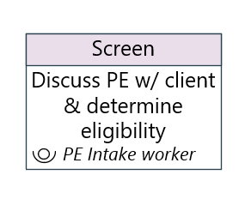
Process Box
High-level capture of who does what
Keep it short
Acronyms OK
Role, not people

Slide 16
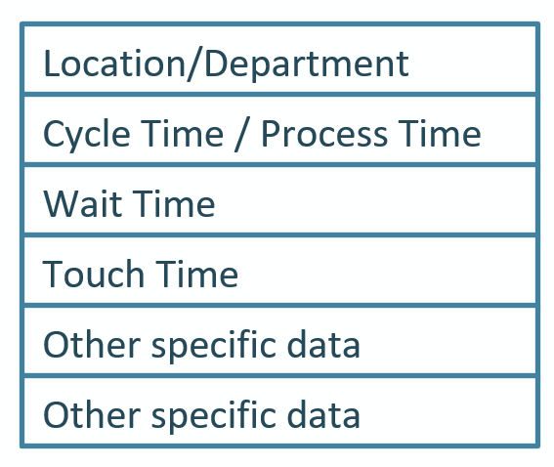
Data Box
Where (department/location)
# staff available
How long

Slide 17
Time Metrics
Name | Abbreviation | defined
Cycle Time / Process Time | C/T or P/T | Time it takes to complete one step or task of the larger process; includes wait time
Touch Time | T/T | Amount of time one process step is actively being worked on (excludes wait time, rework, and other waste)
Wait Time | W/T | Amount of time spent waiting within a given process step or between process steps
Takt Time |  | A measure of how often a process needs to be completed to meet customer demand

Slide 18
Takt time
To what extent a process can keep up with customer demand
Help with
  resource management
  decision packages
  policy development
Example: a call center with 5 staff
  Available work time: 8 hours (480 minutes) x 5 staff =2,400 minutes
  # calls/day: 800 (average)
  2400/800 = 3 minutes
  6 hours (360 minutes) x 5 staff = 1,800 minutes @ 800 calls/day = 2.25 minutes

Slide 19
Using Takt Time
 | August 2019 Barcode Report
 | BLEND PHYSICAL (30%) & EMAIL (70%) - ASSUMPTION
22,495 | batches (excludes imports) processed
15,747 | email
12.0 | estimated minutes to process each import (email) based on current time studies
188,958 | minutes to process August's batch
3,149 | HOURS to process
22.7 | STAFF required to process @ 80% Direct Hours
24.2 | STAFF @ 75% Direct Hours
28.0 | STAFF @ 65% Direct Hours
6,749 | physical documents
18.0 | minutes - assumption with interruptions, questions, and re-work
121,473 | minutes to process August's batch
2,025 | HOURS to process
14.6 | STAFF required to process @ 80% Direct Hours
15.6 | STAFF @ 75% Direct Hours
18.0 | STAFF @ 65% Direct Hours
37.3 | staff required for combined physical and email batch processing
FTE request

Slide 20
Calculating hours
100% Hours | 2,080
100% hours/mo./FTE = 173
State Holidays | (72)
Vacation | (80)
Sick | (40)
Personal | (16)
Training | (40)
Jury Duty | (40)
Adjusted Hours (86%) | 1,792
Direct Hours % | 0.80 | 0.75 | 0.65
Direct hours | 1,664 | 1,560 | 1,352
Adjusted hours/mo./FTE | 139 | 130 | 113
Calculate annual ‘direct’ based on role (65-75% recommended)
  Then monthly availability
Use adjusted available hours to determine:
Takt Time
Capacity to take on new projects/tasks
Prioritize projects

Slide 21
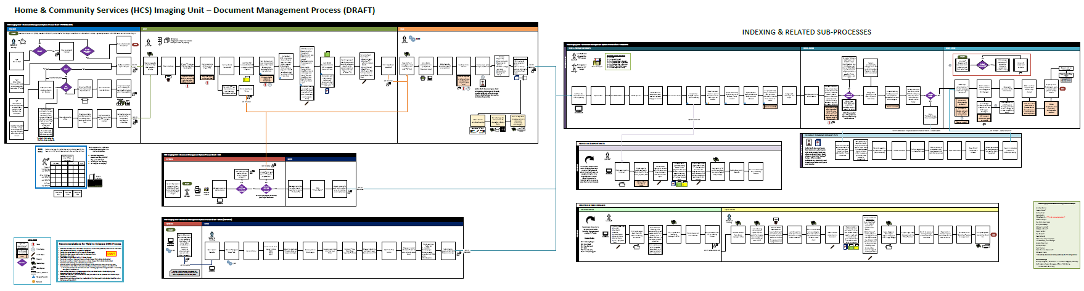
HIU process

Slide 22
Other metrics
Name | What | Fictional Example
Batch Size | The number of units processed in a batch (a group of like work) | 5 applications
Client Throughput | The number of applications processed from start to finish) in a given timeframe | 10 applications/ week
Completion Rate | Percentage of cases that go through the full assessment and start LTSS services? | 85%
Inventory | Amount of work in progress or held at the step | 6 applications
Documentation Time | Time spent on documentation or paperwork | 2 hours / 180 minutes
Service Time | Actual time spent with client | 1.75 hours / 45 minutes

Slide 23
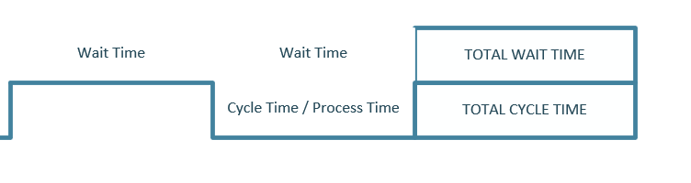
Timeline
How long does it take?
At each step
Between steps
Total

Slide 24
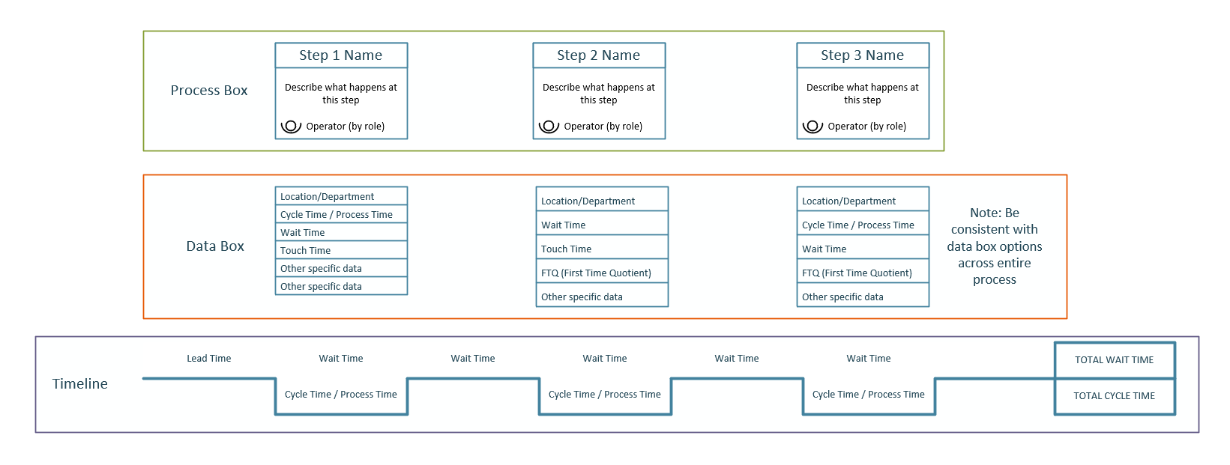
Bringing together the data elements

Slide 25
Symbols & Icons
Arrows
Information
Indicator
Work-Specific
USE A KEY

Slide 26


Arrows
Arrows | Icon | Description
Push |  | Push of material or goods – usually from supplier to process
Pull |  | Worker pulls from previous process step (information, form, etc.) – doesn’t occur automatically
Manual Information Flow |  | Use to indicate flow between steps or when manual entry is required
Electronic Information Flow |  | Use to indicate flow to/from a database or between steps that occurs automatically

Slide 27






Information icons
Information Icons | Icon | Description
Supplier/Customer |  | Add name(s) of supplier(s) - top left of map Add name(s) of customer(s) - top right of map
Database |  | Add the name of each database; draw the right arrow to indicate what is happening and how to/from the map and each database
Inventory |  | Amount of work in progress (e.g., applications, contracts, forms, investigations)
First In, First Out |  | First part in a sequence is first to be dealt with and exit process step
On-Page Reference |  | Use to reference something on the page • In Visio, on-page references can be hyperlinked • Color code or add numbers/letters
Off-Page Reference |  | Use to reference something off the page • In Visio, on-page references can be hyperlinked • Color code or add numbers/letters

Slide 28





Indicator icons
Indicator Icons | Icon | Description
Bottleneck |  | Where there is congestion, inventory exceeds capacity
Kaizen Burst |  | Highlights where improvement needed
Chaos/Issues |  | Where there are issues or problems use chaos if there are a lot of issues
Rework |  | Where something needs to be redone
Waiting/Time Delay |  | Used for any type of waiting or time delays

Slide 29

Work-specific icons
Just because you can….
Critical to the process?
Helps with ‘reading’ map?

Slide 30
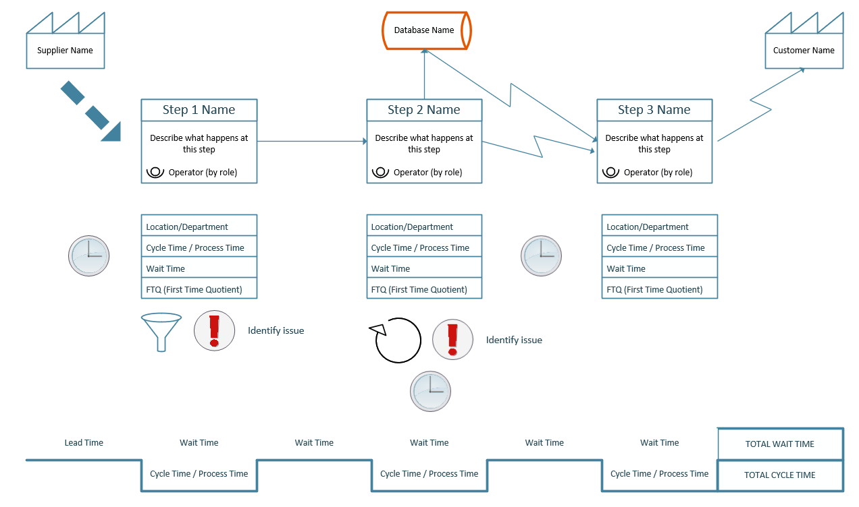
All together

Slide 31
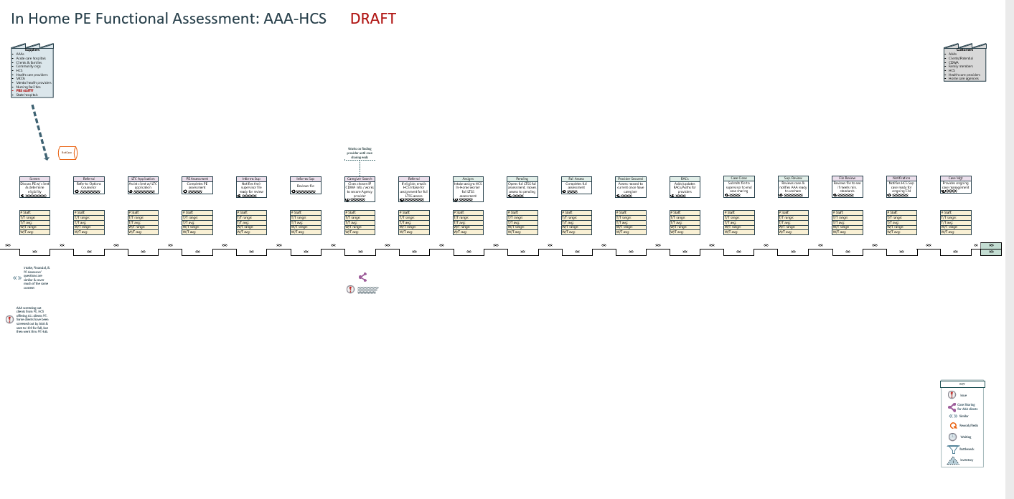
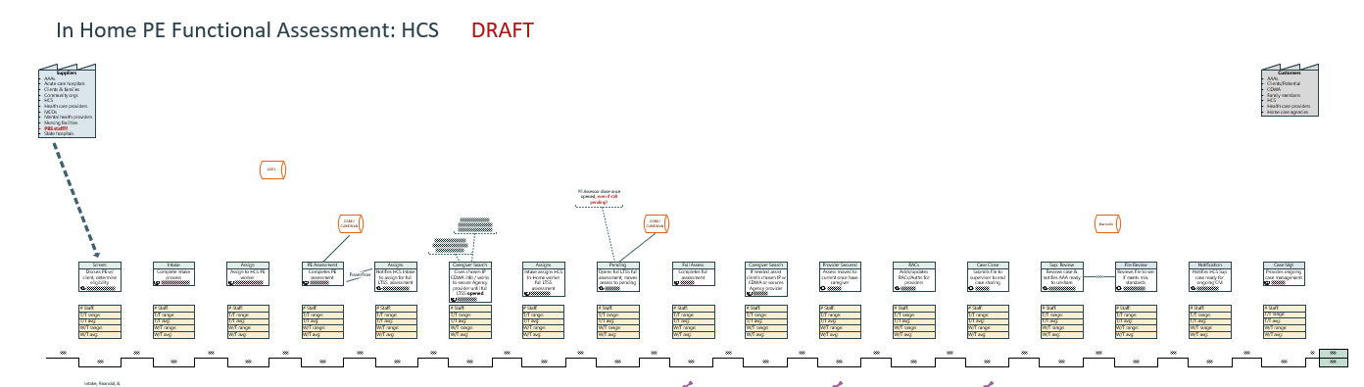
Draft example (old)

Slide 32
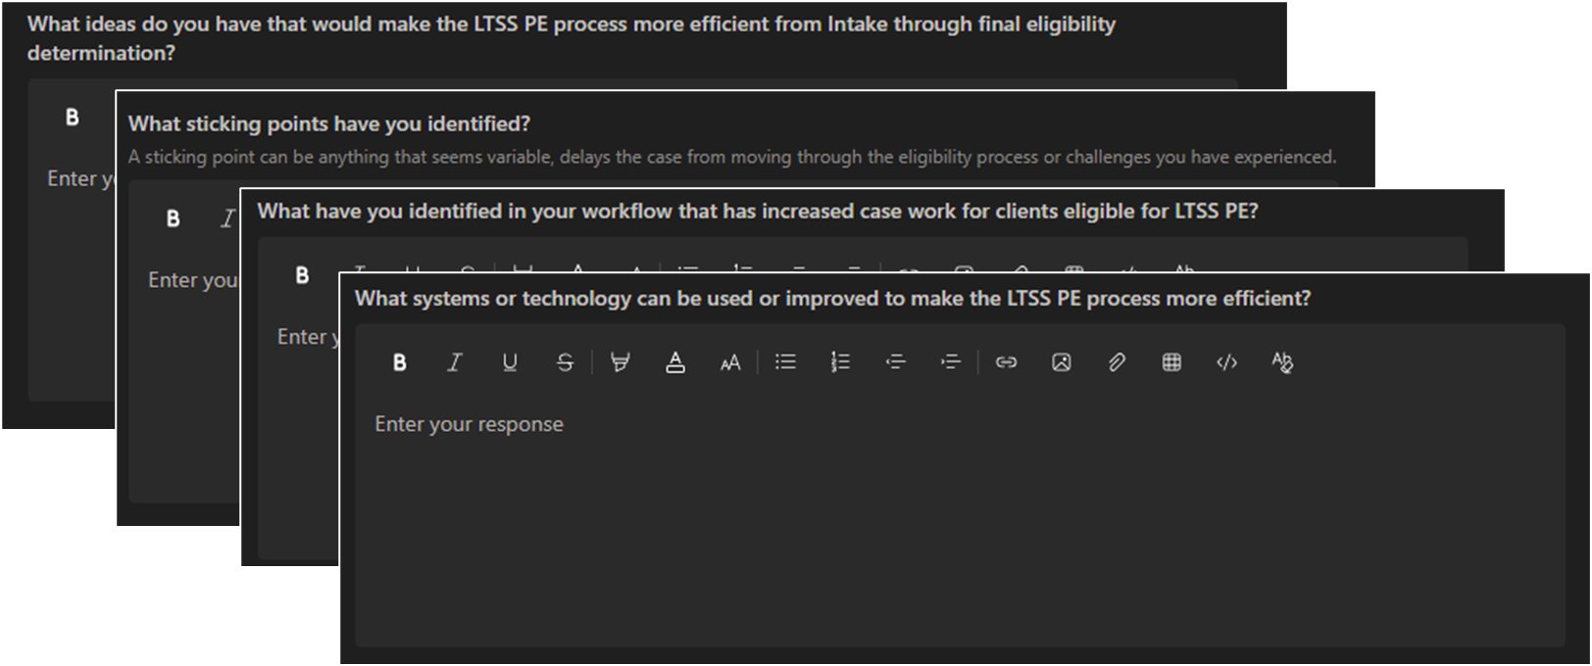
PE Survey
If you can’t be at the in-person meeting

Slide 33


Bridging the gap

Slide 34
how
Getting started with creating a VSM

Slide 35
Getting started with a VSM
Use a project charter
Keep it simple
Involve the right people
Choose starting and ending points
Map actual, not ‘should’
Use actual data, not assumptions
Analyze as a team
Design future state
A charter demonstrates leadership’s commitment to making needed changes.

Slide 36





SIPOC
Preparing for a VSM
S | I | P | O | C
SUPPLIERS Who/what provides what we need? | INPUTS What do we need to get started? | PROCESS What steps do we take? | OUTPUTS What gets created? | CUSTOMERS Who benefits?

Slide 37
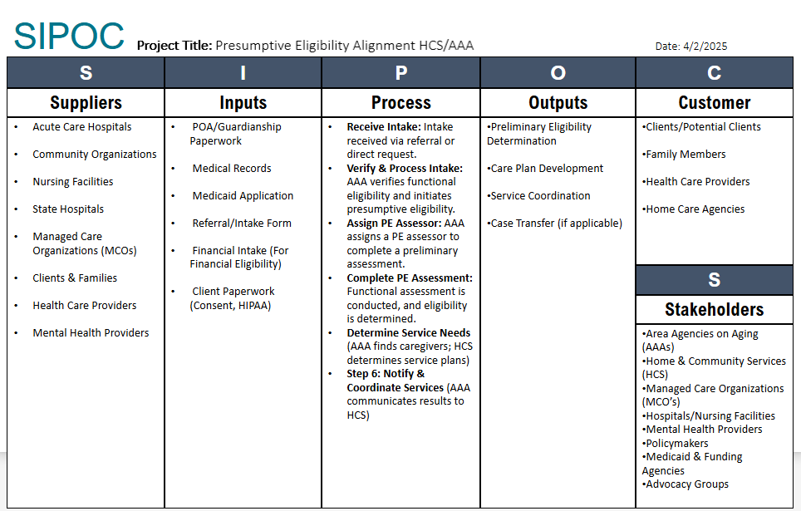
SIPOC example
Notes:
We also talked about the need to change language of stakeholders to partners to be more encompassing and respectful, particularly to our tribal partners and government to government relationships.

Slide 38

Final tips and takeaways
Keep needs of customer at forefront
Draw the actual, not “supposed to”
Be consistent with time, role(s), and data box elements
We can always come back and identify issues
Do the root cause analysis
Focus on fixing what’s within your sphere of control
Start to think about the future state – what will it take to get there?
We’re all in this together!

Slide 39

Questions?
Thank you!
Beth Adams
Elizabeth.Adams@dshs.wa.gov

