Slide 1


Achieving Desired Outcomes with the Behavioral Cycle of Results

Slide 2

What if…
There was a way to not only understand results, but to understand and control the leading indicators that reliably indicate those results?

Slide 3
RESULTS!
What are some of the RESULTS we are working to achieve through Results Washington?
  Key Performance Indicators
  Goals
  Strategies
  Means + Target Pairs
  Hoshins

Slide 4
What gets in the way?

Slide 5
“Waste” in lean terms
D.O.W.N.T.I.M.E.
DEFECTS
OVER-PRODUCTION
WAITING
NON-UTILIZED TALENT
TRANSPORTATION
INVENTORY
MOTION
EXTRA PROCESSING

Slide 6
Waste Gets In the Way
Errors
Long
data entry
times
Scheduling
Capacity
Break-downs
Disconnected Programs
Notes:
Waste is a results of problems that remain unsolved, and the workarounds and band aids we create instead of the (often challenging) work of true problem solving.

Slide 7
Overcoming Waste… with Waste!
!
← SEA OF RESOURCES→
← SEA OF HEROISM →
Errors
Long
data entry
times
Scheduling
Capacity
Break-downs
Disconnected Programs
Notes:
The Sea of Resources: Over Production (leads to extra inventory), Inventory, Wait times (searching inventory, delays, missing deadlines), Transportation, Motion, Extra processing.
The Sea of Heroism: The person (people) who jump in and accelerate the wastes described above in order to get to the needed result, often at the cost of their time, energy, and the team’s budget.

Slide 8

How Often Have YOU
Had to be a Hero?
✓
☐ Too Often
☐ Sometimes
☐ Never

Slide 9


The Behavioral Cycle of Results
INSPIRED BY

Slide 10

The Ugh Mug

Slide 11

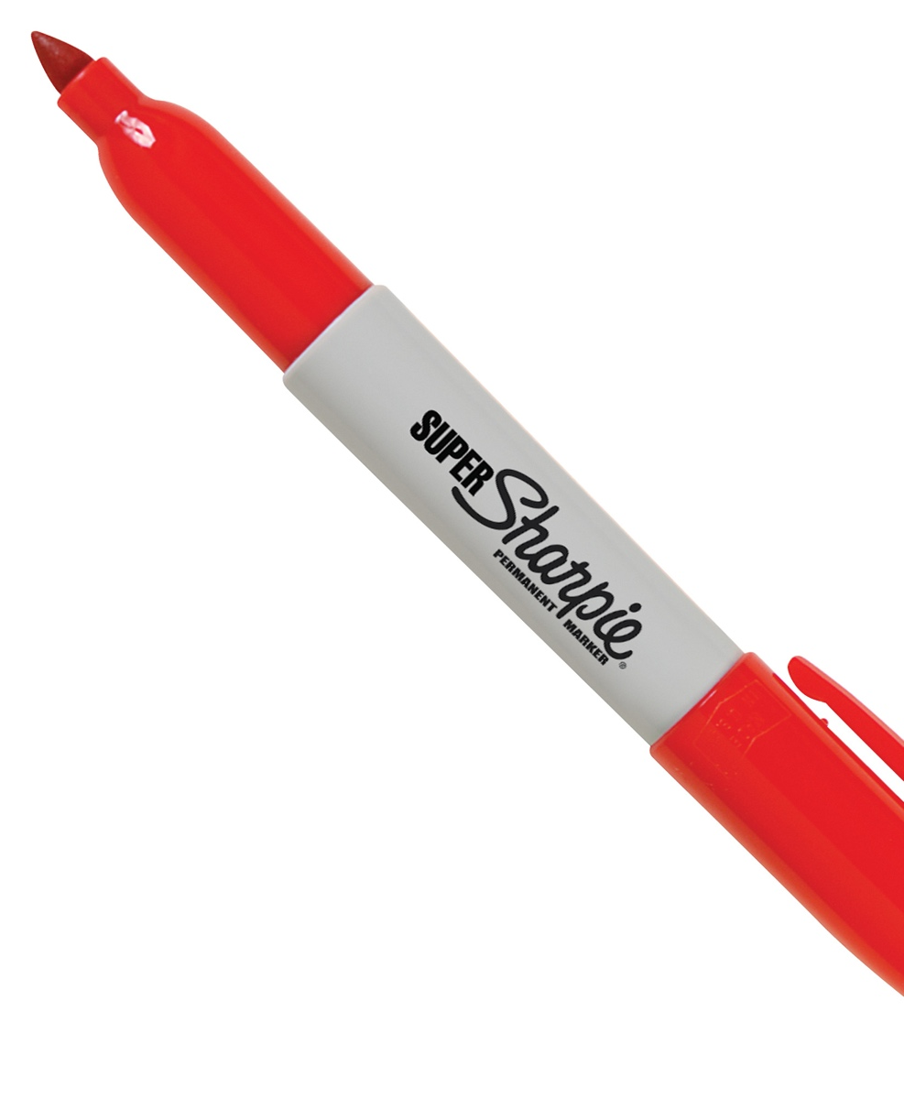

Do More with Less
Do more.
Do less.
Do more with less.

Slide 12
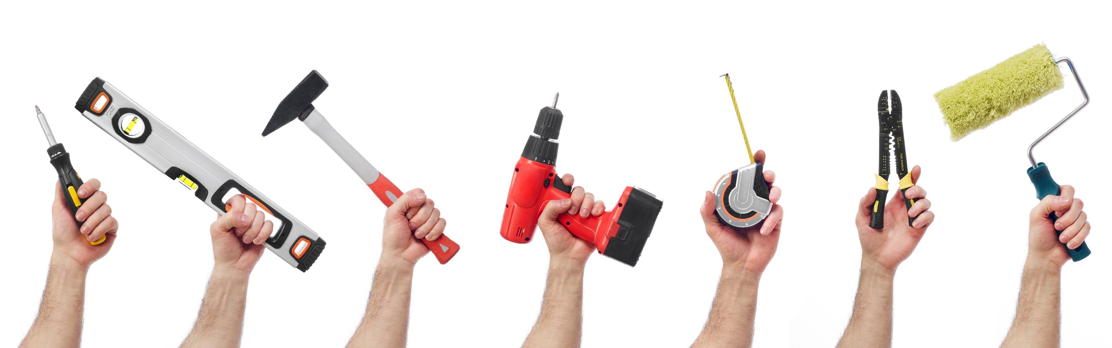
Have you ever experienced…
Notes:
The use of a tool across the organization in the hopes of dramatic improvements, BUT WITH LIMITED RESULTS?

Slide 13

Have you ever experienced…
Notes:
A series of point improvements without an overall strategy in linking those improvements together?

Slide 14
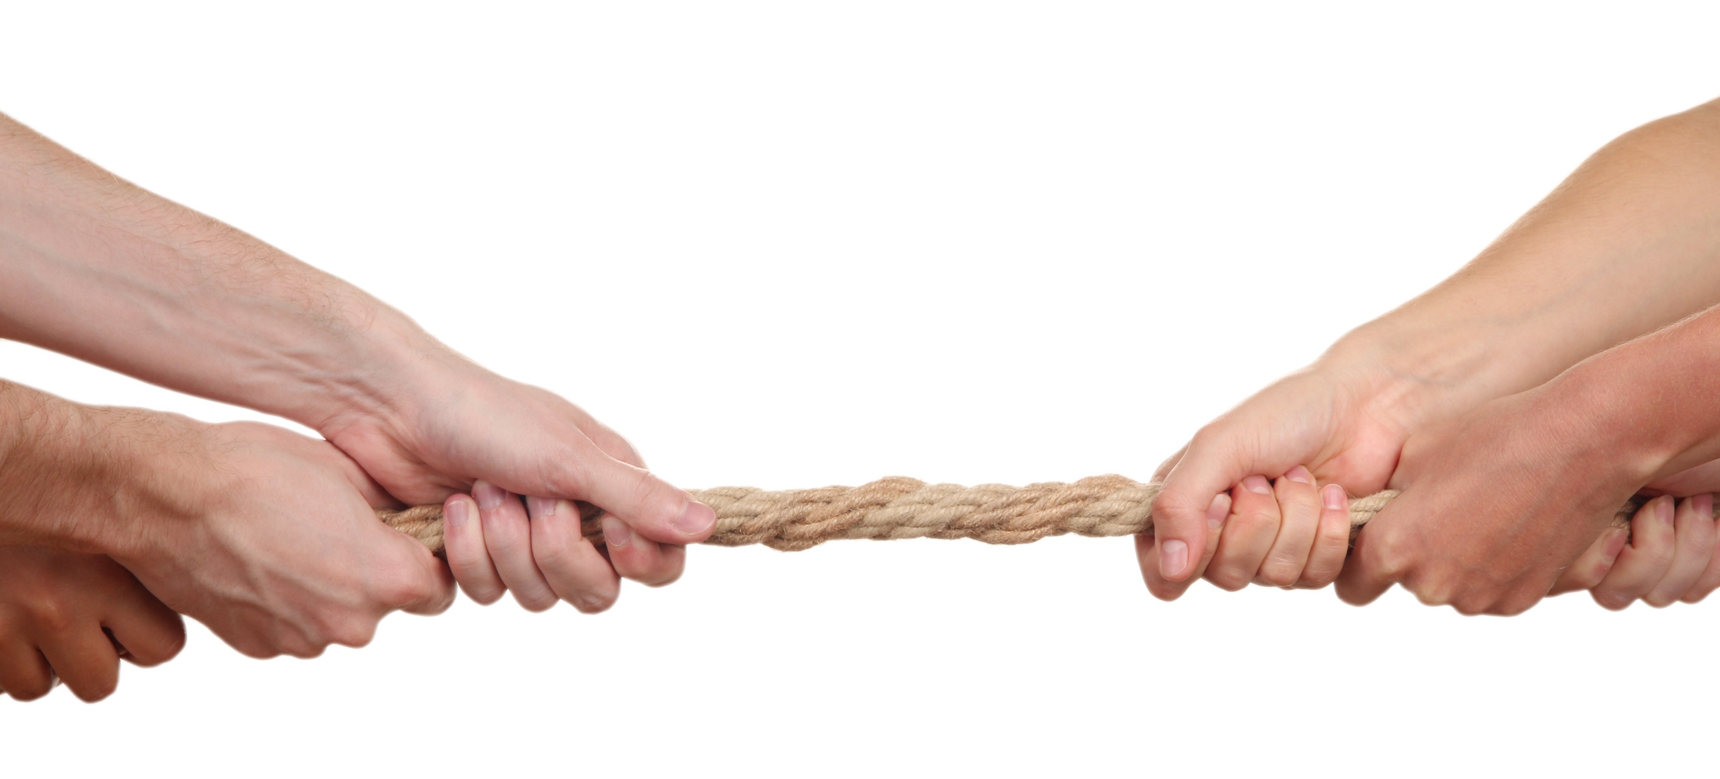
Have you ever experienced…
Notes:
Resistance to improvement efforts due to past failures and programs that have not sustained?

Slide 15

You’re not alone!
In organizations:
Leaders are responsible for results
Employees deserve meaningful work
Most organizations have attempted some type of enterprise-wide improvement effort.
Most experience a “series of programs,” rather than the pursuit of a philosophy of improvement*.
*J. Liker and M. Rother, Why Lean Programs Fail, (Lean Enterprise Institute, 2011)
Notes:
Most CI efforts fail.

Slide 16

A new path
Notes:
Some feel there has got to be a different way; a radically new path which, if pursued, leads to a new way of being.

Slide 17

Principles
Principles are universal truths that govern consequences. Not understanding or ignoring these guiding principles will put a company out of business.
Notes:
Here are some key points about these guiding principles:
1. Principles are not the same as “values.” Every individual develops their values early on in life. They are personal, subjective and govern the individual’s behavior.
2. Principles are universal truths that govern everyone and govern consequences.
3. Not understanding or ignoring these guiding principles will put a company out of business (some faster than others).
4. Understanding these principles will help to identify ideal behaviors or key behavior indicators (KBI’s).
5. Understanding these principles guides the adjustment of systems and selection appropriate tools, which helps to deliver better results (key performance indicators – KPI’s).
6. Learning these principles (and unlearning existing beliefs and principles) is a challenging and life-long task. Understanding how our minds work, including our mental maps, and the distinction between hard-wire and working memory is critical.

Slide 18
Business Principles
  Embrace standardization
  Articulate and adhere to the best known way
  Solve problems scientifically
  Use deliberate problem-solving methods
  Always improve
  Create flow and pull
  Quality at the source
  Visual controls
  Proximity & colocation
  Reliable, tested technology
  Level the workload
Universal truths that inform
the behaviors we practice,
the systems we develop,
and the methods we use.
Create value for the customer
Focus on customer needs
Systems thinking
End-to-end value streams, not silos
Constancy of purpose
Craft a vision, align the work to achieving it
Respect for people
Empower the people who do the work to improve the work
Lead with humility
Leaders are coaches who serve their people
Learn continuously
Share and celebrate learning
IMPROVE
ALIGN
ENGAGE
Notes:
There has been a tremendous amount of planning, experimenting, observation, and documentation, around certain principles that are essential for an organization to be successful. These principles have been collected into a group that are referred to as “Lean Principles” or “Principles for Continuous Improvement” (handout) (inspiration from Shingo and IEX)

Slide 19
Behaviors
KBI
Understanding the principles will help to identify ideal behaviors.
KBI
Notes:
KBI= Key Behavior Indicators, like Key Performance Indicators
Understanding the principles will help to identify ideal behaviors.

Slide 20
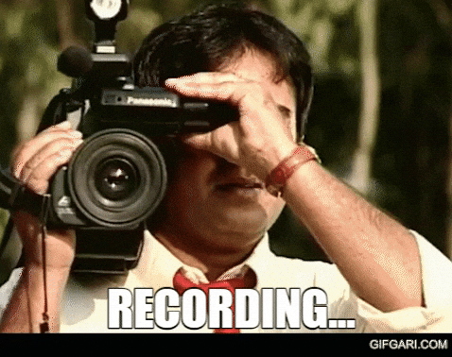
Behaviors
A behavior is something we could record with video
Principles are foundational to defining ideal behaviors
  Rule-based vs principle based behaviors

Slide 21

Rule vs Principle Based Behaviors
Rule: RCW 46.61.050 …every pedestrian shall obey the instructions of any official traffic control device applicable thereto, and as specified in this chapter…
What is the principle behind this rule?
Can you think of a situation where one must
break the rule in order to follow the principle?
Notes:
For example, one of the principles here may be safety. (Don’t cross the street against the signal for safety reasons – you might get hit by a vehicle!)
A situation where one might be following the principle of safety and jay-walk could be if their safety is otherwise threatened in another, greater way – such as moving away from a threatening situation.

Slide 22
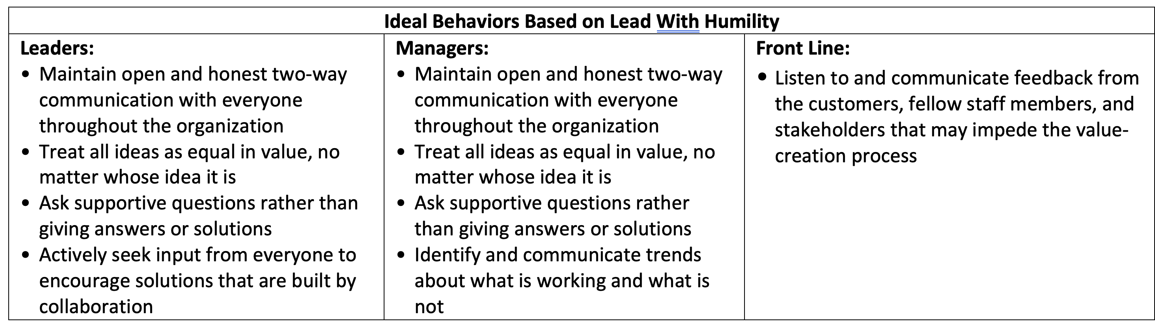
Behaviors
KBI
Lead with Humility
What kinds of behaviors might we see if this principle was understood and applied in an organization?

Slide 23

Systems
Systems enable and support ideal behaviors.
KBI
Notes:
Systems enable and support ideal behaviors.

Slide 24
Your system (your business) is producing the behaviors and results EXACTLY as designed.
🤯

Slide 25
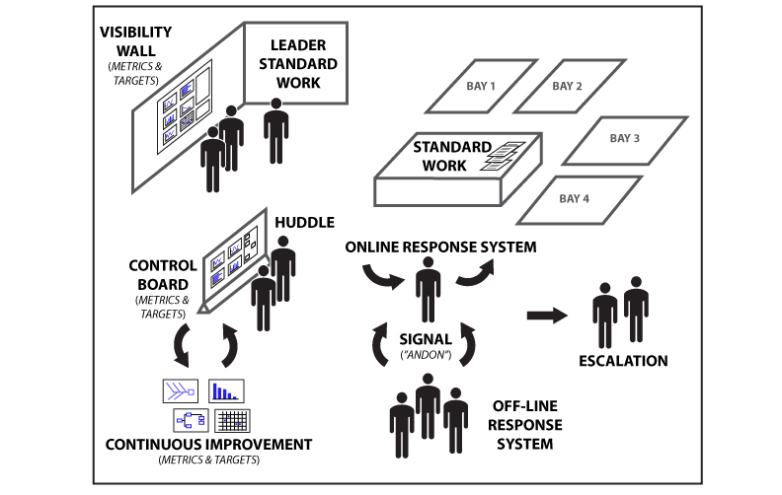
Management System

Slide 26


Tools
When principles are understood, and systems are designed to support ideal behavior, the individual contributors create and “pull” for tools.
KBI
Notes:
When principles are understood, and systems are designed to support ideal behavior, the individual contributors create and/or “pull” for tools. The ASK FOR the ”green pans!!”

Slide 27
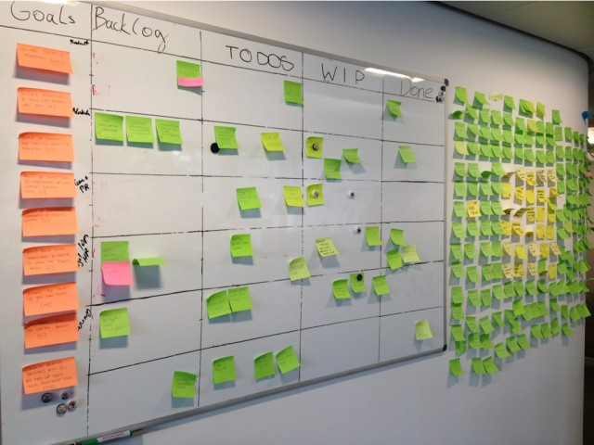
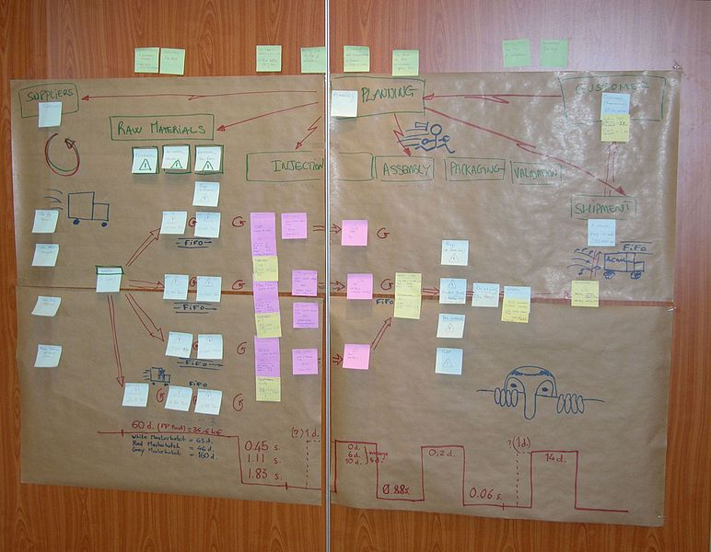
Tools

Slide 28
Results
KPI
All of these elements working together create a self-regulating and accelerating engine that drives results.
KBI
KPI
Notes:
All of these elements working together create a self-regulating and accelerating engine that drives results.

Slide 29
Results
KPI
All of these elements working together create a self-regulating and accelerating engine that drives results.
KBI
Executives “own” the principles and ideal behaviors.
Executive board (gov office) & Policy Advisors, or Agency Leaders
Management “own” the systems that support ideal behaviors.
Division Directors, Managers, Supervisors.
KPI
Individual contributors “own” (and pull for) the tools.

Slide 30
Virtuous Cycle
Results help adjust the system, refining ideal behaviors, adjusting systems, tools, and improving future results.
KBI
KPI

Slide 31
Sustaining the Virtuous Cycle
Results help adjust the system, refining ideal behaviors, adjusting systems, tools, and improving future results.
KBI
KPI
PSYCHOLOGICAL SAFETY
Notes:
The cycle is sustained when leaders and managers foster an environment of psychological safety.

Slide 32

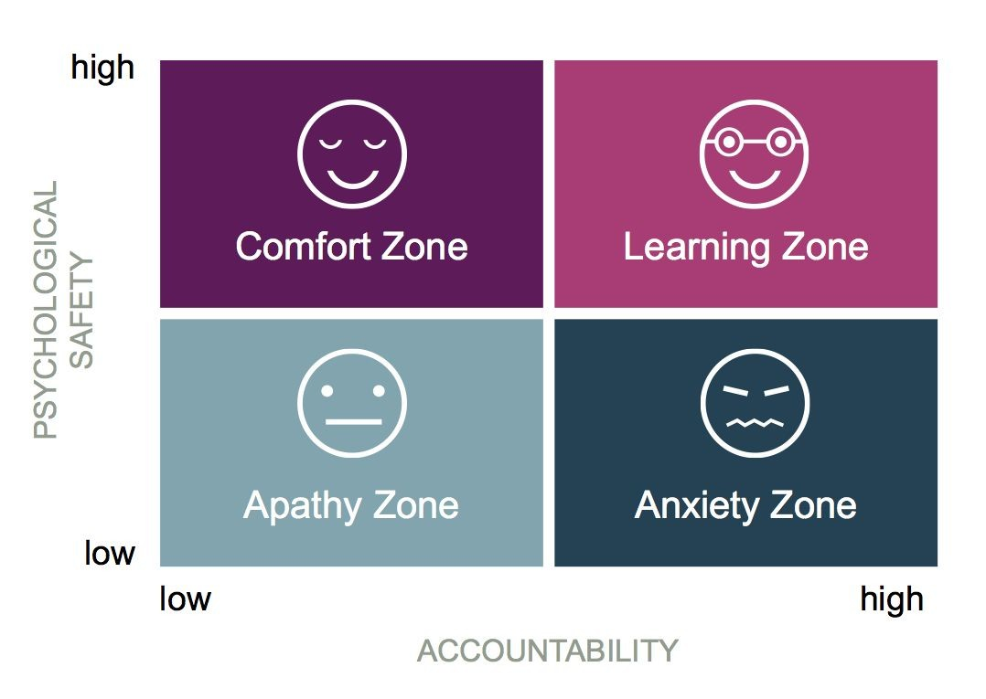
Does Psychological Safety Hinder Performance?
Waste
Profitability
Slowness
Development
Confusion
Joy
Fear
Bullying
Errors
Infighting
Theft
Results over People
Dr. Amy C. Edmondson, The Fearless Organization

Slide 33
Principle Centered Outcomes
Slow gains at first, requires an investment mentality
Learning at all levels
Culturally relevant
Creates synergy and self sustainment
Exponential growth in improvement
Continuous Improvement culture begins to form
KBI
CULTURE
OF JOY
KPI
PSYCHOLOGICAL SAFETY

Slide 34
One Reason Why People Resist Improvement…

Slide 35

Selective Perception
Selective Perception is the process by which individuals perceive what they want to while ignoring opposing viewpoints.

Slide 36
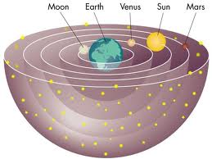
Selective Perception
Failing to recognize our own biases prevents us from working to correct them.

Slide 37

Selective Perception
When presented with counterintuitive principles, the bias of intuition is often stronger than facts and observation.

Slide 38
Selective Perception Examples
Batch processing is more efficient than Single Piece Flow.
Flexibility is diminished as standard work is applied.
Having excess inventory or materials is better than “just enough.”
A lean environment requires that everybody work harder.
Undefined roles are key to flexibility and high service levels.
The average pace of work is a key efficiency metric.
Economies of Scale means lean only works in high-volume environments.
Metrics in a file folder or binder are effective visual controls.
Lean principles add stress to everyone’s work.

Slide 39
Actual Lean Outcomes:
Single Piece Flow is much more efficient than Batch processing.
Flexibility is increased as standard work is applied.
Having excess inventory or materials creates shortages.
A lean environment makes the work easier.
Defined roles are key to flexibility and high service levels.
The fastest pace of work is a key benchmark for improvement.
Economies of Scale are often a source of extraordinary waste.
Visual controls exist in line of sight from the work environment
Applying the lean principles creates a joyful workplace.

Slide 40
Countering Selective Perception
Awareness & Acknowledgement Become aware of the unconscious biases that exist in the workplace, and their impact.
Self-Examination Look within to see where the bias exists in us, and acknowledge how it has been expressed.
Learning (by taking risks and making mistakes): Try an experiment that follows a counterintuitive Lean principle.
Creating Structures: Systems help counter bias in others, e.g. metrics, standardization, etc.

Slide 41
Resources:
The Shingo Institute www.shingo.org
The Fearless Organization by Amy C. Edmondson
Selective Perception: They Saw A Game: A Case Study by Albert Hastorf & Hadley Cantril

Slide 42

Thank You!
Thank You!
Q & A
and Discussion

