Slide 1
Work Life Harmony
(not Balance!)
WA State Government Lean Transformation Conference
2024
Amy Leneker

Slide 2
Thank You!
Hello!

Slide 3
Goal:
Improve work life harmony for self & others
Hello!

Slide 4
2-word check in
Hello!

Slide 5
Connection

Slide 6
Hello!
Stress Ruler
Workbook Page 4

Slide 7
People’s mental wellbeing has been worsening.
In the last 10 years, the number of people expressing stress, sadness, anxiety, anger or worry has been on the rise, reaching its highest levels since the Gallup surveys began.
Gallup’s State of the Global Workforce, 2024

Slide 8
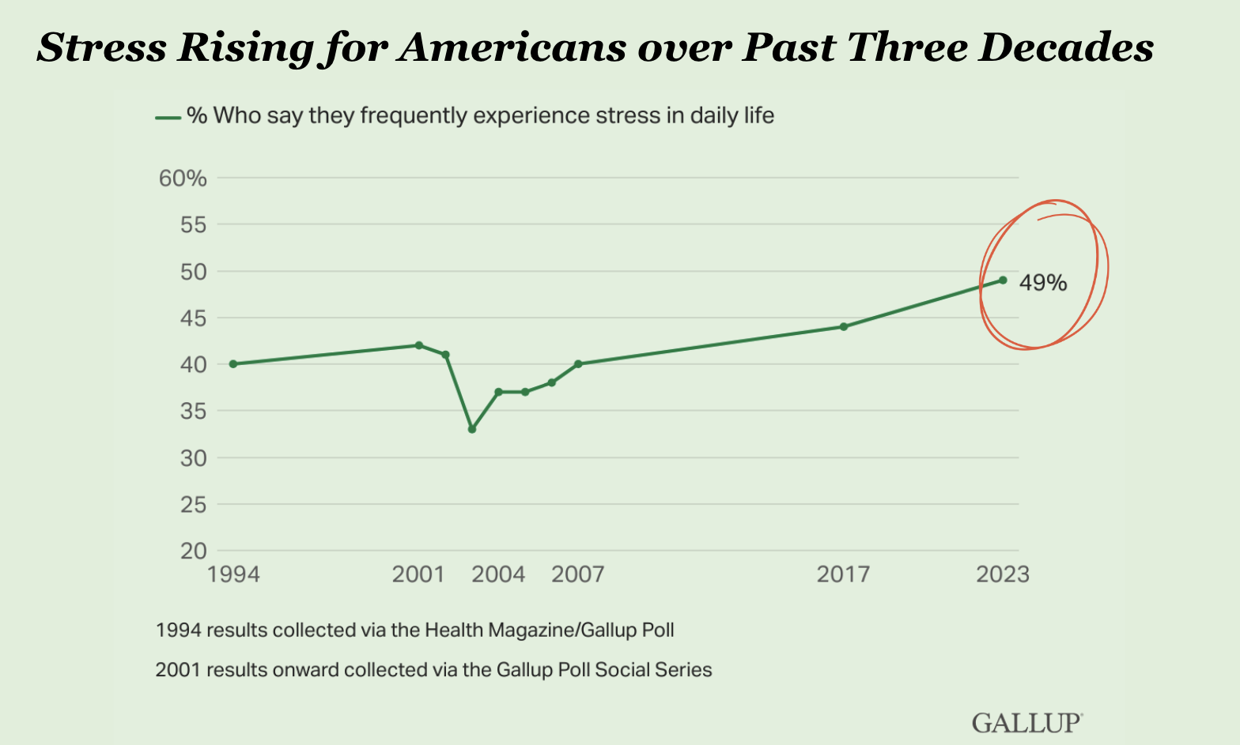
Stress Rising for Americans over Past Three Decades

Slide 9
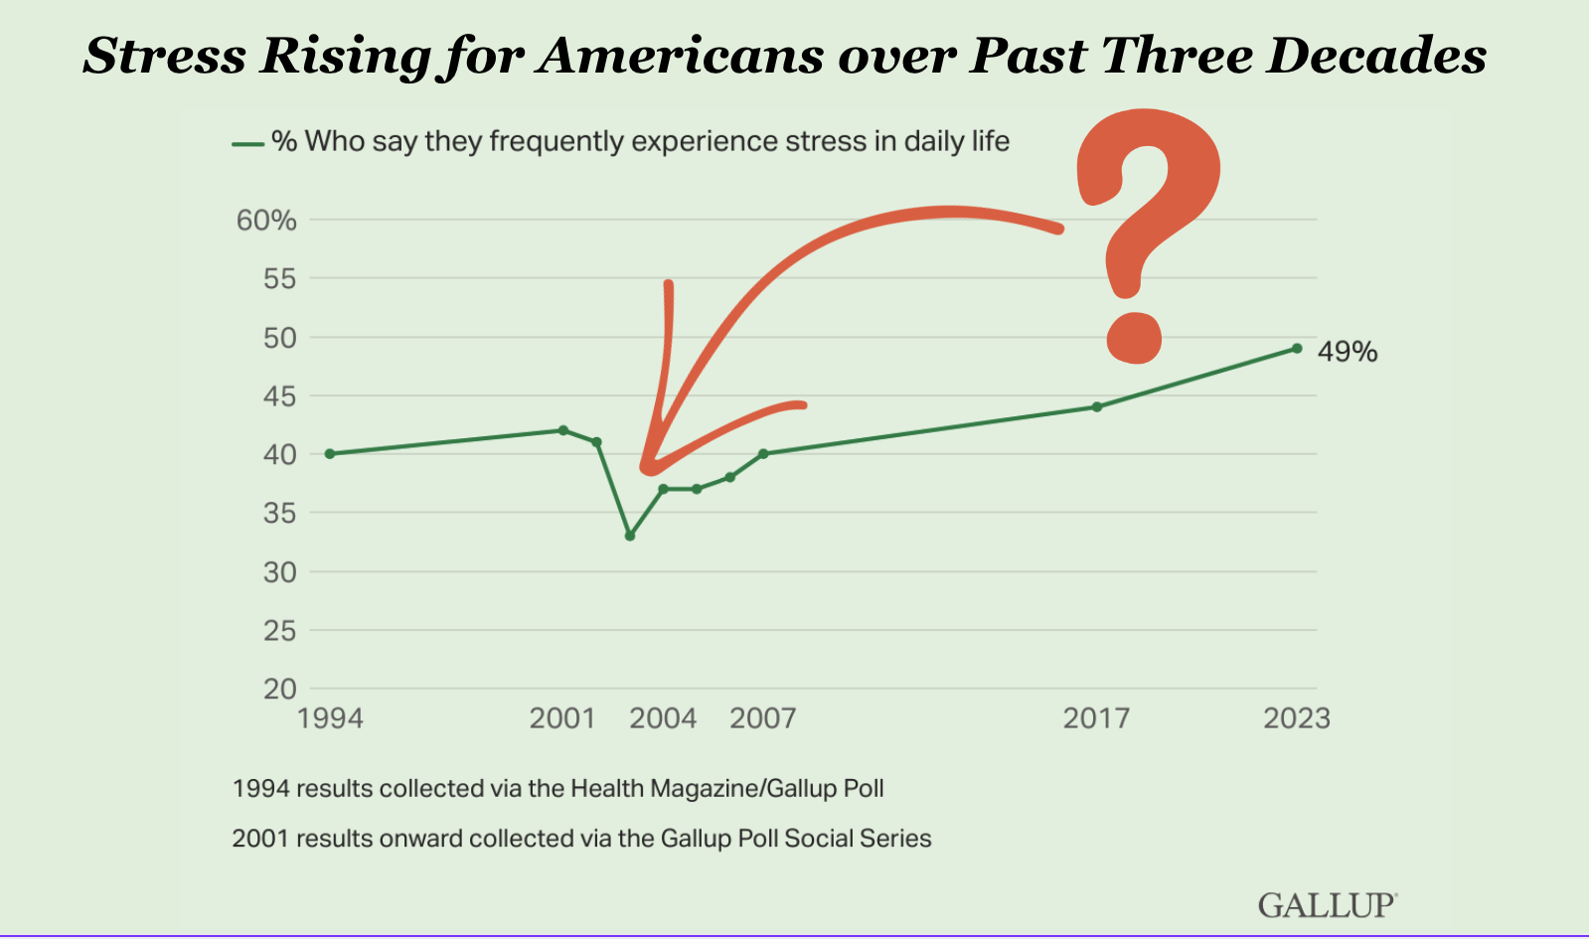
Stress Rising for Americans over Past Three Decades continued

Slide 10
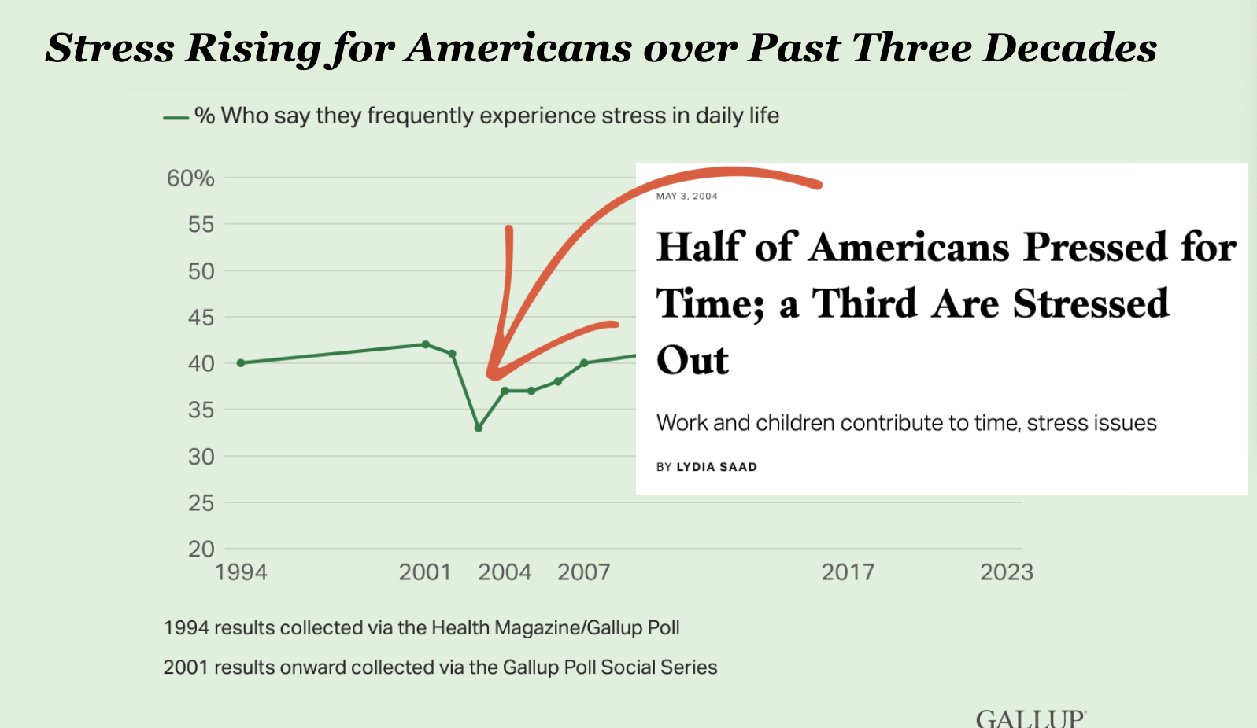
Half of Americans Pressed for Time; A Third are Stressed out. Work and children contribute to time, stress issues

Slide 11
Burnout
Hello!

Slide 12
In 2023, global employee engagement stagnated, and overall employee wellbeing declined.
The result is that the majority of the world’s employees continue to struggle at work and in life, with direct consequences for organizational productivity.
Gallup’s State of the Global Workforce, 2024

Slide 13
Work Life Harmony

Slide 14
Work Life Harmony
A state in which an individual is able to achieve both personal and professional goals in a combination that is uniquely satisfactory. ​
​
This differs across individuals as different people have different needs, responsibilities, values and priorities.
Source:https://www.humanresourcesonline.net/

Slide 15
Question 1
What does work life harmony
look like for you in this season of life?

Slide 16
1996 2024

Slide 17
1996

Slide 18
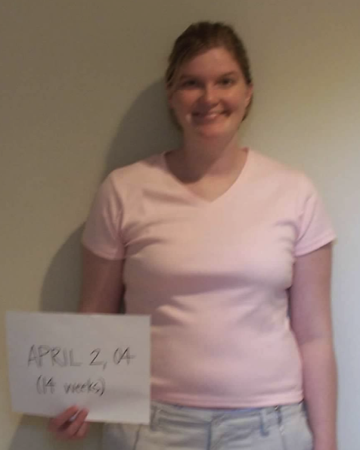
1996 2003

Slide 19
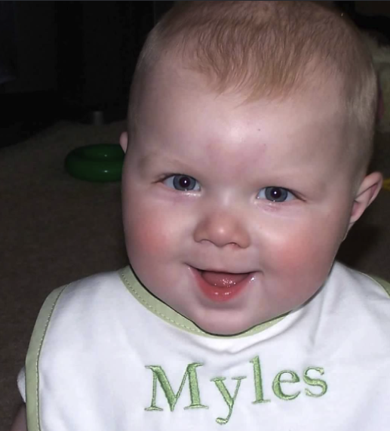
1996 2003 2004

Slide 20
1996 2003 2004 2010

Slide 21
2011, The Evergreen State College
1996 2003 2004 2010 2011

Slide 22
2024
1996 2003 2004 2010 2011
2024

Slide 23
Question 1
What does work life harmony
look like for you in this season of life?

Slide 24
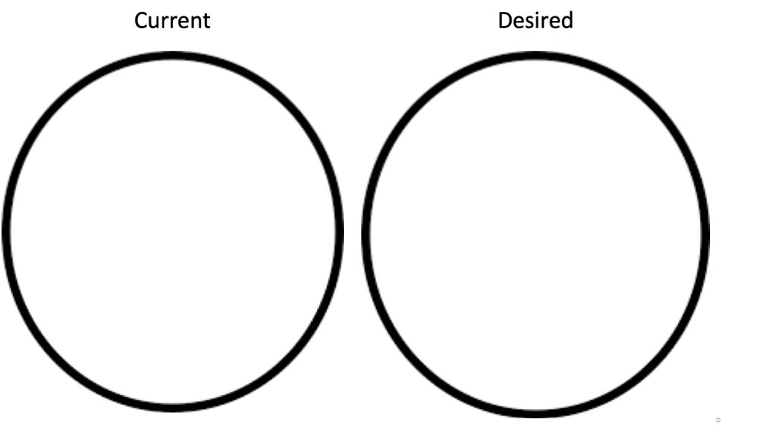
What portion of your life is work?

Slide 25
Question 2
What gets in the way of
work life harmony?

Slide 26
What gets in the way?
Organizational Culture
Boundaries
Ourselves and Others

Slide 27
Organizational Culture
The collection of values, expectations, and
practices that guide and inform the
actions of team members.

Slide 28
Boundaries
What’s ok and not ok?

Slide 29
Boundaries to Consider
Communication

Slide 30
Boundaries to Consider
Communication
Meetings

Slide 31
Boundaries to Consider
Communication
Meetings
Availability

Slide 32
Boundaries to Consider
Communication
Meetings
Availability
Deadlines

Slide 33
Boundaries to Consider
Communication
Meetings
Availability
Deadlines
Priorities and workload

Slide 34
Boundaries to Consider
Communication
Meetings
Availability
Deadlines
Priorities and workload
Other?

Slide 35
Do you get in your own way?
Others’ way?

Slide 36
Life: work/career, home/family, community/society, self - mind, body, spirit

Slide 37
Question 3
What is my intended impact?

Slide 38
Hold the Ladder

Slide 39
3 Questions
What does work life harmony mean to me in this season of life?
What gets in the way?
What is my intended impact in this season of my life?
Hello!
Workbook Page 9

Slide 40
Hello!
What is one thing you can do TODAY to move closer to your desired state?
Workbook Page 9

Slide 41
Hello!

Slide 42
Keep in Touch!
Amy@TheLenekerTeam.com
360-520-0290
TheLenekerTeam.com
Amy Leneker
Leadership Consultant &
Certified Dare to Lead™ Facilitator

